Slide 1
Group 3 project Parcel Express
Requirements Engineering 2017
Helen Daly, Dave Corcoran, Janusz Sledziewski, Maciej Kubiniec

Slide 2
System Overview
Parcel express is a new way of sending and receiving parcels, that is cost effective and more convenient than traditional delivery companies.
We have created an application that is easy for the customer to use, that will allow them to avail of lower delivery costs.
Our application allows for quick and easy use by our drivers, and allows them to send information in a timely manner to the team back at the depot.

Slide 3
Problems addressed
Keeping costs to a minimum by using an app on standard equipment to manage the business e.g. phones for couriers
Allowing real time updates for deliveries or collections to allow the most cost effective routes.
Providing a quick clear and easy to use method of processing pacakages at the depots.
Providing a robust system for tracking and managing parcels.

Slide 4
Personas

Slide 5

Manager
Sharon | Sharon is 39 Has 2 poodles Has worked for parcel express for 10 years 6 as a manager | This app allows Sharon To track deliveries Track couriers Make enquires for customers

Slide 6
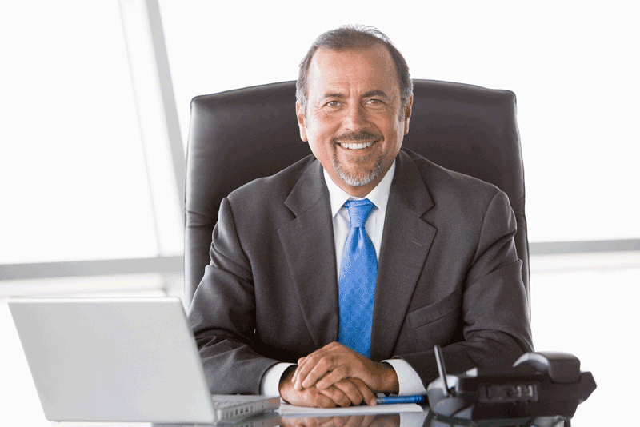
Administrator
Janusz | Married, 2 kids and dog 10 yrs experience working with parcel delivery After work play in heavy metal group on guitar. In past had gambling problem. | Use app to route and schedule parcels

Slide 7

Courier
Dave | Single, hates job, worked for delivery companies for too long | Use app to check and make deliveries and collections

Slide 8

Customer
Maciej | Maciej is originally from Poland Married 1 child Mature student | Parcel express allows Maciej to shop for figures unavailable in Irish stores.

Slide 9
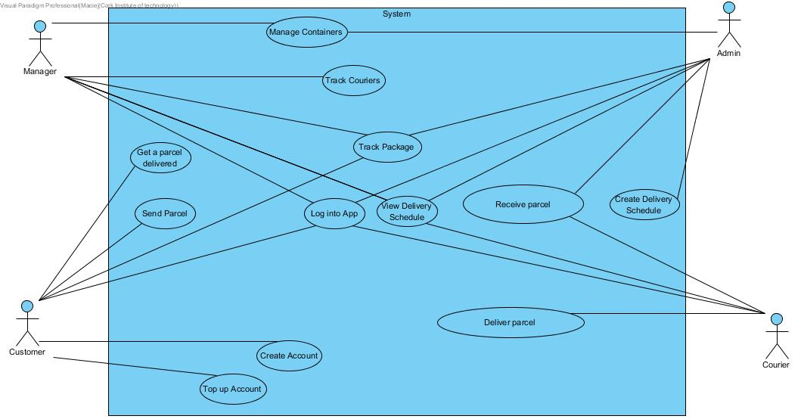
Use case Diagram

Slide 10
Project Retrospective
What worked well
The shared management, all had a stake in the outcome of the project
The effort applied by everyone.
Trello and whazapp

Slide 11
Problems encountered
Communication
Group met up at the weekend to try to work through sticking points#
The information on whatsapp could get confusing.
Working with ueXceler and Visual Paradigm
All were working on separate files, took time to get them all in one group on vpository. Lots of research and tutorials.

Slide 12
What would we do differently
Brainstorm earlier
Review each others scenarios more
Not do separate brainstorms on ueXceler

Slide 13
Participation
Maciej 25%
Dave 25%
Janusz 25%
Helen 25%

