Slide 1
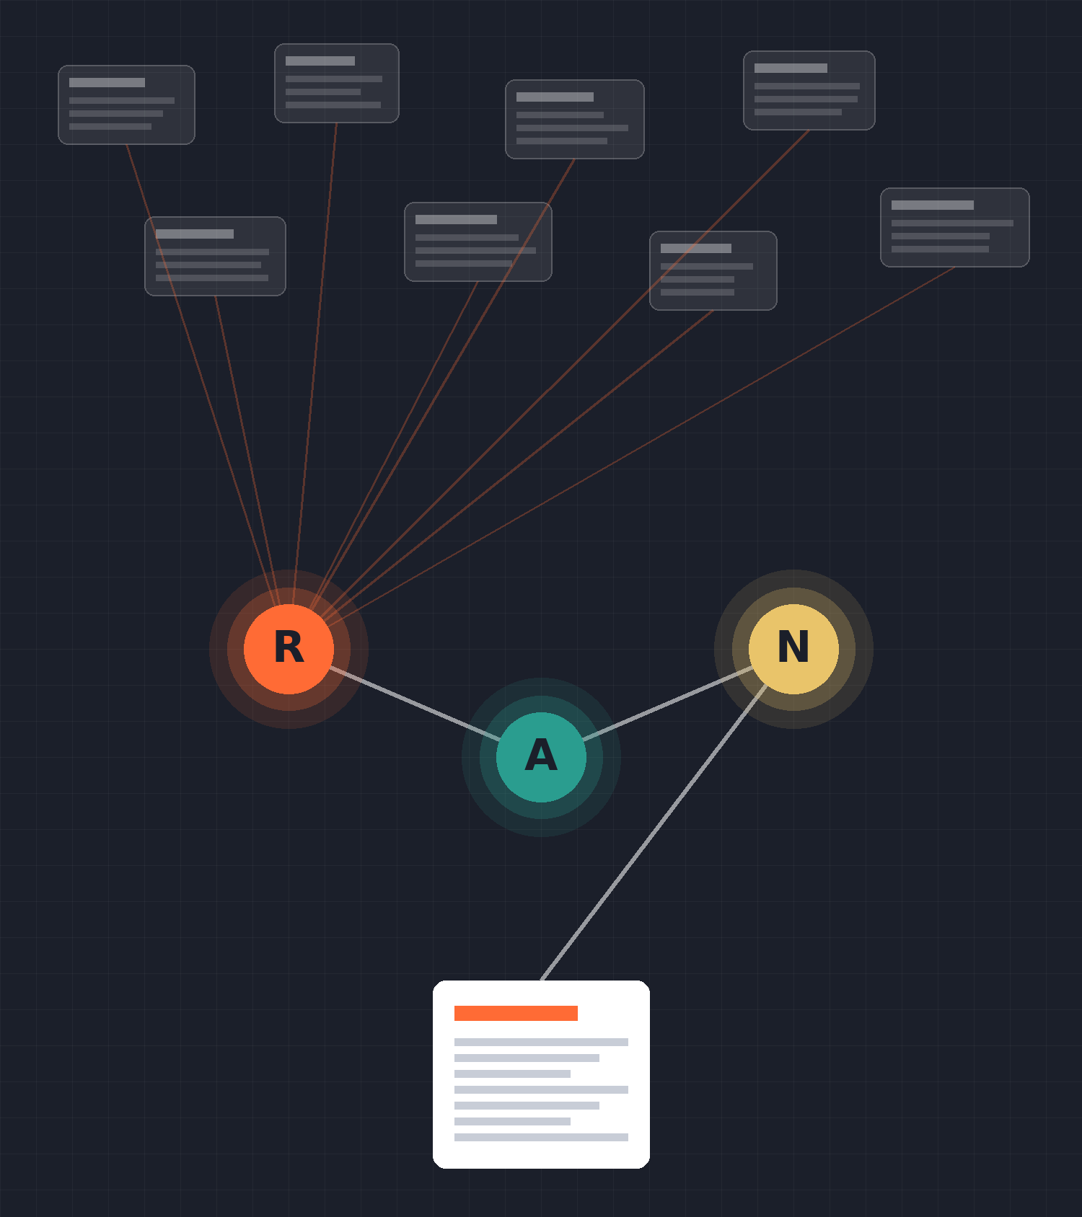
AI News Assistant
MULTI-AGENT · LANGGRAPH · PYTHON
Three cooperating agents that research, analyse and deliver audience-specific technology news briefings
Notes:
Introduce the project: a command-line multi-agent system built with LangGraph. A user picks a topic and an audience; three agents research the news, pick the key points and write a briefing tailored to that audience.

Slide 2



Why build a news assistant?
Too much news
One size fits nobody
Hard to trust
Tech news is spread across dozens of sites. Reading it all to find what matters takes hours every week.
An engineer, a security analyst and a manager need different things from the same story.
Automated summaries can repeat errors. Readers need to see sources and how sure the system is.
Notes:
Three problems motivate the project: volume of news, different needs per audience, and the need for transparency about how reliable an automated summary is.

Slide 3





The solution at a glance
Input
Research
Analysis
Notifier
Output
Topic + audience
from the CLI
Finds up to 10 recent
articles via Tavily
Picks 5 key points,
rates confidence
Writes the briefing
for the audience
Timestamped .txt
report in /outputs
Key idea: each agent does one job and passes a shared state object to the next, so steps can be tested, replaced or upgraded independently.
Notes:
End-to-end flow. The three agents in the middle are the core. Emphasise separation of concerns: each agent is a plain Python function that reads and updates a shared state.

Slide 4
LangGraph workflow
check_research
check_analysis
ok?
ok?
START
research
analysis
notifier
END
"stop" → END (error, or no results / no summary)
StateGraph(NewsState) · 3 nodes · 2 conditional edges · compiled once at import as news_workflow
Notes:
workflow/graph.py builds a StateGraph over NewsState. Conditional edges after research and analysis route to END if an error occurred or there is nothing to pass on. That keeps the notifier from producing an empty report.

Slide 5
One shared state object
User input
class NewsState(TypedDict, total=False):
topic: str
audience: str
research_results: list[dict]
summary: list[dict]
verification_notes: list[str]
email_content: str
output_file: str
research_attempts: int
research_sufficient: bool
error: Optional[str]
topic and audience, set by main.py
Research Agent
writes the list of found articles
Analysis Agent
writes key points + verification notes
Notifier Agent
writes the email text and file path
Workflow control
error flag and research counters
Notes:
All agents communicate only through this TypedDict. Each agent returns a partial dict and LangGraph merges it into the state. Colours match the owning agent.

Slide 6
Research Agent: finding the news
Query
10
max articles per search
Searches Tavily for "Latest technology news about {topic}" in news mode
Deduplicate
Skips results with a missing or repeated URL
7 days
search time window
Structure
Keeps title, description, source, date and URL for each article
Guard
≥ 3
articles = "sufficient"
Missing API key or network errors return a clear error message instead of crashing
Notes:
agents/research_agent.py. Uses TavilyClient.search with topic='news', max_results=10, time_range='week'. Sets research_sufficient when at least three unique articles come back.

Slide 7





Analysis Agent: rule-based, no LLM
1. Split
2. Deduplicate
3. Score
4. Select
5. Corroborate
Break descriptions into sentences; keep those with 8+ words
Drop sentences over 90% similar (difflib)
Count matches against 14 priority keywords
Keep the top 5 sentences as key points
≥ 65% match in another source → medium, else low confidence
Priority: 2+ keyword hits = high, 1 = medium, 0 = normal. Every point carries its status, confidence, priority and source URLs.
Notes:
agents/analysis_agent.py. Fully deterministic and free to run: no paid model calls. The trade-off is that keyword scoring and string similarity are blunt instruments, which shows up in the test results later.

Slide 8



Notifier Agent: one story, four audiences
Engineering
Cybersecurity
Every briefing contains
Date, topic and audience
Subject line
Audience-specific intro
Top 5 key points with sources
Recommended action
Verification notes + disclaimer
Developments affecting teams, tools and systems; asks teams to assess impact
Vulnerabilities and digital risk; asks whether security action is needed
Management
All Employees
Business and strategy impact; asks whether further assessment is needed
General briefing; points staff to official company guidance
Notes:
agents/notifier_agent.py maps each audience to an introduction and a recommended action, then writes the email to outputs/news_report_<topic>_<timestamp>.txt.

Slide 9
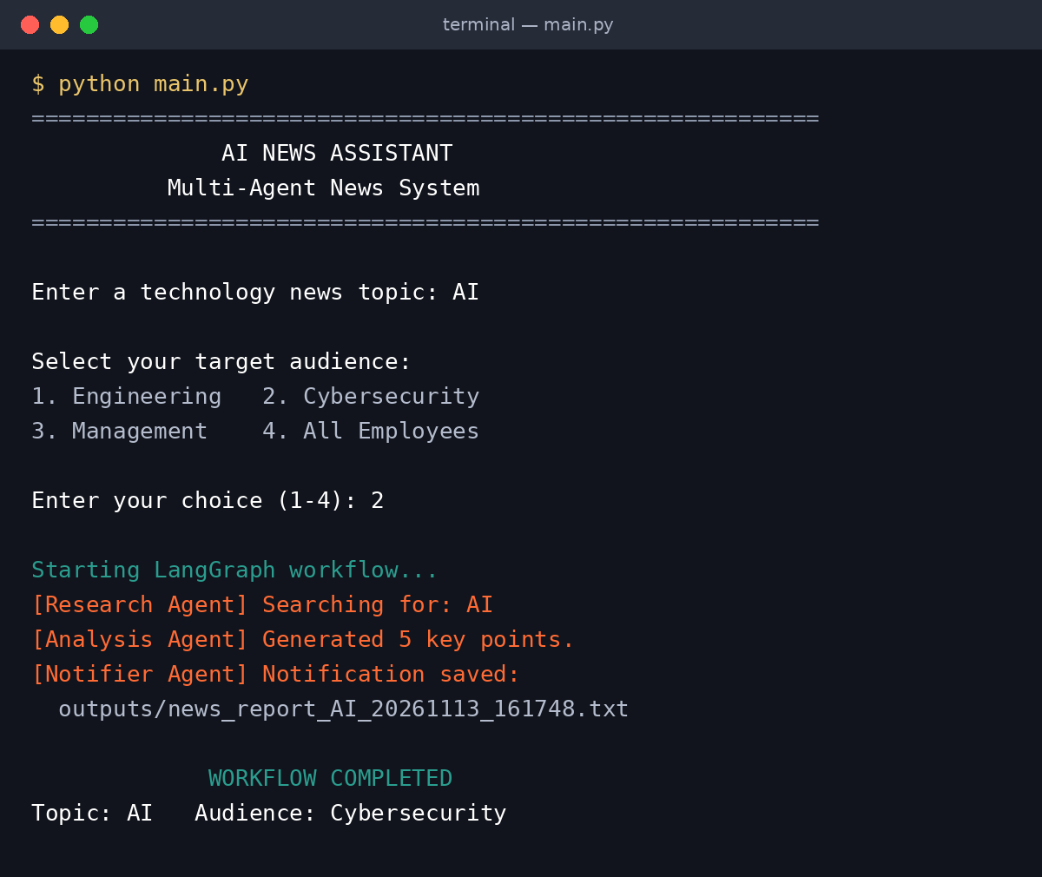
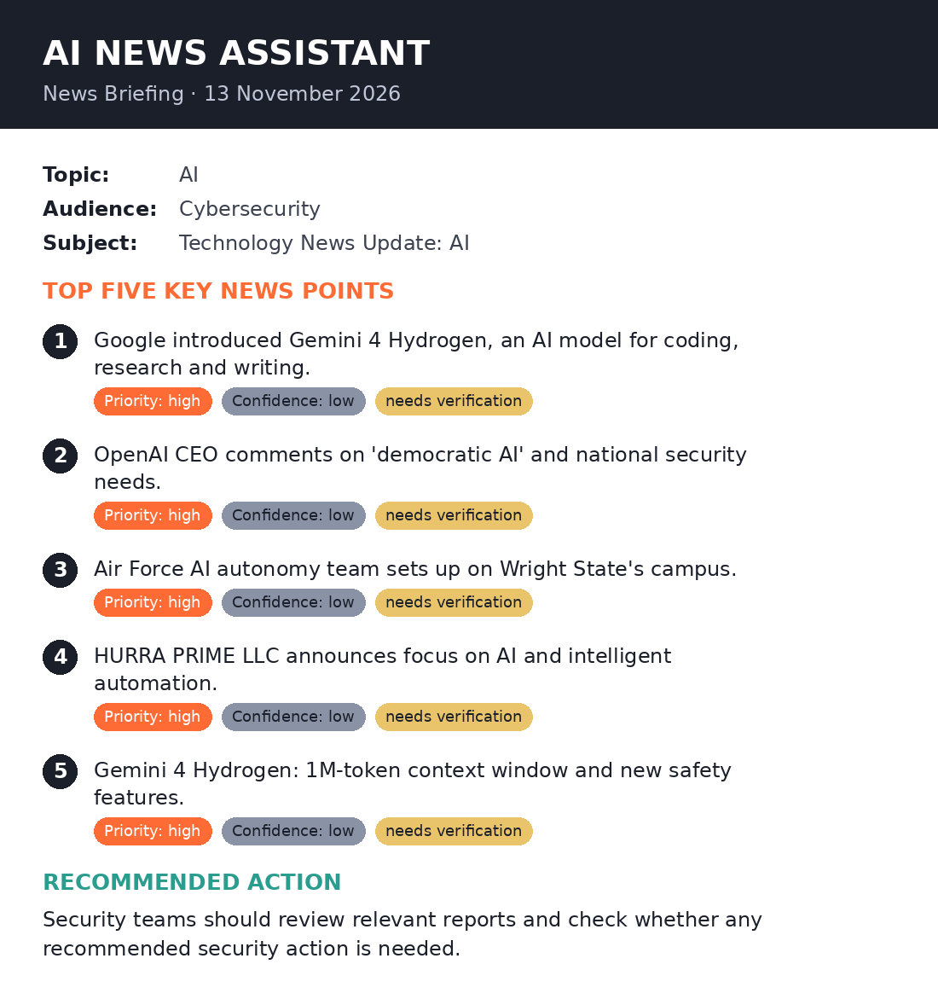
A run, end to end
1 Input & agent logs
2 Generated briefing (tidied preview)
Notes:
Real run from 13 Nov 2026: topic 'AI', audience Cybersecurity. Left: the console prompts and agent log lines from main.py. Right: the content of news_report_AI_20261113_161748.txt, laid out for readability; the actual output is plain text.

Slide 10
Test runs: 4 reports, 20 key points
4
test runs
3
distinct topics
20
key points
Notes:
Scores recomputed from the four saved reports using the agent's own keyword list. The two Nvidia CEO runs were identical, so they appear once. Every one of the 20 points scored 2 or more, which means every point was labelled high priority.

Slide 11


What the test runs revealed
Scraped clutter leaks in
Headings, "Sign in Subscribe", "[...]" and bylines end up inside key points.
13 / 20
Every point is "high" priority
Keyword "ai" is matched as a substring, so words like "said" and "chair" count.
noisy points
0 of 20 corroborated
Paraphrased stories never reach 65% string similarity, so all confidence is low.
Duplicates and off-topic hits
"Super Mario" repeated one point and pulled in unrelated tech pages.
Notes:
Honest evaluation. The pipeline works end to end, but the rule-based analysis has clear limits. The 'ai' substring issue is a one-line fix with word-boundary regex. Low confidence everywhere is expected given a 0.65 character-similarity threshold across differently worded articles.

Slide 12





Tech stack
Python
LangGraph
Tavily API
Core language; TypedDict state, re, difflib
StateGraph orchestration with conditional edges
News search limited to the past week
python-dotenv
difflib
Plain-text output
Loads API keys from .env
SequenceMatcher for similarity checks
Timestamped briefing files in /outputs
Notes:
requirements.txt also lists langchain and langchain-openai, which are installed but not yet used; they are the path to the LLM-based analysis on the roadmap.

Slide 13
Roadmap
Now
Later
1
2
3
4
Quick fixes
Smarter analysis
Retry loop
Delivery
Strip page clutter; match keywords on word boundaries; stronger dedupe
LLM summaries via langchain-openai; semantic similarity for corroboration
Use research_attempts and research_sufficient to re-search with a wider query
Send by email or Slack; schedule daily briefings; add a web UI
Notes:
Ordered by effort. The state already has research_attempts and research_sufficient fields, so the retry loop needs only a new conditional edge back to research.

Slide 14
Thank you
TAKEAWAY
A working, modular multi-agent pipeline today, with a clear path to smarter, more trustworthy briefings. Questions?
Notes:
Close: the architecture is the main achievement; the analysis layer is the natural next upgrade. Invite questions.

