Slide 1

Report Title
Report KPIs
Logo
Report Canvas
Help & Information
Page Name
Date Refreshed

Slide 9
Report Information
Overview
Navigation Details
Key Metrics Definitions
Context & Insights
Data Sources
Update Frequency
Support Info
Notes:
Designing an information page in a Power BI report is a great way to orient users and provide them with essential insights. Here are some key sections that can be helpful:
Overview of the Report: Provide a brief description of the purpose and key objectives of the report. Include what users should expect to find or achieve.
Navigation Instructions: If the report has multiple pages or interactive elements, guide users on how to navigate them effectively (e.g., filters, slicers, drill-throughs).
Key Metrics and Definitions: Display the main KPIs or metrics featured in the report and provide definitions or explanations to ensure users understand them.
Data Sources: Mention where the data comes from and its credibility. This builds trust in the insights provided.
Update Frequency: Inform users about how often the data is refreshed and whether it reflects real-time changes or scheduled updates.
Context and Insights: Briefly summarize the most critical insights or trends users should focus on, especially if the report is data-dense.
Contact or Support Info: Include the name of the analyst or team responsible for the report and how users can reach out with questions or feedback.

Slide 10
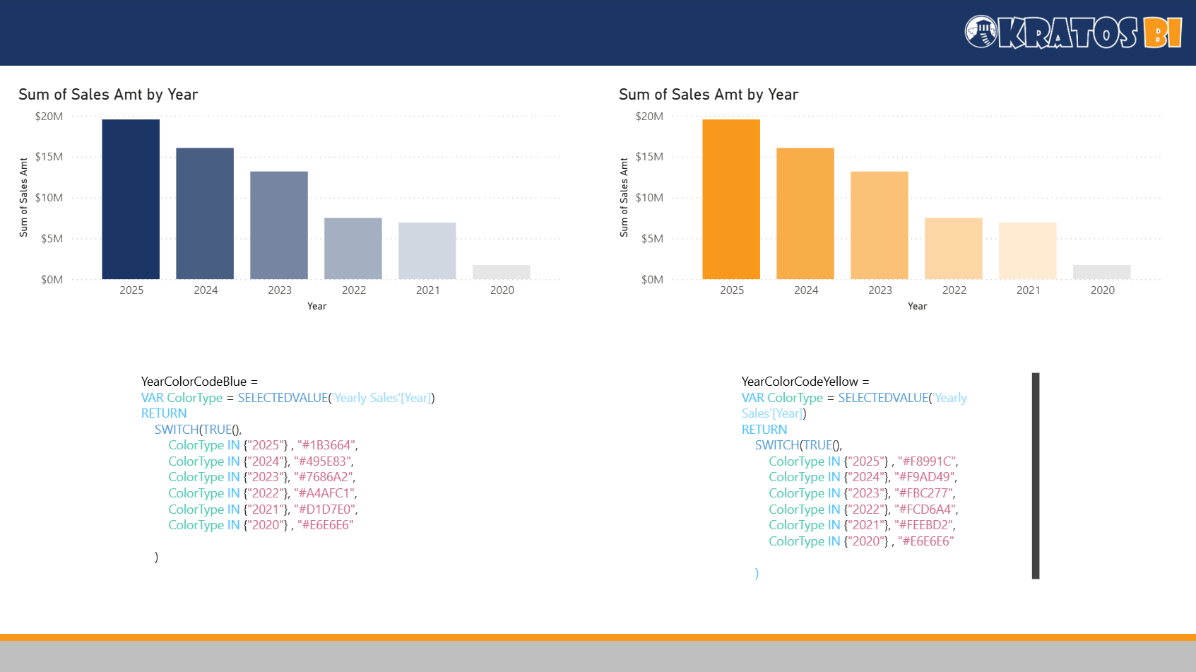
YearColorCodeBlue =
VAR ColorType = SELECTEDVALUE('Yearly Sales'[Year])
RETURN
SWITCH(TRUE(),
ColorType IN {"2025"} , "#1B3664",
ColorType IN {"2024"}, "#495E83",
ColorType IN {"2023"}, "#7686A2",
ColorType IN {"2022"}, "#A4AFC1",
ColorType IN {"2021"}, "#D1D7E0",
ColorType IN {"2020"} , "#E6E6E6"
)
YearColorCodeYellow =
VAR ColorType = SELECTEDVALUE('Yearly Sales'[Year])
RETURN
SWITCH(TRUE(),
ColorType IN {"2025"} , "#F8991C",
ColorType IN {"2024"}, "#F9AD49",
ColorType IN {"2023"}, "#FBC277",
ColorType IN {"2022"}, "#FCD6A4",
ColorType IN {"2021"}, "#FEEBD2",
ColorType IN {"2020"} , "#E6E6E6"
)

Slide 11
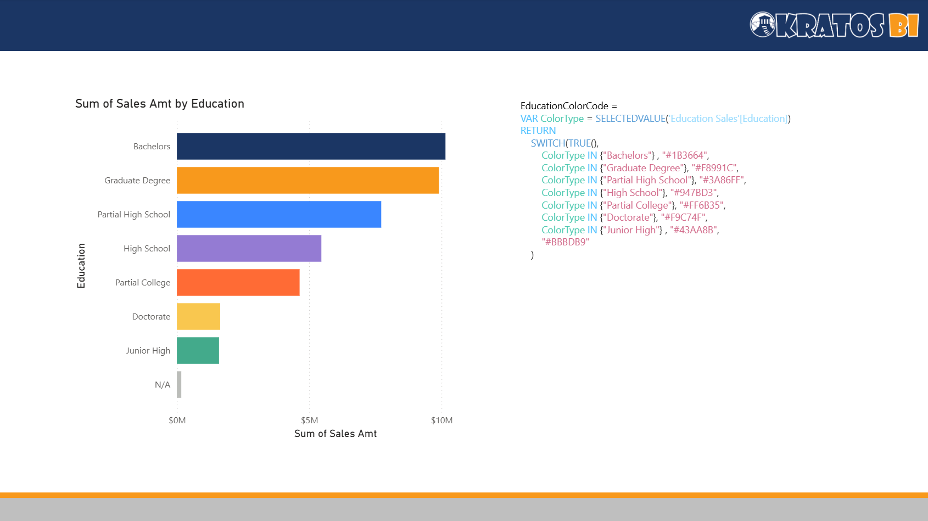
EducationColorCode =
VAR ColorType = SELECTEDVALUE('Education Sales'[Education])
RETURN
SWITCH(TRUE(),
ColorType IN {"Bachelors"} , "#1B3664",
ColorType IN {"Graduate Degree"}, "#F8991C",
ColorType IN {"Partial High School"}, "#3A86FF",
ColorType IN {"High School"}, "#947BD3",
ColorType IN {"Partial College"}, "#FF6B35",
ColorType IN {"Doctorate"}, "#F9C74F",
ColorType IN {"Junior High"} , "#43AA8B",
"#BBBDB9"
)

