Slide 1
How to compile
Kratos
Carlos A. Roig
Kratos Workshop - 2018

Slide 2
Index
What’s new
Linux
Windows
Remarks
Kratos Workshop - 2018

Slide 3
What’s New
New features that will affect how you compile kratos:
Kratos uses C++11 as standard
Boost.Python has been replaced for Pybind11
Some requirements have been revised as a consequence.
Recommended versions:
CMake 3.11 (min 3.4)
Compilers:
Visual Studio 2017 (min 2015 update 3)
CLang 5.x (min 3.9)
GCC 8.1 (min 4.9)
Boost 1.67 (min 1.54)
Python 3.6 (min 3.3)
Kratos Workshop - 2018

Slide 4
Linux

Slide 5

Linux Introduction
Dependencies
Obtain Kratos sources
$ sudo apt-get install python3-dev gcc g++ gfortran libblas-dev liblapack-dev cmake git
$ mkdir $HOME/Kratos
$ git clone https://github.com/KratosMultiphysics/Kratos $HOME/Kratos
Kratos Workshop - 2018

Slide 6

Linux Boost
Opt1
Download latest version from http://www.boost.org/users/download/
Decompress in a folder of your choice (Ej: $HOME/Boost)
Opt2*
$ sudo apt-get install libboost-dev
* Tested on Ubuntu 16.04 & 18.04
No need to compile boost
6
Kratos Workshop - 2018

Slide 7

Linux Configuration
Configure Kratos
Navigate to $HOME/kratos/cmake_build
Copy example_configure.sh.do_not_touch to configure.sh
If you used Opt1 for boost you will need to change -DBOOST_ROOT: (Otherwise delete it)
Don’t forget the \ at the end of the line!
cmake .. \
-DCMAKE_C_COMPILER=/usr/bin/gcc \
-DCMAKE_CXX_COMPILER=/usr/bin/g++ \
-DBOOST_ROOT=$HOME/Boost \
-DPYTHON_EXECUTABLE=/usr/bin/python3 \
-DCMAKE_BUILD_TYPE=Release \
-DMESHING_APPLICATION=ON \
# More options …
configure.sh
Kratos Workshop - 2018

Slide 8
Linux Compilation
Compile Kratos
Run the file and wait for the compilation to end
This may take some time…
$ cd $HOME/Kratos/cmake_build
$ sh ./configure.sh
Kratos Workshop - 2018

Slide 9
Linux Final Steps
Add Kratos to your environment
You must tell your system where Kratos is located
You can also modify the file $HOME/.bashrc manually if you want.
$ echo “LD_LIBRARY_PATH=$LD_LIBRARY_PATH:$HOME/Kratos/libs” >> $HOME/.bashrc
$ echo “PYTHONPATH=$PYTHONPATH:$HOME/Kratos” >> $HOME/.bashrc
Kratos Workshop - 2018

Slide 10
Windows

Slide 11



Windows Dependencies I
You will need to fetch some software
Visual Studio 2017 Community ( Select C++ module)
https://www.visualstudio.com/es/downloads/
Git (Any client will do)
https://desktop.github.com/
Cmake
https://cmake.org/download/
11
Kratos Workshop - 2018

Slide 12

Windows Dependencies II
You will need to fetch some software
Python
https://www.python.org/downloads/
Blas & Lapack
https://web.cimne.upc.edu/users/maceli/data/libs.7z
MinGW
https://sourceforge.net/projects/mingw-w64/
Please take special care to install version 6.4.0 for x64
12
Kratos Workshop - 2018

Slide 13
Windows Boost
Get a version of boost sources
Download latest version from http://www.boost.org/users/download/
Decompress in a folder of your choice (Ej: C:\Boost)
No need to compile boost
13
Kratos Workshop - 2018

Slide 14
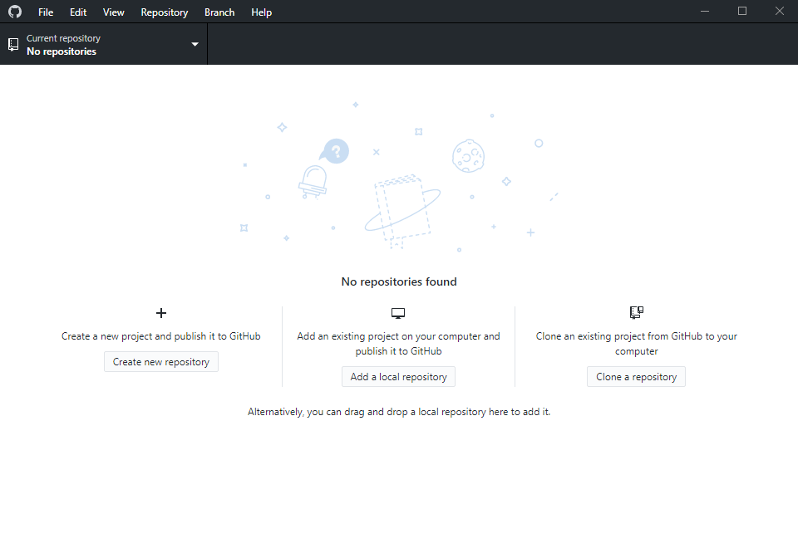
Windows Sources
Obtain the sources. Example using GitHub Desktop
14
Kratos Workshop - 2018

Slide 15
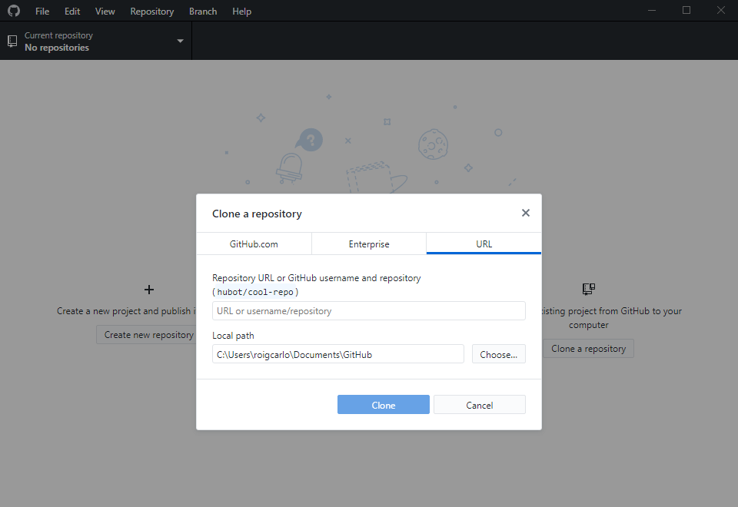
Windows Sources
Obtain the sources. Example using GitHub Desktop
15
Kratos Workshop - 2018

Slide 16
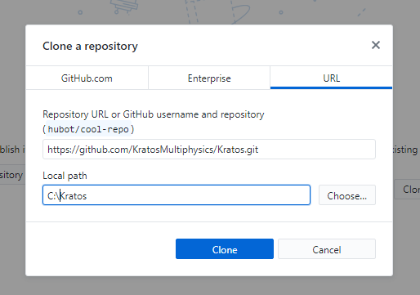
Windows Sources
Obtain the sources. Example using GitHub Desktop
16
Kratos Workshop - 2018

Slide 17
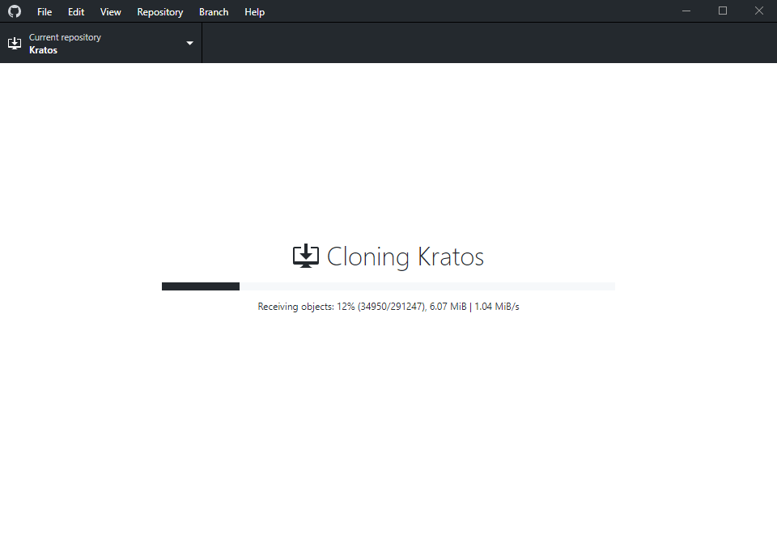
Windows Sources
Obtain the sources. Example using GitHub Desktop
17
Kratos Workshop - 2018

Slide 18
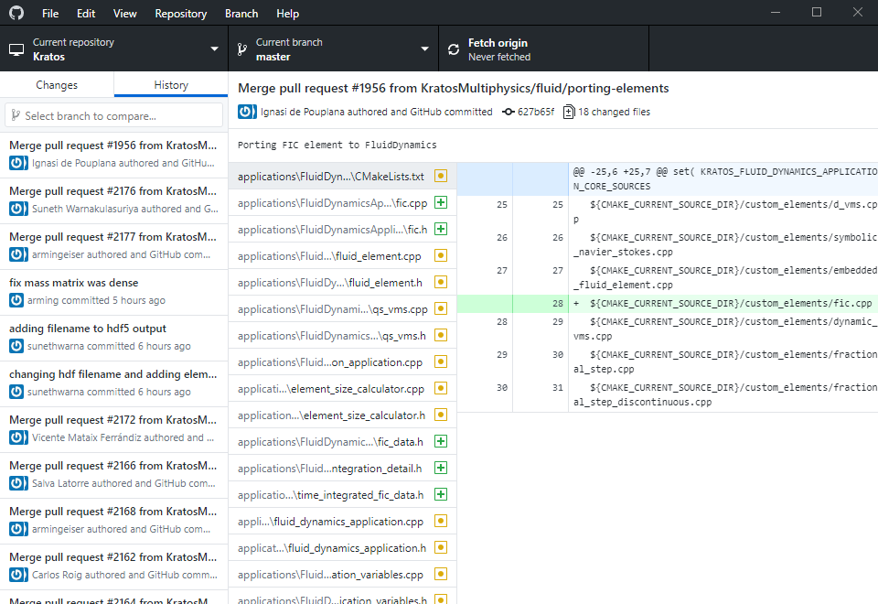
Windows Sources
Obtain the sources. Example using GitHub Desktop
18
Kratos Workshop - 2018

Slide 19
Windows Configuration
Configure Kratos
Navigate to C:\Kratos\cmake_build
Copy example_configure.bat.do_not_touch to configure.bat
Make sure boost, python, lapack and blas paths are correctly set:
Don’t forget the ^ at the end of the line!
cmake –G “Visual Studio 25 2017 Win64” ^
-DBOOST_ROOT=“C:\Boost” ^
-DPYTHON_EXECUTABLE=“C:\Python35\python.exe” ^
-DLAPACK_LIBRARIES=“C:\Libraries\liblapack.lib” ^
-DBLAS_LIBRARIES=“C:\Libraries\libblas.lib” ^
-DCMAKE_BUILD_TYPE=Release ^
-DMESHING_APPLICATION=ON ^
# More options …
configure.bat
19
Kratos Workshop - 2018

Slide 20
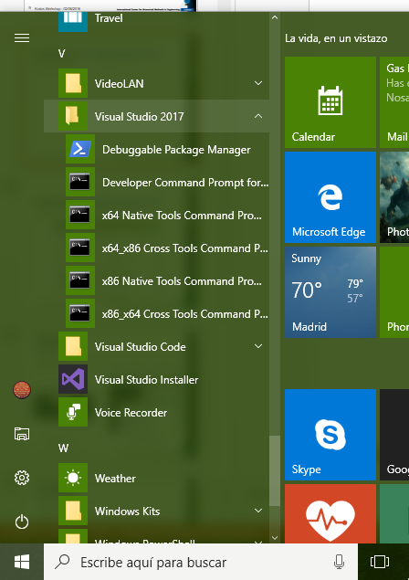
Windows Configuration II
Execute configure.bat
$ cd C:\Kratos\cmake_build
$ configure.bat
20
Kratos Workshop - 2018

Slide 21
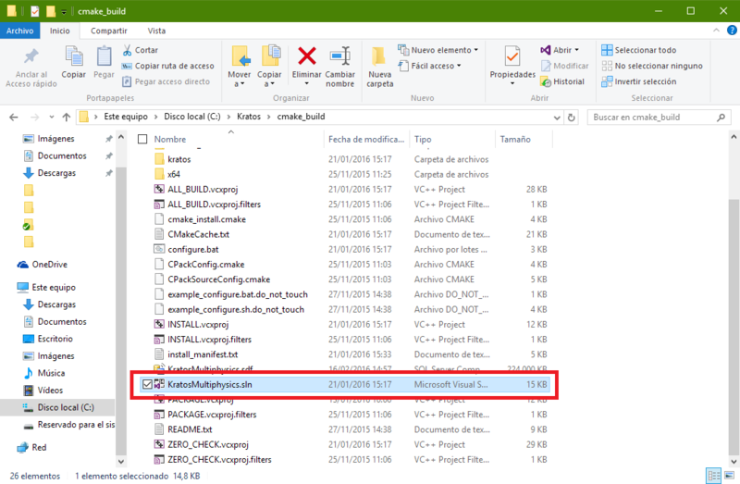
Windows Configuration III
Open the visual studio project that has been generated
21
Kratos Workshop - 2018

Slide 22
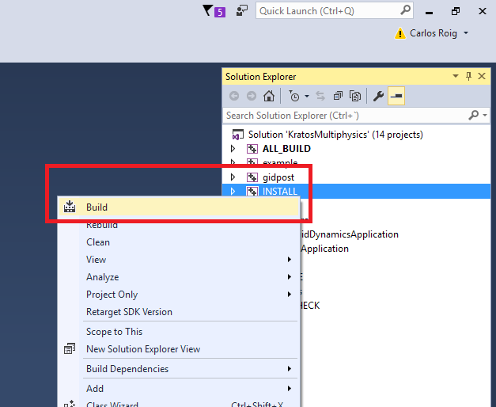
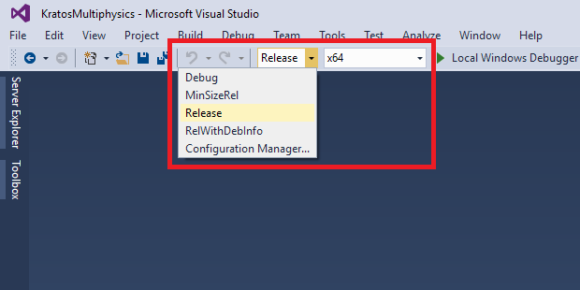
Windows Compilation
Check that Build type is set to Release and select the Build option in the INSTALL project. It may take some time…
22
Kratos Workshop - 2018

Slide 23
Windows Final Steps
Once the project finished, you are done.
To avoid runtime errors, please copy these DLL to the Kratos/libs folder:
libblas.dll
liblapack.dll
Finally, copy all the .dll located in your MinGW binary dir to the Kratos/libs folder:
C:\MinGW\bin
23
Kratos Workshop - 2018

Slide 24
Windows Remarks
Remember that you can find the content of this slides expanded in the wiki!
For Windows:
https://github.com/KratosMultiphysics/Kratos/wiki/Windows-Install
For Linux:
https://github.com/KratosMultiphysics/Kratos/wiki/Linux-Build
For MacOSX (thx to Ignasi!):
https://github.com/KratosMultiphysics/Kratos/wiki/MacOS-Install
If you have any question:
Win or Linux: croig@cimne.upc.edu
Mac: ipouplana@cimne.upc.edu
Issue at: https://github.com/KratosMultiphysics/Kratos/issues
24
Kratos Workshop - 2018

Slide 25
Thx!

