Slide 1
HW3&4

Slide 2
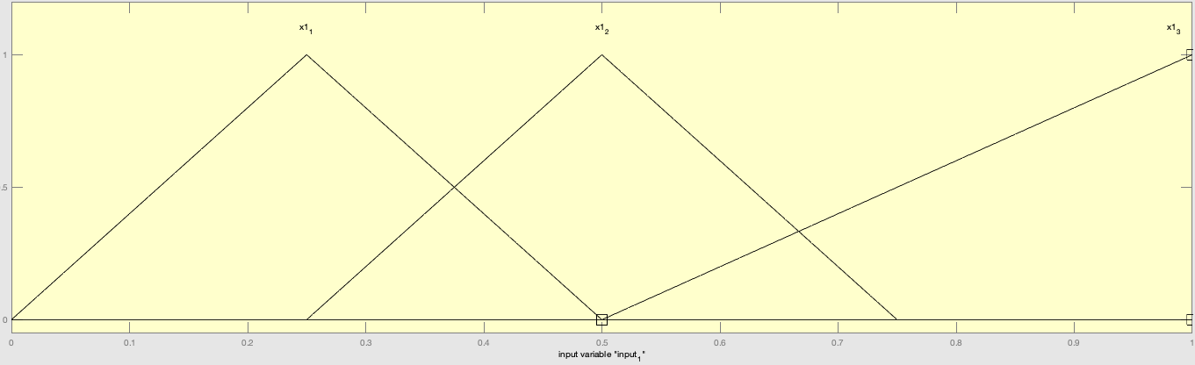
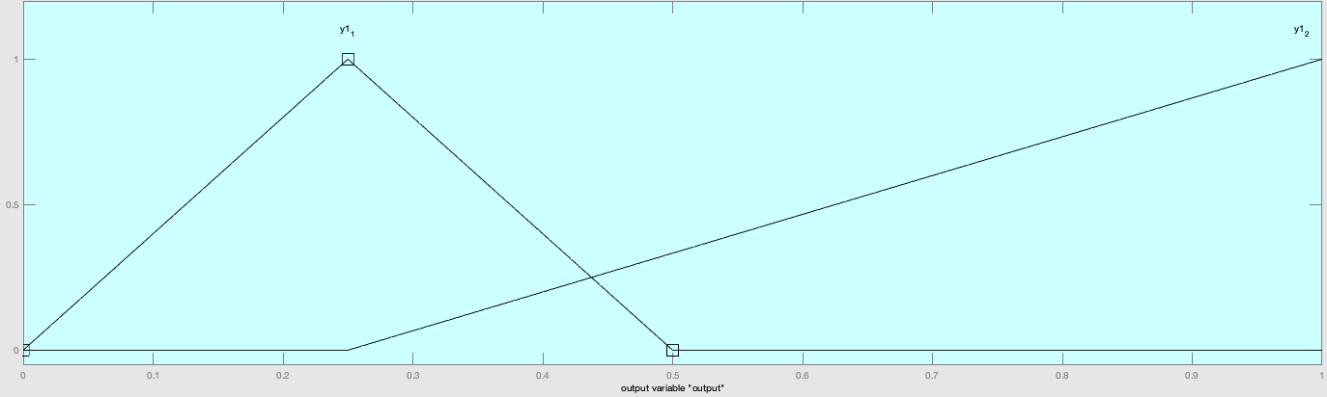
Problem 1 - Toolbox Test A: Hint Setup
MEMBERSHIP FUNCTIONS:
RULES:
If input = x1_1, then output = y1_1
If input = x1_2, then output = y1_2
If input = x1_3, then output = y1_2

Slide 3
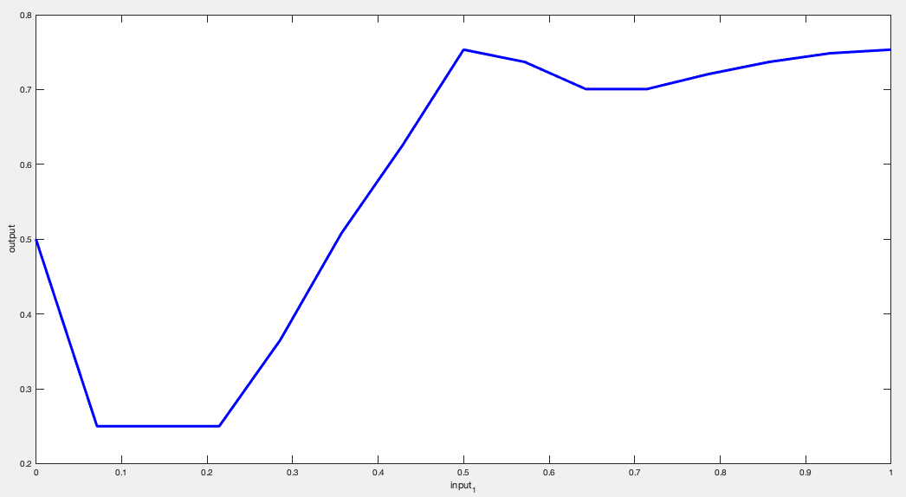
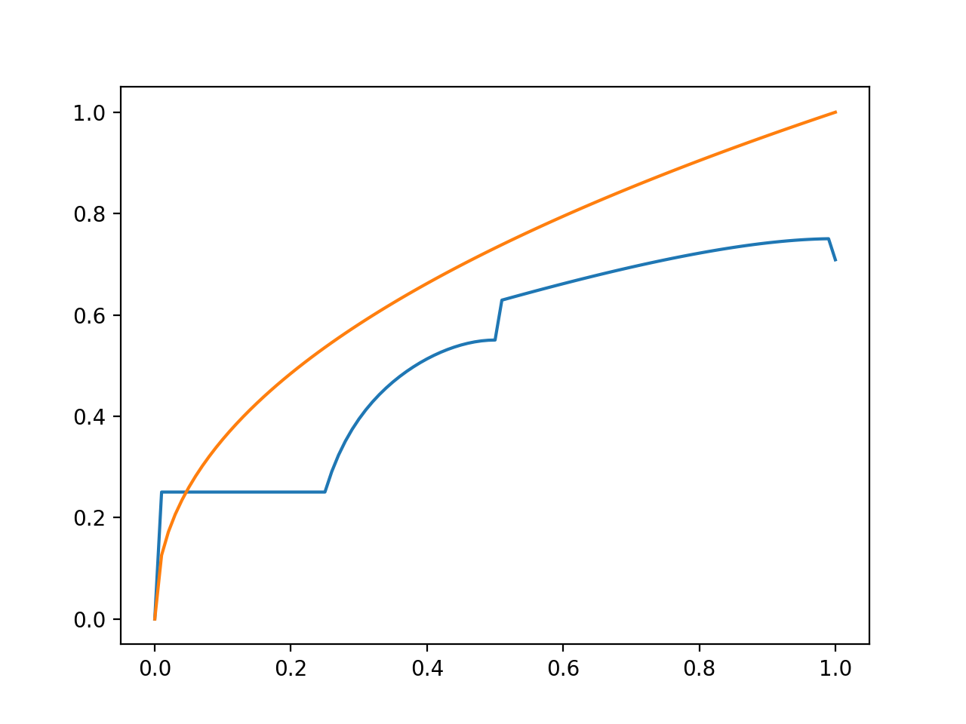
Problem 1 - Toolbox Test A: Hint Result
Matlab Toolbox Result:
Xin’s Result:

Slide 4
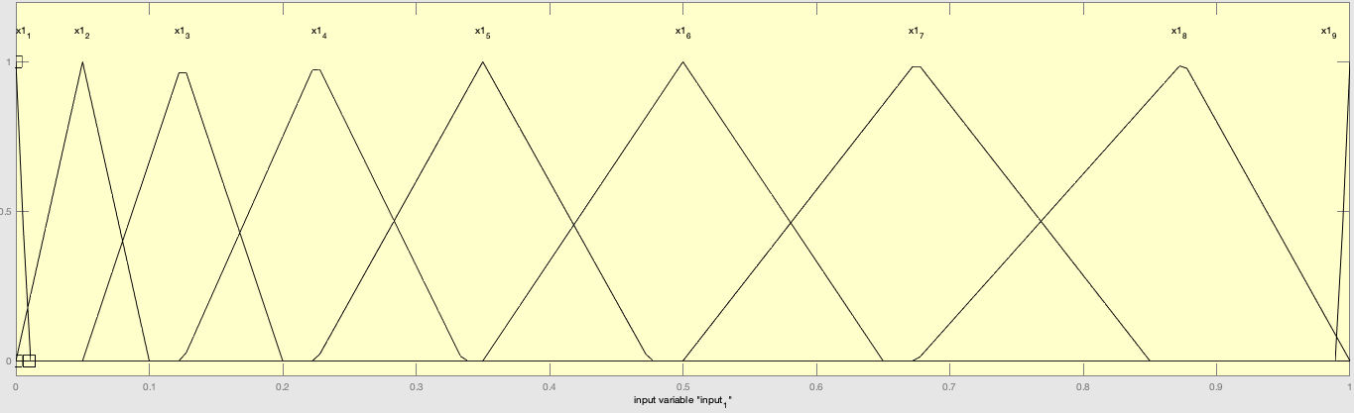
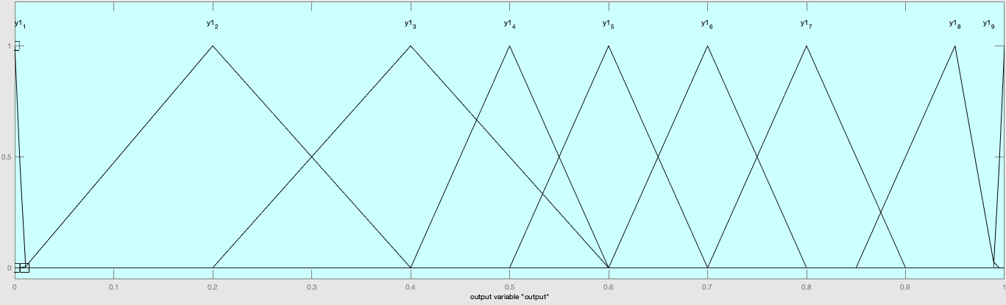
Problem 1 - Toolbox Test B: Updated Setup
MEMBERSHIP FUNCTIONS:
RULES:
If input = x1_1, then output = y1_1
If input = x1_2, then output = y1_2
If input = x1_3, then output = y1_3
If input = x1_4, then output = y1_4
If input = x1_5, then output = y1_5
If input = x1_6, then output = y1_6
If input = x1_7, then output = y1_7
If input = x1_8, then output = y1_8
If input = x1_9, then output = y1_9

Slide 5
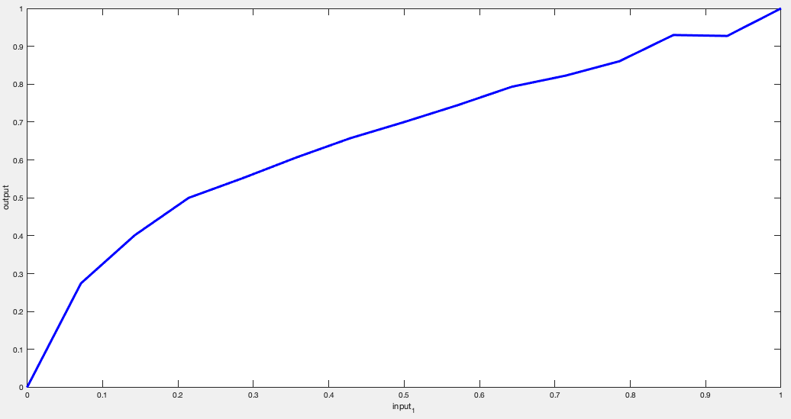
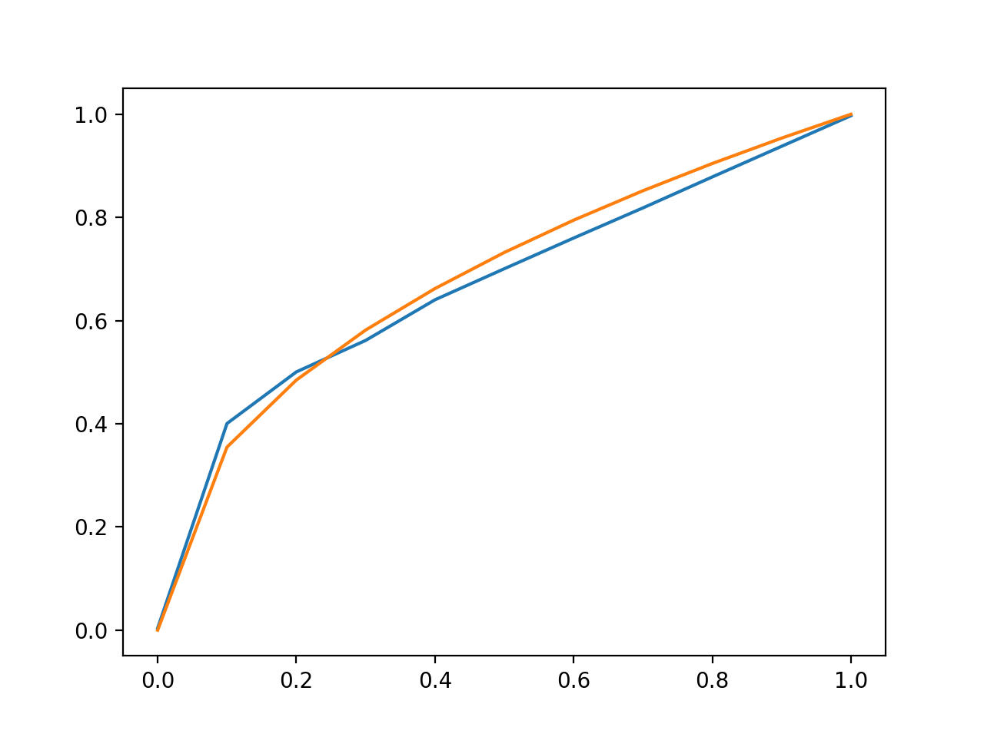
Problem 1 - Toolbox Test B: Updated Result
Matlab Toolbox Result:
Xin’s Result:

Slide 6
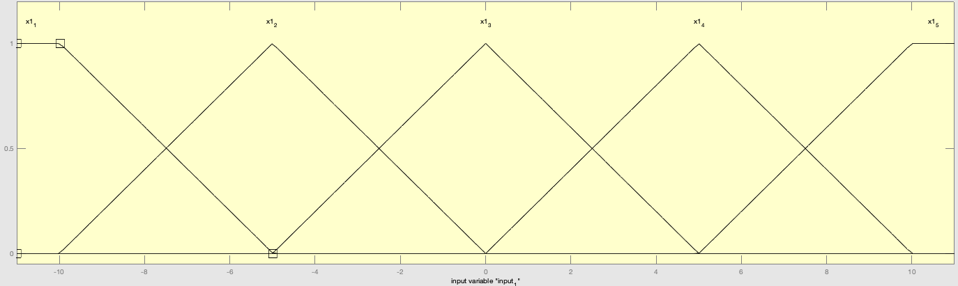
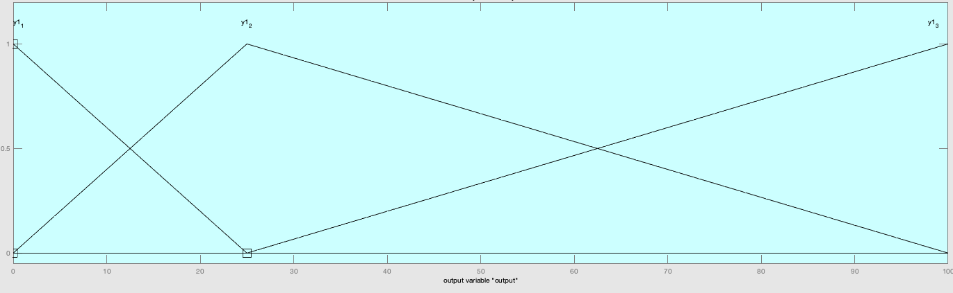
Problem 2 - Toolbox Test A: Hint Setup
MEMBERSHIP FUNCTIONS:
RULES:
If input = x1_3, then output = y1_1
If input = x1_2, then output = y1_2
If input = x1_3, then output = y1_2

Slide 7
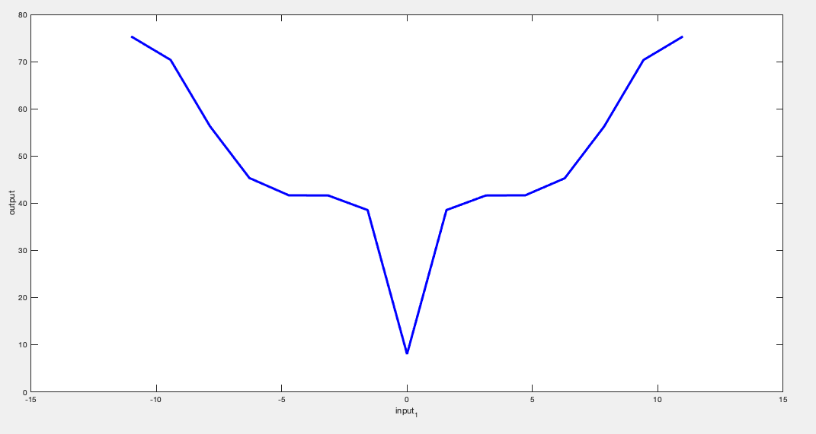
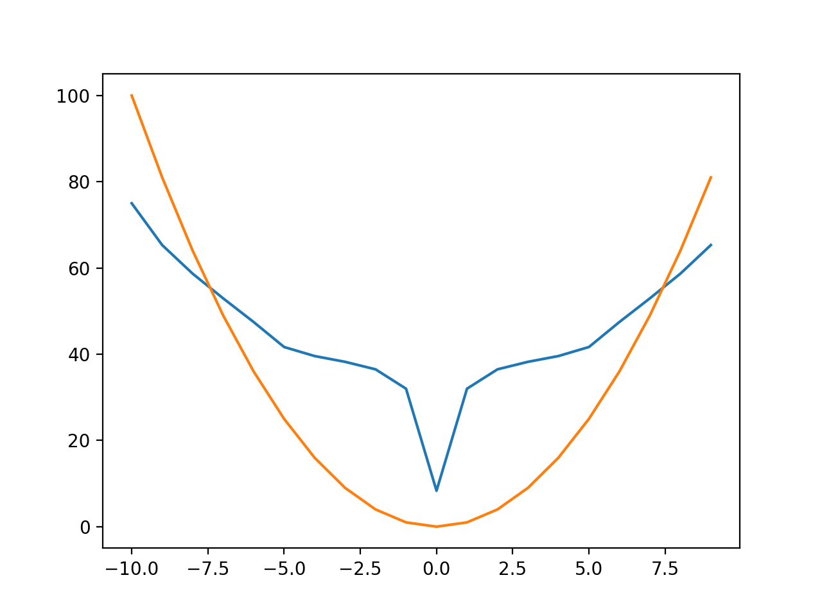
Problem 2 - Toolbox Test A: Hint Result
Matlab Toolbox Result:
Xin’s Result:

Slide 8
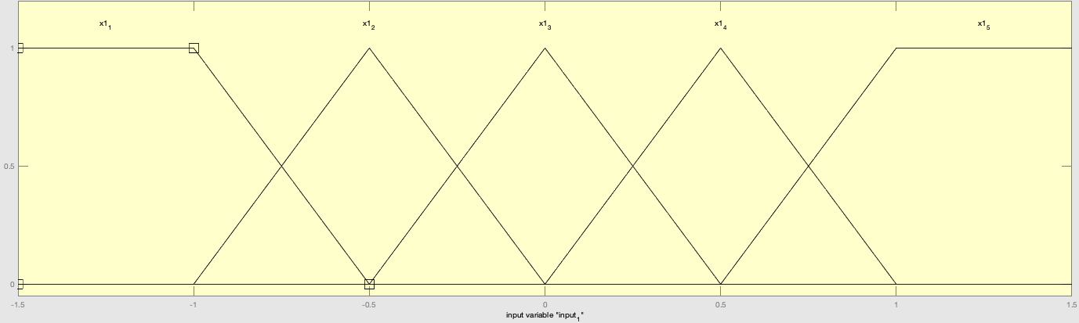
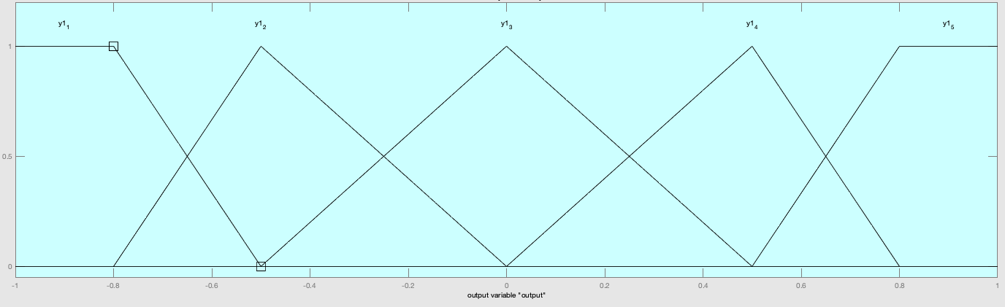
Problem 3 - Toolbox Test A: Hint Setup
MEMBERSHIP FUNCTIONS:
RULES:
If input = x1_1, then output = y1_1
If input = x1_2, then output = y1_2
If input = x1_3, then output = y1_3
If input = x1_4, then output = y1_4
If input = x1_1, then output = y1_5

Slide 9
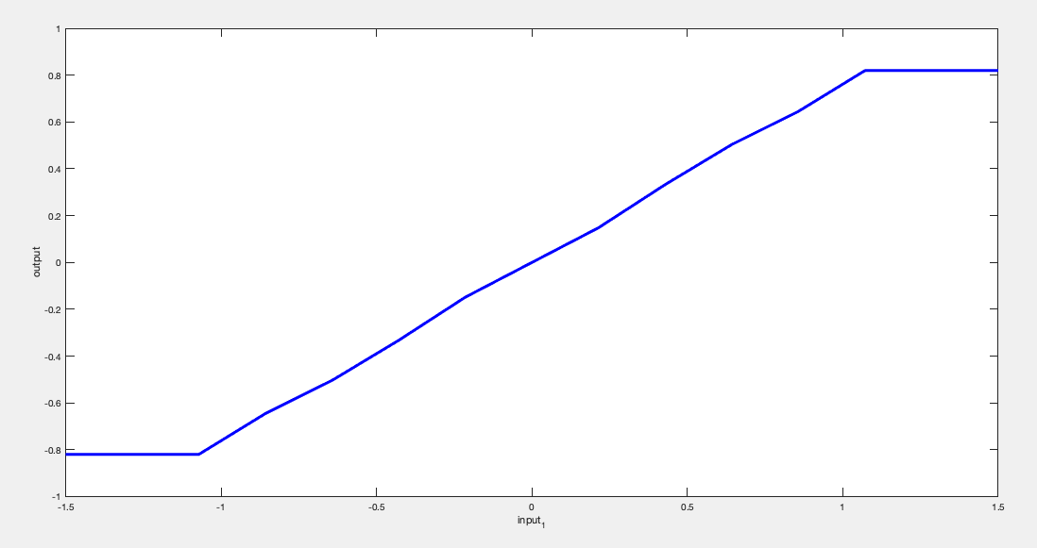
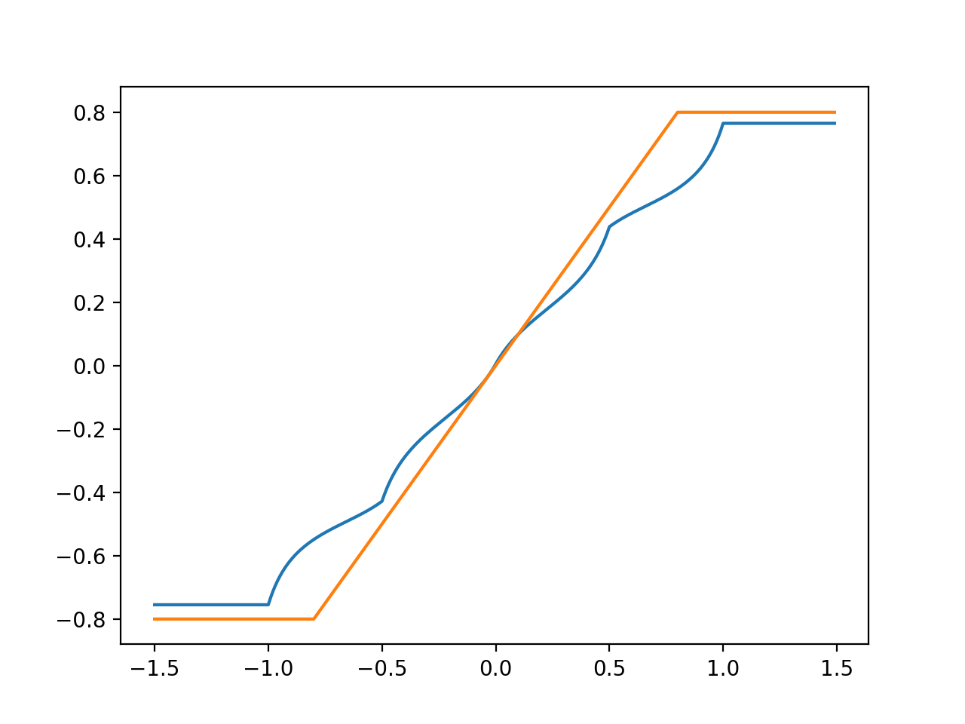
Problem 3 - Toolbox Test A: Hint Result
Matlab Toolbox Result:
Xin’s Result:

Slide 10
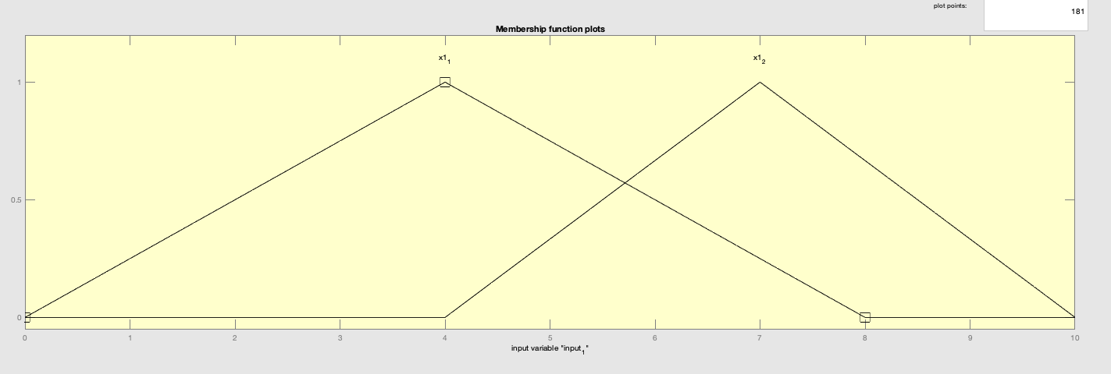
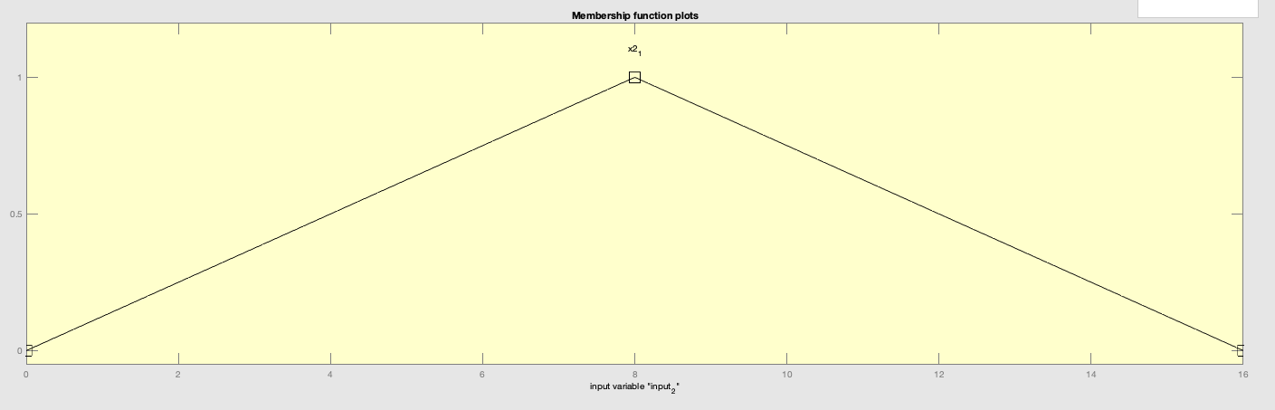
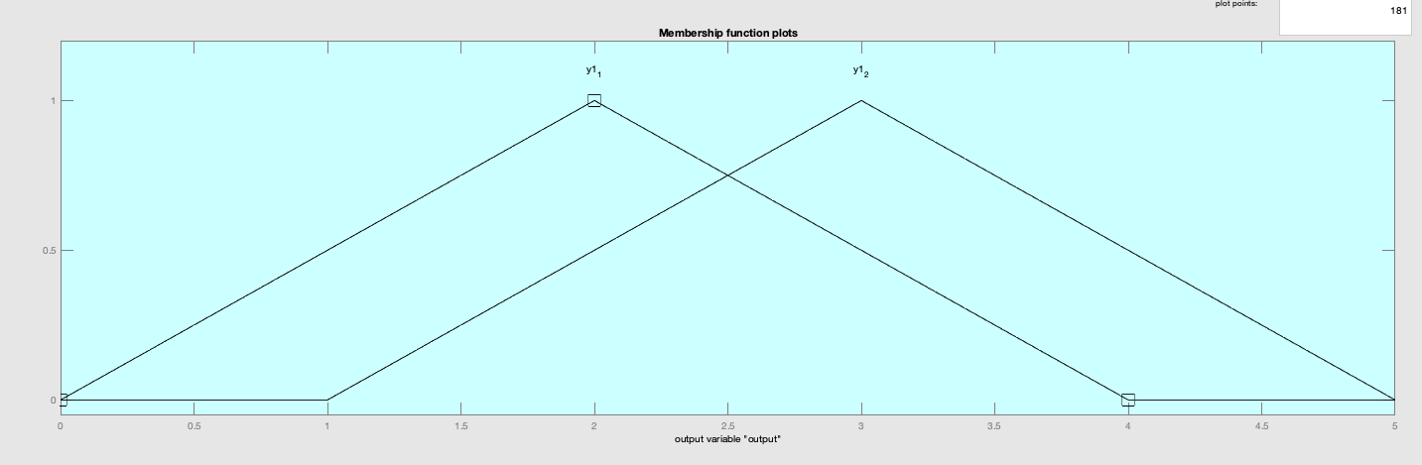
Problem 4 - Toolbox Test A: Hint Setup
MEMBERSHIP FUNCTIONS:
RULES:
If input = x1_1 and x2_1,
then output = y1_1
If input = x1_2 and x2_1,
then output = y1_2

Slide 11
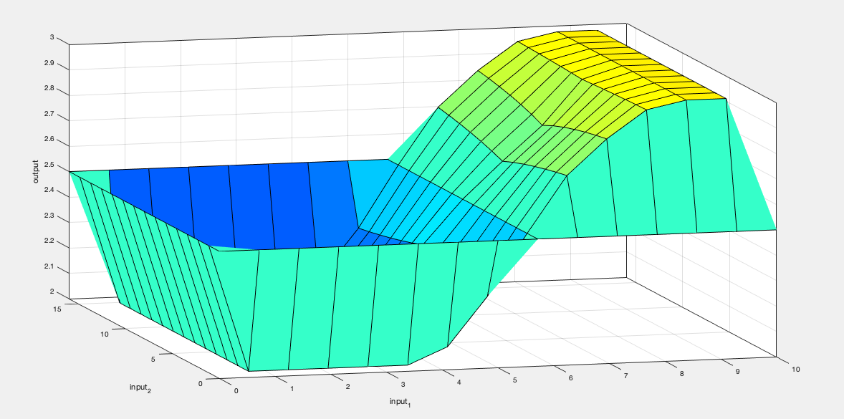
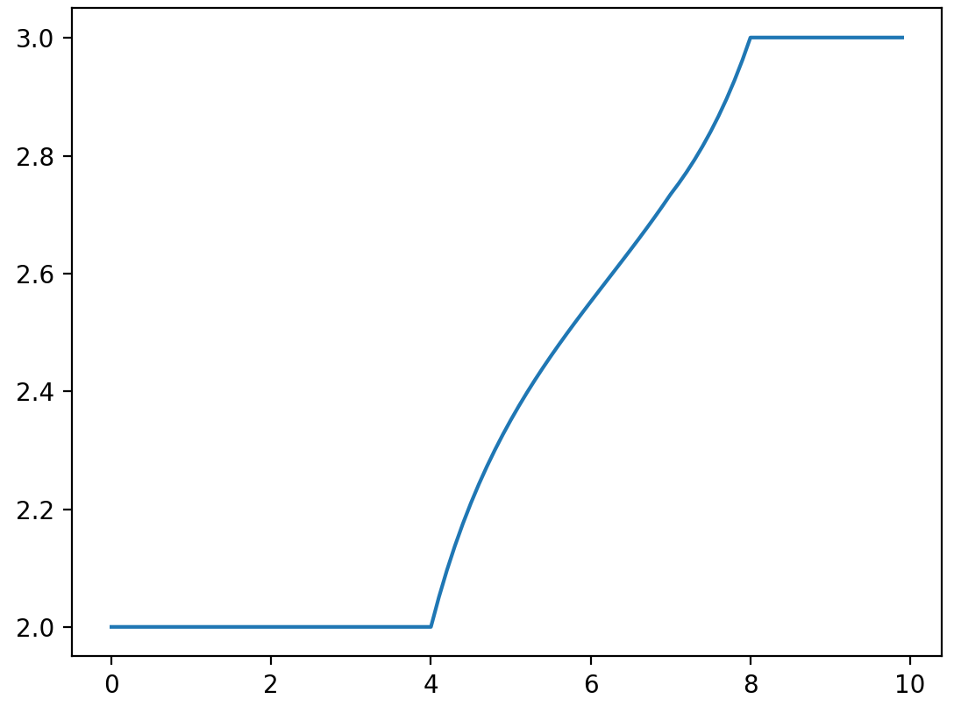
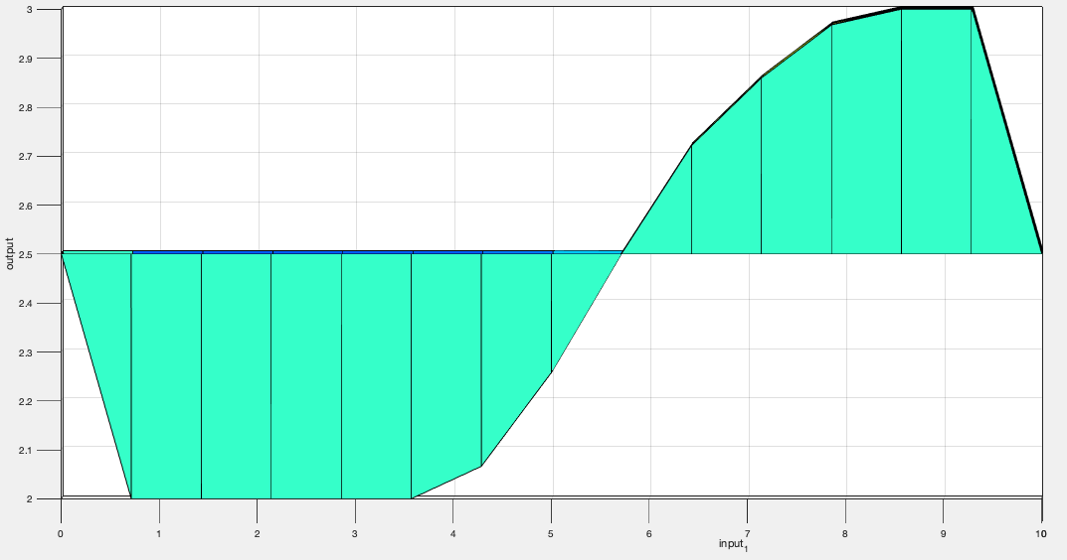
Problem 4 - Toolbox Test A: Hint Result
Matlab Toolbox Result:
Xin’s Result:
Set x2 = 10, iterate x1 within [0, 10]

Slide 12
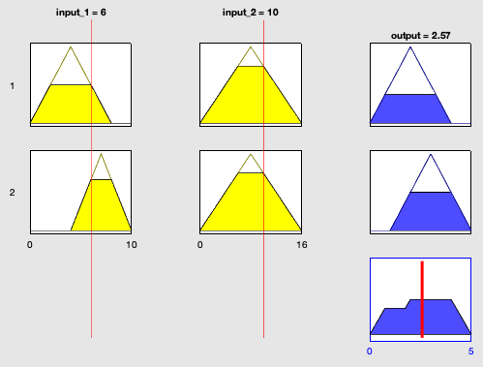
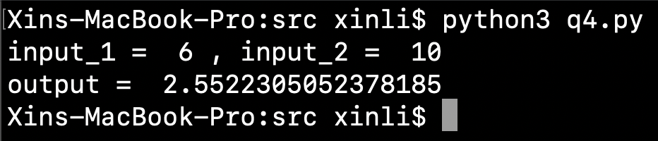
Problem 4 - Toolbox Test A: Hint Result
Matlab Toolbox Result:
Xin’s Result:

Slide 13
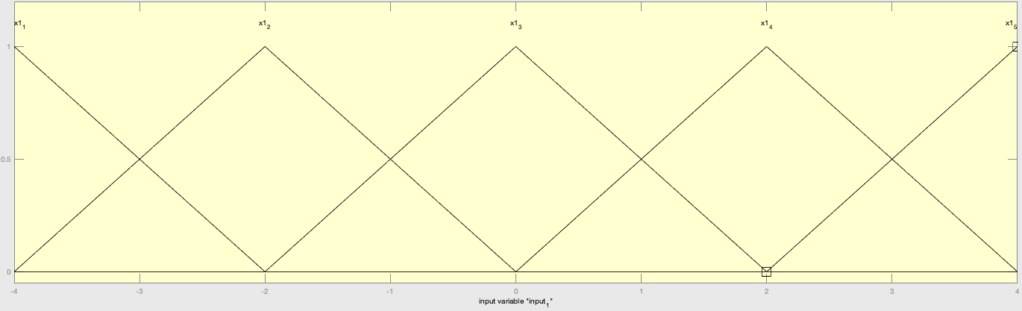
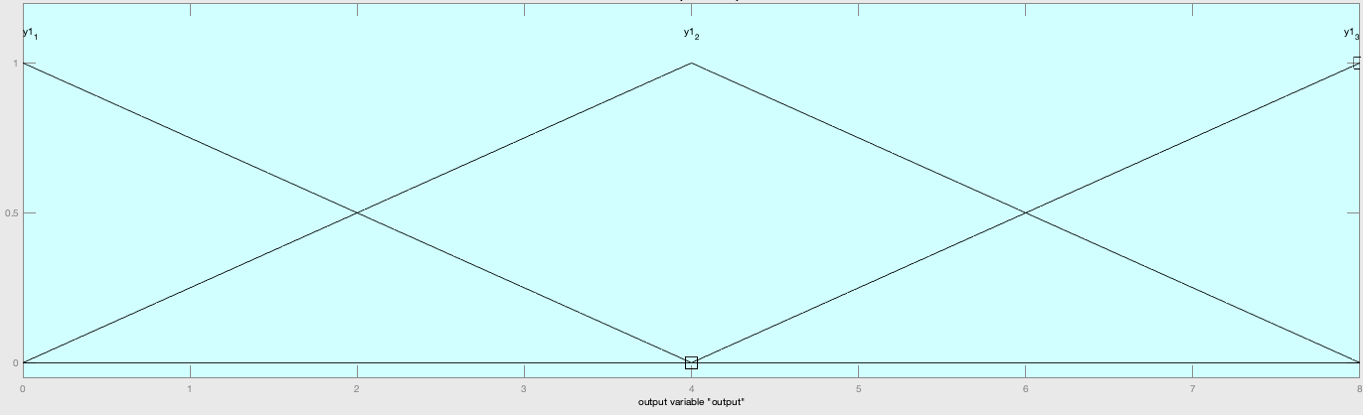
Problem 5 - Toolbox Test A: Hint Setup
MEMBERSHIP FUNCTIONS:
RULES:
If input = x1_3, then output = y1_1
If input = x1_1, then output = y1_3
If input = x1_5, then output = y1_3
If input = x1_2 , then output = y1_2
If input = x1_4, then output = y1_2

Slide 14
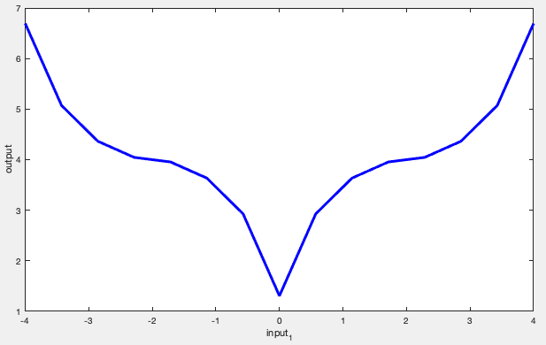
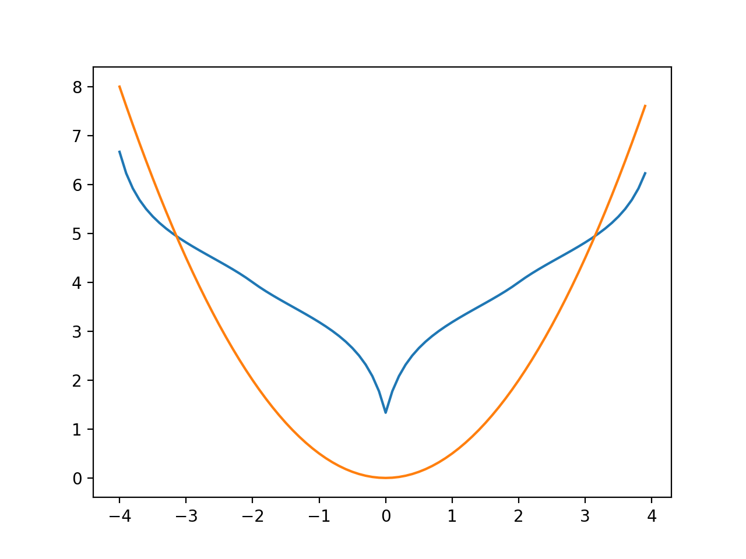
Problem 5 - Toolbox Test A: Hint Result
Matlab Toolbox Result:
Xin’s Result:

Slide 15
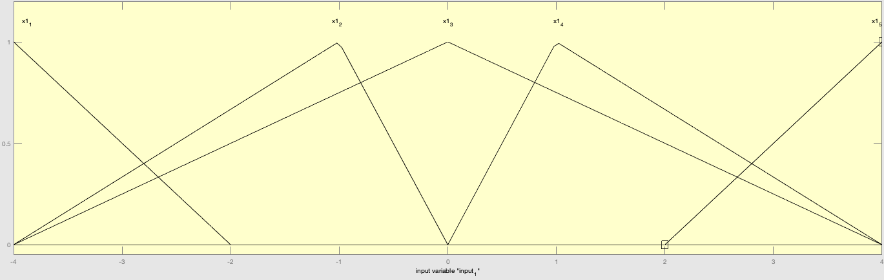
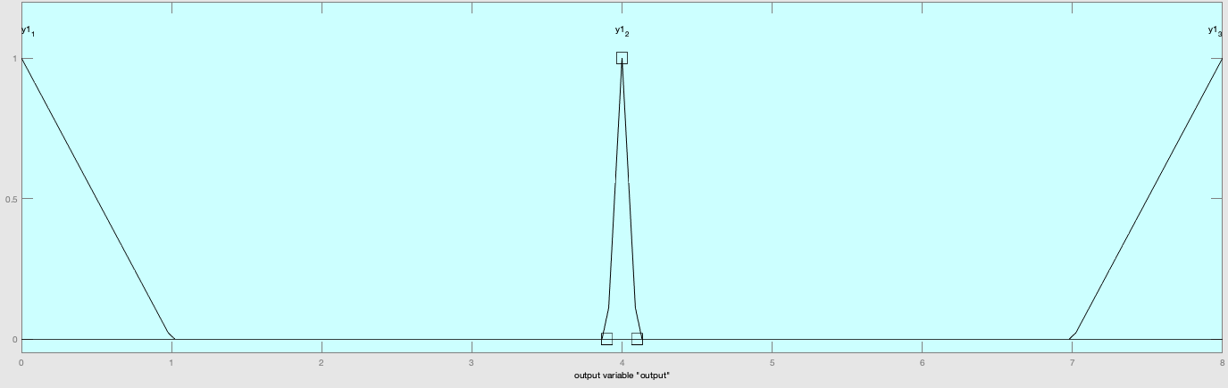
Problem 5 - Toolbox Test B: Updated Setup
MEMBERSHIP FUNCTIONS:
RULES:
If input = x1_3, then output = y1_1
If input = x1_1, then output = y1_3
If input = x1_5, then output = y1_3
If input = x1_2 , then output = y1_2
If input = x1_4, then output = y1_2

Slide 16
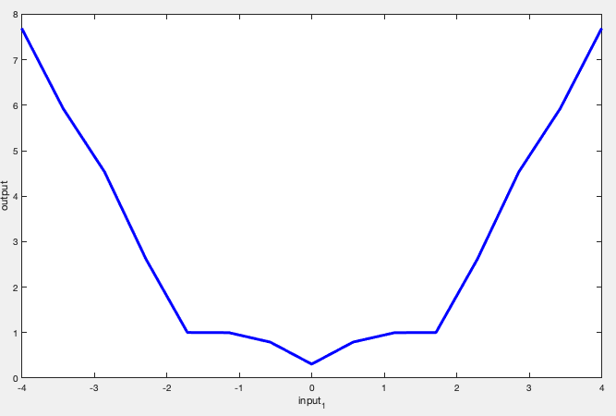
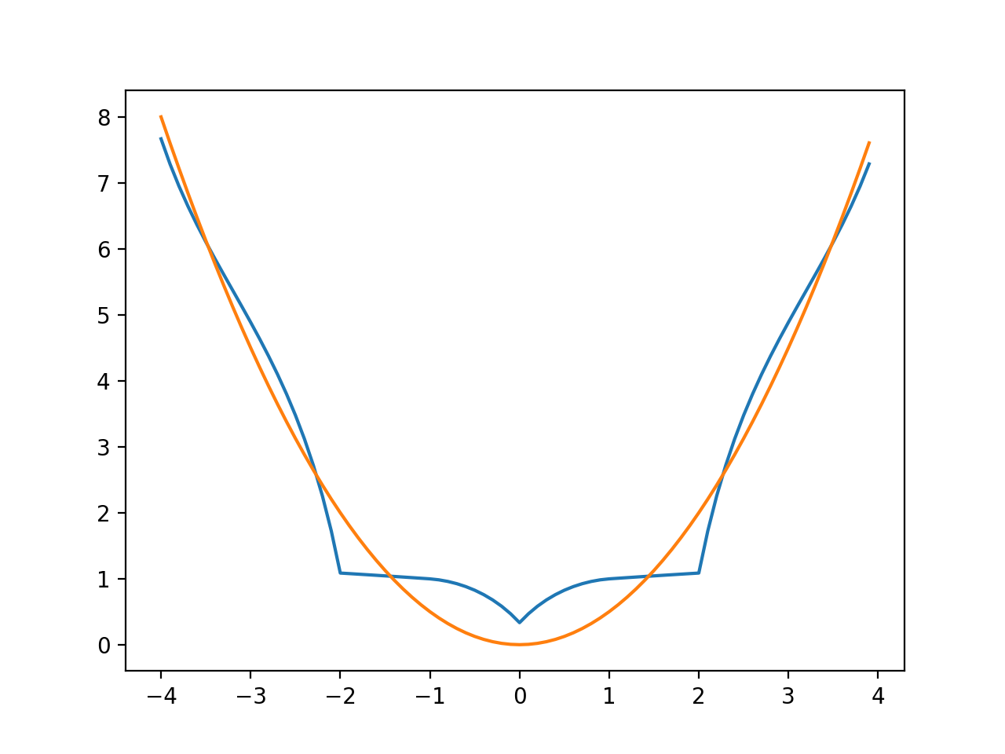
Problem 5 - Toolbox Test B: Updated Result
Matlab Toolbox Result:
Xin’s Result:

