Slide 1
HW3&4
AEEM 7010
XIN LI

Slide 2
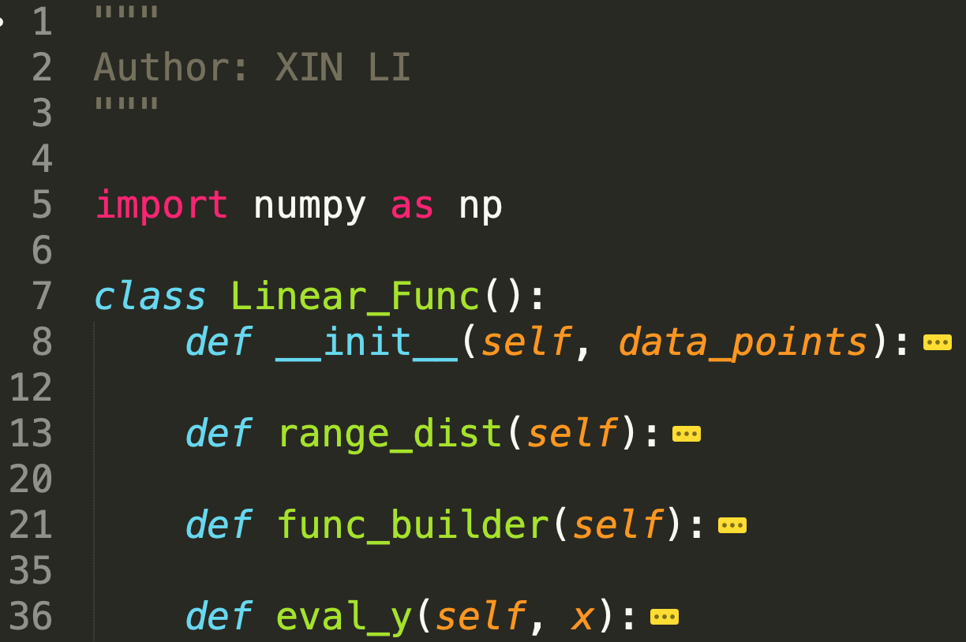
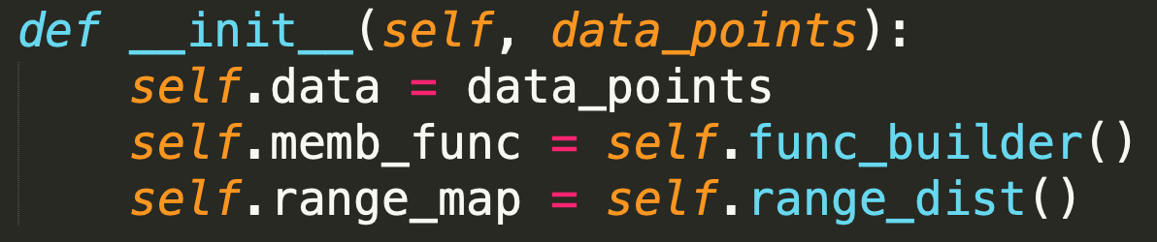
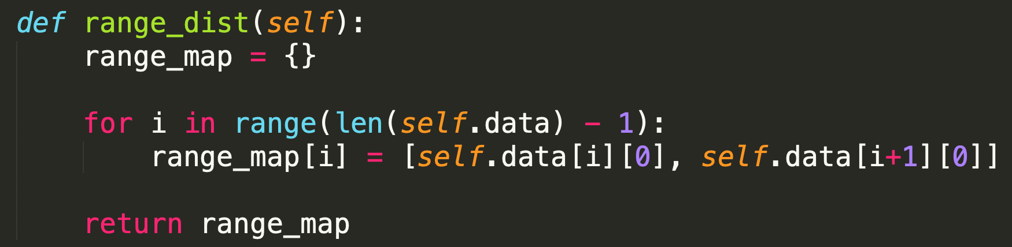
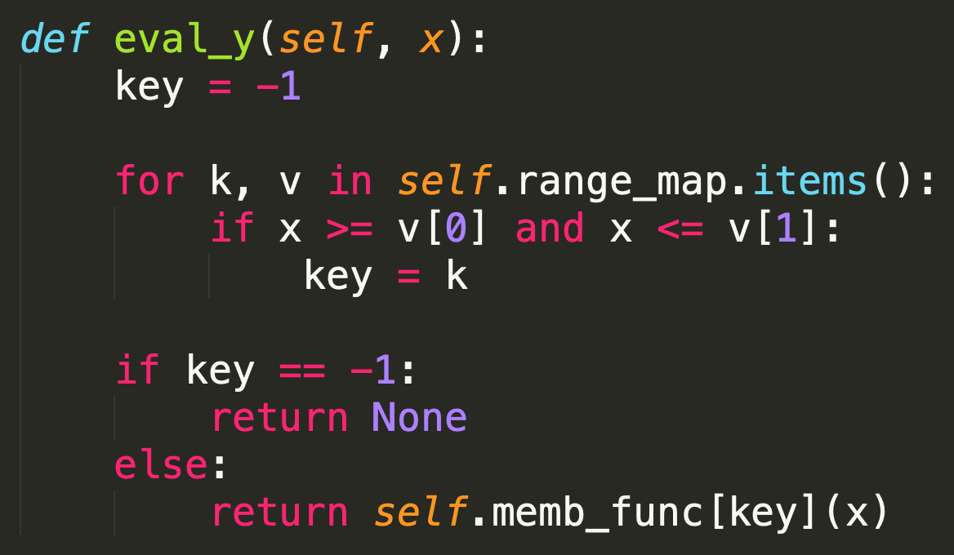
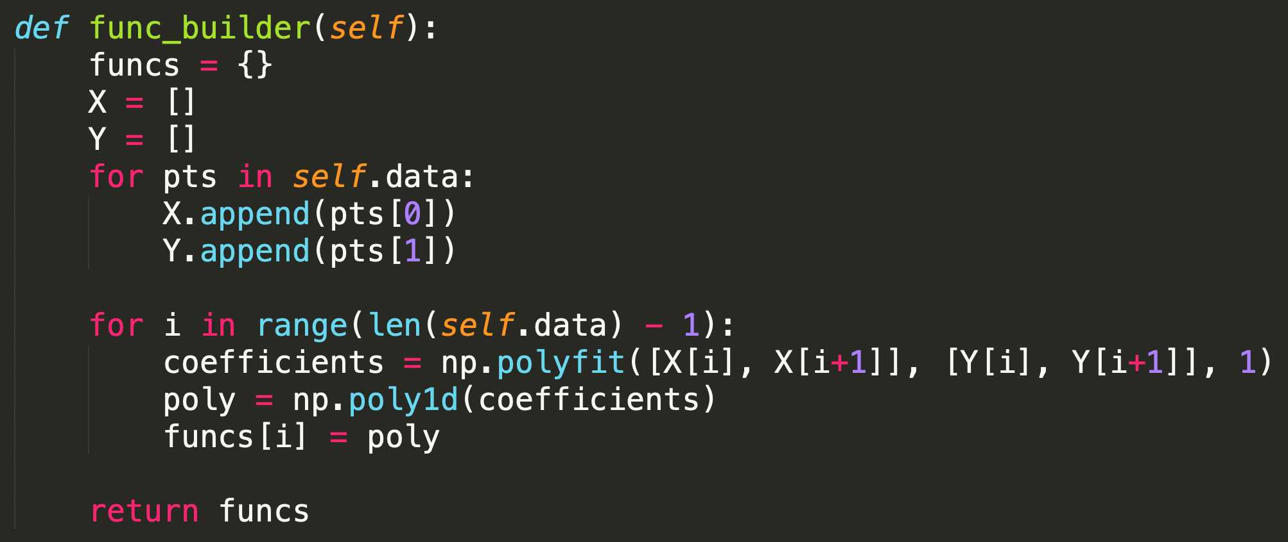
Code Details – Linear Func()

Slide 3
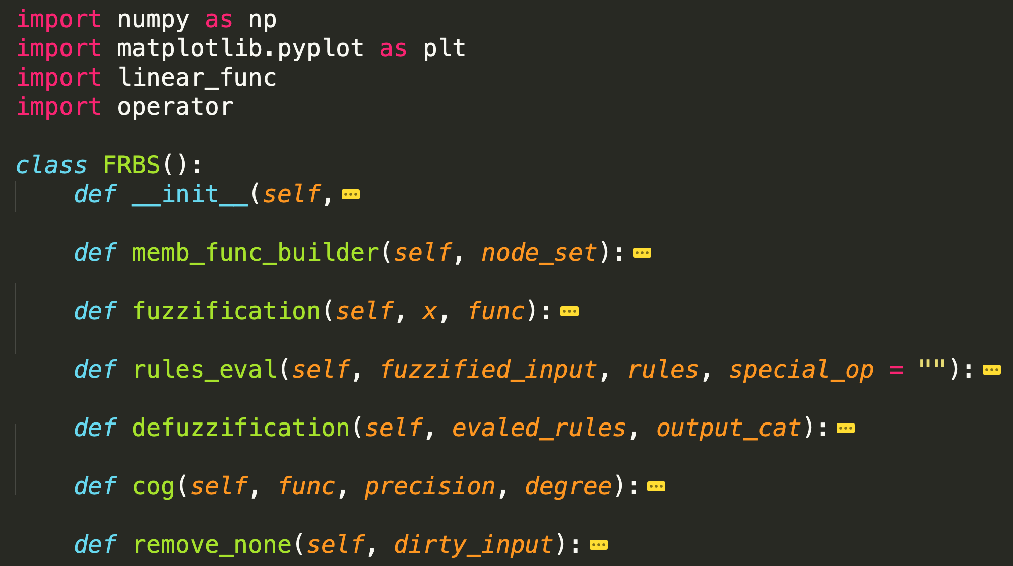
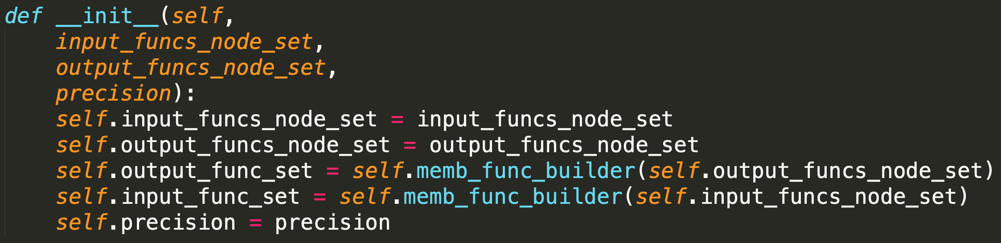
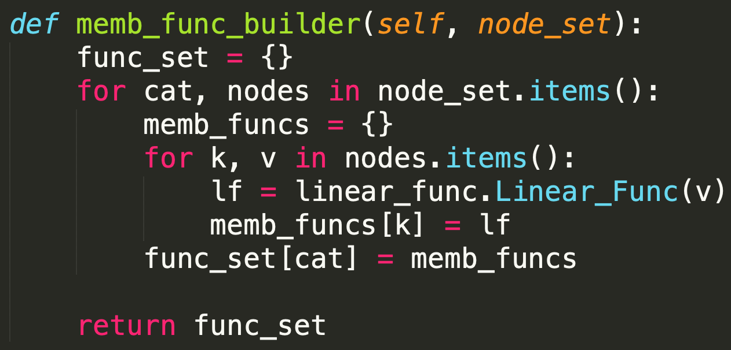
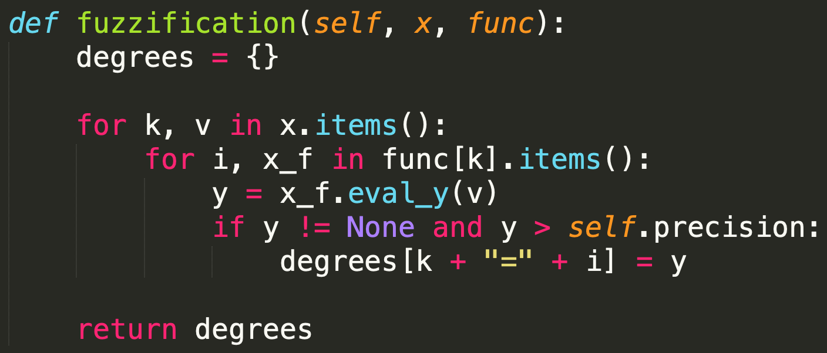
Code Details – FRBS()

Slide 4
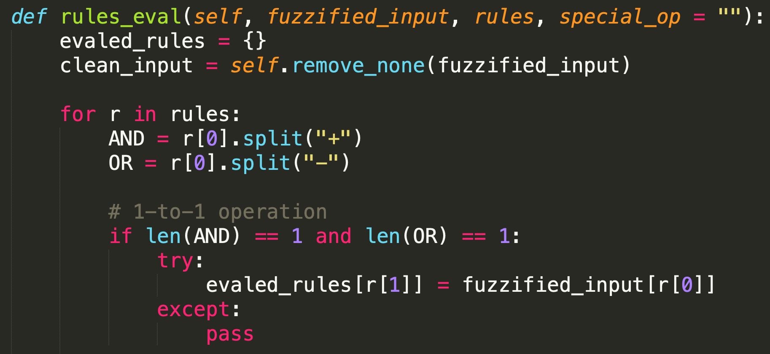
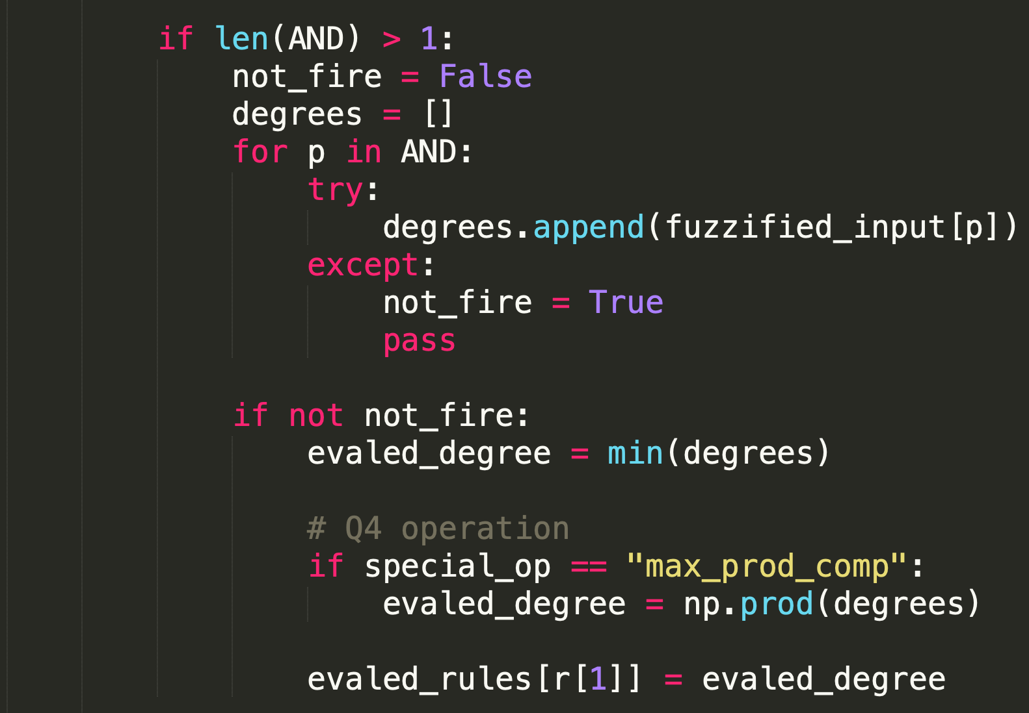
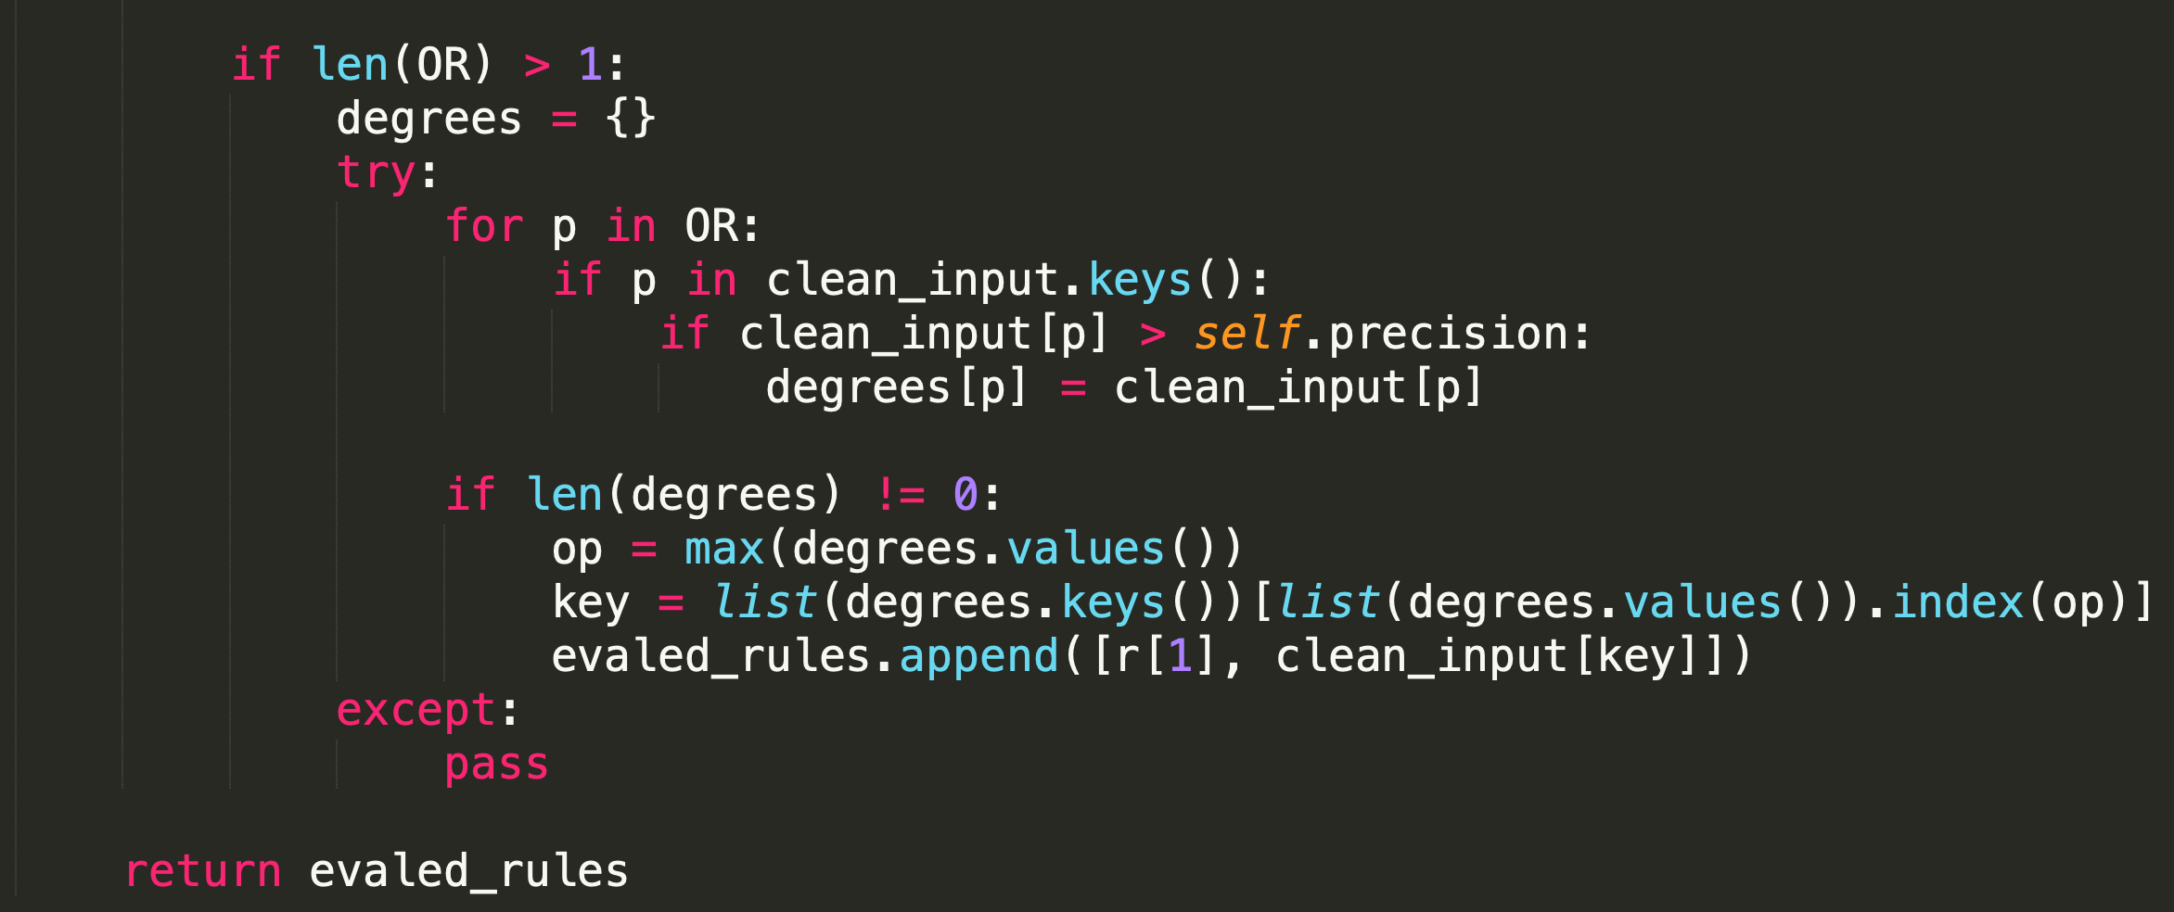
Code Details – FRBS()
(1)
(2)
1&2&3
(3)

Slide 5
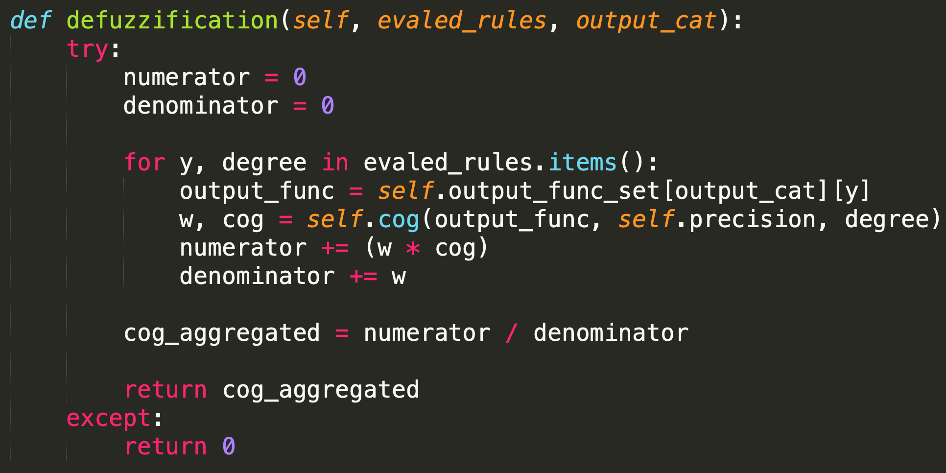
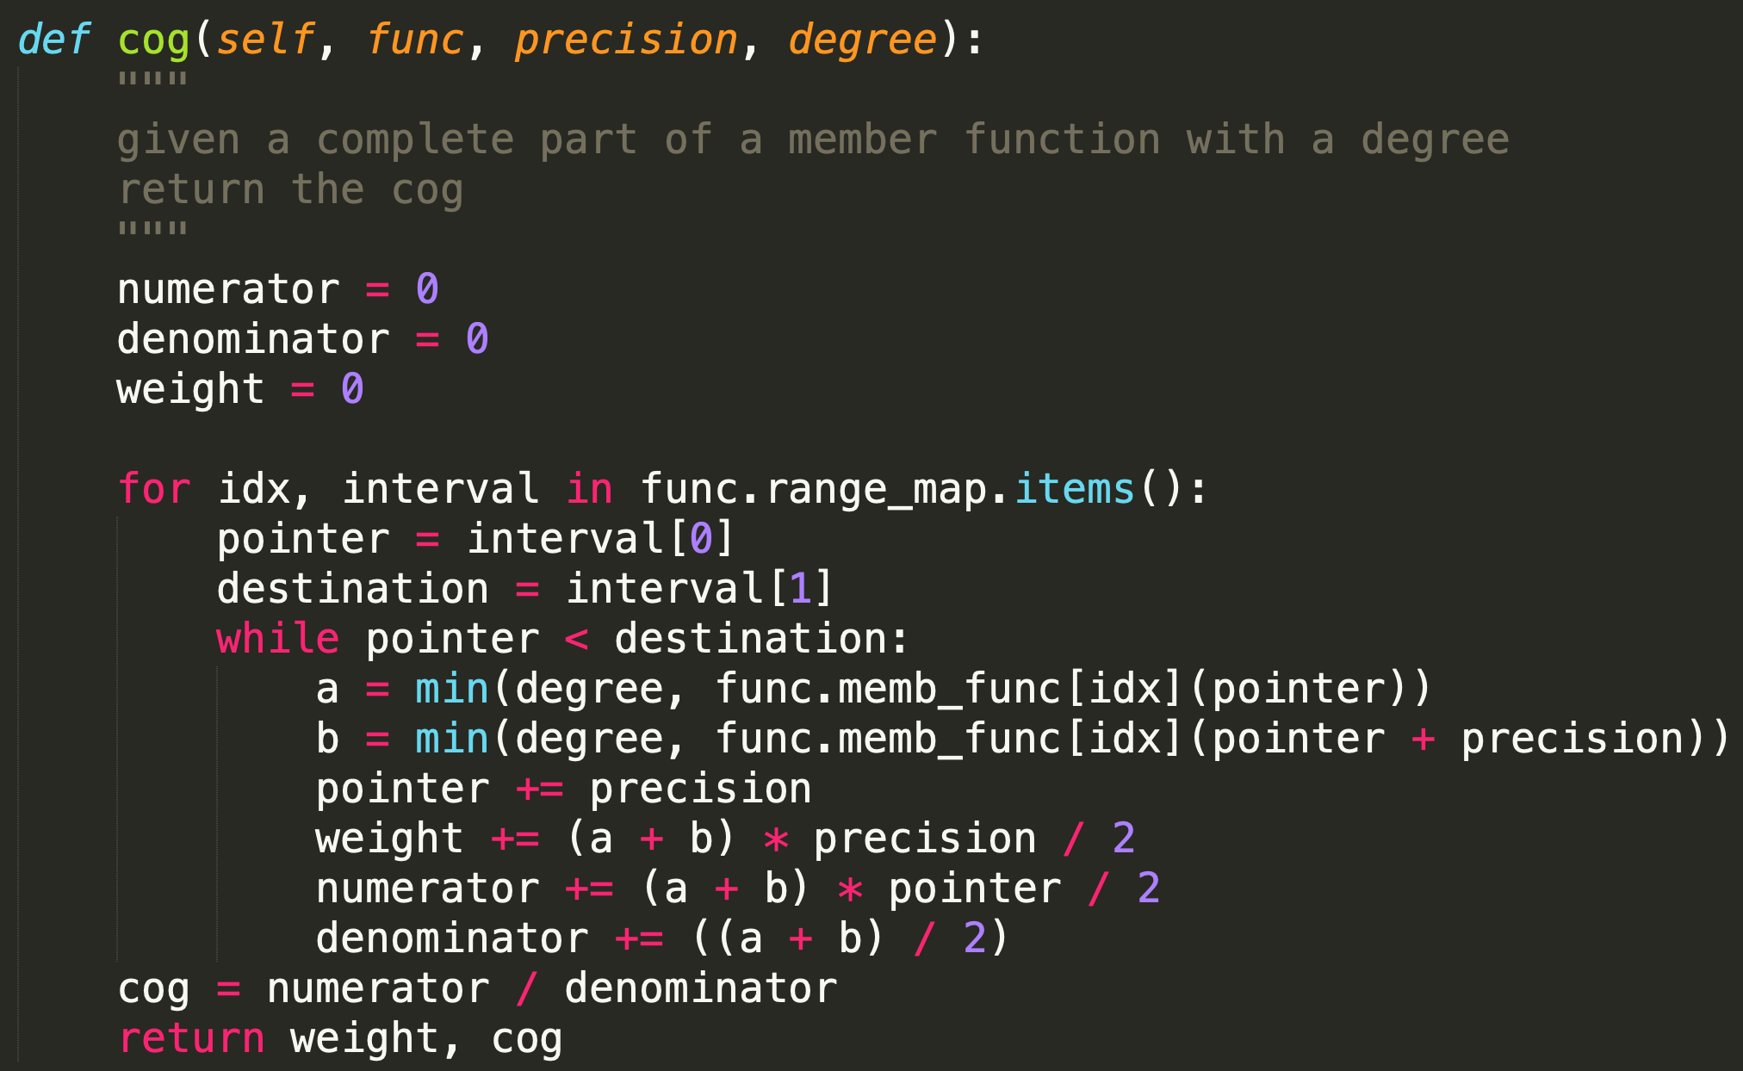
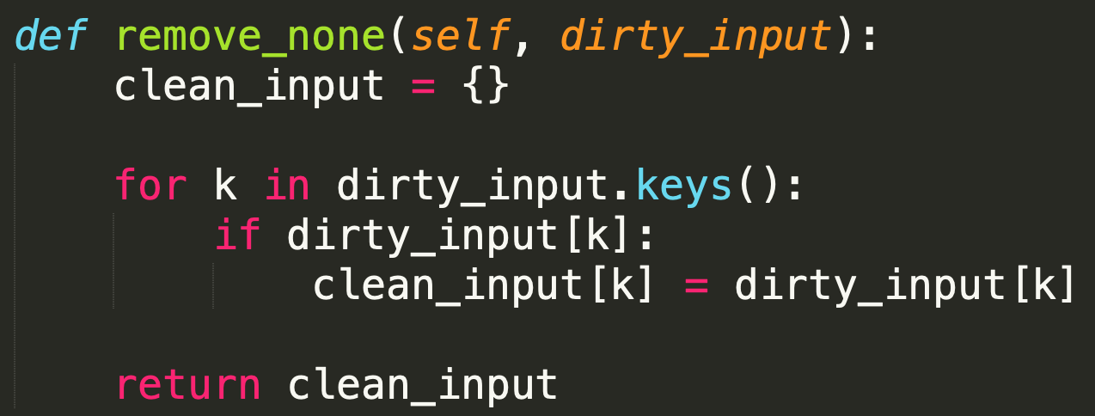
Code Details – FRBS()

Slide 6
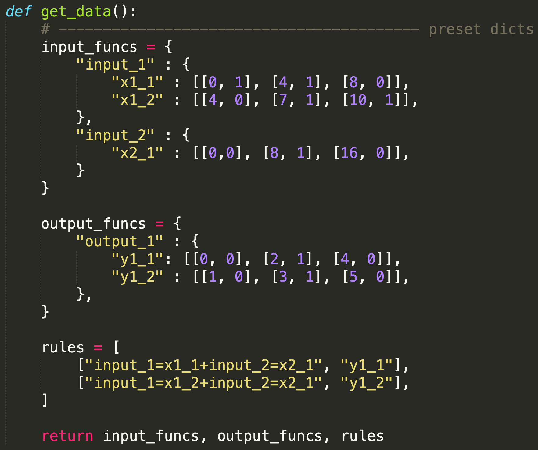
Code Details – Data Structure

Slide 7
Code Explain
Linear_Func(): used for constructing membership functions and related calculations.
FRBS(): the main program for handling fuzzification, rule operations, and defuzzification.
Membership function is constructed in a similar way compare to matlab toolbox, by providing each node coordinates.
Rule is constructed in a readable way, such “AND” is represented as “+”.
For each problem, simply enter “python3 q[number].py” in terminal.
ex: $ python3 q1.py for problem 1

Slide 8
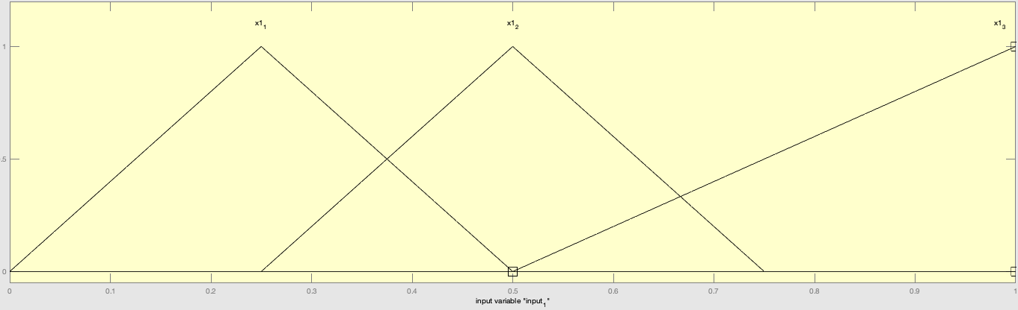
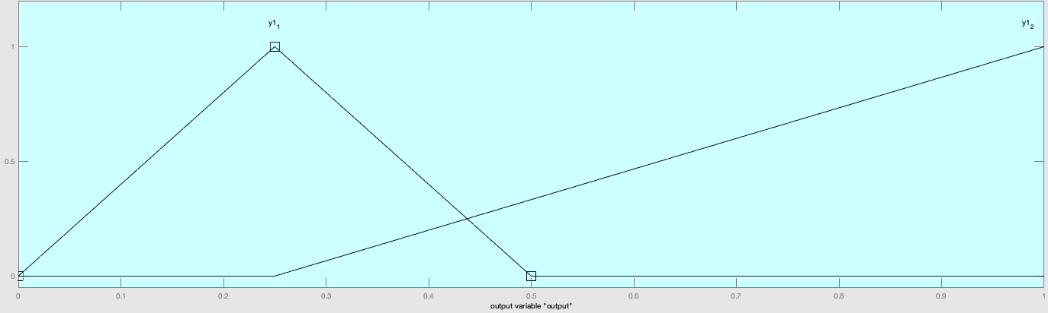
Problem 1 - Toolbox Test A: Hint Setup
MEMBERSHIP FUNCTIONS:
RULES:
If input = x1_1, then output = y1_1
If input = x1_2, then output = y1_2
If input = x1_3, then output = y1_2

Slide 9
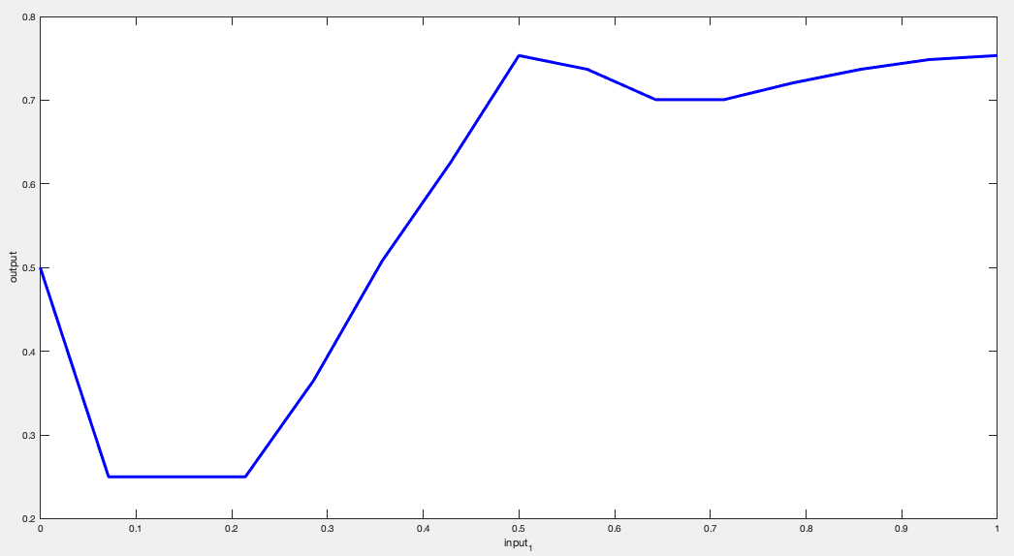
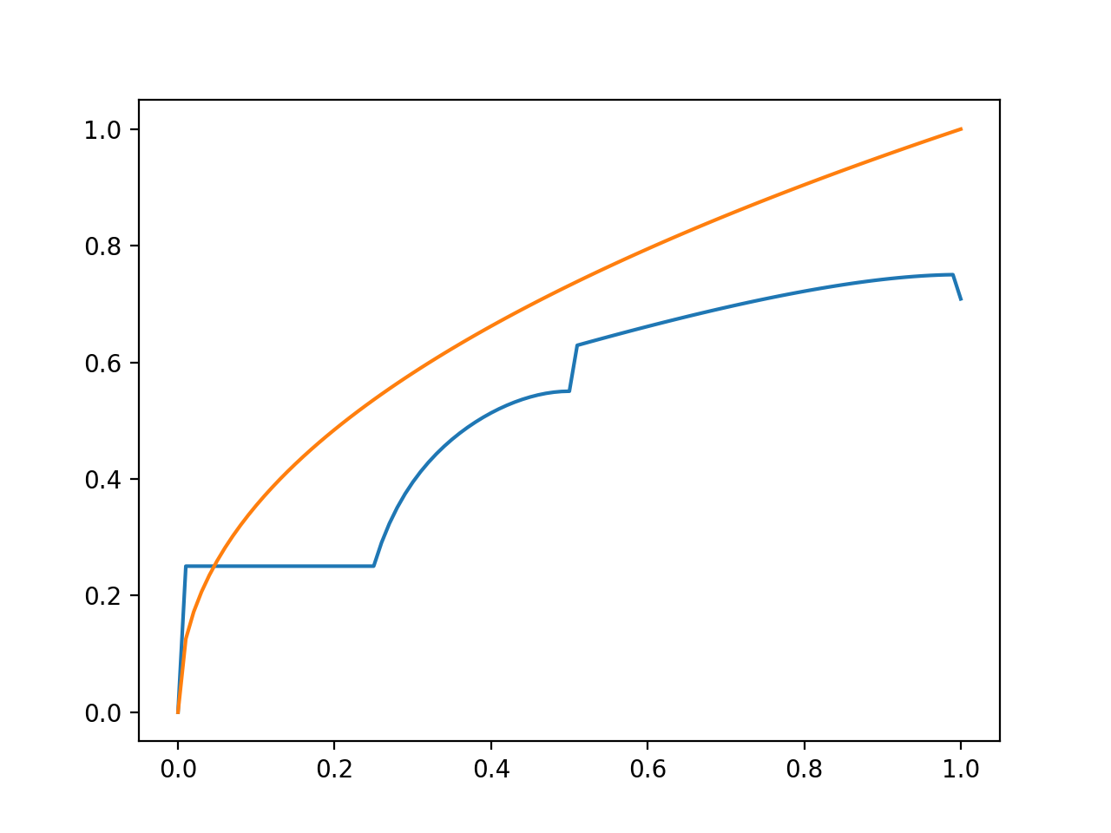
Problem 1 - Toolbox Test A: Hint Result
Matlab Toolbox Result:
Xin’s Result:

Slide 10
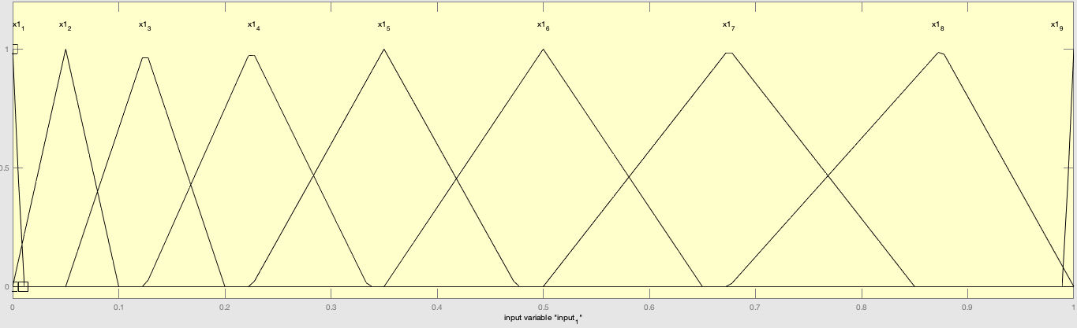
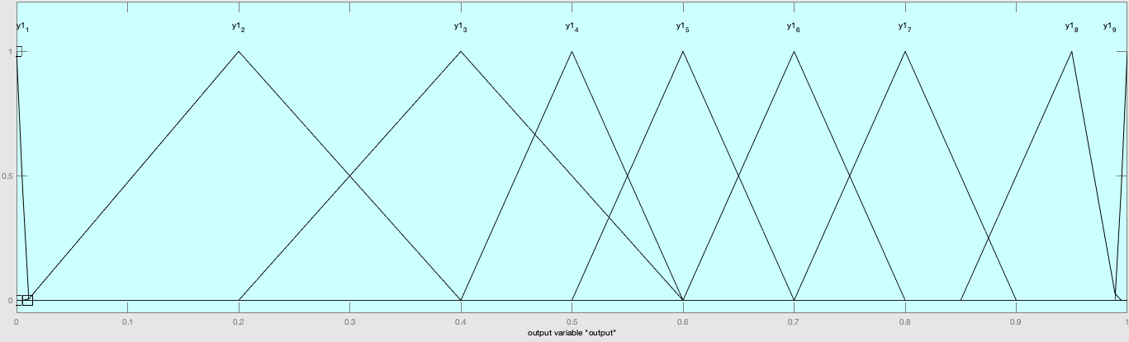
Problem 1 - Toolbox Test B: Updated Setup
MEMBERSHIP FUNCTIONS:
RULES:
If input = x1_1, then output = y1_1
If input = x1_2, then output = y1_2
If input = x1_3, then output = y1_3
If input = x1_4, then output = y1_4
If input = x1_5, then output = y1_5
If input = x1_6, then output = y1_6
If input = x1_7, then output = y1_7
If input = x1_8, then output = y1_8
If input = x1_9, then output = y1_9

Slide 11
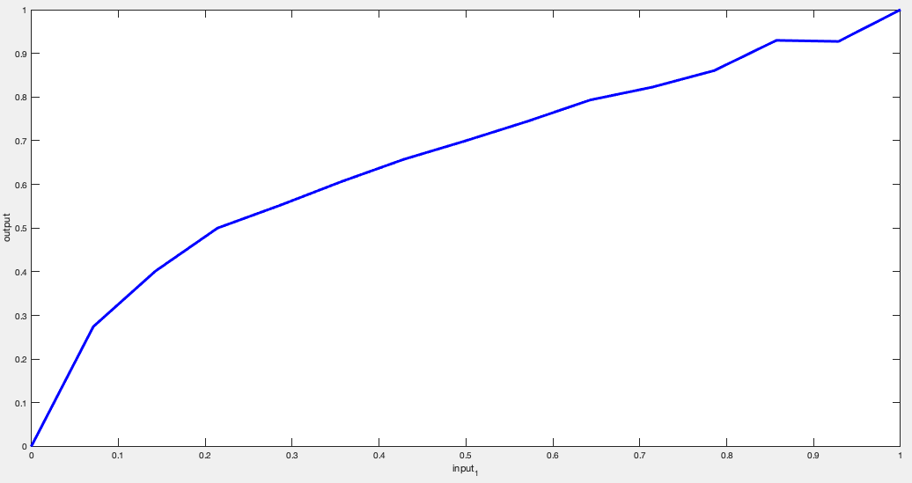
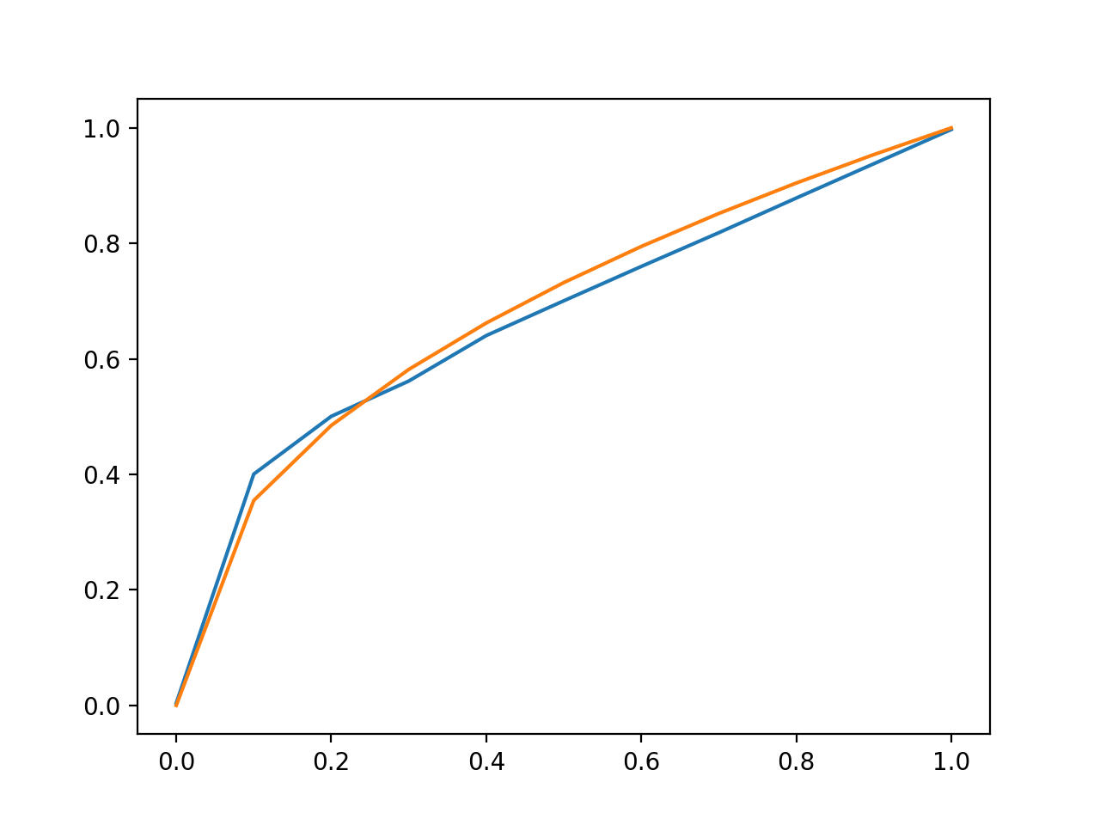
Problem 1 - Toolbox Test B: Updated Result
Matlab Toolbox Result:
Xin’s Result:

Slide 12
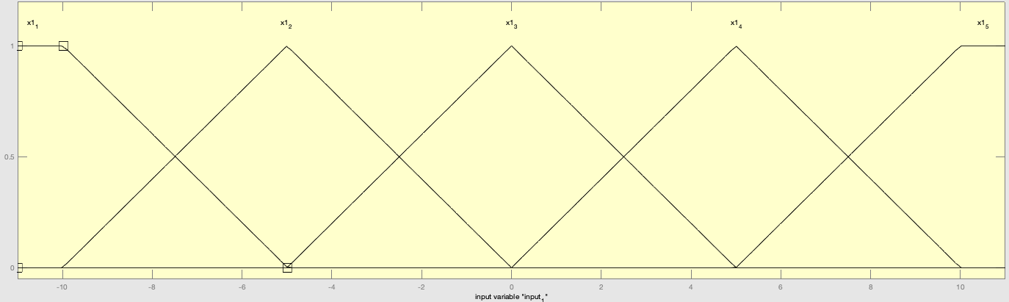
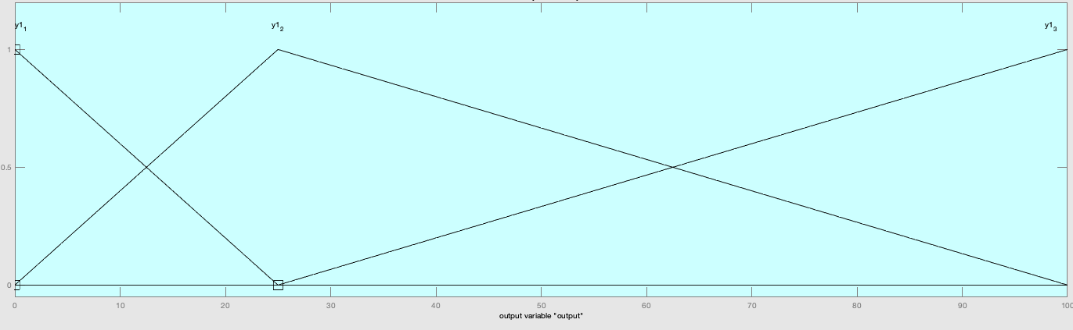
Problem 2 - Toolbox Test A: Hint Setup
MEMBERSHIP FUNCTIONS:
RULES:
If input = x1_3, then output = y1_1
If input = x1_2, then output = y1_2
If input = x1_3, then output = y1_2

Slide 13
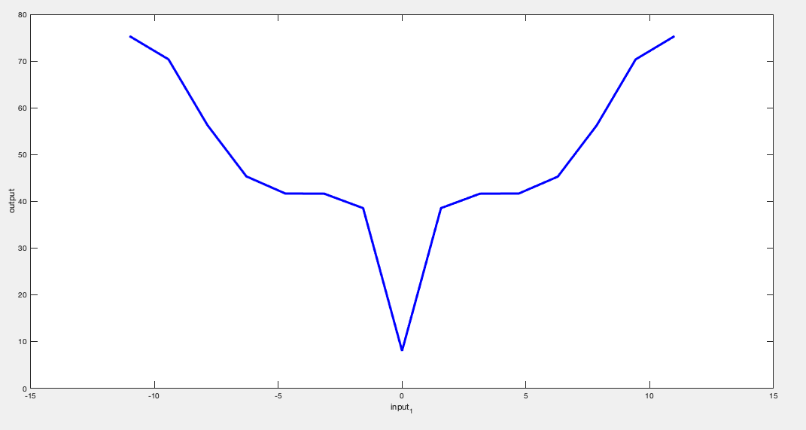
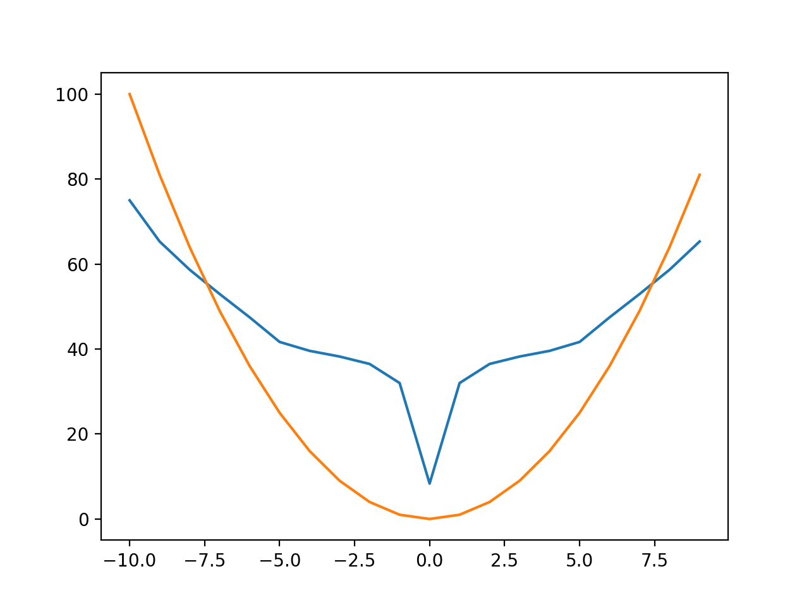
Problem 2 - Toolbox Test A: Hint Result
Matlab Toolbox Result:
Xin’s Result:

Slide 14
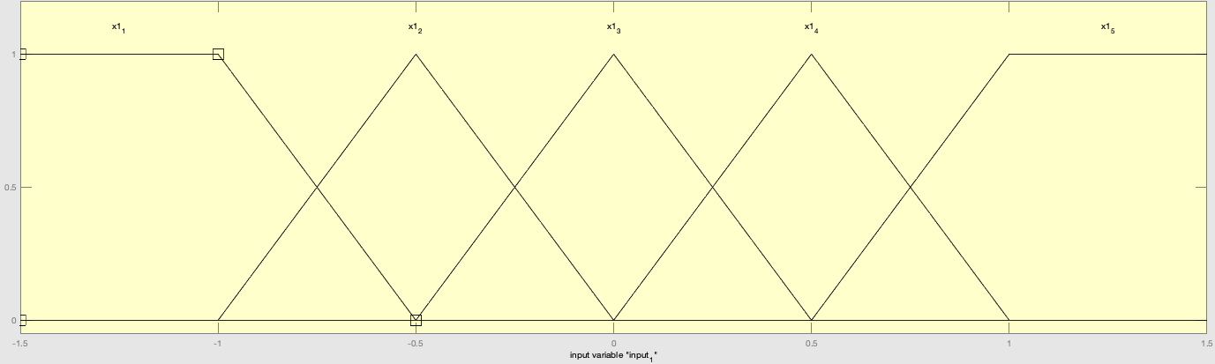
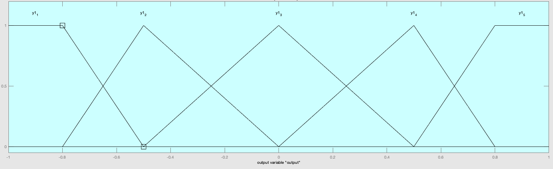
Problem 3 - Toolbox Test A: Hint Setup
MEMBERSHIP FUNCTIONS:
RULES:
If input = x1_1, then output = y1_1
If input = x1_2, then output = y1_2
If input = x1_3, then output = y1_3
If input = x1_4, then output = y1_4
If input = x1_1, then output = y1_5

Slide 15
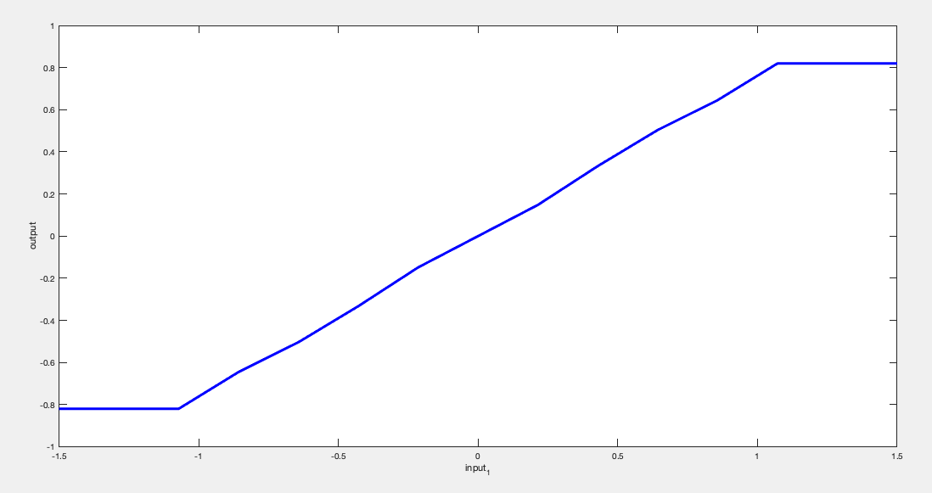
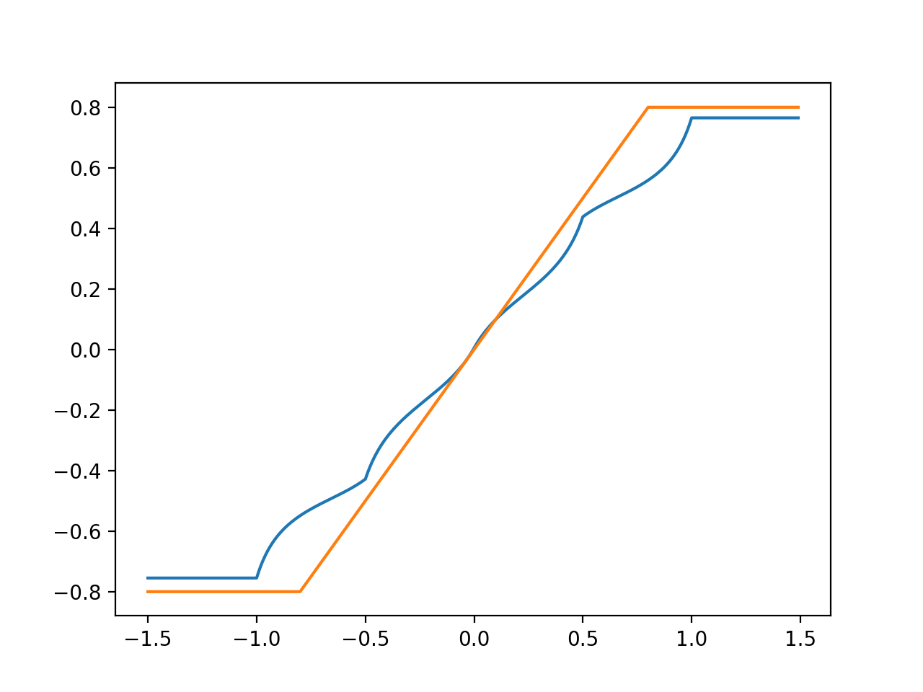
Problem 3 - Toolbox Test A: Hint Result
Matlab Toolbox Result:
Xin’s Result:

Slide 16
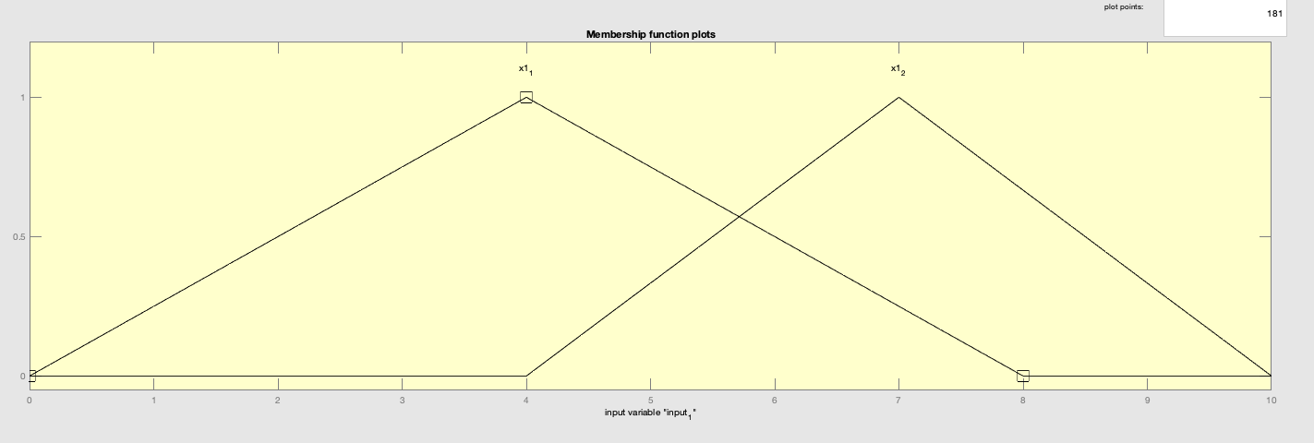
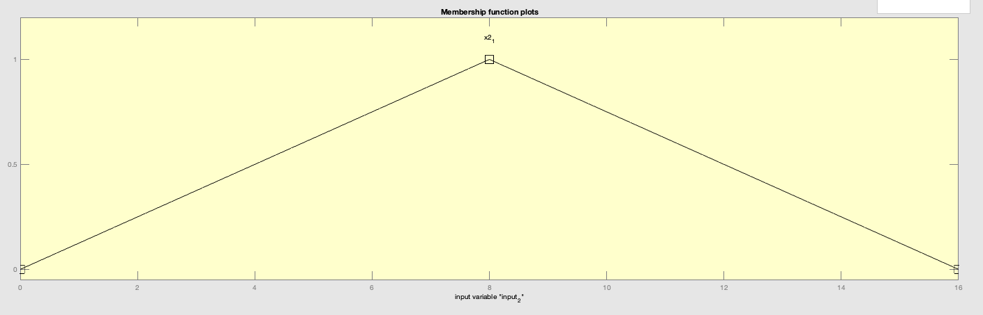
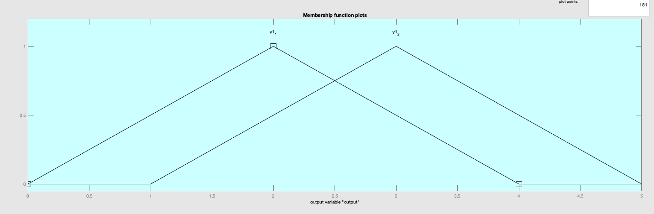
Problem 4 - Toolbox Test A: Hint Setup
MEMBERSHIP FUNCTIONS:
RULES:
If input = x1_1 and x2_1,
then output = y1_1
If input = x1_2 and x2_1,
then output = y1_2

Slide 17
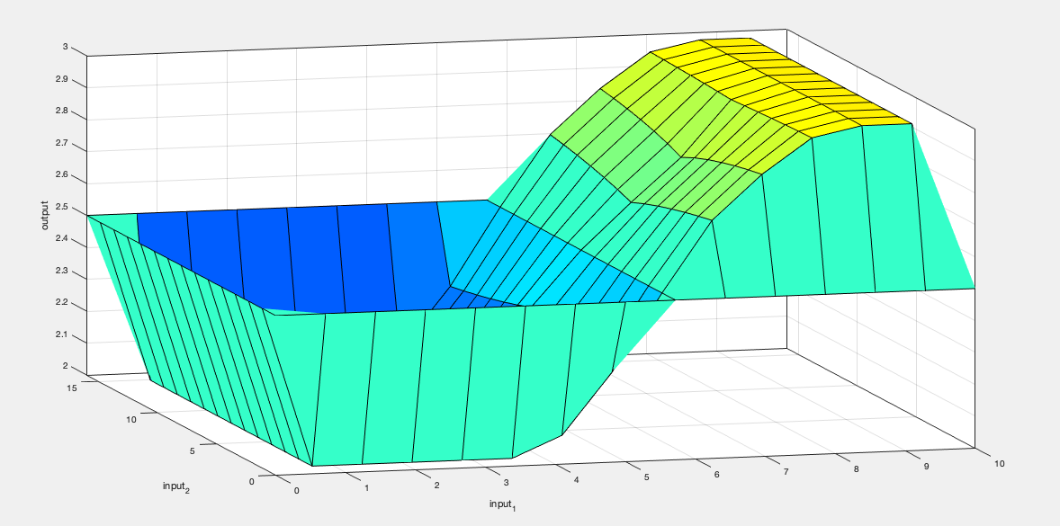
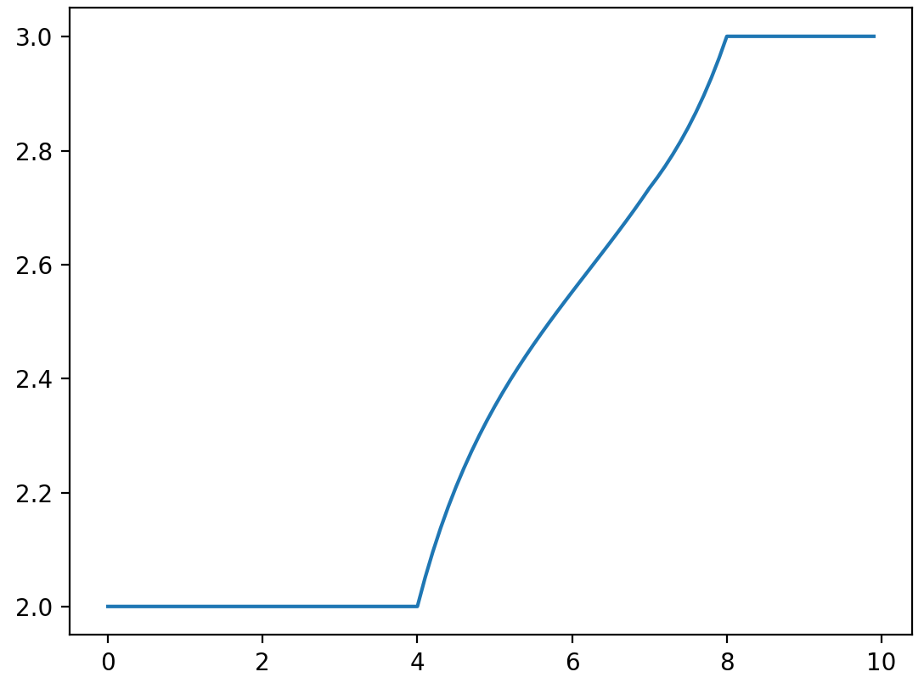
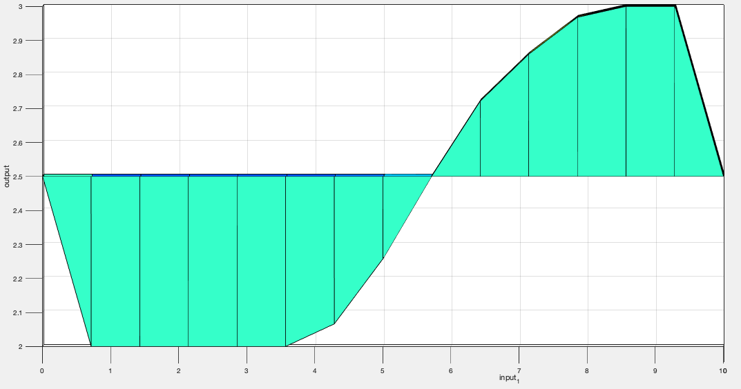
Problem 4 - Toolbox Test A: Hint Result
Matlab Toolbox Result:
Xin’s Result:
Set x2 = 10, iterate x1 within [0, 10]

Slide 18
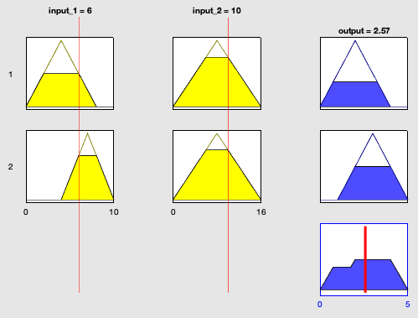
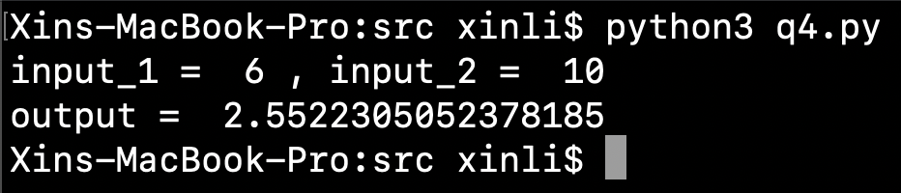
Problem 4 - Toolbox Test A: Hint Result
Matlab Toolbox Result:
Xin’s Result:

Slide 19
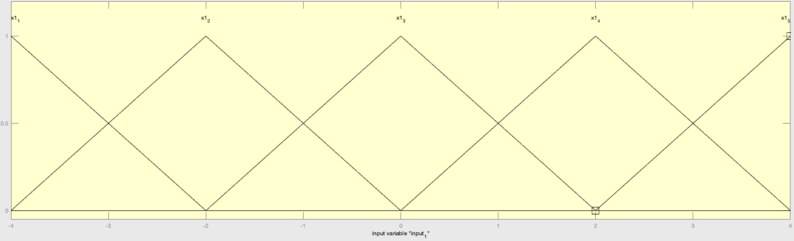
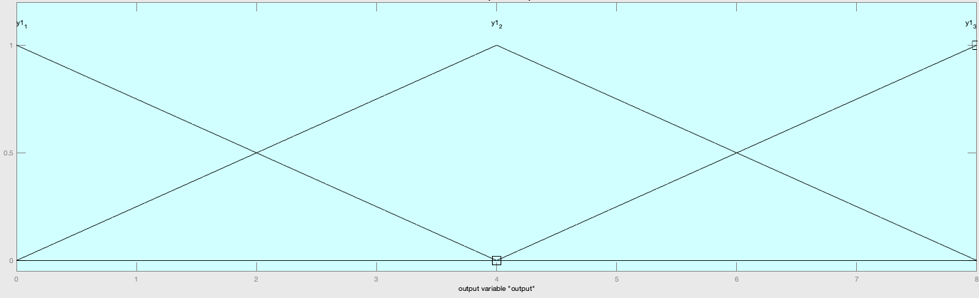
Problem 5 - Toolbox Test A: Hint Setup
MEMBERSHIP FUNCTIONS:
RULES:
If input = x1_3, then output = y1_1
If input = x1_1, then output = y1_3
If input = x1_5, then output = y1_3
If input = x1_2 , then output = y1_2
If input = x1_4, then output = y1_2

Slide 20
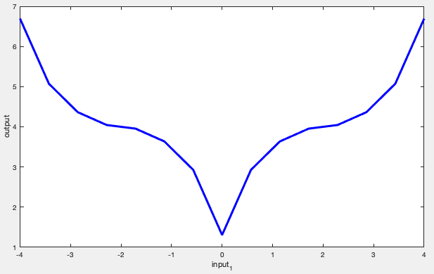
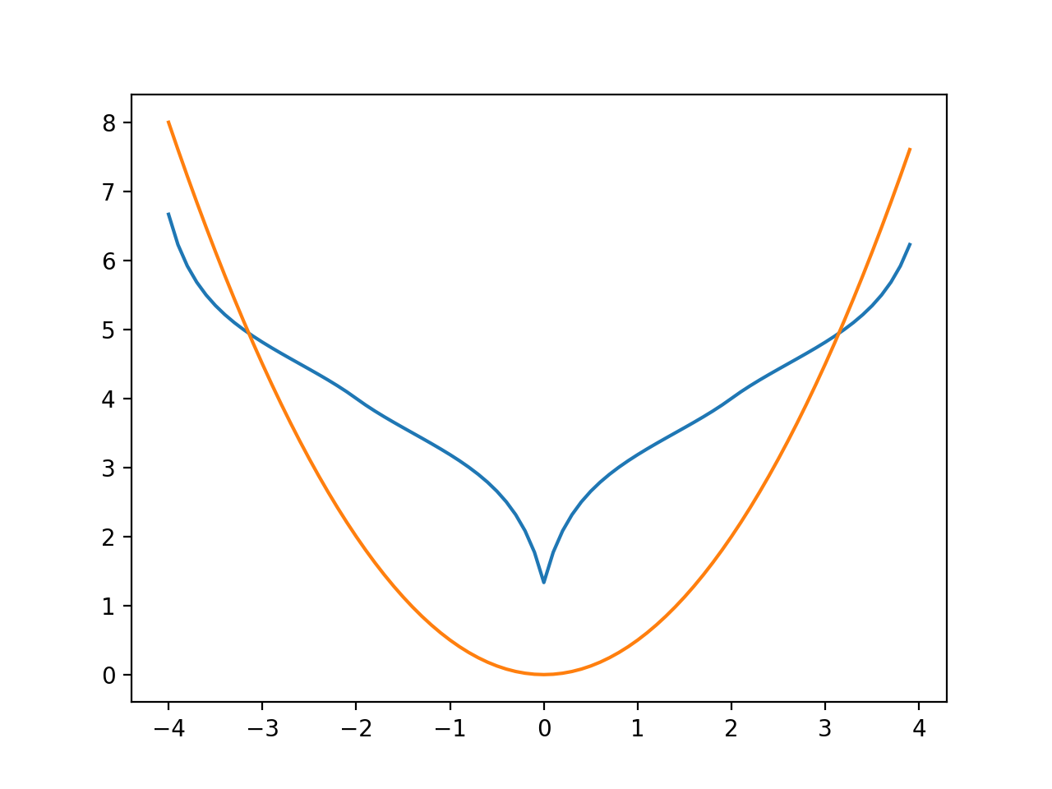
Problem 5 - Toolbox Test A: Hint Result
Matlab Toolbox Result:
Xin’s Result:

Slide 21
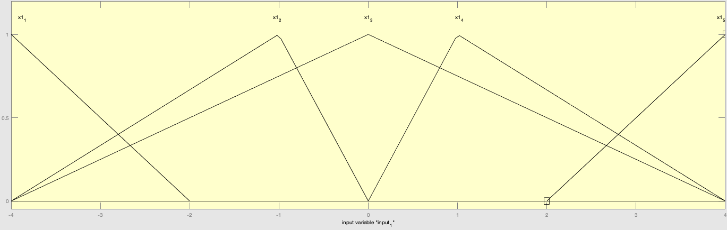
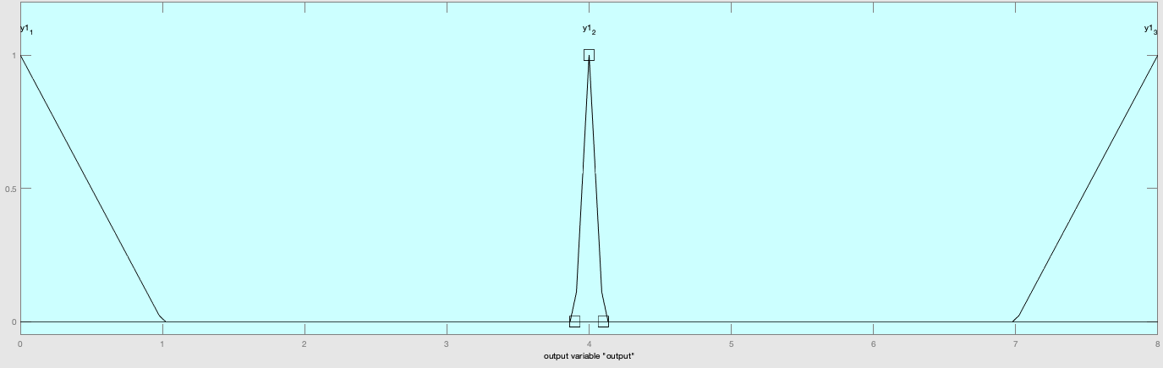
Problem 5 - Toolbox Test B: Updated Setup
MEMBERSHIP FUNCTIONS:
RULES:
If input = x1_3, then output = y1_1
If input = x1_1, then output = y1_3
If input = x1_5, then output = y1_3
If input = x1_2 , then output = y1_2
If input = x1_4, then output = y1_2

Slide 22
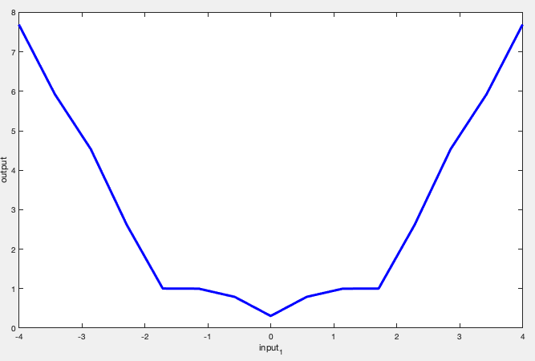
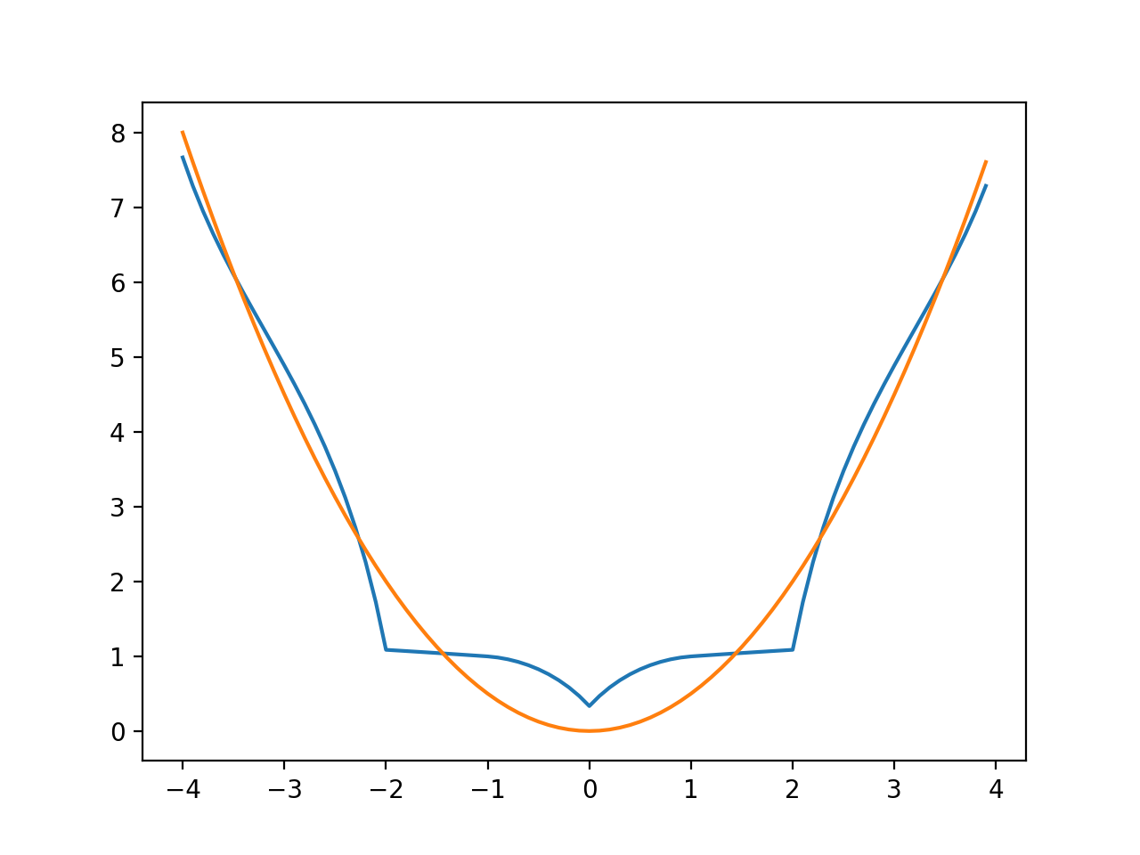
Problem 5 - Toolbox Test B: Updated Result
Matlab Toolbox Result:
Xin’s Result:

Slide 23
Summary
Different resolutions affect the output plot. Such as Problem 1, 0.1 resolution will give a much better plot than 0.01 resolution does.
Input membership functions should have overlaps to ensure the input domain is fully covered. On the other hand, output membership functions do not need to fully cover the output domain. Instead, we can use some gaps among output membership functions to adjust the center of gravity as we need.
The more overlap areas among input membership functions / among output membership functions, the flatter (no dramatic changes) result plot will be.

