Slide 1
Final Project Milestone
XIN LI

Slide 2
Abstract
Title: Speed Harmonization (SH) with Fuzzy System
Team member: XIN LI

Slide 3
Background
Traffic flows merge from 3 lanes into 2 lanes lead to traffic jam.

Slide 4
Why SH Is Important
Provides a solution for the traffic flow merging issue.
Optimize the throughout rate

Slide 5
Why Fuzzy System Is Used?
Robustness to the traffic environment

Slide 6
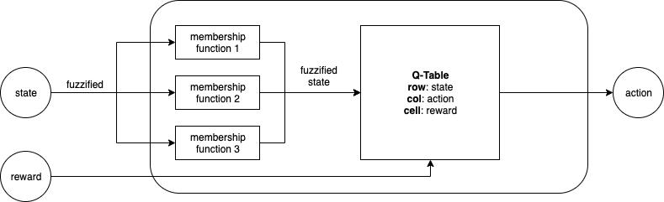
Block Diagram

Slide 7
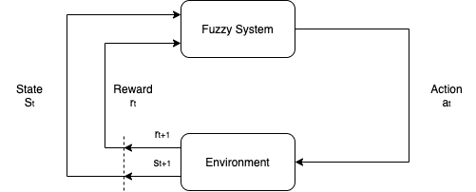
Block Diagram (Cont.)

Slide 8
Research Program Objectives
Reduce the possibility of traffic jam and increase the total throughput rate in any given circumstance (state).
Test the performance of combination of fuzzy system and reinforcement learning.
Extend the domain of using fuzzy system in traffic optimization.

Slide 9
Figure of Merit

Slide 10
Approach – Membership Function

Slide 11
Approach – Rule Base

Slide 12
Approach – Inference Method

Slide 13
Approach - Defuzzification

Slide 14
Challenges

Slide 15
Expected Outcomes

Slide 16
References

Slide 17
Additional Reference
1
2
3

Slide 18
Thank you!

