Slide 1
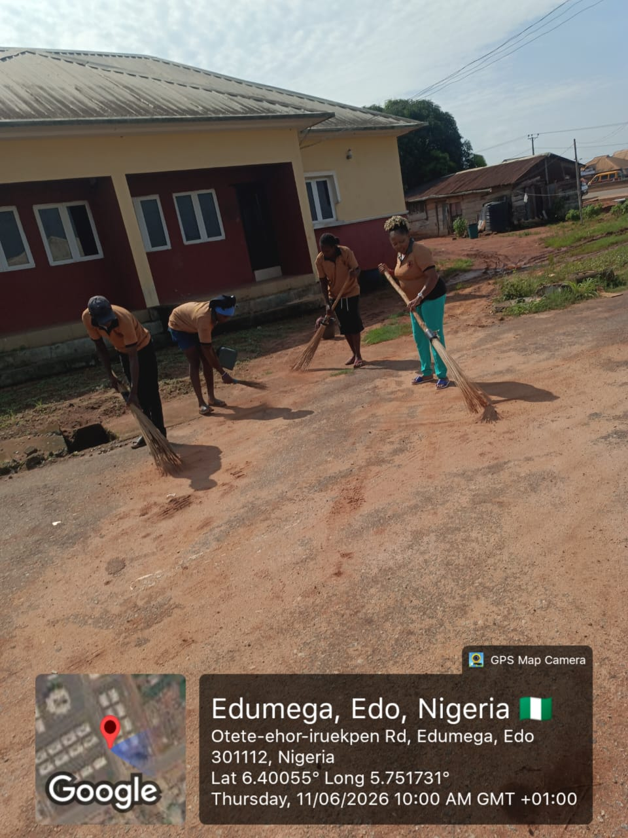
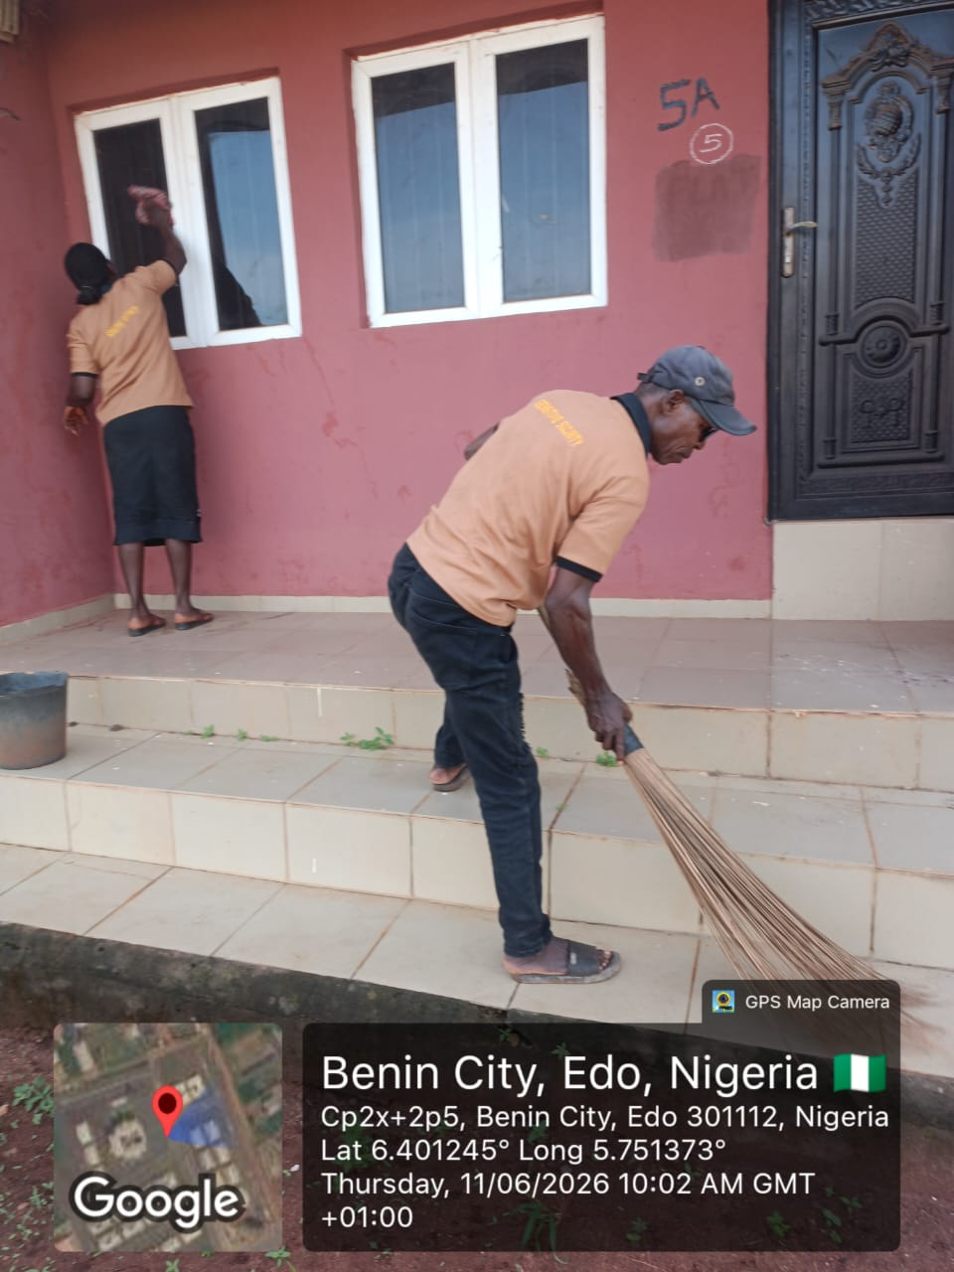
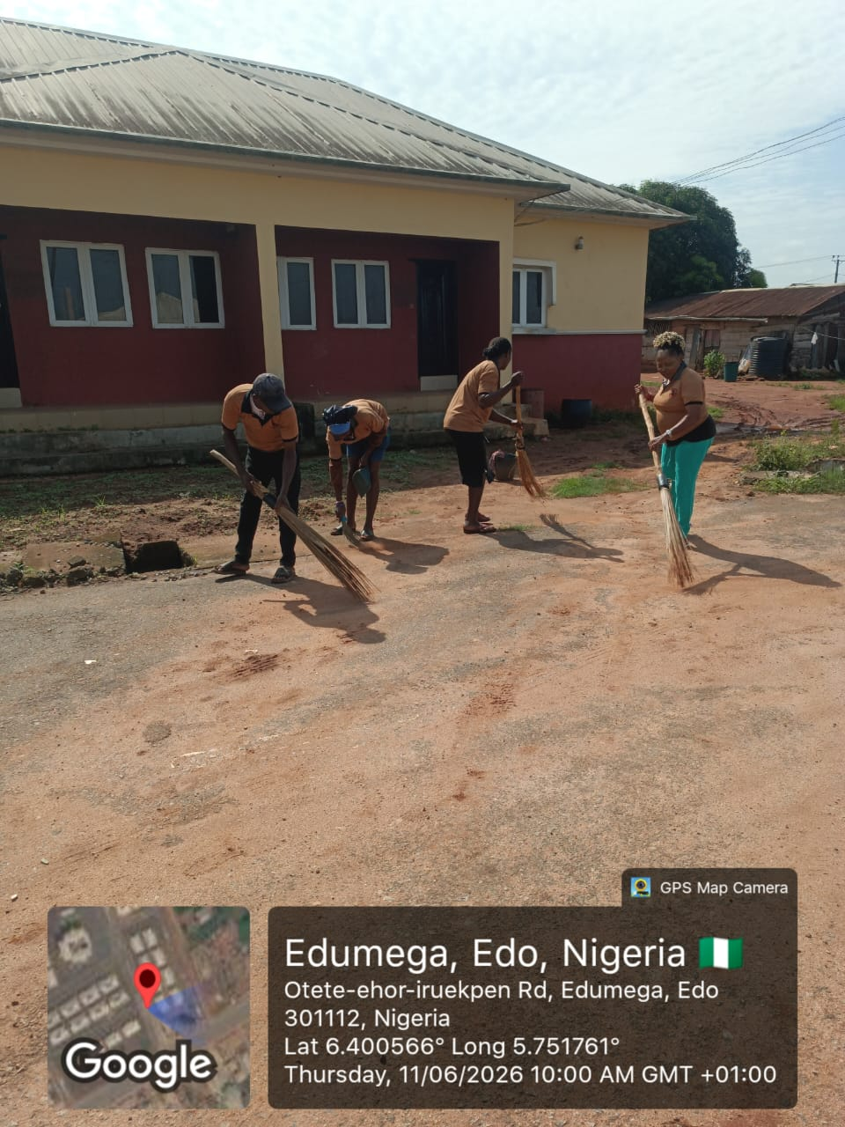
FACILITY MANAGEMENT OF NATIONAL HOUSING PROGRAM, EDO STATE

Slide 2
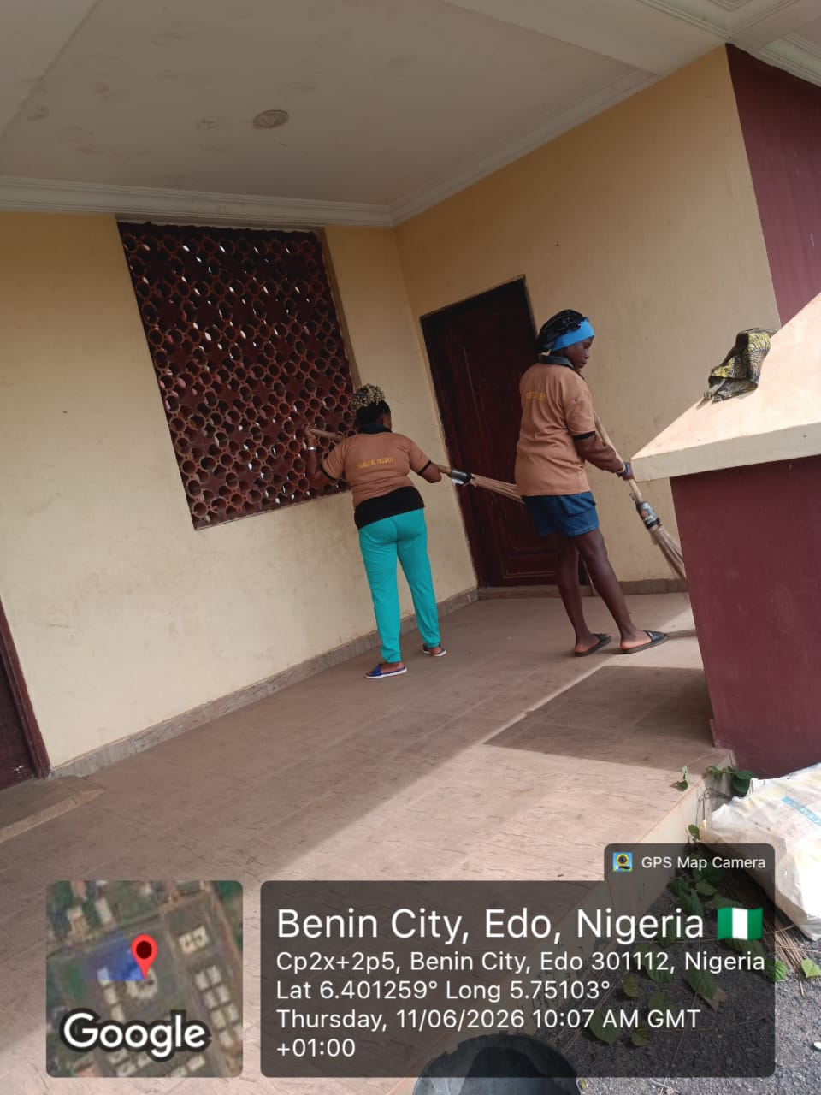
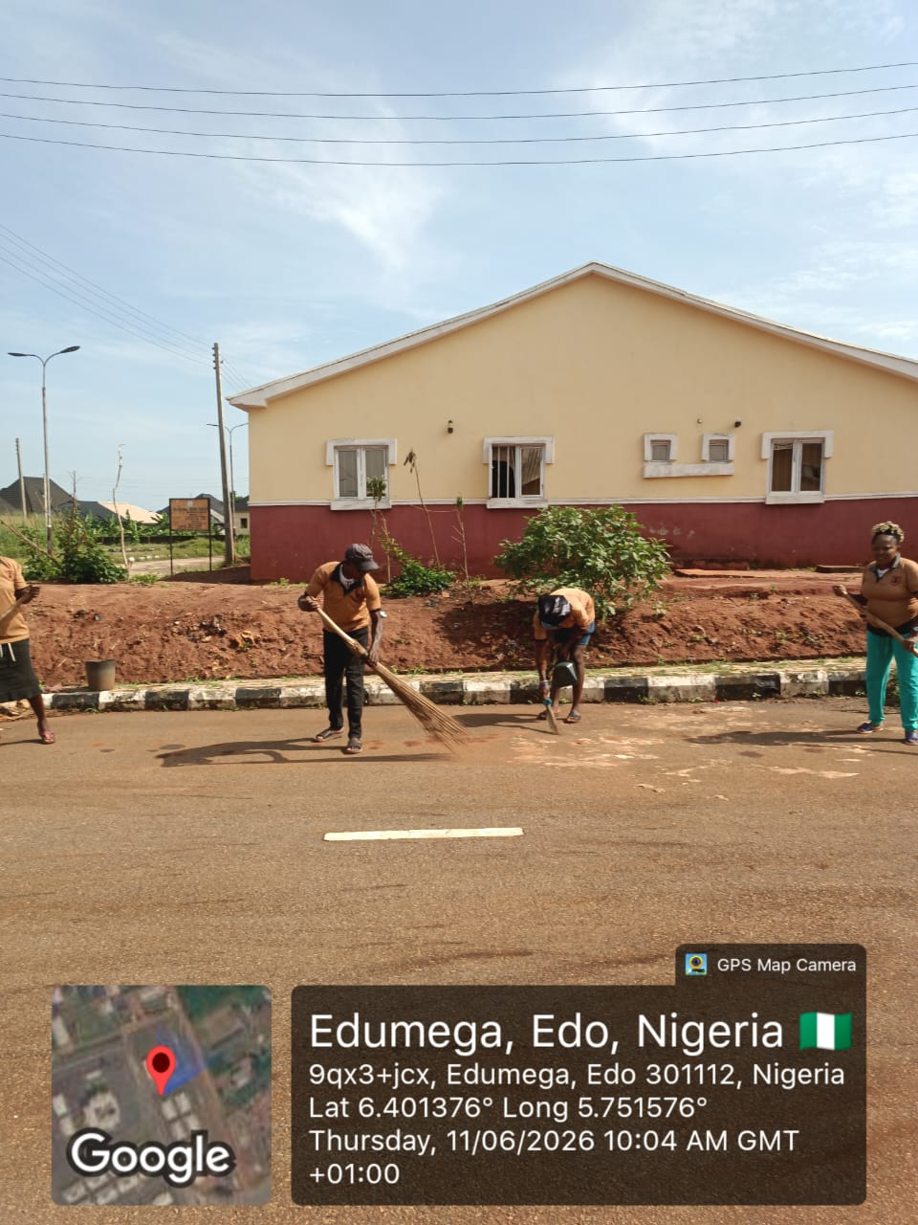
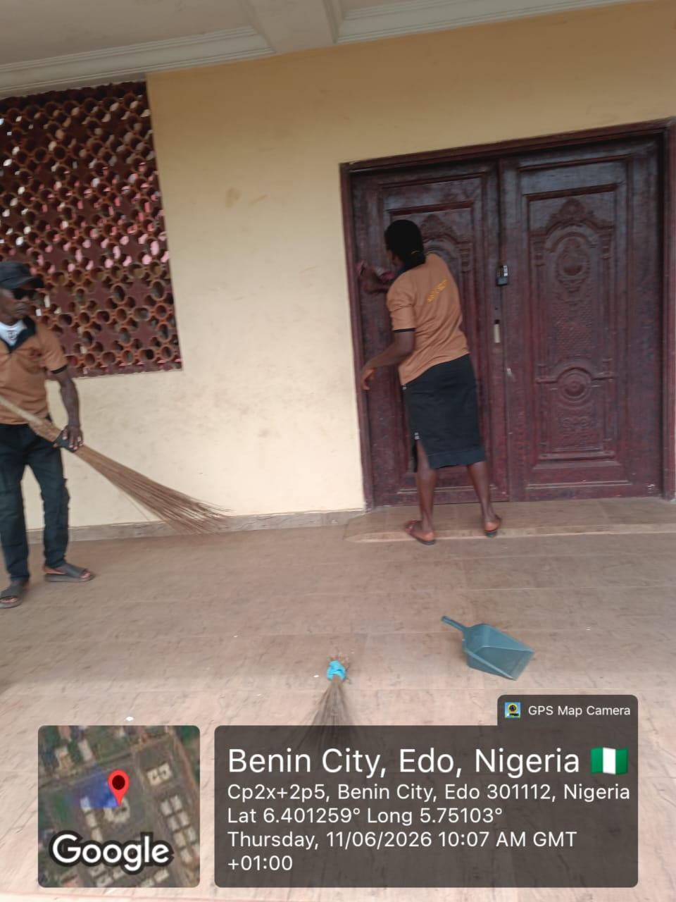
FACILITY MANAGEMENT OF NATIONAL HOUSING PROGRAM, EDO STATE

Slide 3
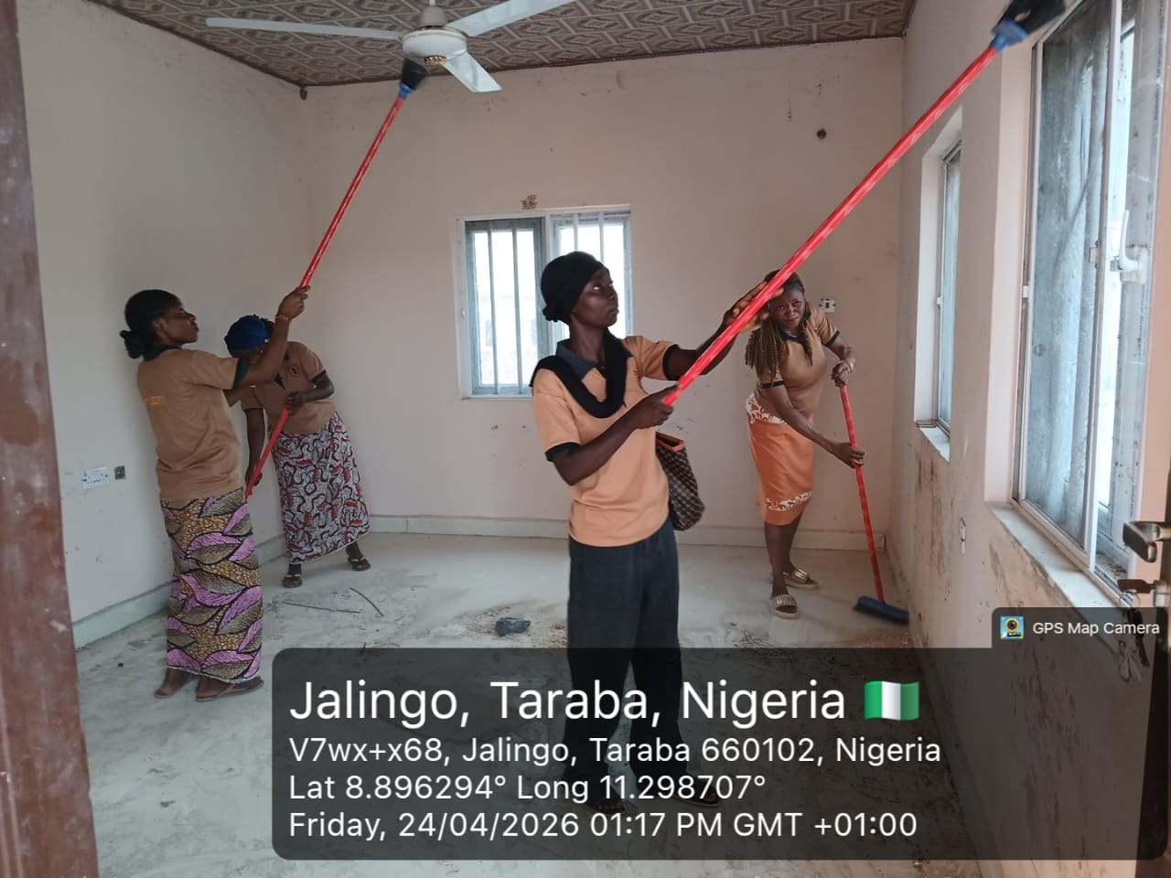
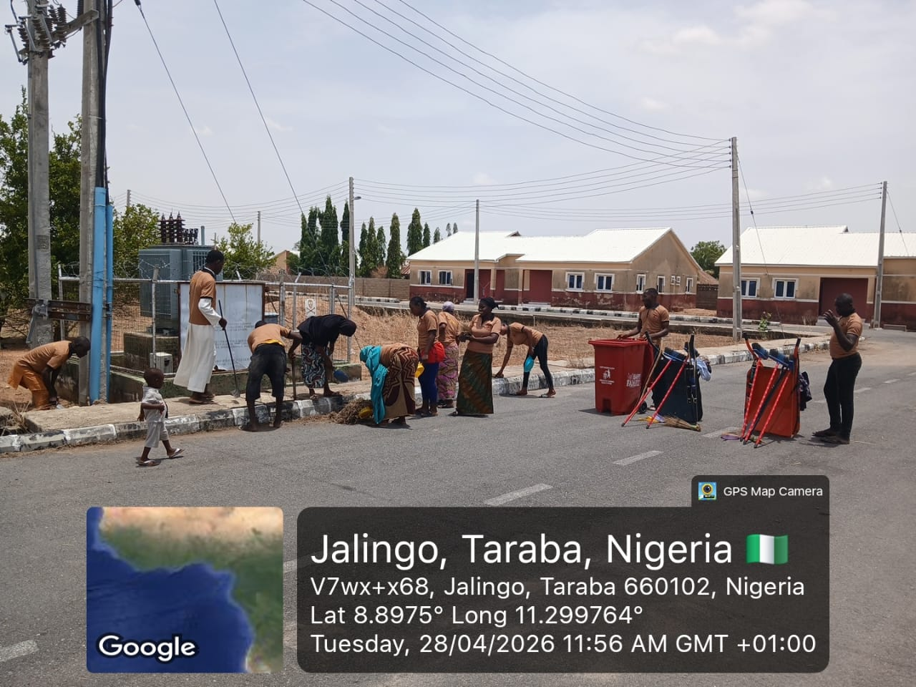
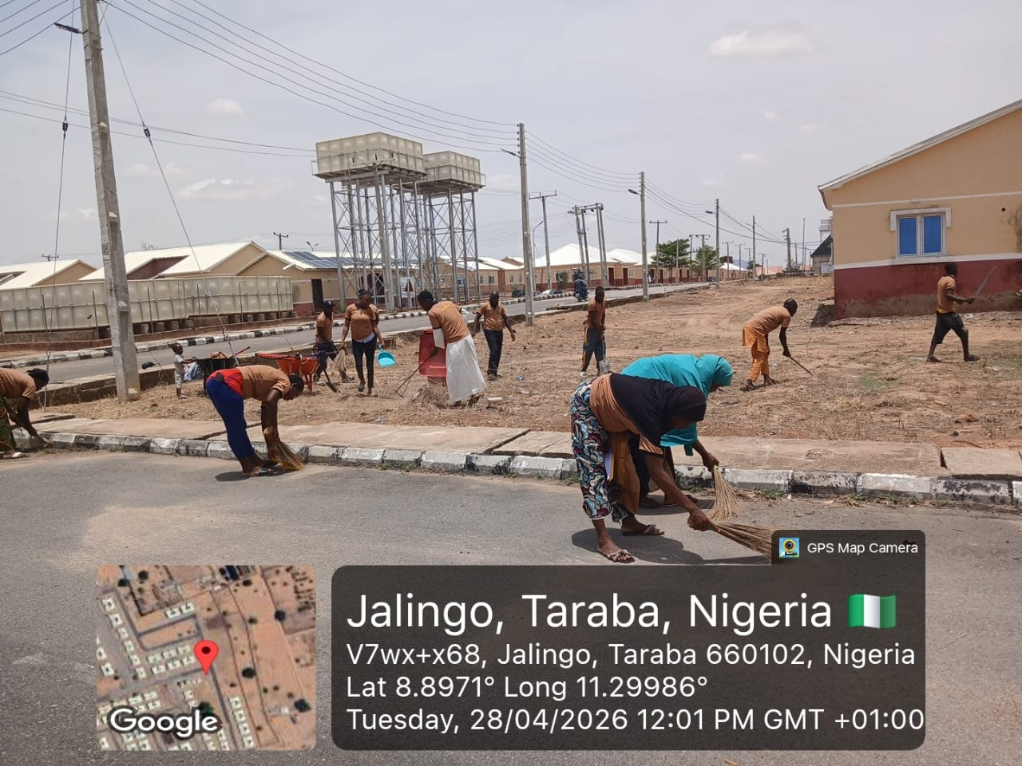
FACILITY MANAGEMENT OF NATIONAL HOUSING PROGRAM, JALINGO, TARABA STATE

Slide 4


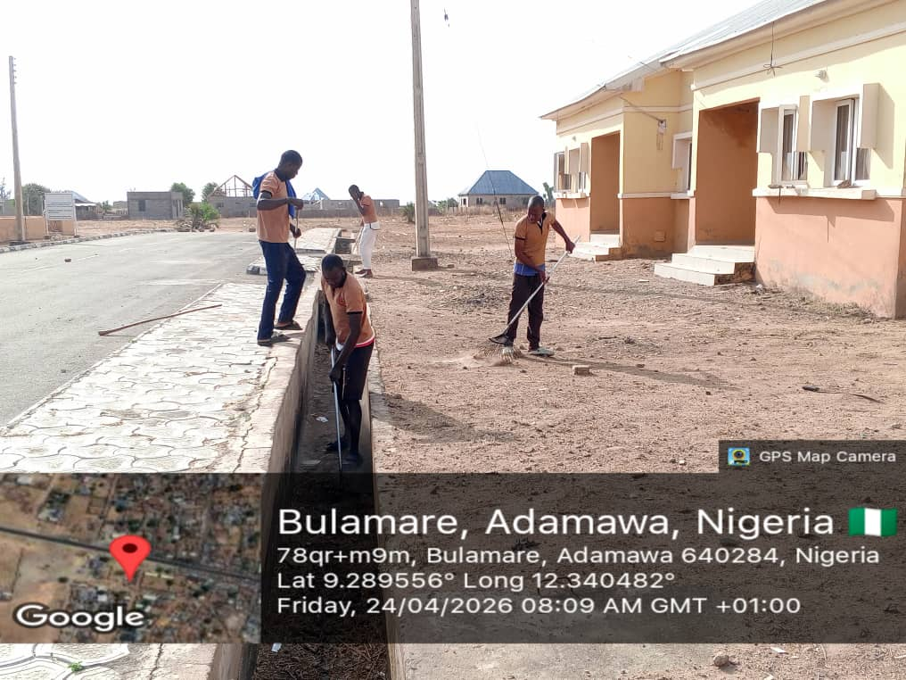
FACILITY MANAGEMENT OF NATIONAL HOUSING PROGRAM, ADAMAWA STATE

Slide 5
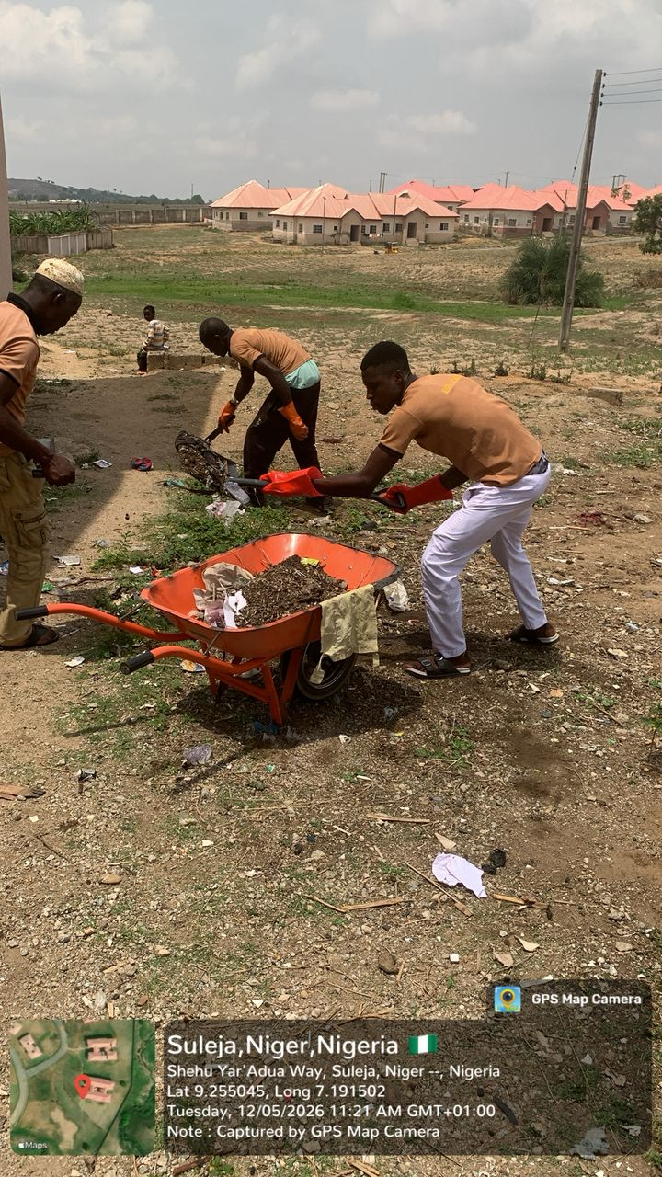

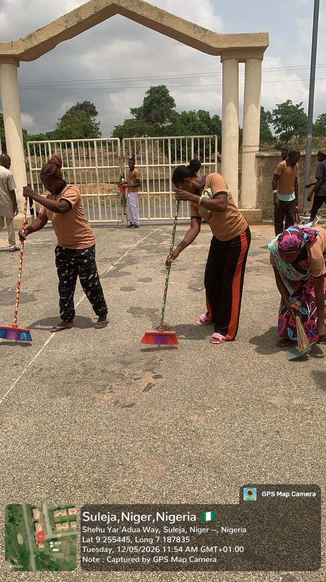
FACILITY MANAGEMENT OF NATIONAL HOUSING PROGRAM, SULEJA, NIGER STATE

Slide 6
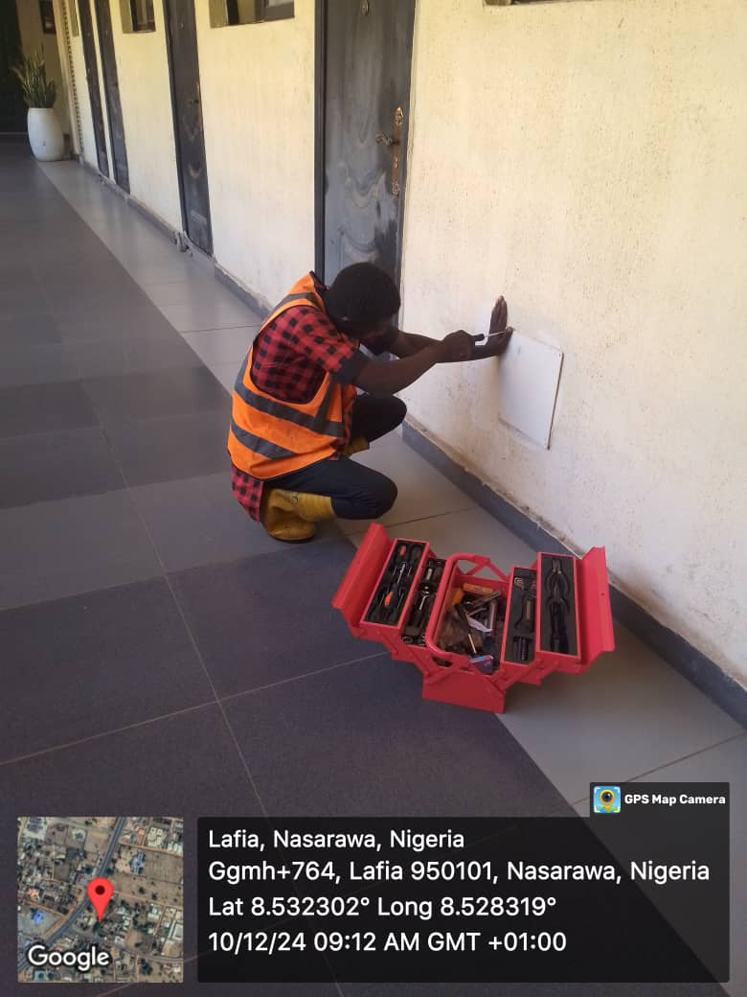


FACILITY MANAGEMENT OF FEDERAL SECRETARIAT, LAFIA NASARAWA STATE

Slide 7
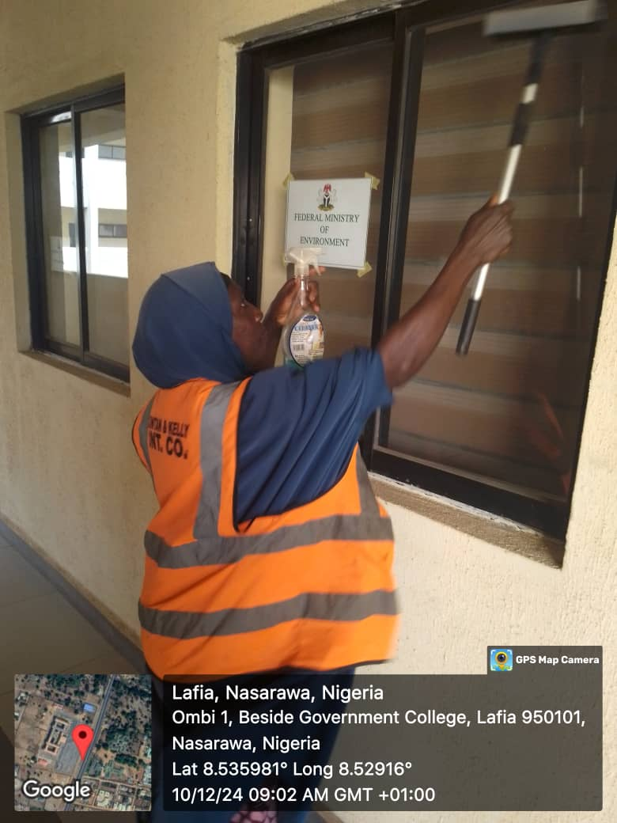
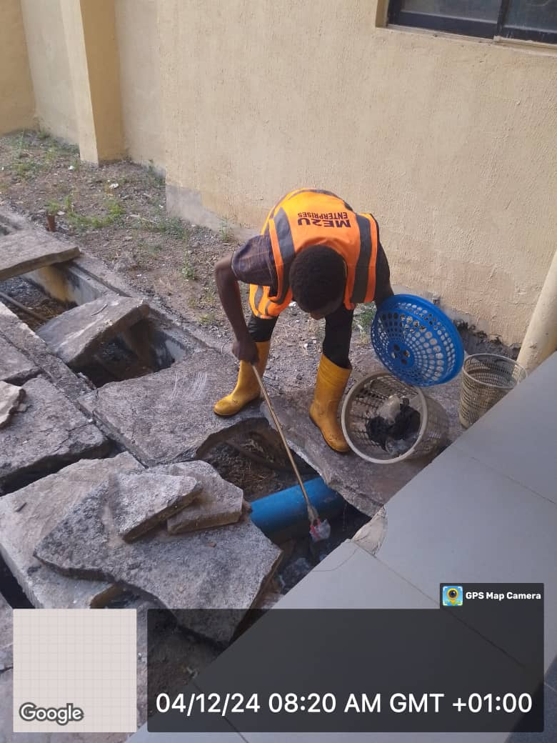
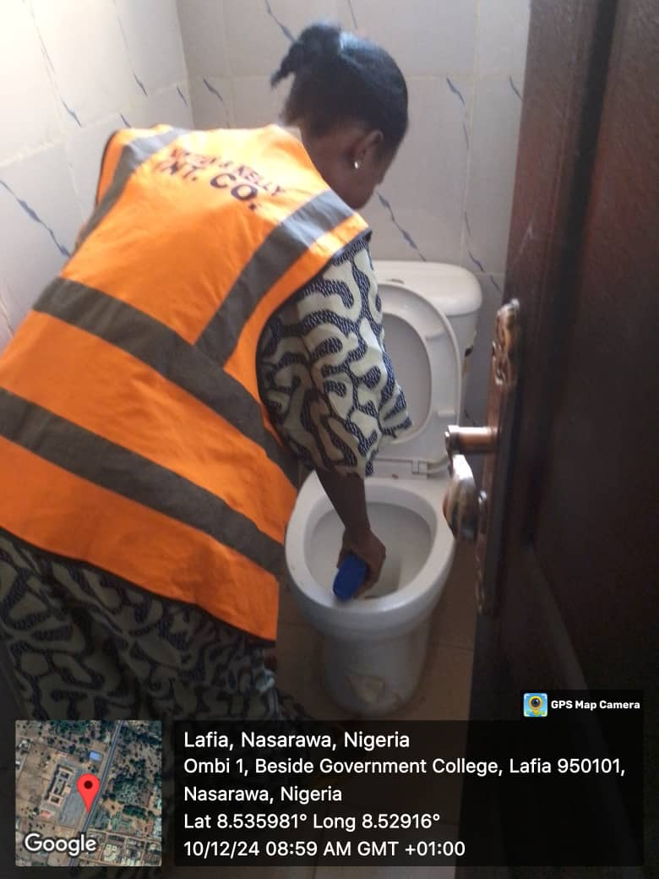
FACILITY MANAGEMENT OF FEDERAL SECRETARIAT, LAFIA NASARAWA STATE

Slide 8
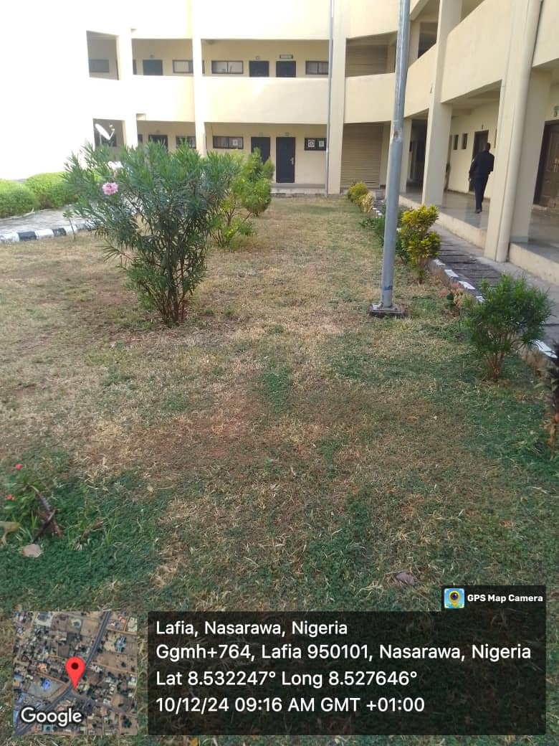
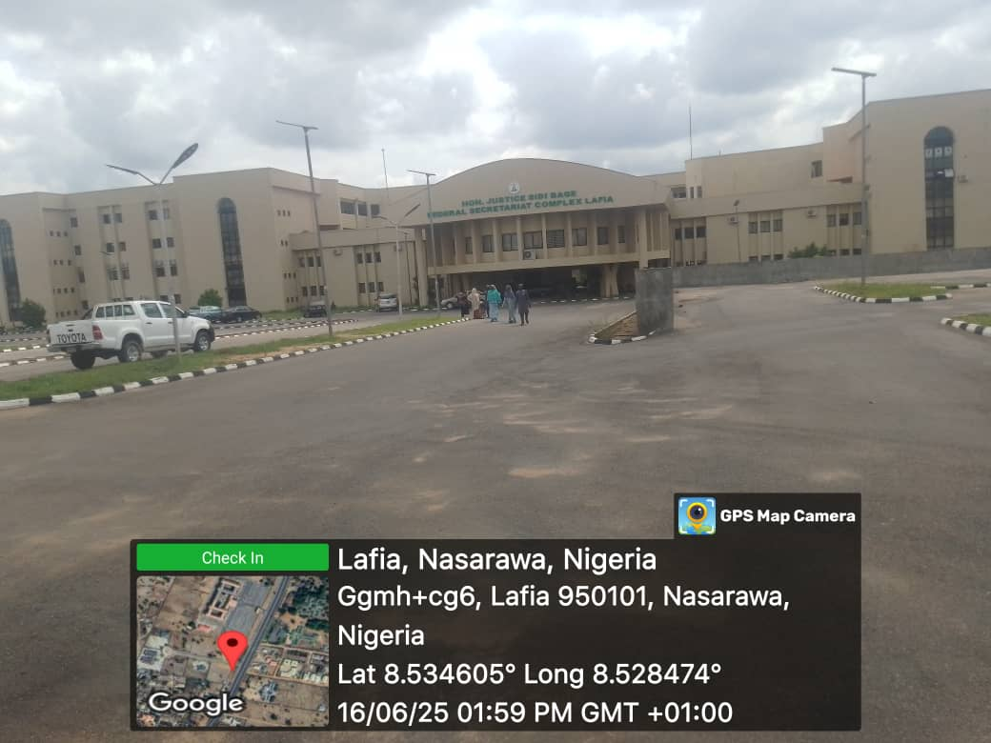
FACILITY MANAGEMENT OF FEDERAL SECRETARIAT, LAFIA NASARAWA STATE

