Slide 2
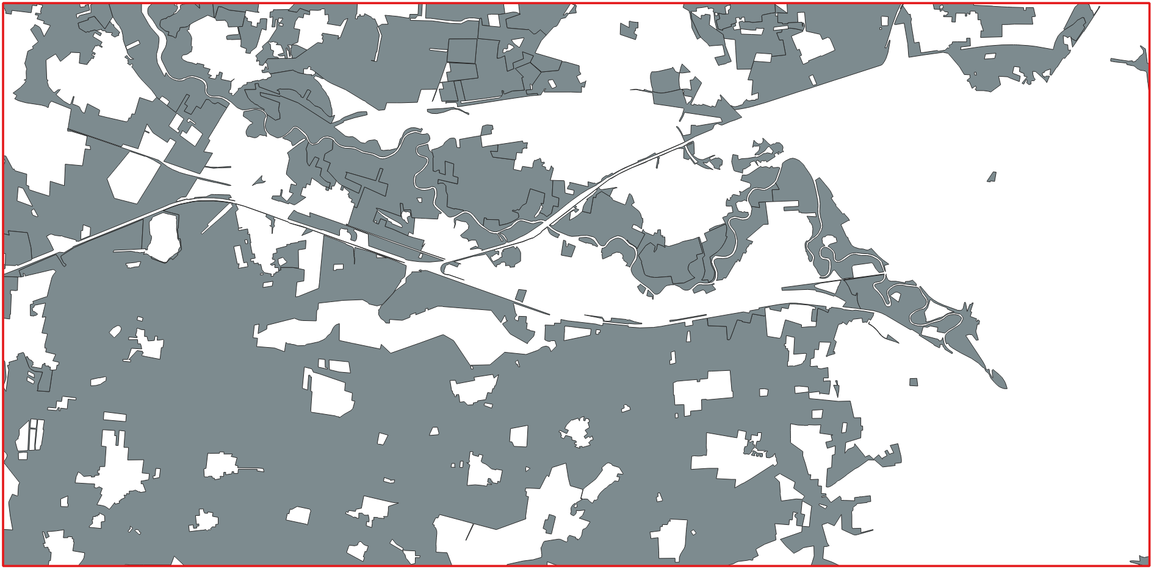
3. Identification of Suitable Wind Farm Areas
3.1 Filter the grassland and arable land areas.
Figure1: the grassland and arable land areas
Notes:
From the Landnutzung layer, I used the Extract by Expression tool with the expression "typ" IN ('Ackerland', 'Gruenland') and obtained the result shown in the figure above.
The gray areas represent the Grünland and Ackerland areas after filtering.

Slide 3
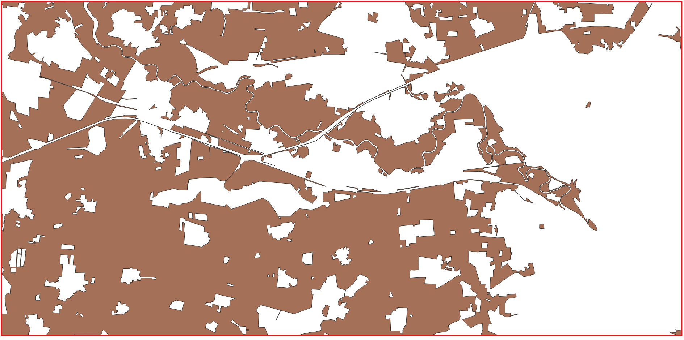
3.2 Merge adjacent polygons into a single continuous area and remove the internal boundaries between them.
Figure1: the grassland and arable land areas
Figure 2: the grassland and arable land areas after remove boundary
Notes:
Next, I merged adjacent areas into larger continuous areas using the Dissolve tool. This step is important because the 18 ha criterion applies to a continuous area, not to each original parcel individually. For example, a 10 ha Ackerland polygon directly adjacent to a 10 ha Grünland polygon can form a continuous 20 ha area after applying Dissolve.

Slide 4
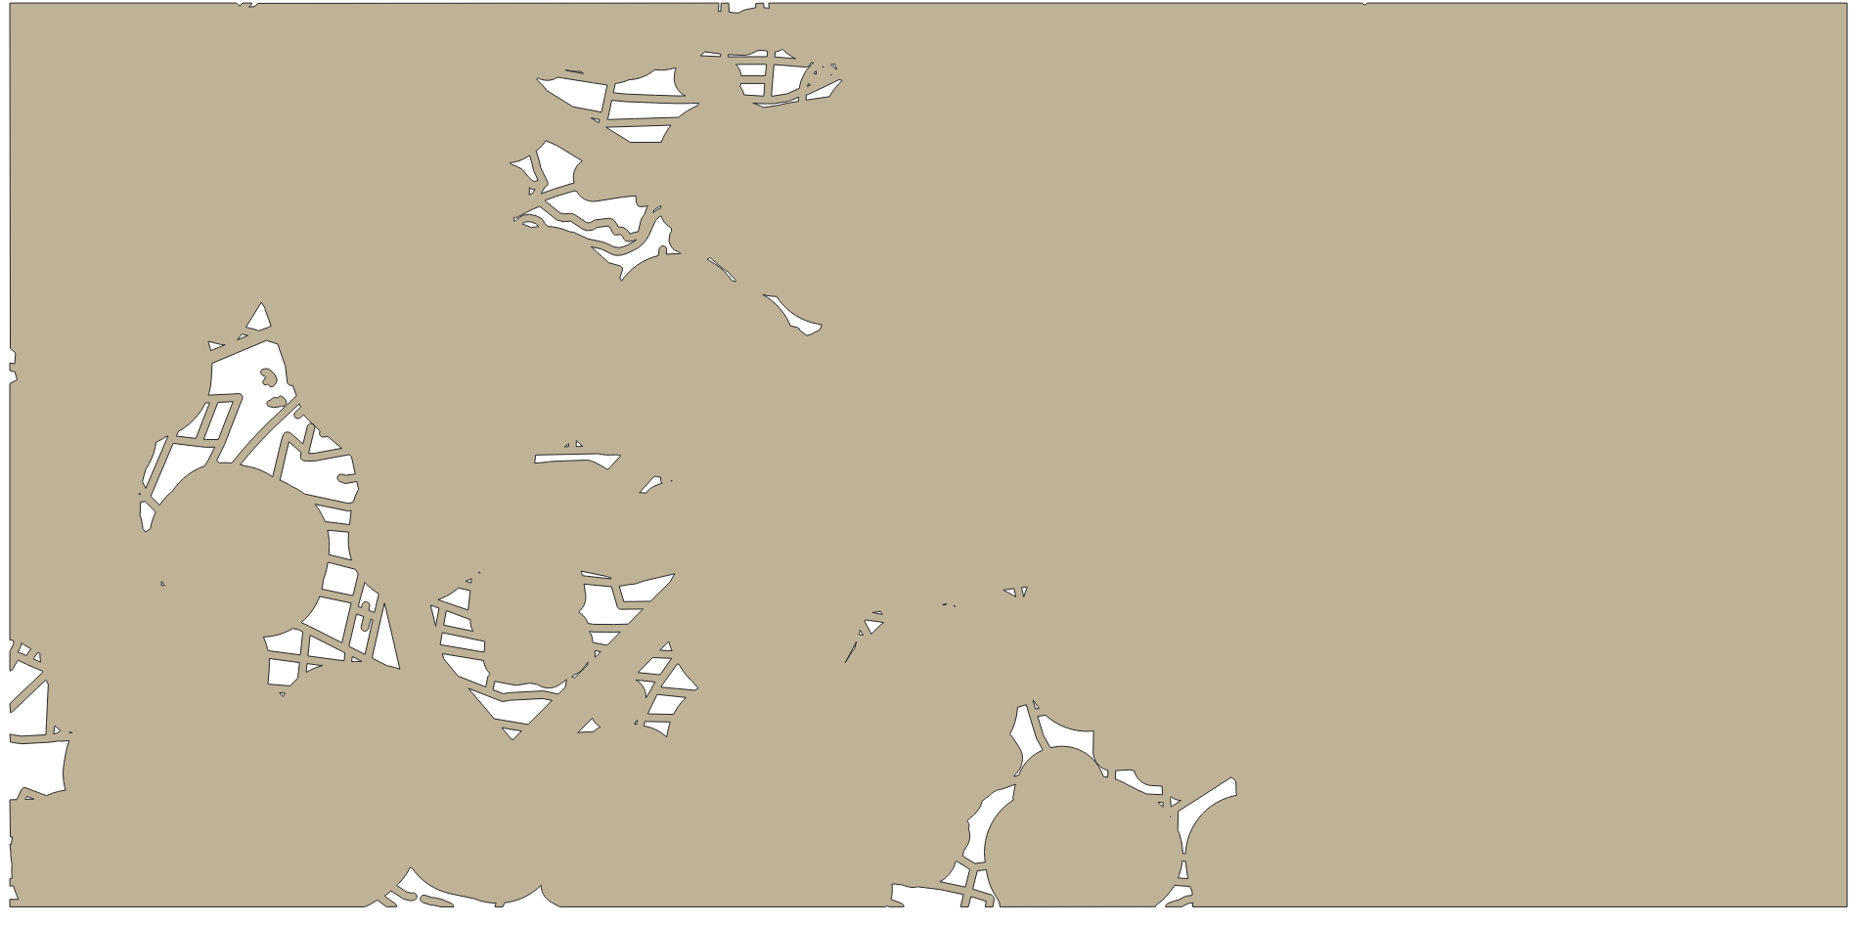

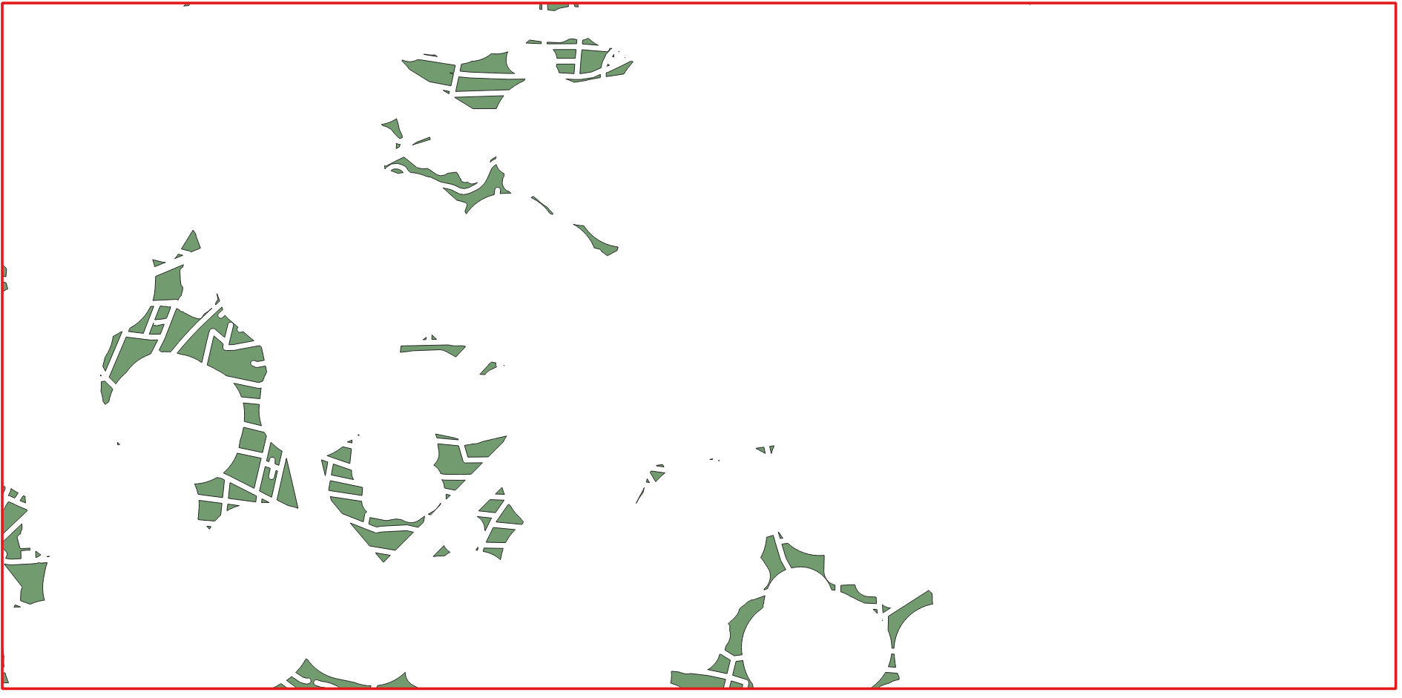
3.3 Remove all parts of the Ackerland/Grünland areas that lie within the restricted zones.
+
Figure 2: the grassland and arable land areas after remove boundary
Figure 3: The land areas that meet the criteria and are located at a sufficient distance from roads and rivers.
Figure 4: Günland and Ackerland that meet the criteria and are located at a sufficient distance from roads and rivers.
Notes:
Next, I used the Difference tool to remove restricted areas, such as railway lines, roads, and rivers, based on the previously prepared Egur map.
As a result, I obtained the suitable Ackerland and Grünland areas for wind farm development, which are marked in green on the map.

Slide 5

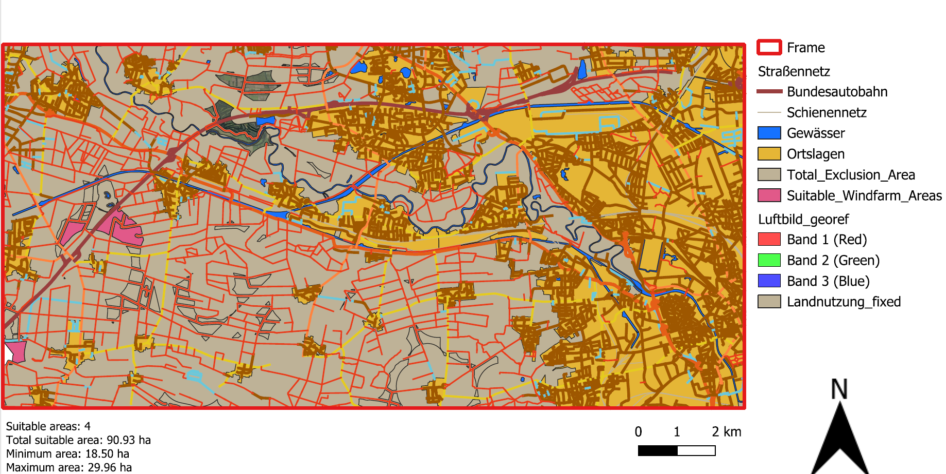
3.3 Filter the areas with an area greater than 18 ha.
Figure 5: Suitable land for Wind Farm Areas
Figure 6:final Result
Notes:
Finally, I used the Extract by Expression tool to filter the areas with a size of 18 ha or more, obtaining the final result.
Finally, I created the map layout and obtained the final result shown in the image

Slide 6
4.Final Result
4 suitable areas
Total area: 90,93 ha
Individual areas: from 18.5 to 29,96
The suitable areas are concentrated
mainly in the western and southwestern
Reason: high density of settlements,
, transport infrastructure
, water bodies
Figure 6:final Result
Notes:
The analysis identified four suitable areas with a total area of approximately 90.93 ha. The individual areas range from approximately 18.50 ha to 29.96 ha.
Spatially, the suitable areas are concentrated mainly in the western and southwestern parts of the study area. Very few suitable areas remain in the central and eastern parts. This pattern can be explained by the high density of settlements, transport infrastructure, water bodies, and other protected features. Their overlapping buffer zones exclude a large proportion of the study area, which further reduces the number of feasible sites.

