Slide 1


G.H. RAISONI COLLEGE OF ENGINEERING
AND MANAGEMENT, WAGHOLI, PUNE
Department of CSE ( AI & AIML)
LogicLink : A GUI-Driven Approach to Intelligent Reasoning Model
Guide:
PROF. BARKHA KUMARI
Name of Projectees
KRATU YOGENRA GAUTAM : - A-27
GEETANK RAVINDRA SAHARE:- A-28

Slide 2
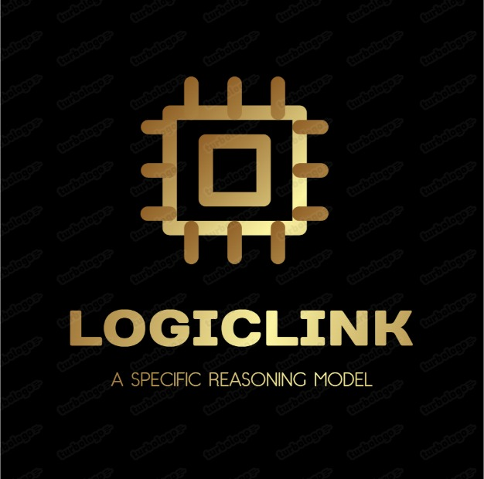
Introduction
LogicLink is a GUI-based reasoning system developed to simulate intelligent, rule-based decision-making in an interactive and user-friendly manner. It allows users to input logical facts and rules, view outcomes dynamically, and understand complex reasoning processes without requiring deep technical knowledge. Designed to bridge the gap between advanced AI models and usability, LogicLink targets a wide audience—including academic researchers, healthcare professionals, and diagnostic analysts by providing a transparent and interpretable decision support system. Its modular, intuitive interface empowers users across domains to interact with AI logic engines in real-time, promoting better decision-making through accessible and explainable reasoning workflows.

Slide 3
Justification For Selecting The Title
Justification of the Title: "LogicLink : “A GUI-Driven Approach to Intelligent Reasoning Model”
"Logic" refers to the use of rule-based reasoning and structured decision-making.
The name signifies how the system links user inputs to logical inferences through a seamless process.
It reflects the integration of AI reasoning with an intuitive GUI, making complex systems understandable.
"Link" represents the connection between facts, rules, and outcomes in the reasoning process.
The title highlights the system’s goal of bridging the gap between technical AI models and non-technical users.
Overall, "LogicLink" captures the purpose of enabling accessible, transparent, and explainable decision-making.

Slide 4
Problem Statement
Problem Identified:
AI and rule-based systems have advanced but are often inaccessible to non-technical users. Most tools are black-box models requiring programming skills and lack intuitive interfaces for inputting rules or visualizing reasoning. This limits their use in fields like healthcare and education, where interpretability and real-time decision-making are crucial.
Justification:
LogicLink addresses these issues by providing a user-friendly interface that allows users to define rules, input facts, and see visual feedback without coding. It improves transparency, builds trust, and supports decision-making in critical domains, fostering broader adoption of explainable AI.

Slide 5
Literature Survey
Sr. No. | Paper Title and Year | Advantage | Disadvantage
1 | Bishop, C.M. (2006) | Foundation of ML and inference | Lacks GUI focus
2 | Patel et al. (2019) | GUI-based diagnostics via Bayesian Networks | Domain-specific
3 | Wong & Rao (2023) | Explainable AI for non-tech users | No GUI integration

Slide 6
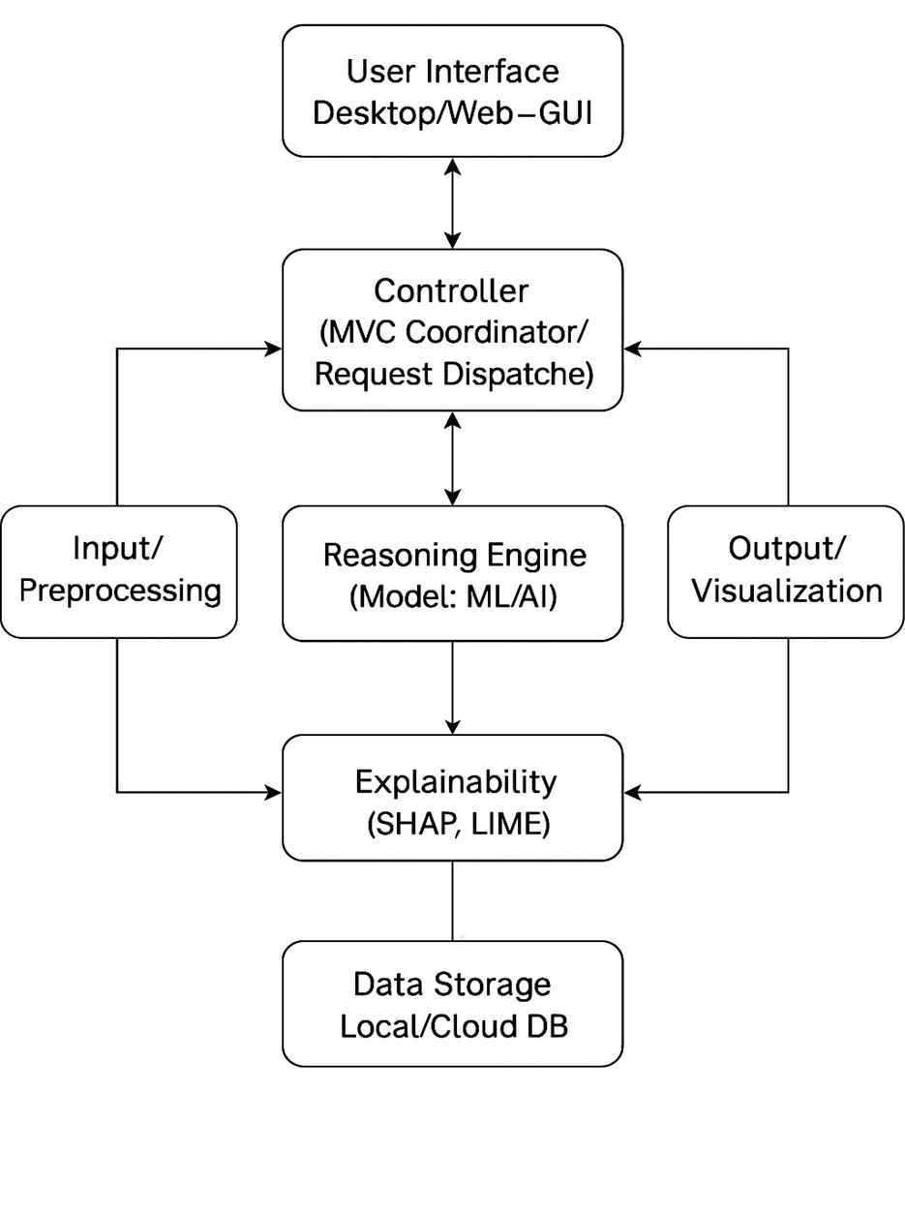
Block Diagram

Slide 7
Expected Result
The expected outcomes of this project include:
GUI-based reasoning : A graphical interface that allows users to easily interact with and manage the logic reasoning process without coding.
Simple input : Users can input rules and facts effortlessly, with results updating instantly based on the provided information.
Real-time inference : The system displays conclusions and reasoning in real-time, ensuring that users can follow the decision-making process.
Explainable output : Outputs are explained through basic Explainable AI (XAI) methods, helping users understand the reasoning behind decisions made.
Modular design : Built with an MVC architecture, making it easy to maintain, update, and scale the system as needed.

Slide 8
Work – Plan
Months Activities | Jan’25 | Feb’25 | Mar’25 | Apr’25
Literature Reviews | √
Requirement Analysis | √
Designing | √
Experimental Analysis | √ | √ | √
Module wise Implementation |  | √ | √
Testing and Debugging |  |  | √ | √
Preparation of Project Report |  |  |  | √

Slide 9
References
Bishop, C. M. (2006). Pattern Recognition and Machine Learning. Springer.
Géron, A. (2022). Hands-On Machine Learning with Scikit-Learn, Keras, and TensorFlow (3rd ed.). O’Reilly Media.
Lee, J., & Kim, S. (2021). Visualizing Machine Learning Decisions: A Toolkit for Explainable AI. Journal of Artificial Intelligence Research, 45(3), 123–145.
Patel, R., Smith, T., & Wong, L. (2019). Bayesian Networks in Healthcare: A GUI-Driven Diagnostic Tool. IEEE Transactions on Biomedical Engineering, 66(5), 789–801.
Raschka, S., & Mirjalili, V. (2023). Python Machine Learning (4th ed.). Packt Publishing.
Summerfield, M. (2020). Rapid GUI Programming with Python and Qt. Addison-Wesley Professional.
VanderPlas, J. (2016). Python Data Science Handbook. O’Reilly Media.
Zhang, Y. (2022). MVC Frameworks for AI: A Case Study on Flask and React Integration. In Proceedings of the ACM Symposium on User Interface Software and Technology (UIST), 45–58.
Shapley, L. S. (1953). A Value for n-Person Games. Annals of Mathematical Studies, 28(2), 307–317.
Wong, A., & Rao, P. (2023). Bridging the Gap: Explainable AI for Non-Technical Users. AI & Society, 38(1), 1–15.
Python Software Foundation. (2023). Python Documentation: Graphical User Interfaces. Retrieved from https://docs.python.org/3/library/tkinter.html

Slide 10
Thank you !

