Slide 1

PE Infector - Cleaner
By: Elad Eliyahu
Yonatan Kravitz
Instructor: Arie Haenel
Jerusalem College of Technology
Presented February 5, 2017

Slide 2
AGENDA
Goals of Project
Why, What, How?
PE Format short Walkthrough
Implementation
Cleaner
Proof Of Concept

Slide 3
PE Infector – Why?
Learn how an executable runs
Add new features
Learn how some malicious software are implemented

Slide 4
PE Infector – What?
Create a Licenser for a Portable Executable file
Manipulate the PEs file structure
Change flow of program to run the license check
If password is correct program continues as originally was, if not program stops.
Create cleaner to remover license check

Slide 5
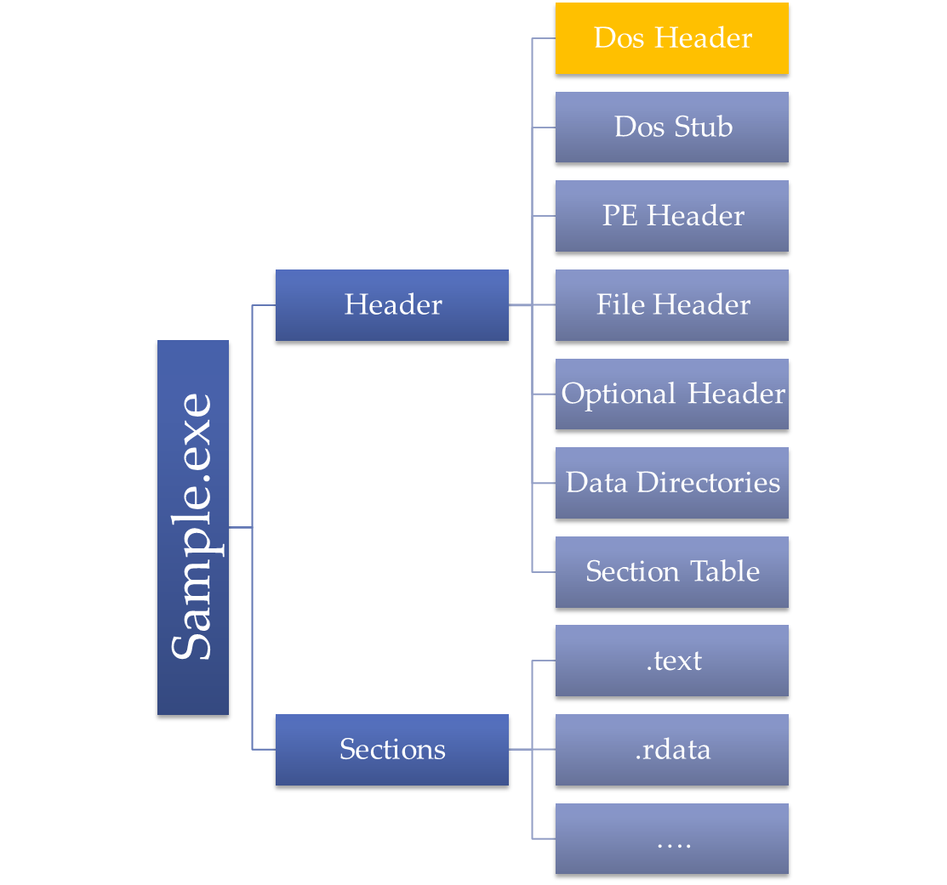
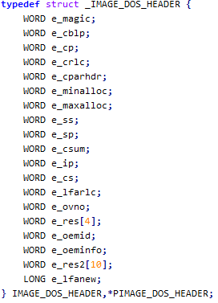
PE Structure
PE File starts with a DOS Header
Contain Signature (“MZ”)
Contains offset to PE Header

Slide 6
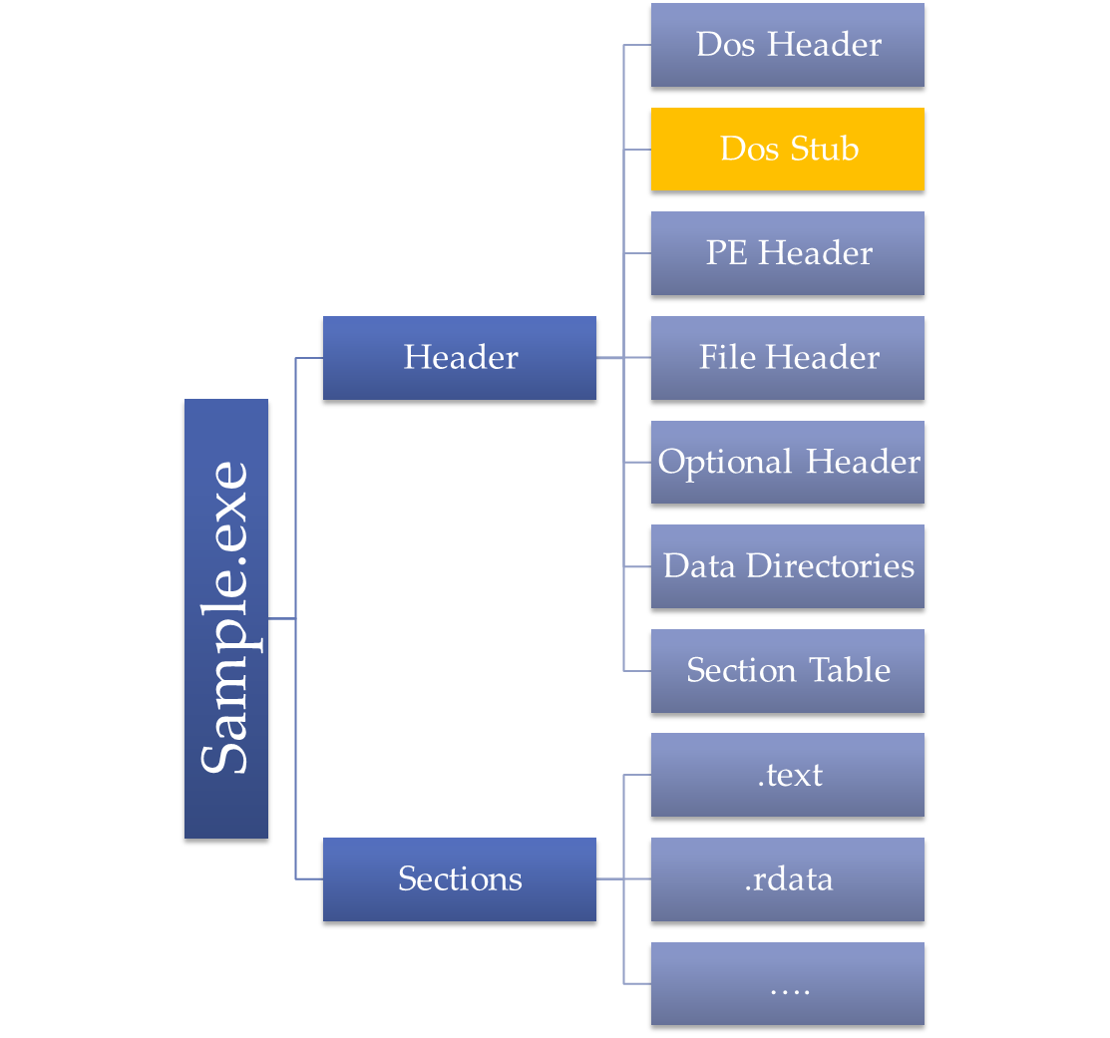
PE Structure
Message to be displayed when run in dos mode
“This program cannot be run in DOS mode”

Slide 7
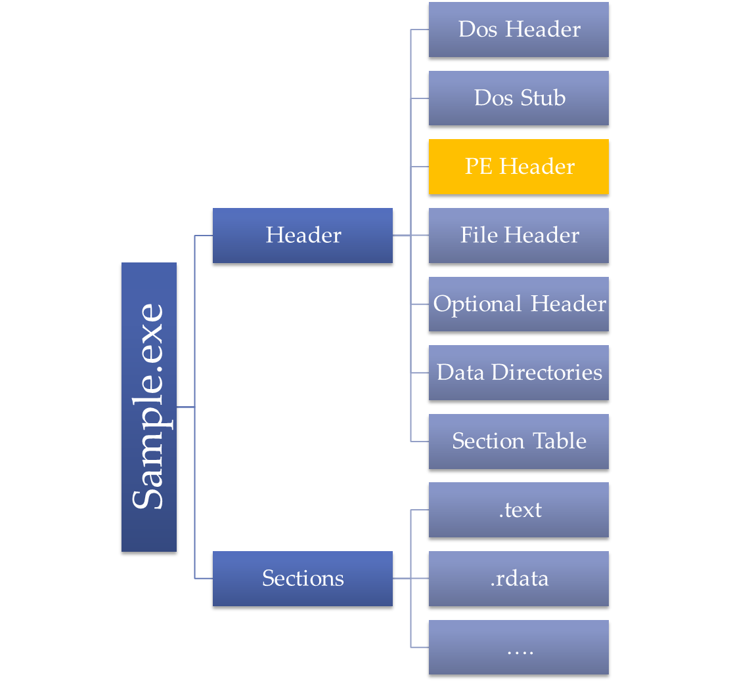

PE Structure
Contains all data needed for running the program

Slide 8
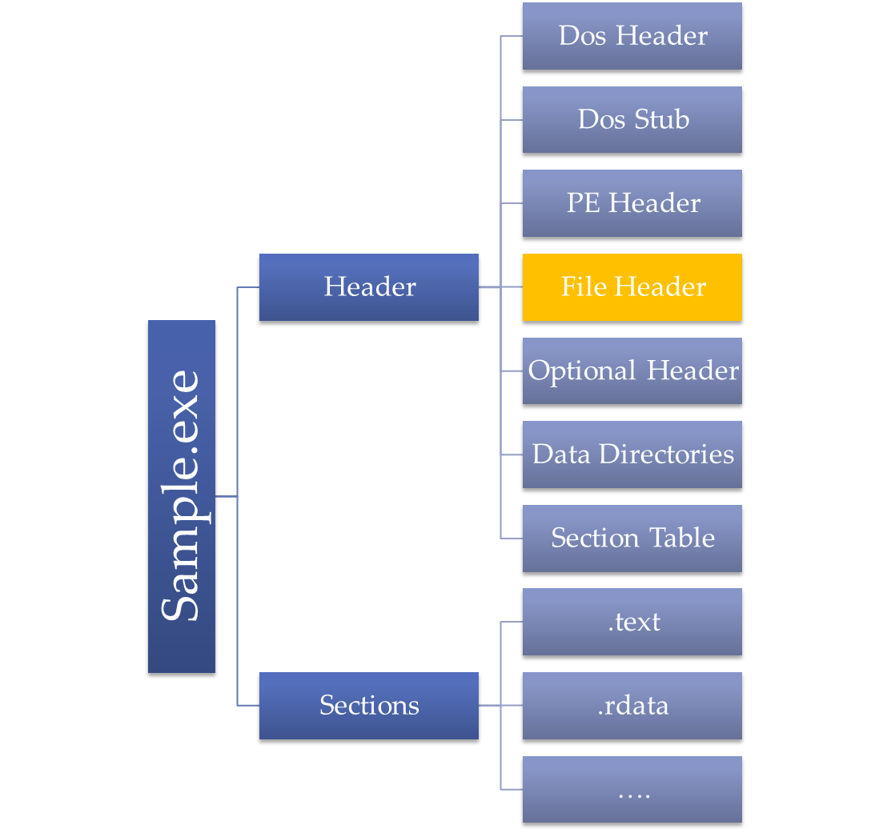
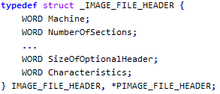
PE Structure
Contains all data needed for running the program

Slide 9
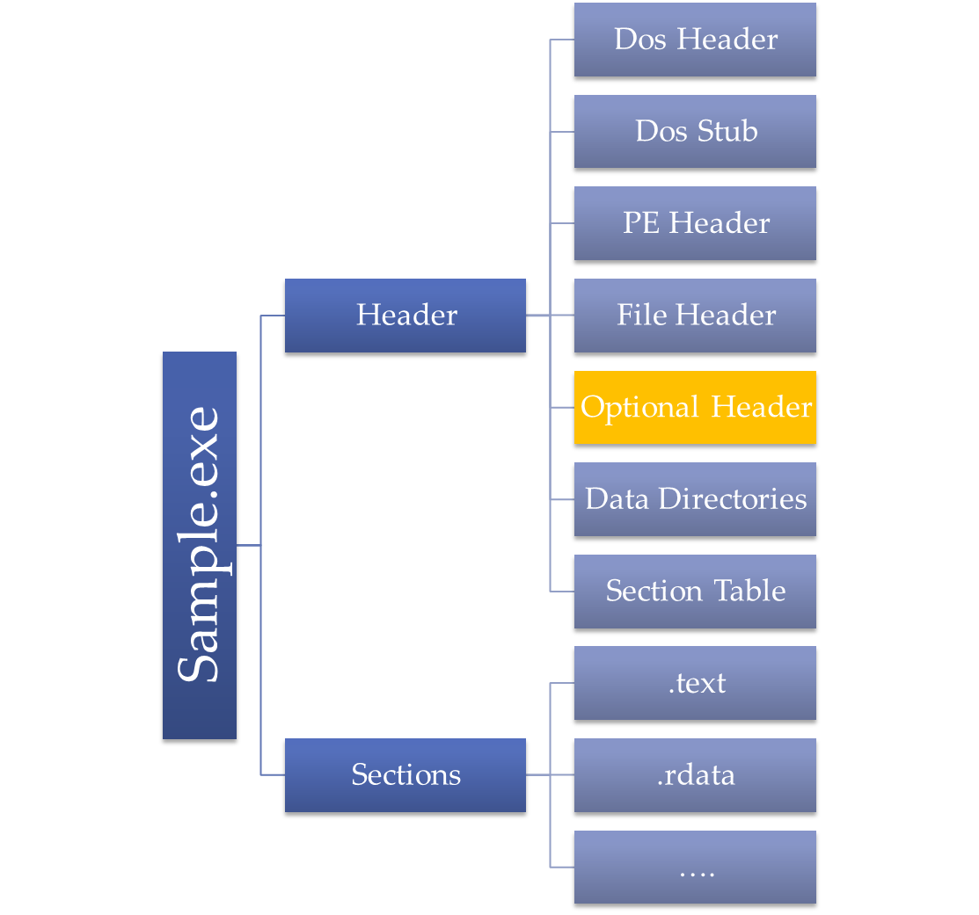
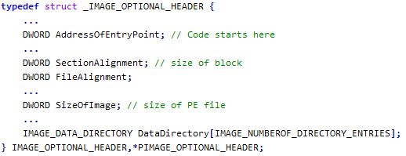
PE Structure
Contains all data needed for running the program

Slide 10
PE Structure
Contains all data needed for running the program

Slide 11
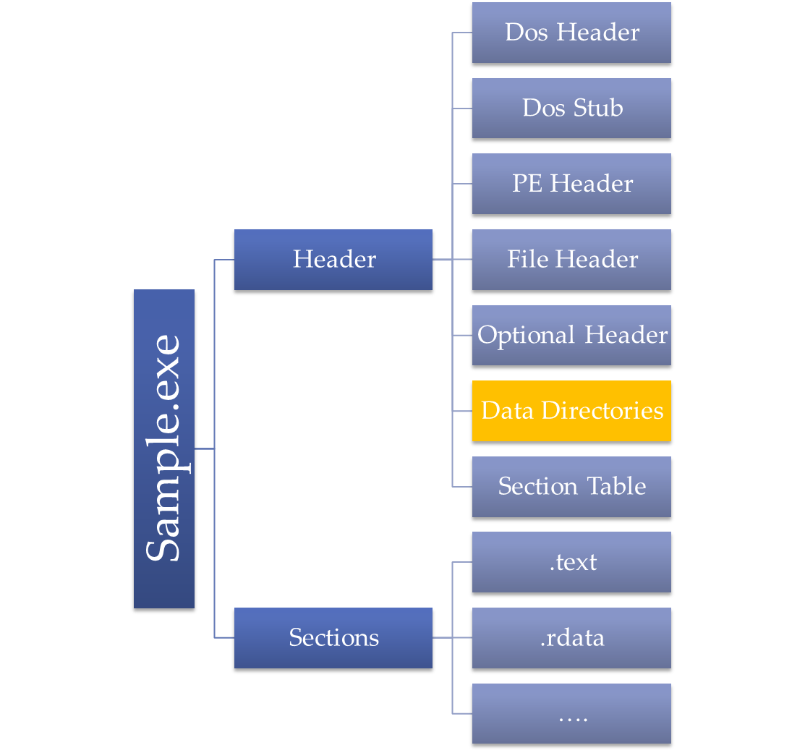

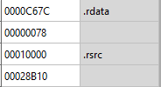
PE Structure
Contains all data needed for running the program

Slide 12
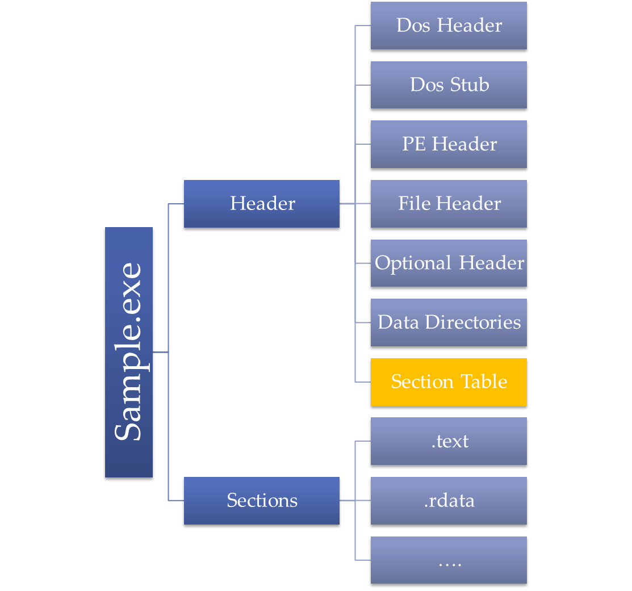
PE Structure
Contains all data needed for running the program
Contains all the data of the different sections

Slide 13
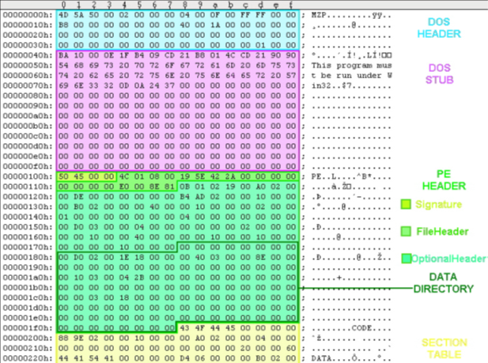

Slide 14
IMPLEMENTATION
Methods:
  Code Cave
  Add a new Section

Slide 15
IMPLEMENTATION
Method:
  Add new section
  Save Original Entry Point
  Change AddressOfEntryPoint to point to new code section
  Run program
  If password is correct jump to Original Entry Point.

Slide 16
IMPLEMENTATION
Problems:
  Program needs resources from file mapped in memory
  New code was injected not linked
  Inserting new code needs address of text used, function calls etc.
  How will the new code know the data?

Slide 17

IMPLEMENTATION
Solution:
  Insert in new section all data it needs to use (strings, dlls, functions).
  Use LoadLibrary, GetProcAddress
  At startup map all functions to real address.
  Use string from data stored

Slide 18

IMPLEMENTATION
Dos Header
Original entry point
LoadLibrary
GetProcAddress
Password
New Section to insert
Dos Stub
PE Header
All string needed for code
Optional Header
Dlls used in code
Data Directories
Section Table
API function names
.text
Function real address
.rdata
…
Code to run

Slide 19
IMPLEMENTATION
Dos Header
Original entry point
LoadLibrary
GetProcAddress
Password
Dos Stub
PE Header
All string needed for code
Optional Header
Dlls used in code
Data Directories
Section Table
API function names
.text
Function real address
.rdata
…
Code to run

Slide 20
IMPLEMENTATION
Dos Header
Dos Stub
PE Header
Optional Header
Data Directories
Section Table
.text
.rdata
…
New Section

Slide 21
Cleaner
Dos Stub
Method:
  Get to last Section
  Get Original Entry Point
  Replace AddressOfEntryPoint
  Update the PE file
PE Header
Optional Header
Data Directories
Section Table
.text
.rdata
…
New Section

Slide 22
Proof Of Concept

