Slide 1

Software development with Xtreme Programming, Scrum and Youtrack
Software Engineering I – Fabian Schwickert
29th October 2020

Slide 2
Table of Contents
Fundamentals of Software Engineering
Xtreme Programming (XP)
Scrum
Youtrack

Slide 3
Fundamentals of Software Engineering
Structure of
Software Engineering
Professional-technical:
Methods and Models
Organizational:
Project Management
Dynamic: Process models
Sharing of work
Situation, requirement analysis, concept,
implementation and system integration, ...
Motivation of employees
Static shape, form, figure: System models
Workflow organization
Petri, SA, SADT, ERM, UML, ARIS, BPMN
Quality management
Support tasks
Configuration management, quality assurance,
Controlling
documentation, profitability calculation
PM-Tools

Slide 4
Fundamentals of Software Engineering
Method, Process Model e. g. Waterfall, Spiral Model or
“The Xtreme Programming Scrum Combi“
Technique:
Planning Game
Technique:
Scrum
Technique:
Customer on-site
Technique:
Coding standards
You-track
Jira
Wrike
Slack
Order
Office
IntelliJ
Sonar Lint
A method is a bundle of coordinated techniques.
Techniques are performed by tools.

Slide 5
Table of Contents
Fundamentals of Software Engineering
Xtreme Programming (XP)
Scrum
Youtrack

Slide 6
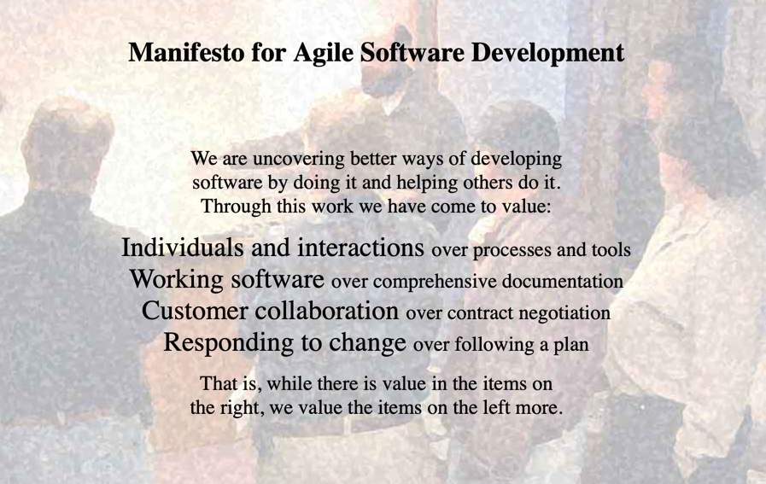
Xtreme Programming (XP)
agilemanifesto.org
Kent Beck and Alistair Cockburn together with approx. 15 colleagues

Slide 7

Xtreme Programming (XP)
Values and principles
  Communication and customer integration
  Feedback + incremental development
  Simplicity and confidence in decision
Practices
  Mutually enhancing
  Cooperation of process, test, architecture questions
On-site Customer
Processes
Metaphor
Planning game
Short releases
Simple desgin
40 hour week
Acceptance testing
Refactoring
Collective ownership
Architecture
Pair programming
Continuous integration
Unit testing
Test
Coding standards
Kent Beck, 1999

Slide 8
Xtreme Programming (XP)
Method, Process Model e. g. Waterfall, Spiral Model or
“The Xtreme Programming Scrum Combi“
Technique:
Planning Game
Technique:
Scrum
Technique:
Customer on-site
Technique:
Coding standards
You-track
Jira
Wrike
Slack
Order
Office
IntelliJ
Sonar Lint
A method is a bundle of coordinated techniques.
Techniques are performed by tools.

Slide 9
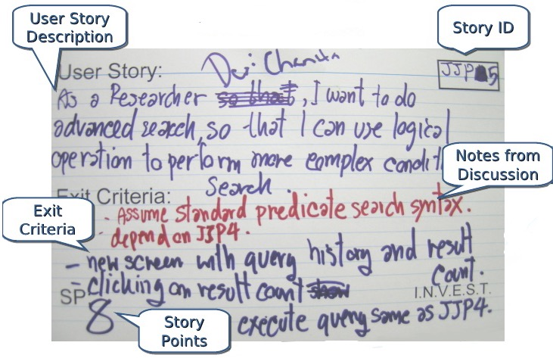
Xtreme Programming (XP)
Planning Game
Collect requests on User Story Cards
  Customer writes the cards.
  Sketches, texts,
  also common language
Developers estimate cost per card
  Estimation based on experience
  (similarities between cards)
  Abstract dimensioning of costs
  (e.g. 1 to 10 points)
  Feedback of customers
  Updating the cards with
  cost notes (Story Points)
Selection of cards for next release by customers
  By importance, utility prioritized
  Development team is limited by its productivity

Slide 10
Xtreme Programming (XP)
Method, Process Model e. g. Waterfall, Spiral Model or
“The Xtreme Programming Scrum Combi“
Technique:
Planning Game
Technique:
Scrum
Technique:
Customer on-site
Technique:
Coding standards
You-track
Jira
Wrike
Slack
Order
Office
IntelliJ
Sonar Lint
A method is a bundle of coordinated techniques.
Techniques are performed by tools.

Slide 11

Xtreme Programming (XP)
Customer on-site
Customer is available for the entire project duration
  Ideally directly on site ...
  ... or at least available quickly and at any time.
Customer writes and reviews user stories
  Requirements (maps) are constantly being refined.
  Questions of the developers are answered immediately.
Customer makes decisions
  Avoid loss of time through direct availability
  No sole (wrong) decision by developers

Slide 12
Xtreme Programming (XP)
Method, Process Model e. g. Waterfall, Spiral Model or
“The Xtreme Programming Scrum Combi“
Technique:
Planning Game
Technique:
Scrum
Technique:
Customer on-site
Technique:
Coding standards
You-track
Jira
Wrike
Slack
Order
Office
IntelliJ
Sonar Lint
A method is a bundle of coordinated techniques.
Techniques are performed by tools.

Slide 13
Xtreme Programming (XP)
Shared code responsibility and coding standards
Shared code responsibility in the pair
  Everyone may edit each other's source code
  Division of labor in Story Cards
  Can compensate for temporary staff shortages
Coding standards create a common understanding
  Precondition for shared code responsibility
  Readability, "speaking" source code
  Structural standards such as parentheses, indentations, naming conventions, upper/lower case, etc.

Slide 14
Xtreme Programming (XP)
Method, Process Model e. g. Waterfall, Spiral Model or
“The Xtreme Programming Scrum Combi“
Technique:
Planning Game
Technique:
Scrum
Technique:
Customer on-site
Technique:
Coding standards
You-track
Jira
Wrike
Slack
Order
Office
IntelliJ
Sonar Lint
A method is a bundle of coordinated techniques.
Techniques are performed by tools.

Slide 15
Table of Contents
Fundamentals of Software Engineering
Xtreme Programming (XP)
Scrum
Youtrack

Slide 16
Scrum
Scrum – The arranged crowd
http://scrum-master.de/Scrum-Glossar

Slide 17
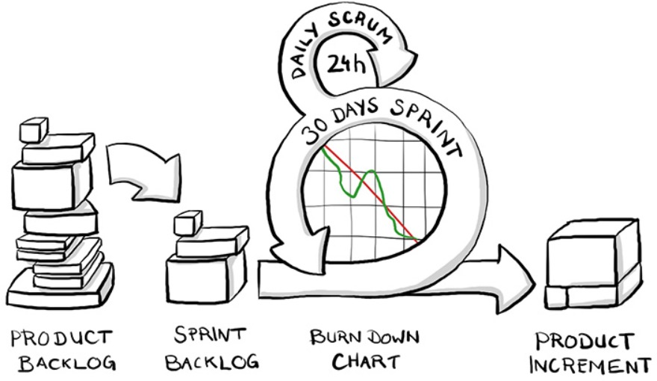
Scrum
Scrum – small, creative, fast
braintime.de

Slide 18
Scrum
“The Xtreme Programming Scrum Combi“
Technique:
Customer on-site
Technique:
Coding standards
Technique:
Planning Game
Technique:
Pair programming

Slide 19
Scrum
“The Xtreme Programming Scrum Combi“
Customer on-site:
Order, Office
Coding standards:
IntelliJ, Sonar Lint
Planning Game:
Youtrack
Pair programming:
Team, Buddy

Slide 20
Table of Contents
Fundamentals of Software Engineering
Xtreme Programming (XP)
Scrum
Youtrack

Slide 21

Youtrack
jetbrains.com

Slide 22
Software development with Xtreme Programming, Scrum and Youtrack
Software Engineering I – Fabian Schwickert
29th October 2020

Slide 23
Sources
Schwickert, Axel; Schick, Lukas: Systems Engineering – Vorlesung zur Wirtschaftsinformatik im Master-Studium, Prof. Dr. Axel Schwickert (Ed.), Justus-Liebig-Universität Gießen, Wintersemester 19/20.
Briantime.de (Ed.): Scrum kompakt, https://www.braintime.de/methoden/ueberblick-scrum-beratung/scrum-grundlagen-kompakt/, retrieved on 25.10.2020.
Kent Beck et al.: Manifesto for Agile Software Development, agilemanifesto.org (Ed.), 2001, https://agilemanifesto.org, retrieved on 25.10.2020.

