Slide 1

BFFL – URL Shortening
Software Engineering – Felix H., Lars H., Bastian S., Fabian S.
18th June 2021

Slide 2
The BFFL-Team
Felix Hirschel (Full Stack Development and Testing)
Lars Hudalla (Full Stack Development and PM) Bastian Schäfer (Full Stack Development and Design) Fabian Schwickert (Full Stack Development and DEV Ops)

Slide 3
Table of contents
What is „URL Shortening“?
Why do you need BFFL?
Project management and approach
State of things
Outlook

Slide 4

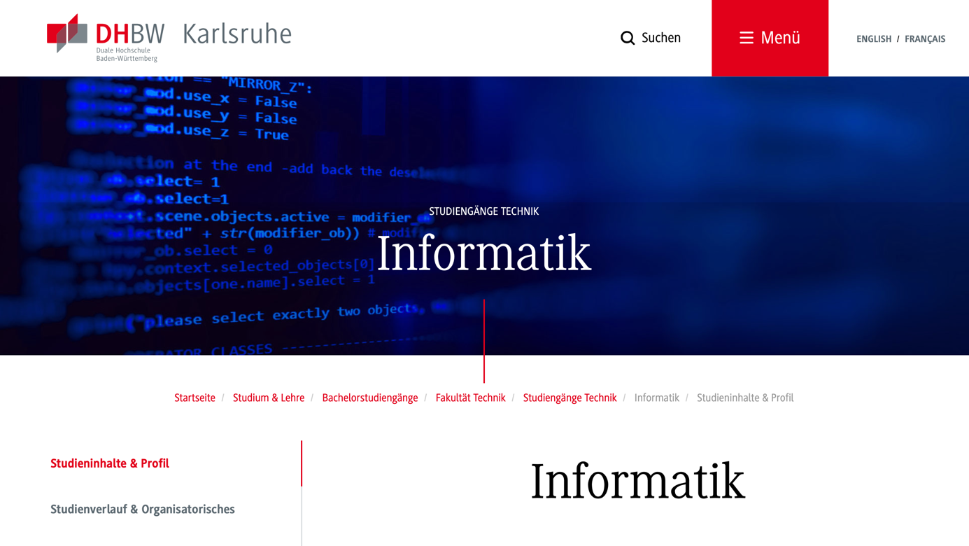
1. What is „URL Shortening“
https://www.dhbwka/inf
Send Redirect to Target
https://www.karlsruhe.dhbw.de/...
GET https://www.dhbwka/inf
Short URLs | Target URL
https://www.dhbwka/inf | https://www.karlsruhe.dhbw.de/inf/studienverlauf-organisatorisches.html#anchor-main-content
... | ...
Website using shortened URLs
URL shortening webservice
URL shortening DBMS

Slide 5
1. What is „URL Shortening“
Benefits of ShortURLs:
Shorter URLs for the same target address
Target address can be changed afterwards
Collect and analyze data from usage of ShortURLs

Slide 6
Table of contents
What is „URL Shortening“?
Why do you need BFFL?
Project management and approach
State of things
Outlook

Slide 7
Your Web Application
2. Why do you need BFFL?
LTS Guarantee
Use your own data.
–
Suited for companies with many web apps
–
Groups help assign resources to apps
BFFL specific
Don't let others obtain the data of your users
Manage the links of your web application centrally, quickly and easily.

Slide 8
Table of contents
What is „URL Shortening“?
Why do you need BFFL?
Project management and approach
State of things
Outlook

Slide 9
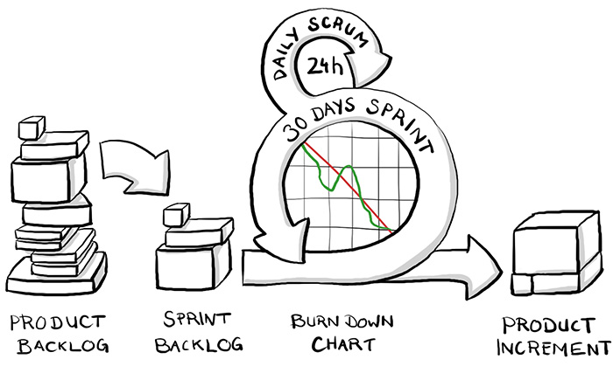
3. Project management and approach
Scrum
Braintime (ed.)

Slide 10
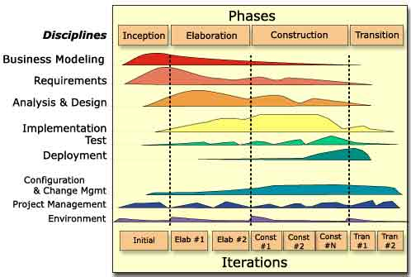
3. Project management and approach
RUP
Torsten Horn (ed.)

Slide 11
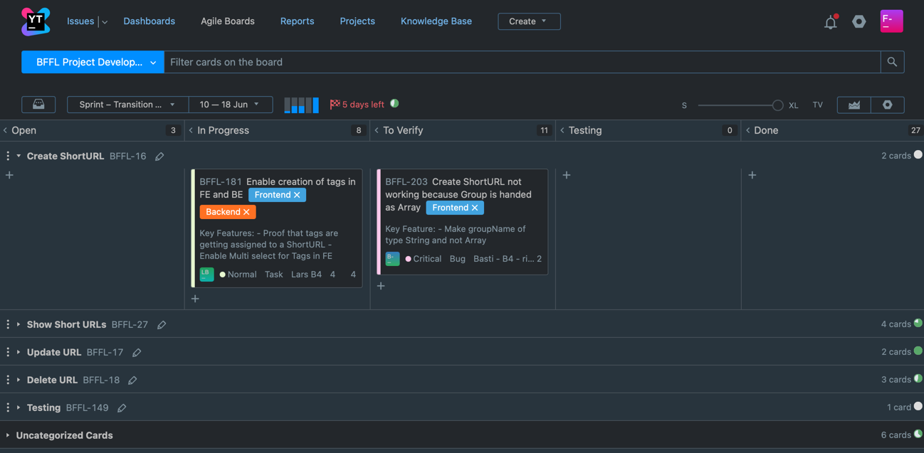
3. Project management and approach
Youtrack

Slide 12
3. Project management and approach
In addition to traditional documentation of project planning (e. g. requirements- and risk-analysis) ...
... comprehensive documentation
according to RUP specification (e. g. SAD, SRS, Testplan)

Slide 13
3. Project management and approach
Riskmanagement
name | description | occurrence | impact
A lot Learning | Everything we do is new to us | 10 | 10
Bad Planning | Disordered approach, No guidance, No experience | 10 | 8
Not enough focus | Participation, work beyond the lecture | 8 | 10
Not enough time | Not enough time for impl. without loss of quality | 7 | 10
Low Motivation | Low motivation due to poor prospects | 7 | 7
Technical problems | Implementation not feasible, too costly, ... | 4 | 7
Bad Tools | Tools for Planning, Development, Communication | 5 | 4
Staff shortage | Illnesses etc. | 2 | 4

Slide 14



3. Project management and approach
Testing

Slide 15
Table of contents
What is „URL Shortening“?
Why do you need BFFL?
Project management and approach
State of things
Outlook

Slide 16
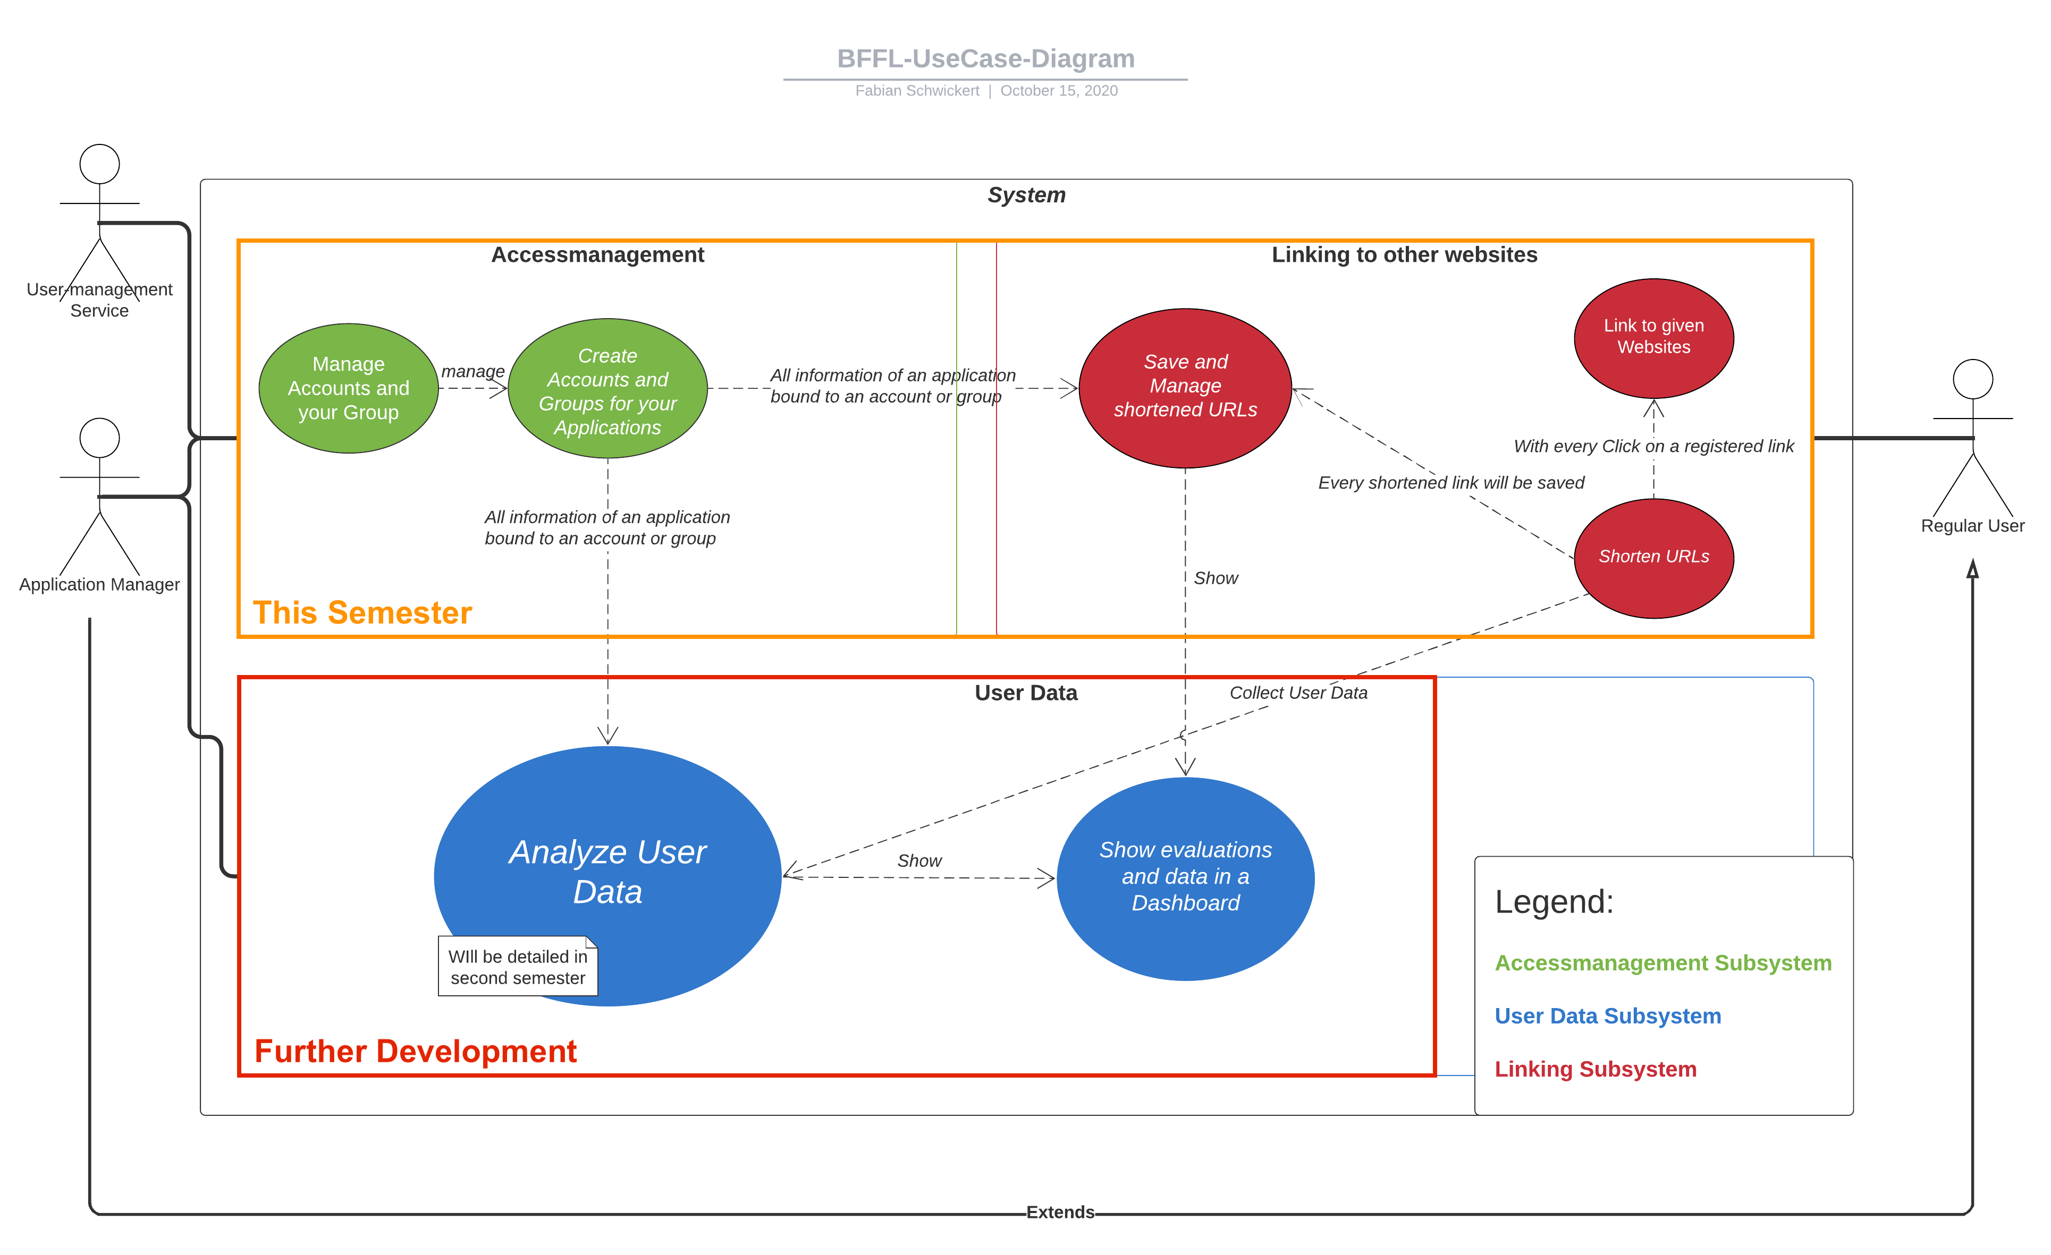
4. The state of things
Usecase diagram
UseCase-Diagram

Slide 17
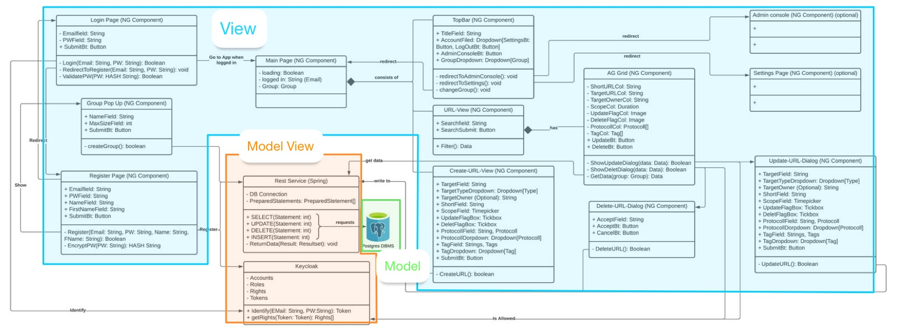
4. The state of things
Class diagram

Slide 18
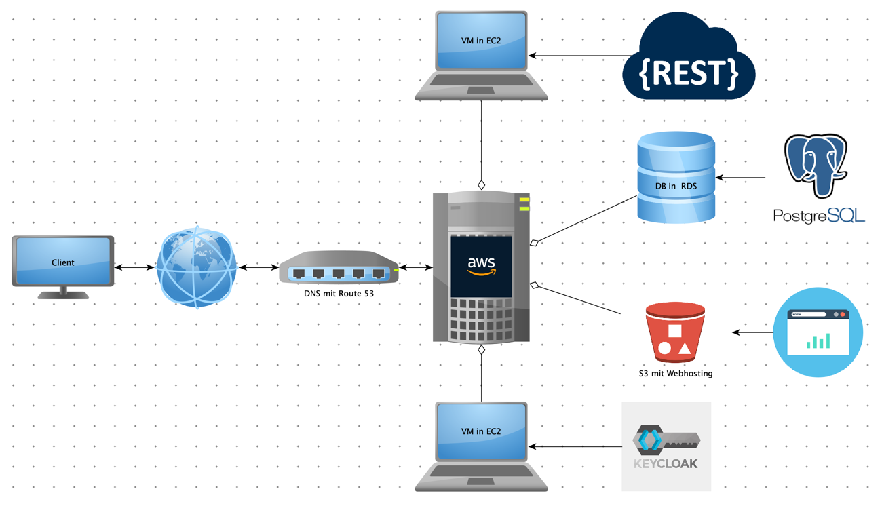
4. The state of things
Hardware architecture

Slide 19
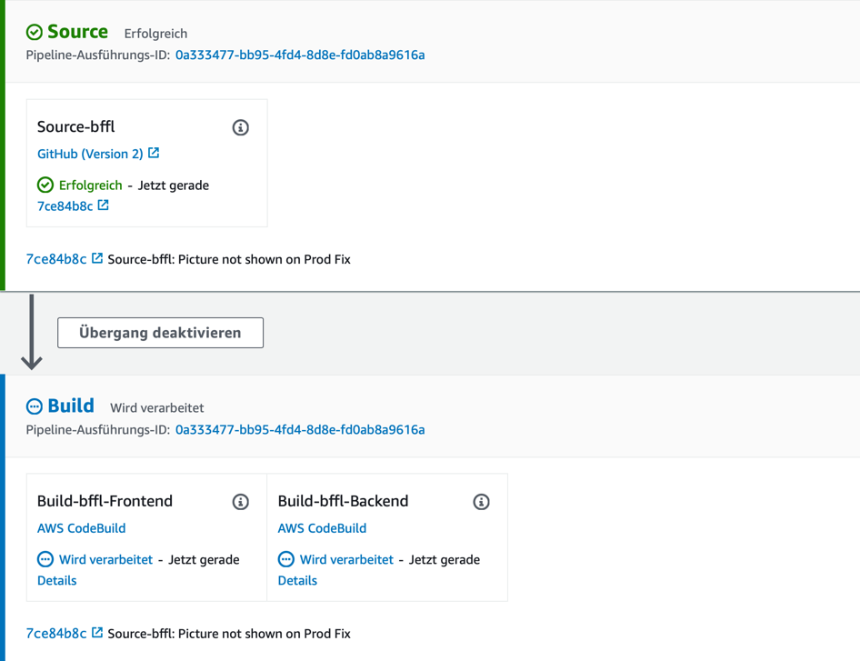
4. The state of things
Pipeline

Slide 20
4. The state of things
Demo

Slide 21
Table of contents
What is „URL Shortening“?
Why do you need BFFL?
Project management and approach
State of things
Outlook

Slide 22
5. Outlook
ToDo list:
Fixes and finish Update-ShortURL-UC
Group management
Admin console
Data analysis

Slide 23
5. Outlook
FP calculation

Slide 24
BFFL – URL Shortening
Software Engineering – Felix H., Lars H., Bastian S., Fabian S.
18th June 2021

Slide 25
Sources
Schwickert, Axel et al.: Shorty – Der URL-Shortener der Professur für Wirtschafts-informatik, E-Campus Wirtschaftsinformatik (ed.), August 2020, https://ilias.uni-giessen.de/ilias/ilias.php?ref_id=190491&cmd=render&cmdClass=ilrepositorygui&cmdNode=wn&baseClass=ilRepositoryGUI, retrieved on 07.12.2020.
Braintime.de (ed.): Scrum kompakt, https://www.braintime.de/me­tho­den/ue­berblick-scrum-beratung/scrum-grundlagen-kompakt/, retrieved on 09.12.2020.
Horn, Thorsten (ed.): Vorgehensmodelle zum Softwareentwicklungsprozess, https://www.torsten-horn.de/techdocs/sw-dev-process.htm, retrieved on 09.12.2020.

Slide 26
Sources
Garcia da Rosa, Santiago: Angular: Unit Testing Jasmine, Karma (step by step), medium (ed.), 30. November 2017, https://medium.com/swlh/angular-unit-testing-jasmine-karma-step-by-step-e3376d110ab4, retrieved on 12.06.2021.
Sharma, Nishant: Protractor, medium (ed.), 18. October 2018, https://medi-um.com/testvagrant/protractor-2aad56e10822, retrieved on 12.06.2021.
Niedringhaus, Paige: Postman vs. Insomnia: Comparing the API Testing Tools, medium (ed.), 02. September 2018,https://itnext.io/postman-vs-insomnia-comparing-the-api-testing-tools-4f12099275c1retrieved on 12.06.2021.

