Slide 1

BFFL – URL Shortening
Software Engineering – Felix H., Lars H., Bastian S., Fabian S.
18th June 2021

Slide 2
The BFFL-Team
Lars Hudalla (Full Stack Development and PM) Felix Hirschel (Full Stack Development and Testing) Bastian Schäfer (Full Stack Development and Design) Fabian Schwickert (Full Stack Development and DEV Ops)

Slide 3
Table of contents
What is „URL Shortening“?
Why do you need BFFL?
Project management and approach
State of things
Outlook

Slide 4
1. What is „URL Shortening“
„URL-shorteners are webservices that can be used on the World Wide Web. They en-able the creation of a shortened, alternative web address, which can be used just like the original "long" URL.“
– Schwickert, Axel et al.: Shorty – Der URL-Shortener der Professur für Wirtschaftsinformatik
Database Table
Short URLs | Target URL
https://www.dhbwka/inf | https://www.karlsruhe.dhbw.de/inf/studienverlauf-organisatorisches.html#anchor-main-content
... | ...

Slide 5

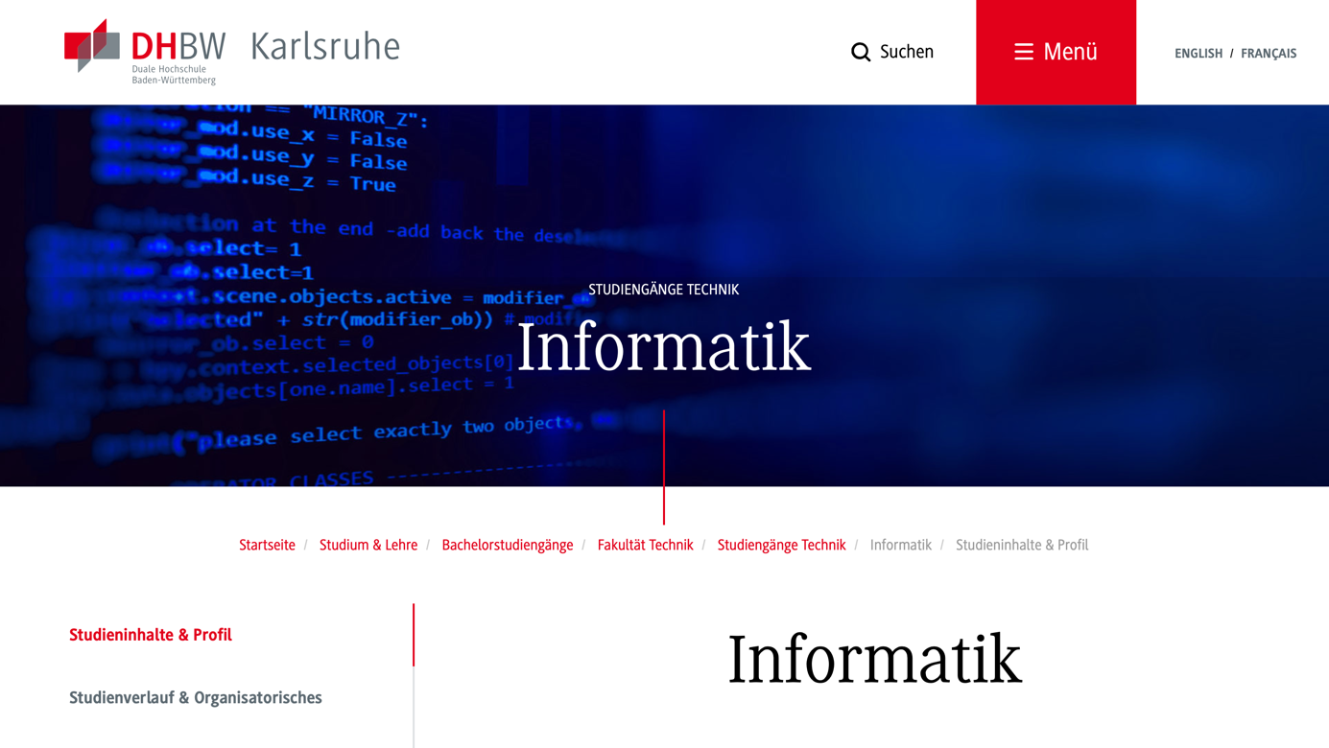
1. What is „URL Shortening“
https://www.dhbwka/inf
Send Redirect to Target
https://www.karlsruhe.dhbw.de/...
GET https://www.dhbwka/inf
Short URLs | Target URL
https://www.dhbwka/inf | https://www.karlsruhe.dhbw.de/inf/studienverlauf-organisatorisches.html#anchor-main-content
... | ...
Website using shortened URLs
URL shortening webservice
URL shortening DBMS

Slide 6
Your Web Application
2. Why do you need BFFL?
LTS Guarantee
Use your own data.
–
Suited for companies with many web apps
–
Groups help assign resources to apps
BFFL specific
Don't let others obtain the data of your users
Manage the links of your web application centrally, quickly and easily.

Slide 7
Table of contents
What is „URL Shortening“?
Why do you need BFFL?
Project management and approach
State of things
Outlook

Slide 8
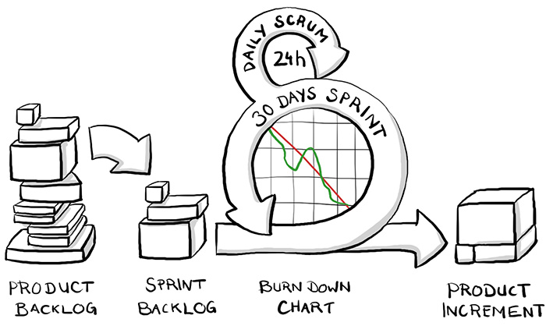
3. Project management and approach
Scrum
Braintime (ed.)

Slide 9
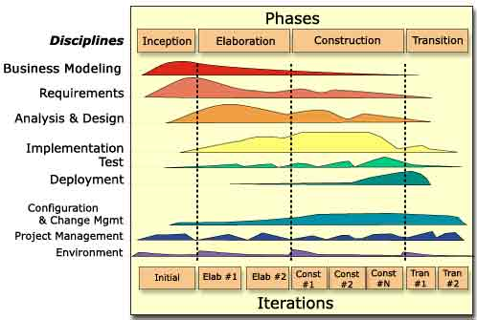
3. Project management and approach
RUP
Torsten Horn (ed.)

Slide 10
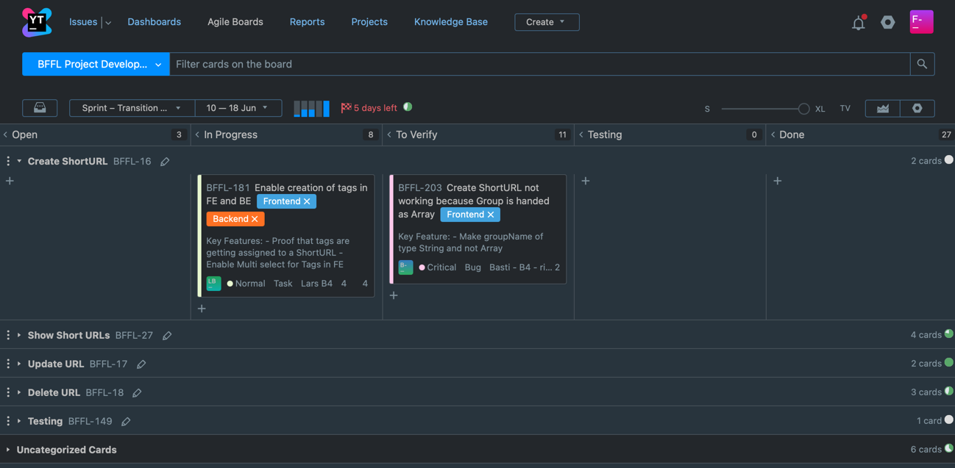
3. Project management and approach
Youtrack

Slide 11
3. Project management and approach
In addition to traditional documentation of project planning (e. g. requirements- and risk-analysis) ...
... comprehensive documentation
according to RUP specification (e. g. SAD, SRS, Testplan)

Slide 12
3. Project management and approach
Riskmanagement
name | description | occurrence | impact
A lot Learning | Everything we do is new to us | 10 | 10
Bad Planning | Disordered approach, No guidance, No experience | 10 | 8
Not enough focus | Participation, work beyond the lecture | 8 | 10
Not enough time | Not enough time for impl. without loss of quality | 7 | 10
Low Motivation | Low motivation due to poor prospects | 7 | 7
Technical problems | Implementation not feasible, too costly, ... | 4 | 7
Bad Tools | Tools for Planning, Development, Communication | 5 | 4
Staff shortage | Illnesses etc. | 2 | 4

Slide 13



3. Project management and approach
Testing

Slide 14
Table of contents
What is „URL Shortening“?
Why do you need BFFL?
Project management and approach
State of things
Outlook

Slide 15
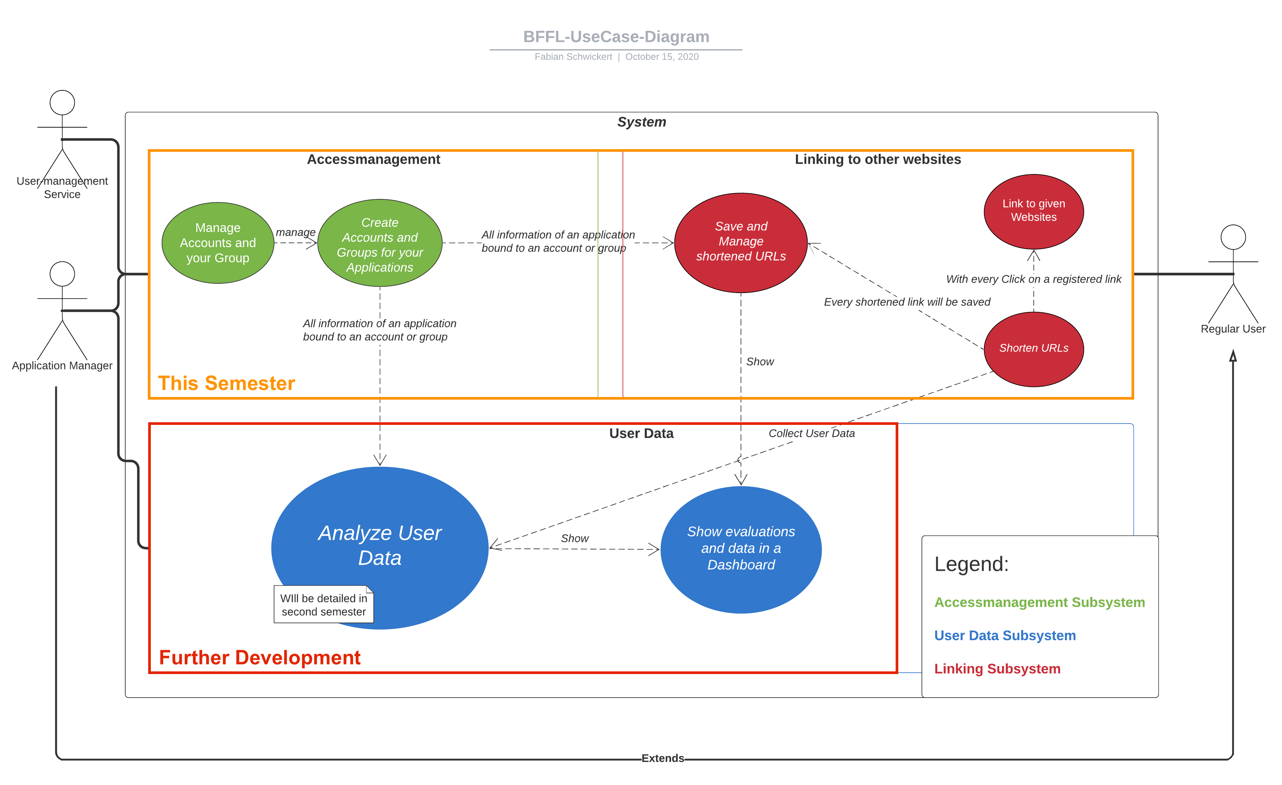
4. The state of things
Usecase diagram
UseCase-Diagram

Slide 16
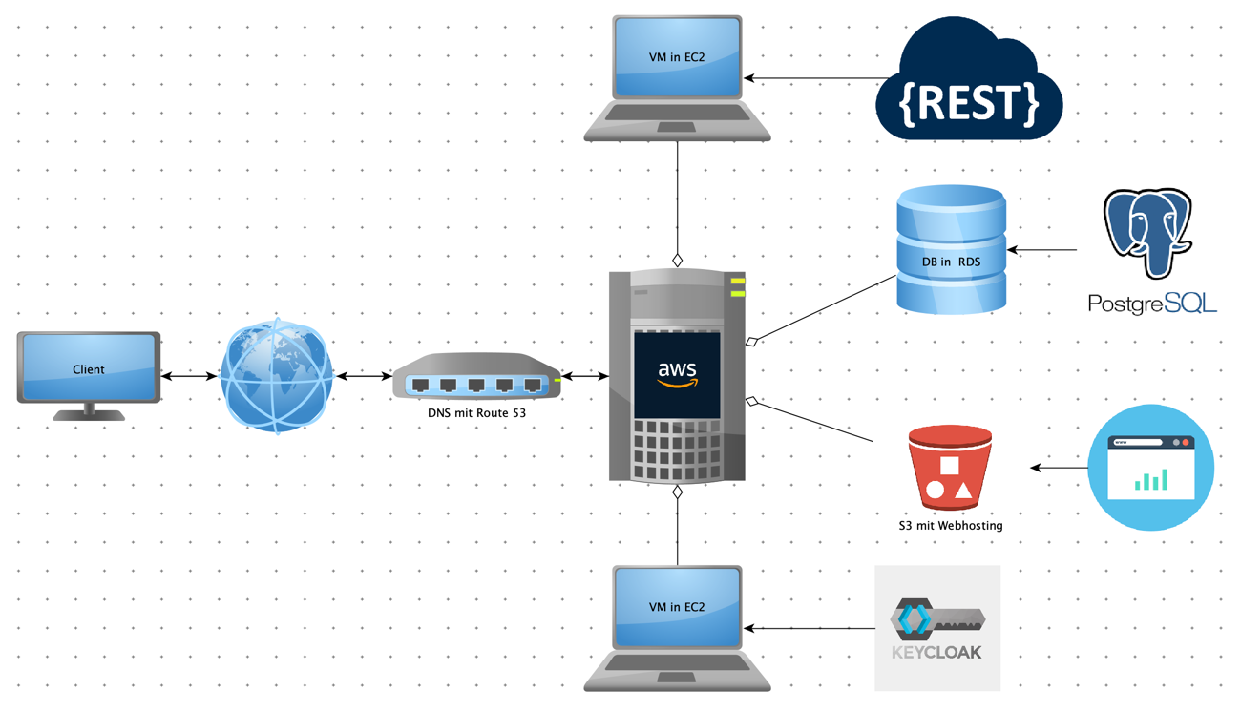
4. The state of things
Hardware architecture

Slide 17
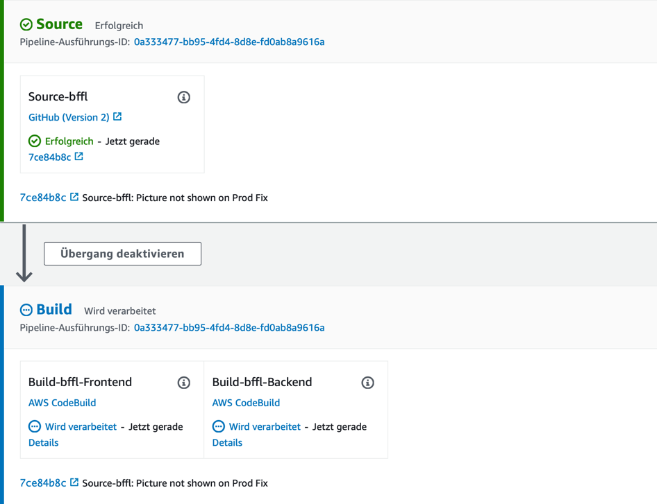
4. The state of things
Pipeline

Slide 18
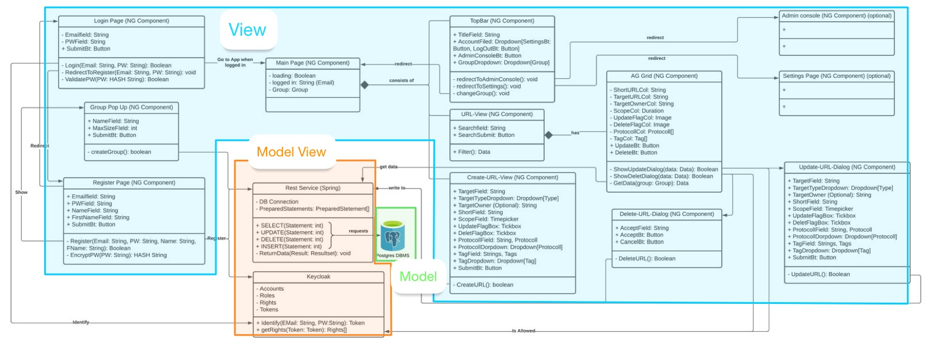
4. The state of things
Class diagram

Slide 19
4. The state of things
Demo

Slide 20
Table of contents
What is „URL Shortening“?
Why do you need BFFL?
Project management and approach
State of things
Outlook

Slide 21
5. Outlook
ToDo list:
Fixes and finish Update-ShortURL-UC
Group management
Admin console
Data analysis

Slide 22
5. Outlook
FP calculation

Slide 23
BFFL – URL Shortening
Software Engineering – Felix H., Lars H., Bastian S., Fabian S.
18th June 2021

Slide 24
Sources
Schwickert, Axel et al.: Shorty – Der URL-Shortener der Professur für Wirtschafts-informatik, E-Campus Wirtschaftsinformatik (ed.), August 2020, https://ilias.uni-giessen.de/ilias/ilias.php?ref_id=190491&cmd=render&cmdClass=ilrepositorygui&cmdNode=wn&baseClass=ilRepositoryGUI, retrieved on 07.12.2020.
Braintime.de (ed.): Scrum kompakt, https://www.braintime.de/me­tho­den/ue­berblick-scrum-beratung/scrum-grundlagen-kompakt/, retrieved on 09.12.2020.
Horn, Thorsten (ed.): Vorgehensmodelle zum Softwareentwicklungsprozess, https://www.torsten-horn.de/techdocs/sw-dev-process.htm, retrieved on 09.12.2020.

Slide 25
Sources
Garcia da Rosa, Santiago: Angular: Unit Testing Jasmine, Karma (step by step), medium (ed.), 30. November 2017, https://medium.com/swlh/angular-unit-testing-jasmine-karma-step-by-step-e3376d110ab4, retrieved on 12.06.2021.
Sharma, Nishant: Protractor, medium (ed.), 18. October 2018, https://medi-um.com/testvagrant/protractor-2aad56e10822, retrieved on 12.06.2021.
Niedringhaus, Paige: Postman vs. Insomnia: Comparing the API Testing Tools, medium (ed.), 02. September 2018,https://itnext.io/postman-vs-insomnia-comparing-the-api-testing-tools-4f12099275c1retrieved on 12.06.2021.

