Slide 1


HDTV: The End of the Road
Jeff Joseph
Vice President, Communications and Strategic Relationships
Consumer Electronics Association
April 19, 2005 NAB 2005 Las Vegas, Nev.

Slide 2
“HDTV is going to be the consumer’s national standard and desire.”
– Gary Shapiro, 1997

Slide 3
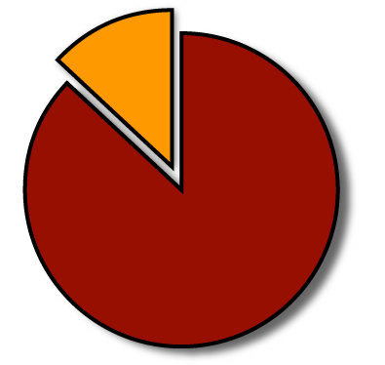
16 Million Units
Cumulative DTV Product Sales
1998-2004
87%
High Definition
Products

Slide 4
DTV Sales Momentum
Millions of Units
15.0
Source: CEA Market Research
7.30
4.10
2.49
1.46
0.65
0.12
1999
2000
2001
2002
2003
2004e
2005p

Slide 5
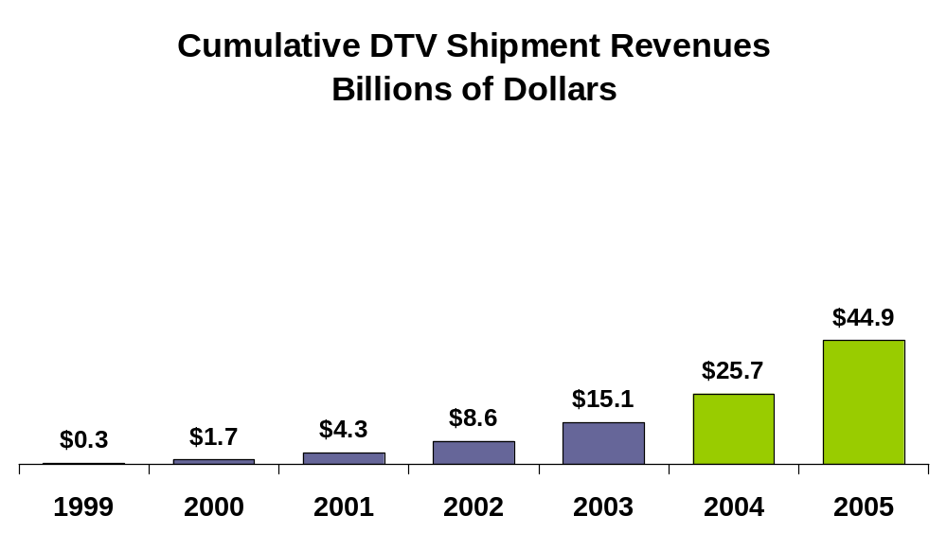
Growing Market Investment
Over $30 billion in consumer investment

Slide 6
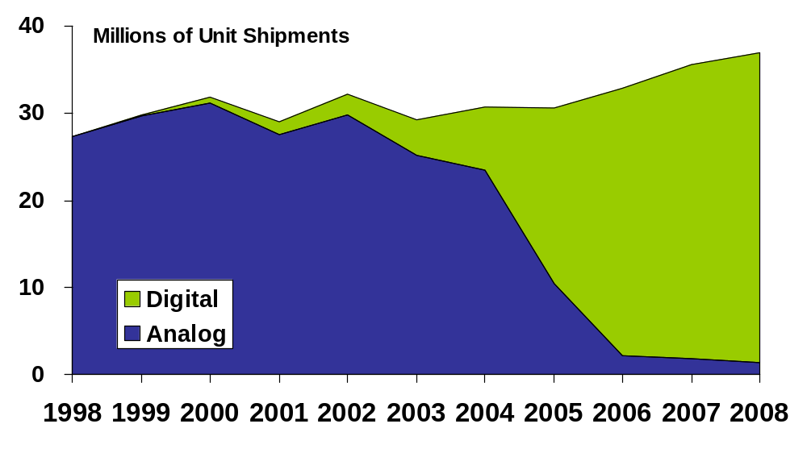
Buying More Digital TVs

Slide 7
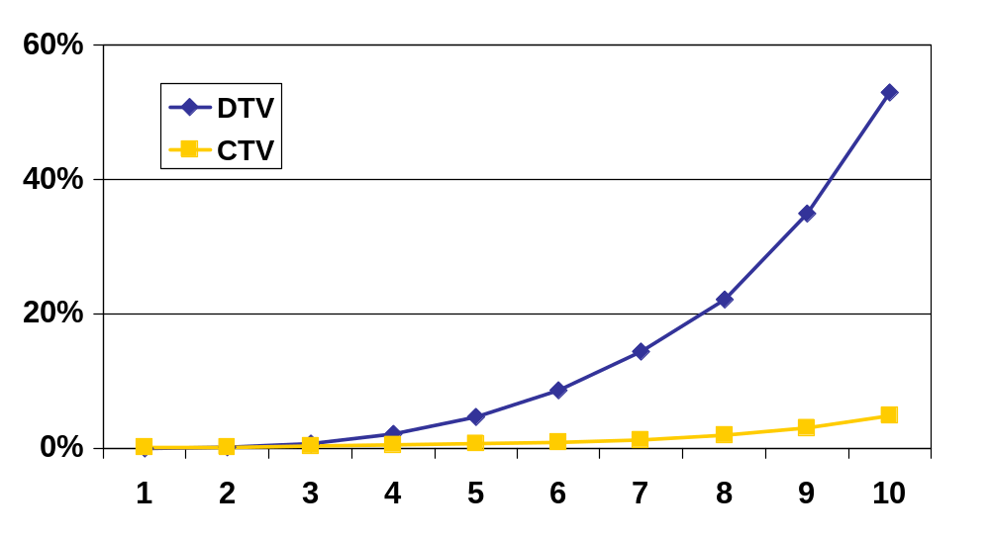
DTV v. *CTV Penetration
Includes Sets and Monitors
Reached 15% in 2004
Only hit 5% in year 10
DTV year 1 is 1998, CTV year 1 is 1956
*Color TV

Slide 8

Hamilton, NY, Pop. 3,509

Slide 9
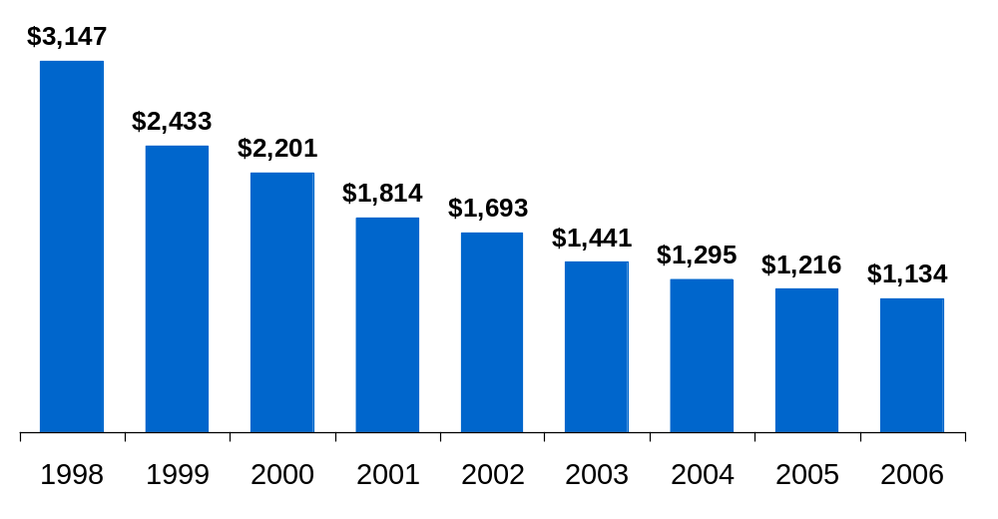
Digital TV Pricing

Slide 10
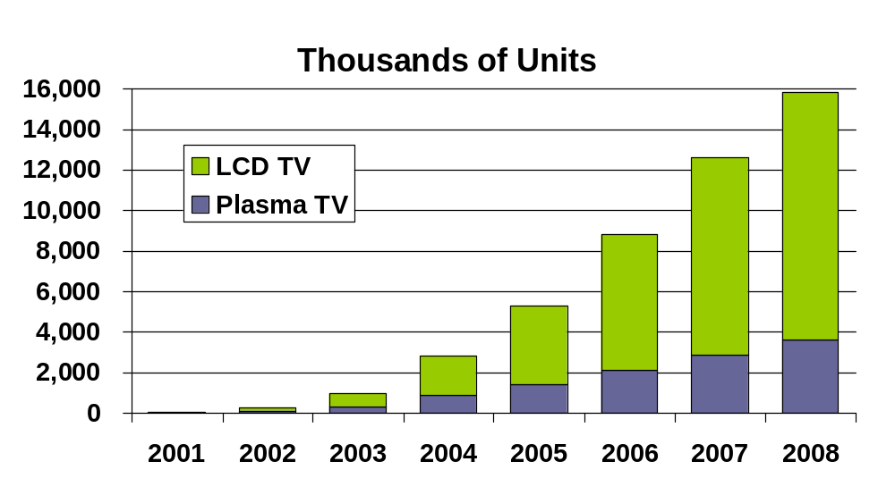
Digital Flat Panel Display Shipments

Slide 11

Growing Consumer Awareness

Slide 12
Awareness of Terms
87%
84%
82%
77%
79%
76%
73%
62%
61%
55%
45%
33%
1999
2001
2003
2005
Digital TV
High Definition
HDTV

Slide 13
Familiarity With Details About HDTV
76%
54%
27%
21%
1999
2001
2003
2005

Slide 14
CEA Consumer/Retailer Education
HDTV Guide
Consumer Brochure and DVD
Sales training materials for retailers
HDTV Updates
Public events and product placements

Slide 15

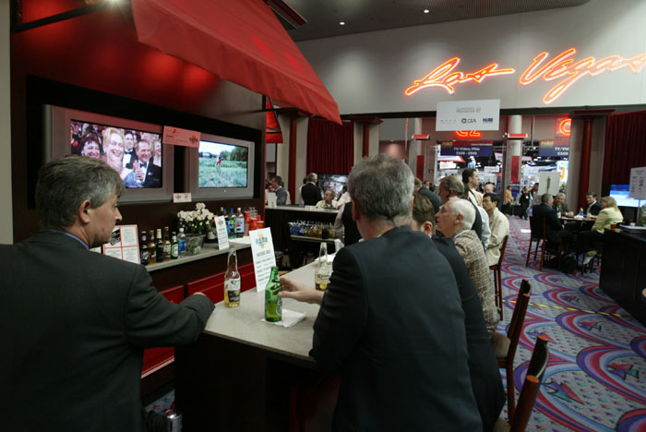
DTV Store and Drafthouse

Slide 16


Slide 17


Slide 18



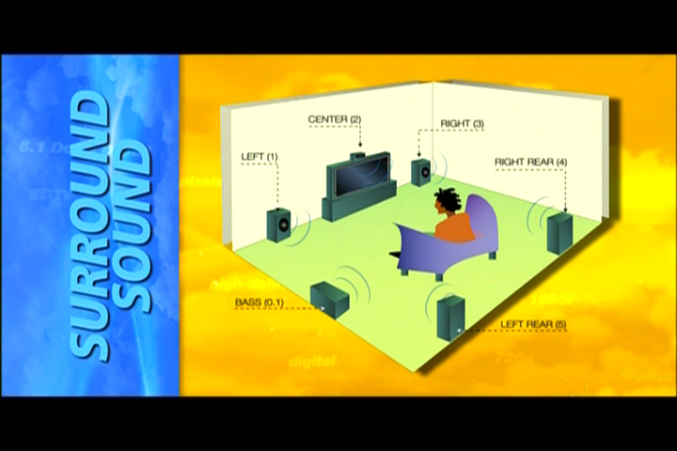

Slide 19

Retailer Training
www.ceknowhow.com

Slide 20


Slide 21
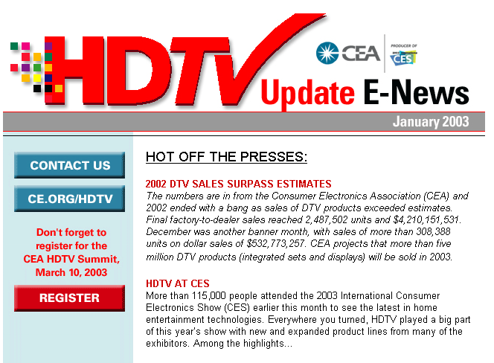
HDTV Update E-News

Slide 22
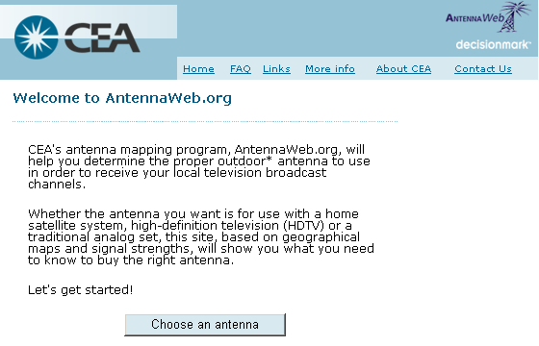
AntennaWeb.org

Slide 23

Notes:
Launching soon
www.ce.org/connectionsguide
Consumer tool to aide home theater set-up and component installation
CEA member companies can customize and post on own website

Slide 24
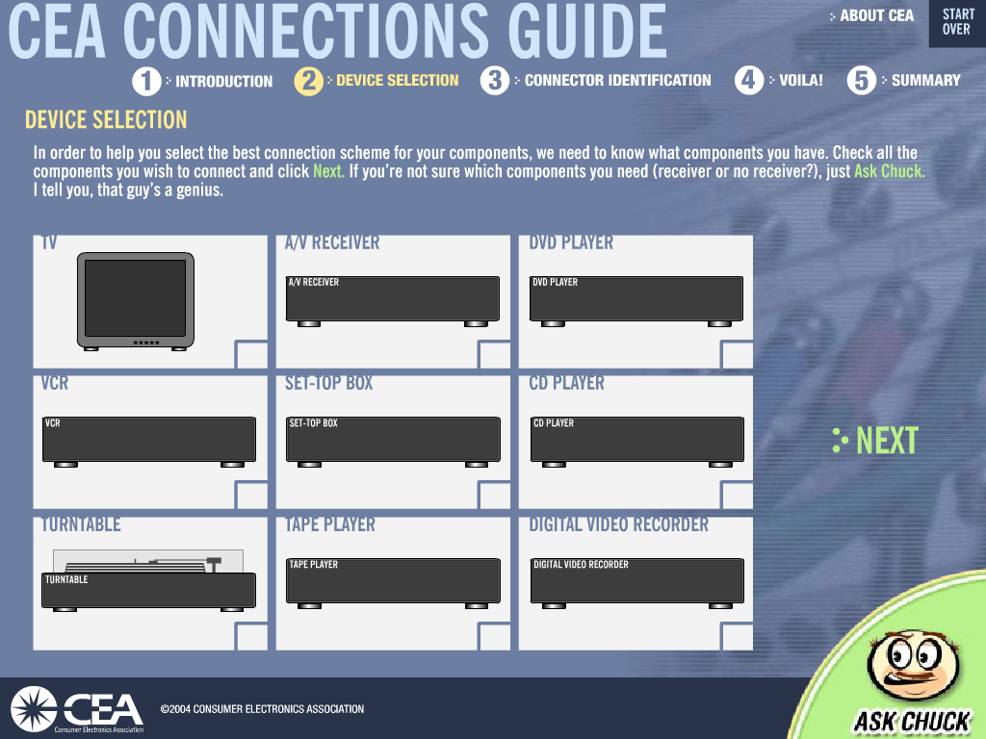

Slide 25
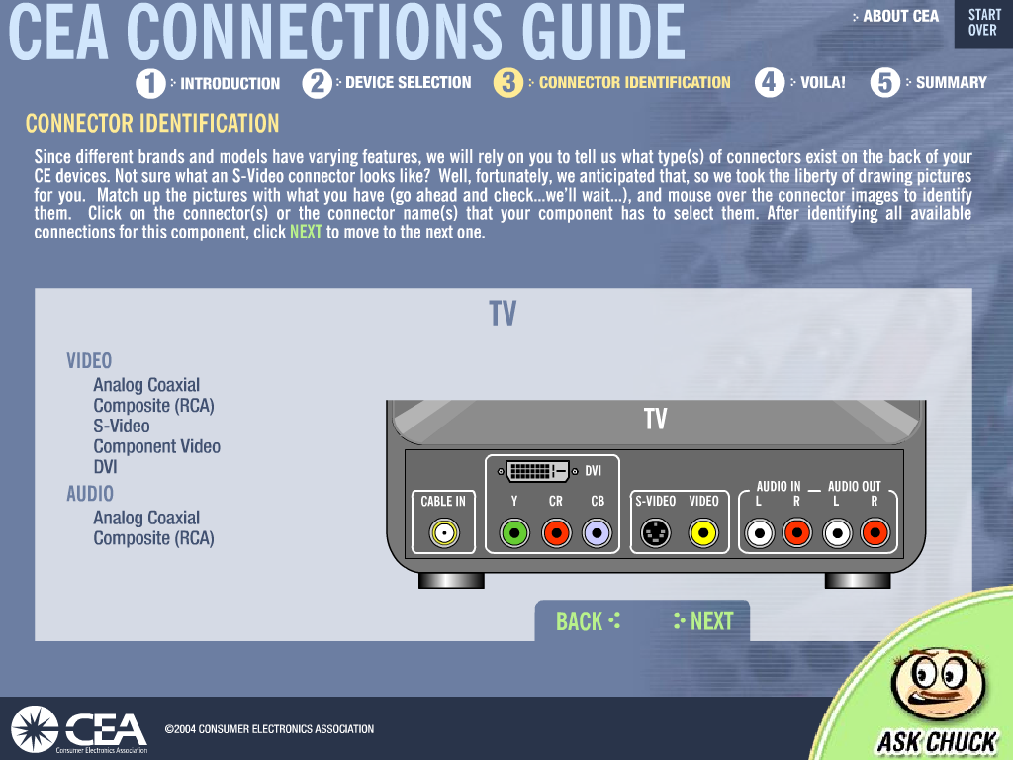

Slide 26
Summary
DTV market continues to gather momentum
Flat panel displays in the driver’s seat.
Falling prices helping to spur adoption.
Best years for DTV growth are ahead.
Promote and Educate!

Slide 27
HDTV: The End of the Road
Jeff Joseph
Vice President, Communications and Strategic Relationships
Consumer Electronics Association
April 19, 2005 NAB 2005 Las Vegas, Nev.

