Slide 1
Astro Crisis
A Game By:
Liam Barnard, Kreason Naidoo,
Shaherin Dehaloo and Muhammad Bassa

Slide 2
Objectives
Develop a c++ OpenGL 3D game
Utilize the skills attained in lectures

Slide 3
Objectives
Astro Crisis
Pays homage to “Asteroids” by Atari
3D space defense shooter
--brief explanation of gameplay--

Slide 4
Objectives
An engaging user experience
Increasing difficulty
Smooth gameplay
Dynamic NPC’s
Cohesive remote collaboration - GitHub

Slide 5
Features
Collision detection
multiple classes
ambient light,
basic keyboard and mouse controls
Explosion effects
Level progression
graphically represented objects
textures and model imports
asteroid split on death
sounds
Heads Up Display
Physics Engine
--Talk about why those features--

Slide 6
Strengths
Collision detection
Dynamic NPCs
Graphics
The Physics Engine

Slide 7
Limitations
Collision detection – interasteroid
Mouse Limitation
Importing of models
The state machine that is Open GL

Slide 8
Demonstration
Live demo with explanations

Slide 9
TBA
Explanation of extension and reasoning for it

Slide 10
World Fitness
Robustness of the code
Extensibility
Portability
Ease of deployment

Slide 11
Lessons Learnt
You will always need more classes
The compiler is your friend
Pointers are important
Stack overflow is a very real danger
Group co ordination is hard but easier with the right tools.
The project is never truly done.
Planning is absolutely key
And finally…

Slide 12
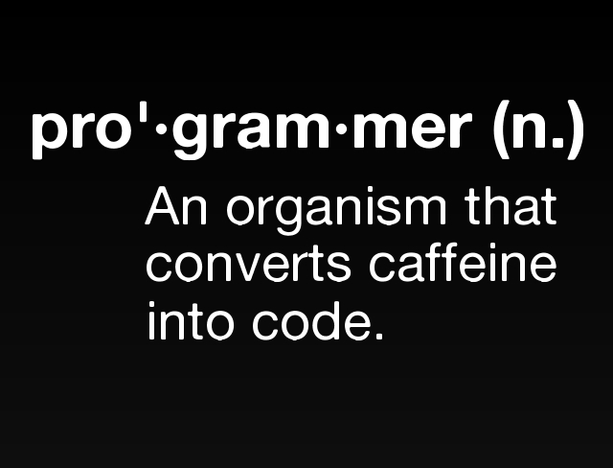
Lessons Learnt

