Slide 1
Temporal ReF-LLE: Personalized Low-Light Enhancement via Reference-Guided Deep Reinforcement Learning for low luminescence videos
Project Presentation

Slide 2
Team members
Anumeya Sehgal
Akshat Sinha
Joel dennis
Adibhatla sai prashanth

Slide 3
PROBLEM APPROACHED
Introduction to Low-Light Image Enhancement (LLIE)
Low-light image enhancement is an important computer vision problem because images captured under insufficient illumination often suffer from poor visibility, loss of detail, color distortion, and degraded perceptual quality. The ReF-LLE paper identifies two major challenges in LLIE: significant variations in low-light images under different conditions and the fact that the desired enhancement level is subjective and depends on user preferences. The goal is therefore not simply to produce one fixed enhancement result, but to adapt enhancement to different lighting conditions and preferred illumination levels. For video, this problem becomes harder because enhancement must also remain consistent across consecutive frames.
Source: ReF-LLE, Introduction and Abstract

Slide 4
BASE PAPER
ReF-LLE: Personalized Low-Light Enhancement via Reference-Guided Deep Reinforcement Learning
ReF-LLE proposes a personalized low-light image enhancement framework that combines Fourier frequency-domain processing with deep reinforcement learning. Low-light enhancement is treated as an iterative optimization of the Fourier amplitude component while preserving the phase component. During training, a zero-reference image evaluation strategy provides reward signals to guide the reinforcement learning agent. During inference, a personalized adaptive iterative strategy uses the Zero-Frequency Component (ZFC) as a prior for global illumination and progressively aligns the enhanced image with the illumination distribution of a user-provided reference image.
Ming Zhao, Pingping Liu, Tongshun Zhang, Zhe Zhang — ReF-LLE

Slide 5
MOTIVATION BEHIND REF-LLE
Fourier Frequency Domain + Deep Reinforcement Learning
The authors observe that luminance information in the Fourier domain is primarily reflected in the amplitude component. They further investigate the Zero-Frequency Component (ZFC) and observe a positive correlation between ZFC and overall image brightness. Based on these observations, ReF-LLE learns amplitude scaling strategies at each iteration instead of relying on a fixed point-to-point transformation. This enables an adaptive and personalized iterative process for low-light enhancement while using a user-provided reference image to guide the desired illumination level.
Key terms: Fourier amplitude component, Zero-Frequency Component (ZFC), adaptive personalized iterative strategy

Slide 6
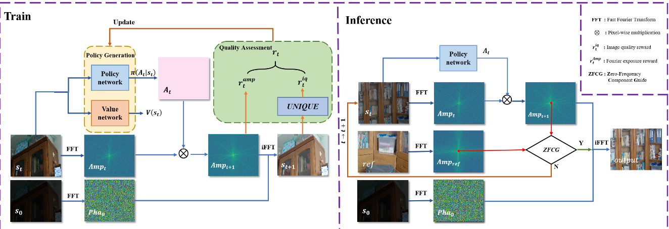
BASE PAPER ARCHITECTURE
ReF-LLE Overall Architecture — Training and Inference
INSERT BASE PAPER ARCHITECTURAL DIAGRAM HERE
Use Figure 3: “Overall architecture of the proposed ReF-LLE.”
Base paper Figure 3 — ReF-LLE training/inference architecture

Slide 7
POLICY GENERATION AND ACTION SPACE
A3C Policy Generation
Action Space Setting
ReF-LLE uses the A3C deep reinforcement learning framework. The A3C method contains a Policy Network and a Value Network. The Policy Network generates the enhancement strategy, while the Value Network estimates the long-term discounted reward V(s_t) for the current state. Together, they learn an enhancement policy that balances immediate rewards with future potential gains.
The network decides how to modulate the Fourier amplitude based on the current state s_t. The action is defined as A = e^α, with α ranging from −0.1 to 0.2 and a discretization step of 0.01. The action range is selected to balance enhancement flexibility against search-space size, computational complexity, and training difficulty.
Keywords from Section III-A and III-B of ReF-LLE

Slide 8
QUALITY ASSESSMENT AND REWARD
Image Quality Reward
Amplitude Exposure Reward
UNIQUE is used as a no-reference image quality assessment model. The quality reward measures the improvement between the current state and the original state:
The Amplitude Exposure Reward uses the Zero-Frequency Component (ZFC) to control the desired global exposure level. The two rewards are combined as the immediate reward:
rᵢqₜ = S(sₜ) − S(s₀)
rₜ = wᵢq rᵢqₜ − wₐₘₚ rₐₘₚₜ
Quality Assessment: UNIQUE + Amplitude Exposure Reward

Slide 9
ZERO-FREQUENCY COMPONENT GUIDE
Personalized Adaptive Iterative Strategy
The Zero-Frequency Component (ZFC) represents the sum or average light intensity of the pixels and directly reflects the overall brightness level. ReF-LLE adopts the ZFC as a prior for global illumination and adaptively iterates so that the Zero-Frequency Component of the enhanced state progressively aligns with the ZFC of the reference image. This provides a simple mechanism for controlling the personalized illumination level during inference.
zfcₜ → zfcᵣₑ𝚏
Key term: Zero-Frequency Component (ZFC) Guide

Slide 10
RESEARCH GAP
From Low-Light Image Enhancement to Low-Luminescence Videos
ReF-LLE provides an image-level deep reinforcement learning framework for personalized LLIE. Its state, enhancement action, and quality assessment are formulated around the current image and its iterative enhancement. When low-light video is processed frame by frame, consecutive frames may receive slightly different enhancement decisions. Even when individual frames have good perceptual quality, the sequence can therefore exhibit unwanted brightness variation, color fluctuation, or temporal flickering. Our research gap is to extend the ReF-LLE framework with temporal information so that enhancement quality and frame-to-frame consistency are considered together.
Proposed research gap — extension of the published image-level framework to video

Slide 11
OUR IMPROVEMENT
Temporal Consistency-Aware ReF-LLE
Our proposed improvement retains the central terminology and formulation of ReF-LLE—Fourier frequency-domain enhancement, amplitude optimization, A3C Policy Network, Value Network, UNIQUE, Image Quality Reward, Amplitude Exposure Reward, and Zero-Frequency Component guidance—but extends the state from an individual image to a sequence-aware representation. Instead of considering only the current frame, the reinforcement learning agent also receives information from the previous frame and can optionally use motion information. The objective becomes to improve the current frame while maintaining consistency with the temporal context.
sₜ = (Iₜ, Iₜ₋₁) or sₜ = (Iₜ, Iₜ₋₁, Fₜ)
Proposed extension — temporal state added to the ReF-LLE formulation

Slide 12
OUR ADDED APPROACH
Proposed Temporal Consistency-Aware ReF-LLE Architecture
INSERT OUR ADDED ARCHITECTURAL
APPROACH HERE
Suggested additions: previous-frame state + motion information + temporal consistency reward
Leave this space for the final proposed architecture diagram

Slide 13
PROPOSED TEMPORAL CONSISTENCY REWARD
Extending the Quality Assessment
The original ReF-LLE reward combines the Image Quality Reward and Amplitude Exposure Reward. Our proposed extension introduces a third component, the Temporal Consistency Reward, to discourage unnecessary variation between consecutive enhanced frames. The agent therefore learns to balance spatial enhancement quality, desired exposure, and temporal stability.
rₜ = wᵢq rᵢqₜ − wₐₘₚ rₐₘₚₜ − wₜc rₜcₜ
rₜcₜ : measures undesirable frame-to-frame variation; motion compensation can be added using optical flow.

Slide 14
FUTURE APPROACH
Implementation Roadmap
Evaluation
First, reproduce the ReF-LLE baseline, including Fourier transform, amplitude/phase decomposition, A3C Policy and Value Networks, UNIQUE, Amplitude Exposure Reward, and ZFC-guided inference. Next, convert the input pipeline from independent images to sequential video frames. Then introduce the temporal state, add the Temporal Consistency Reward, and investigate motion-aware comparison using optical flow. Finally, compare the original image-based strategy, frame-wise enhancement, and the proposed temporal approach.
The evaluation will preserve the metrics reported in ReF-LLE—PSNR, PSNRy, SSIM, LPIPS, and NIQE—while adding video-oriented measures of temporal consistency and flicker reduction. The key comparison is whether temporal information can reduce unwanted frame-to-frame variation without sacrificing low-light enhancement quality. Qualitative evaluation will focus on brightness stability, color consistency, detail preservation, and overall perceptual quality across video sequences.
Base-paper metrics: PSNR, PSNRy, SSIM, LPIPS, NIQE; proposed addition: temporal consistency / flicker

Slide 15
SUMMARY
ReF-LLE Foundation
Our Proposed Direction
ReF-LLE combines Fourier frequency-domain processing with deep reinforcement learning for personalized LLIE. The framework optimizes the Fourier amplitude component, uses A3C Policy and Value Networks, obtains feedback through zero-reference image quality assessment, and uses the Zero-Frequency Component to guide personalized global illumination.
Our project extends this foundation from low-light image enhancement to low-luminescence video enhancement. The key addition is temporal awareness: previous-frame information and a temporal consistency objective are introduced into the reinforcement learning formulation so that enhanced frames remain visually stable over time.
Project objective: personalized enhancement + temporal consistency for low-luminescence videos

Slide 16
THANK YOU

