Slide 1
Bring ROAR to Life
TEAM 1

Slide 2
The goal of Bring ROAR to Life is to design and create an anatomically accurate Stegosaurus that is able to walk and interact with its environment in a lifelike manner
Our end goal of an ideal project will be to provide an educational resource for museums in general

Slide 3
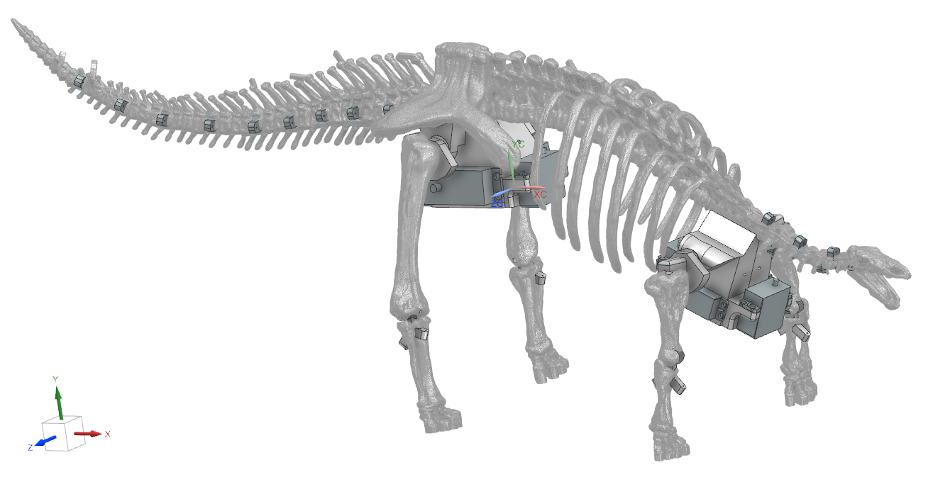
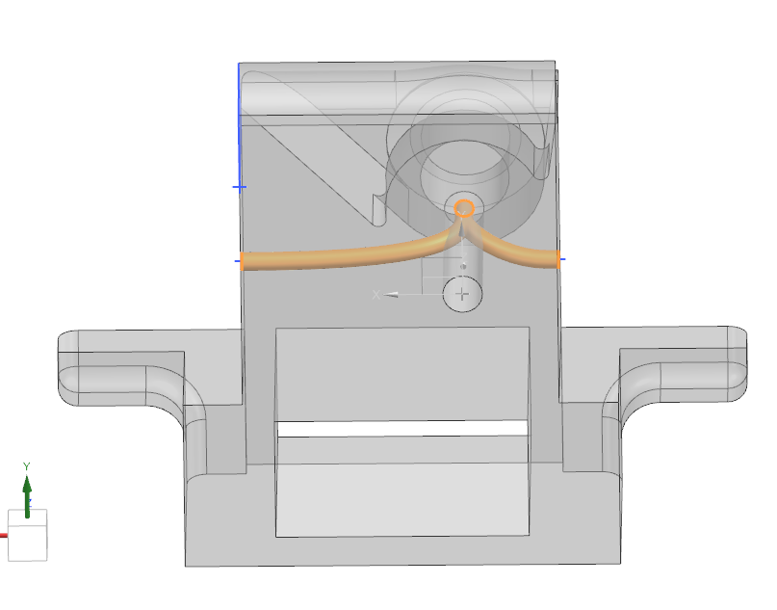
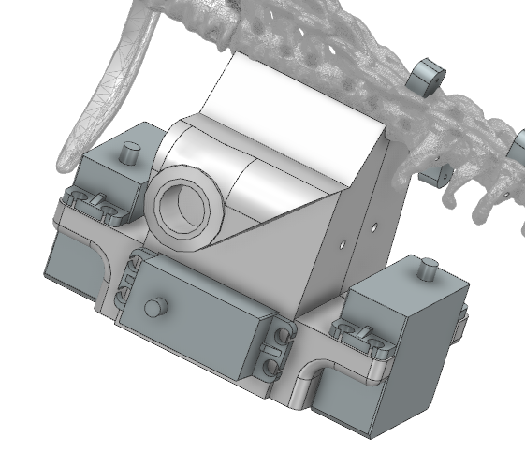
3D Modeling
Gait Study
Electrical System
Control System
3D Modeling
Current layout with primary motor placement.
Largely based on 3D scan data with mechanical components added to the existing structure.
Femur and Upper arms feature capstan drives, tibias and forearms use remote cables/ motors.

Slide 4
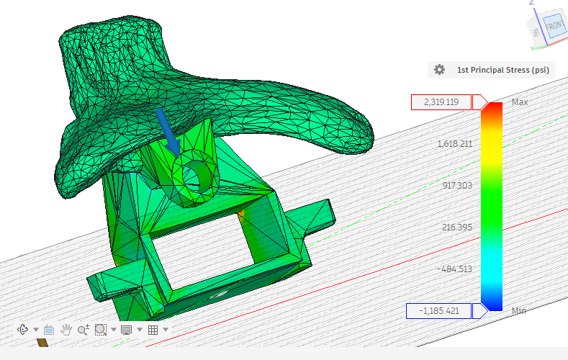
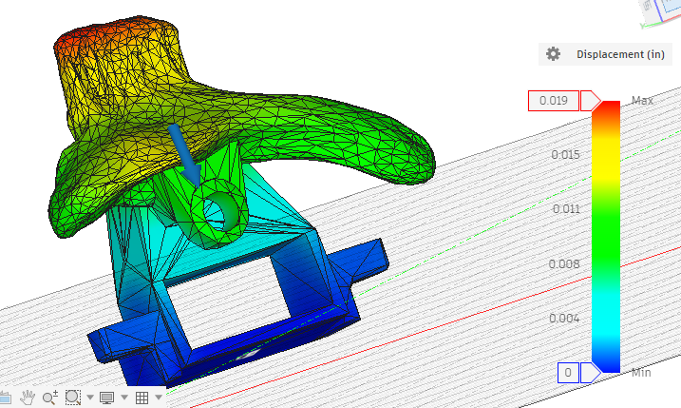
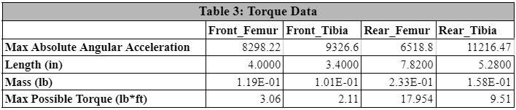
3D Modeling
Gait Study
Electrical System
Control System
3D Modeling
Light FEA was run to get baseline estimates for strength.
Based off maximum motor stall torque.
Limb torque calculations based off gait study and maximum angular acceleration in joints

Slide 5
3D Modeling
Gait Study
Electrical System
Control System
Electronics Packaging
This housing will fit under the ribcage
The housing for the electronics is approximately 5.2in. x 4.5in. x 3in
Many components are fitted precisely into a tight space
The cover will be connected to the dinosaur’s spine, and the housing will be connected to the cover
Some components will be bolted into the housing, and other components will be free floating in their designated space
Cutouts were made so that wires can go out of the housing and into the motors

Slide 6
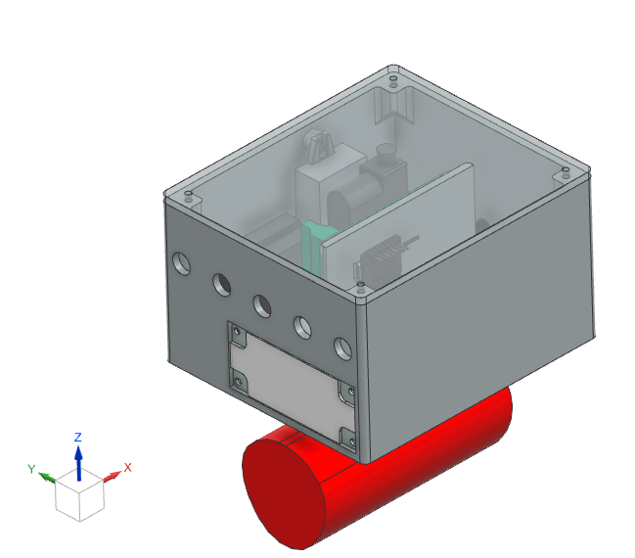
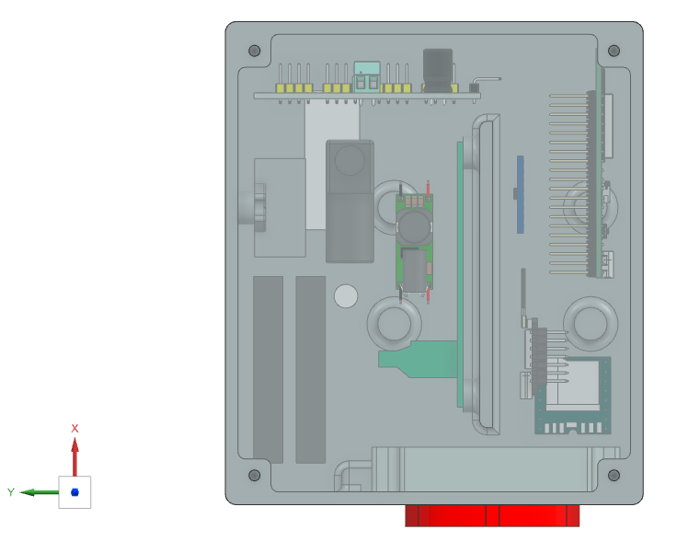
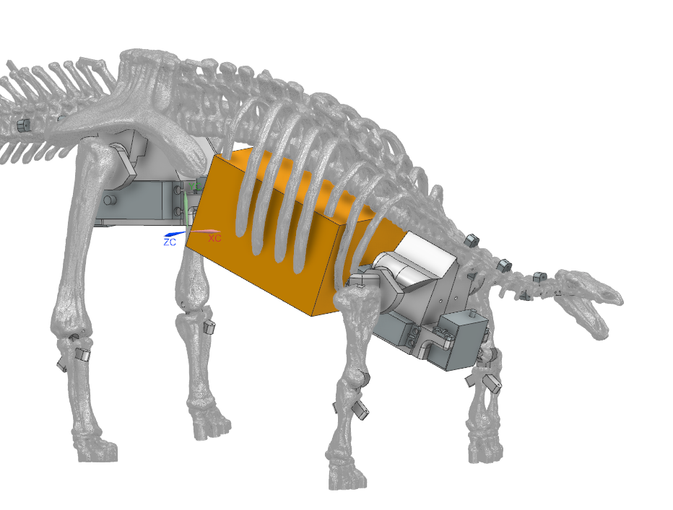
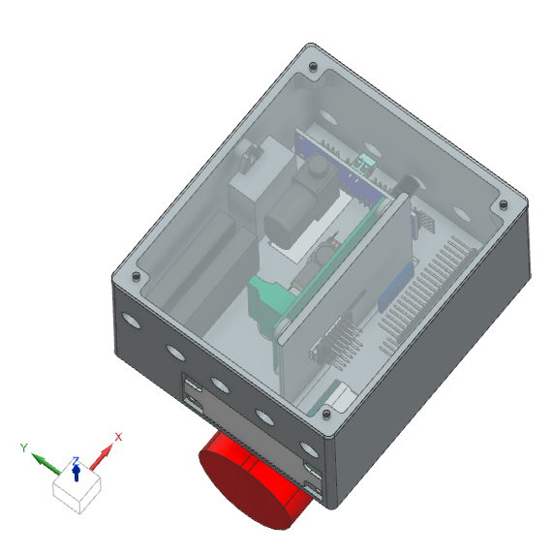
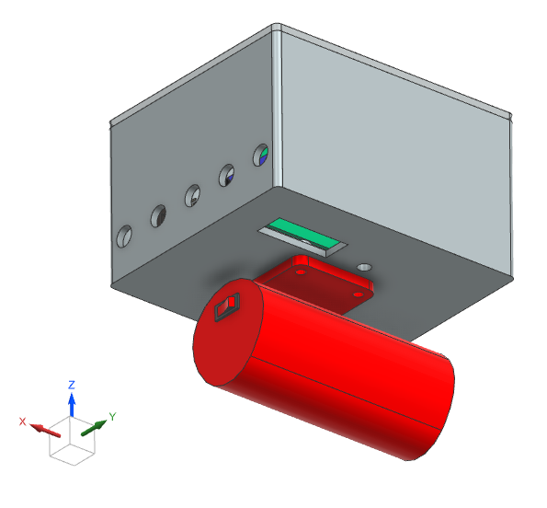
3D Modeling
Gait Study
Electrical System
Control System
Electronics Packaging

Slide 7
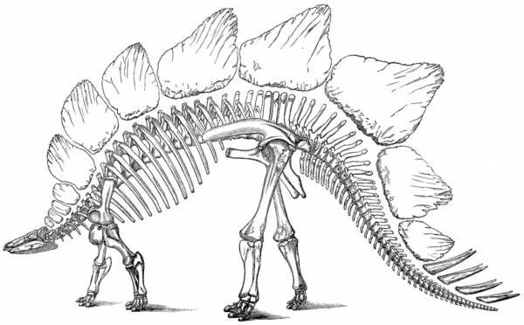
Modeling & Analysis
Gait Study
Electrical System
Control System
Gait Study

Slide 8
Modeling & Analysis
Gait Study
Electrical System
Control System
Gait Study
Front Leg Joint Angles
Stride Status | Gait Percent | Hip Angle | Knee Angle
Heel Touch | 0% | 135° | 150°
Full Load | 50% | 115° | 210°
Toe Off | 65% | 105° | 150°
Leg Swing_1 | 75% | 70° | 100°
Leg Swing 2 | 85% | 120° | 95°
Heel Touch | 100% | 135° | 150°
Rear Leg Joint Angles
Stride Status | Gait Percent | Hip Angle | Knee Angle
Heel Touch | 0% | 75° | 160°
Full Load | 50% | 90° | 175°
Toe Off | 65% | 100° | 160°
Leg Swing 1 | 75% | 110° | 150°
Leg Swing 2 | 85% | 95° | 130°
Heel Touch | 100% | 75° | 160°

Slide 9
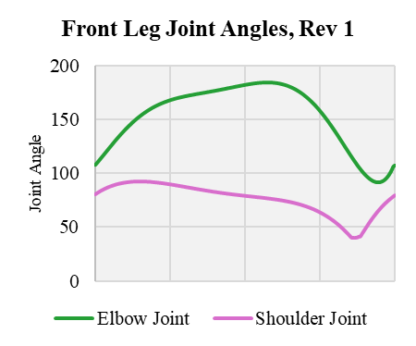
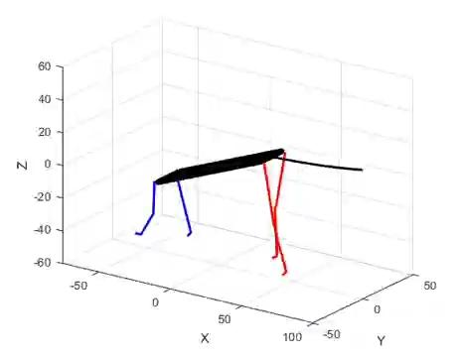
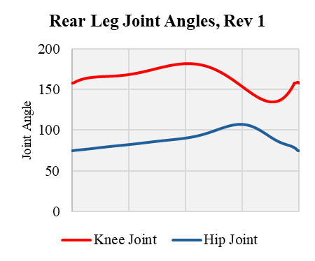
Modeling & Analysis
Gait Study
Electrical System
Control System
Gait Study

Slide 10
Gait Study
3D Modeling
Electrical System
Control System
ITEM NO. | SUBSYSTEM | COMPONENT | QTY
1 | Power | Milwaukee M12 Battery | 1
2 | Power | Battery Adapter | 1
3 | Power | Switch | 1
4 | Power | Fuse | 1
5 | Power | Low Voltage Cutoff Board (30A) | 1
6 | Power | BusBar | 2
7 | Motor | 2-8S LiPo UBEC-8A For 5 Servos Motors | 2
8 | Motor | DS5180 High‑Torque Servo - 80Kg servo | 2
9 | Motor | DS3230MG Servo - 30Kg servo | 6
10 | Motor | 5V 3A Low Volt Buck Converter | 1
11 | Motor | 5V 3A Buck Converter USB-C | 1
12 | Motor | PCA9685 16‑Ch Servo Driver | 1
13 | Control | ESP32-S3-WROOM-U1 | 1
14 | Control | Antenna | 1
15 | Motor | Micro Linear Servo | 5
16 | Motor | Goteck 1.5g Micro Digital Linear Servo Actuator | 1
17 | Audio | 3W 8Ω Speaker | 1
18 | Audio | DFPlayer Mini MP3 | 1
19 | Control | MCP9808 Temp Sensor | 1
20 | Control | GY-NEO6MV2 NEO-6M GPS Module | 1
21 | Control | Additional GY‑521 IMUs | 1
WIRING DIAGRAM
9
8
6
7
9
2
8
1
4
5
9
3
7
6
9
10
9
11
9
12
15
15
13
15
15
17
15
18
14
16
19
20
21
PARTS NOT TO SCALE

Slide 11
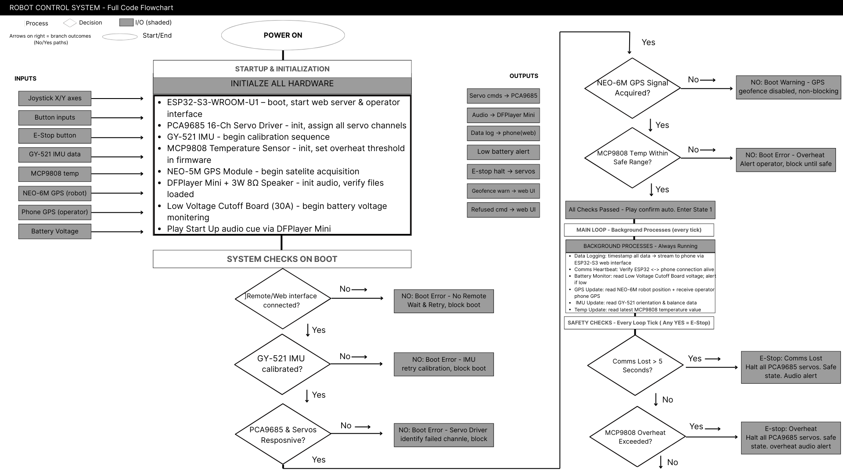
Control System
Modeling & Analysis
Gait Study
Electrical System

Slide 12
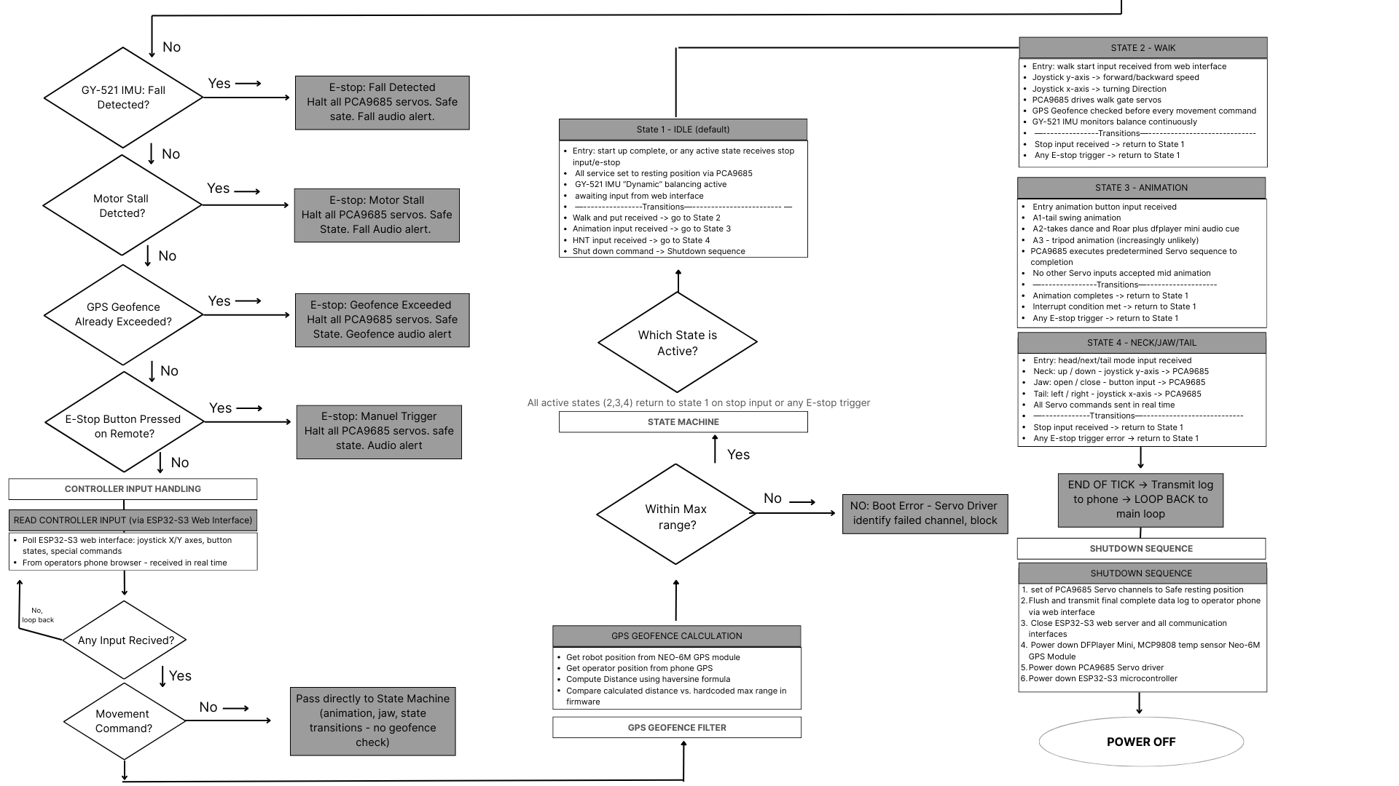
Control System
Modeling & Analysis
Gait Study
Electrical System

Slide 13
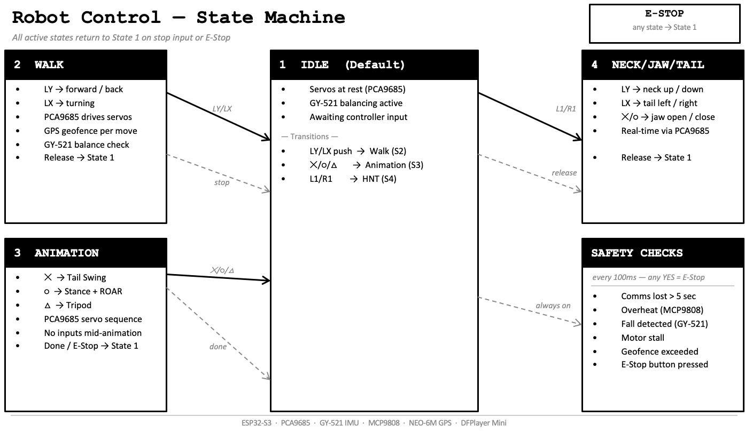
Control System
Modeling & Analysis
Gait Study
Electrical System

Slide 14
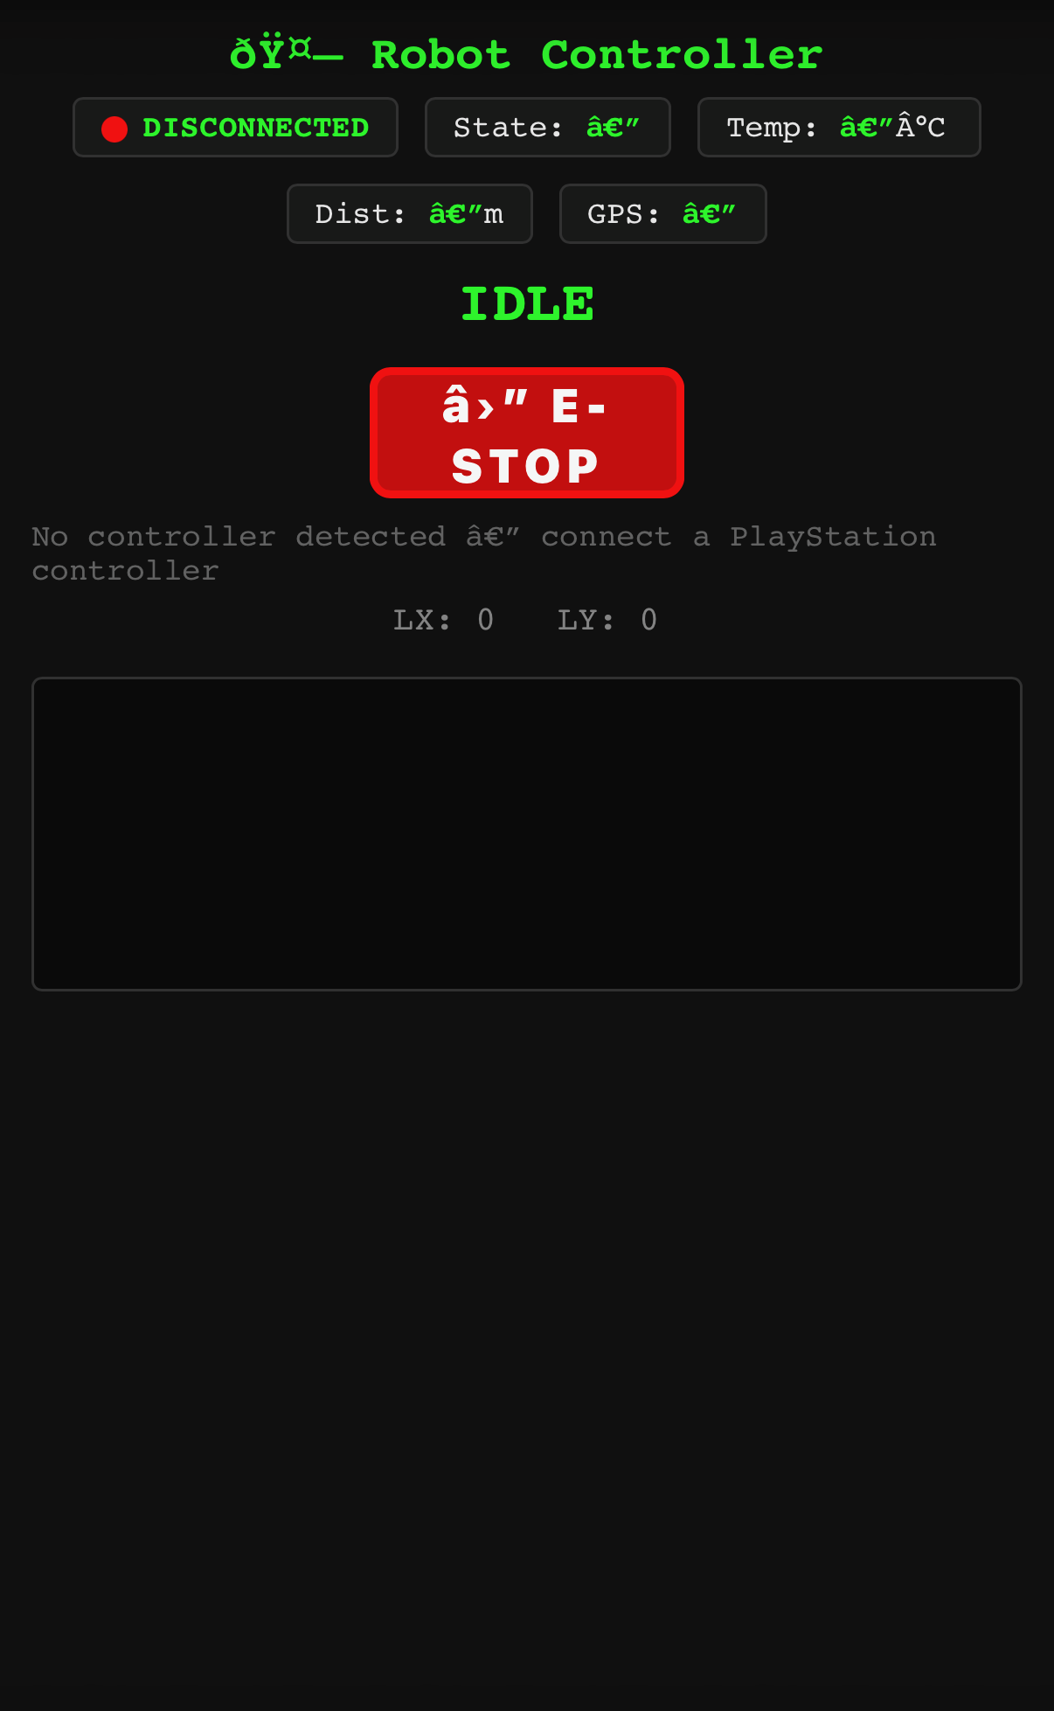
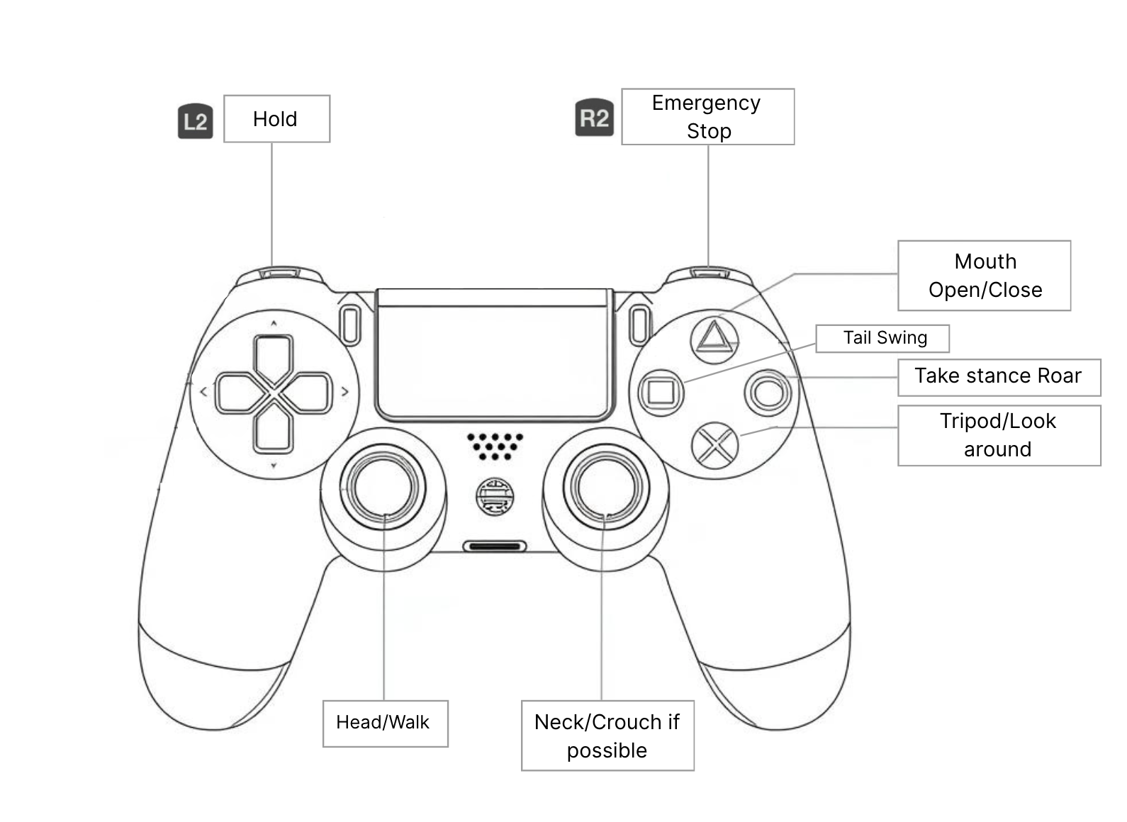
Control System
Modeling & Analysis
Gait Study
Electrical System
Tentative Proposed Controller Layout
Tentative
The visual design is subject to change

Slide 15
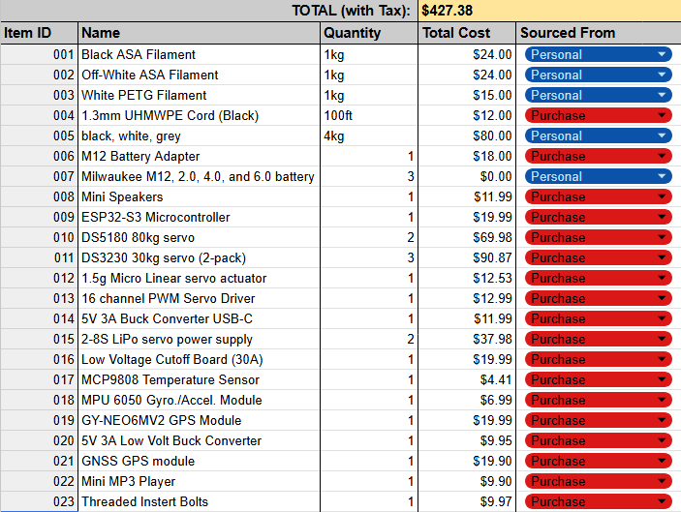
FMEA
Finances
F
Finances
Approved budget: $530.00
Budget used: $427.38
Amount Remaining: $102.62

Slide 16
Thank you!

