Slide 1
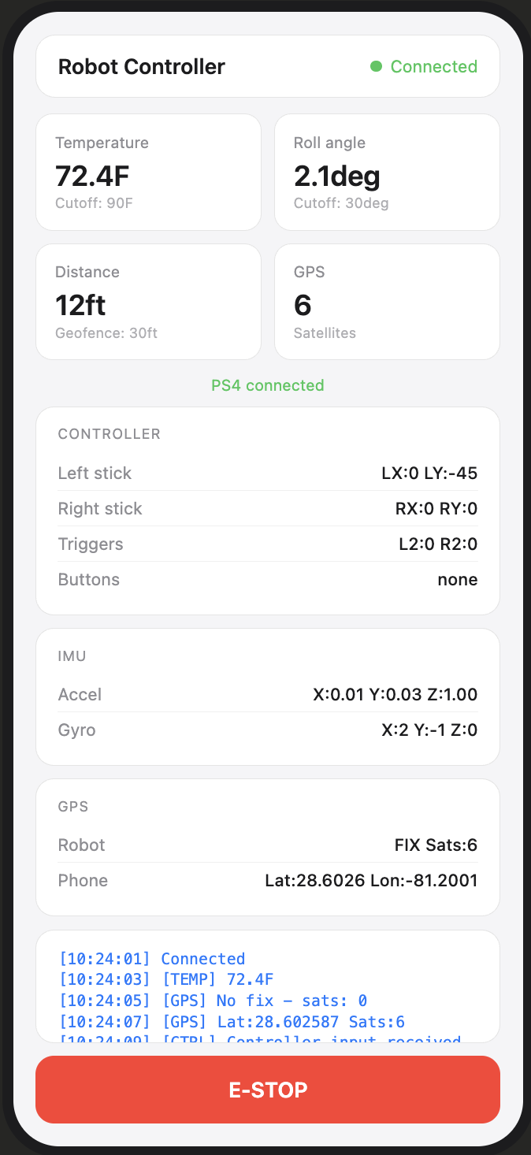
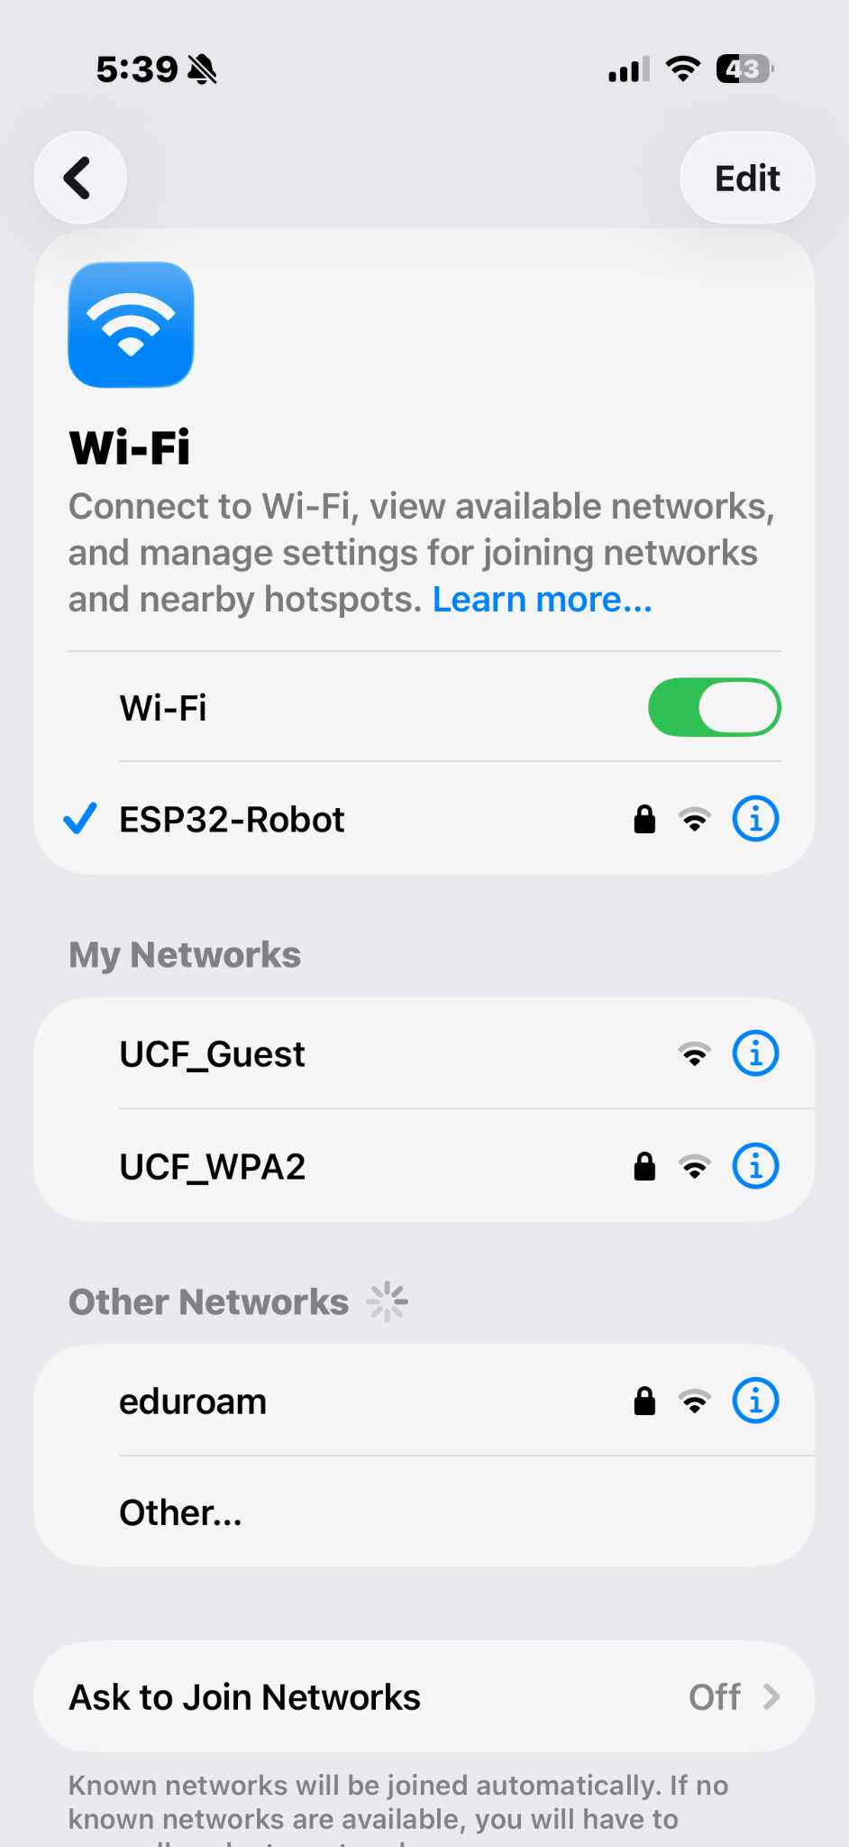
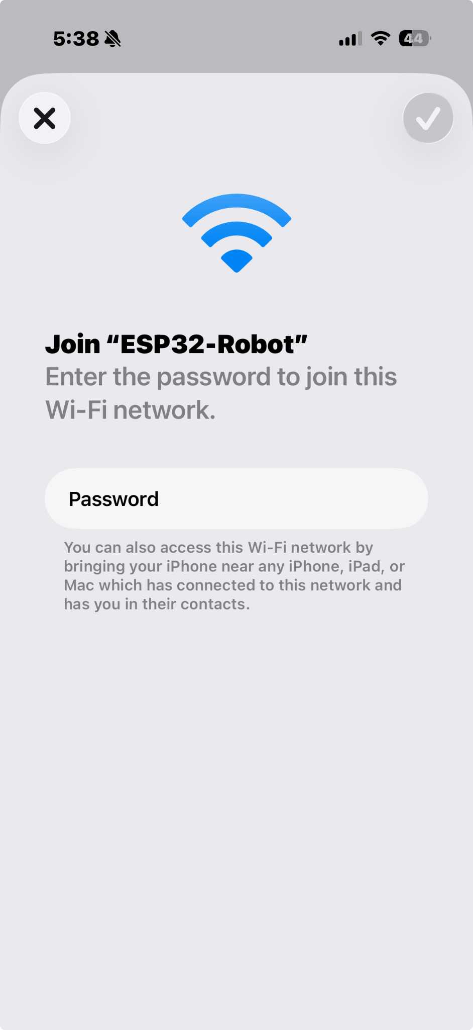
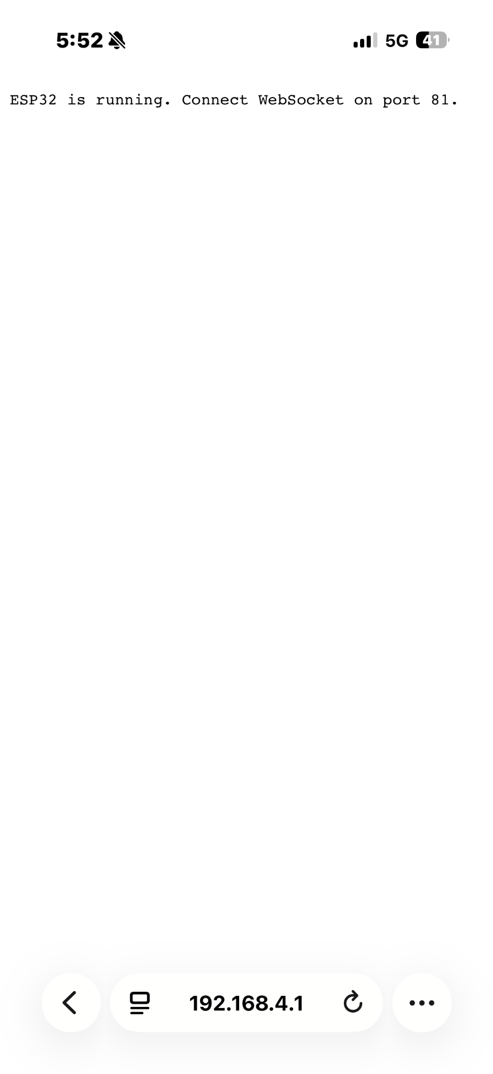
USER INTERFACE

Slide 2
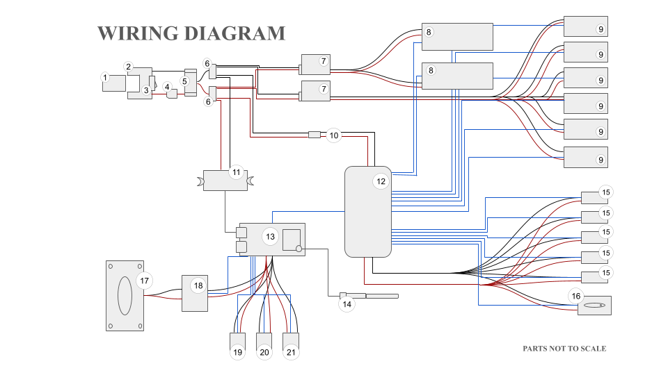

Slide 3
ITEM NO. | SUBSYSTEM | COMPONENT | QTY
1 | Power | Milwaukee M12 Battery | 1
2 | Power | Battery Adapter | 1
3 | Power | Switch | 1
4 | Power | Fuse | 1
5 | Power | Low Voltage Cutoff Board (30A) | 1
6 | Power | BusBar | 2
7 | Motor | 2-8S LiPo UBEC-8A For 5 Servos Motors | 2
8 | Motor | DS5180 High‑Torque Servo - 80Kg servo | 2
9 | Motor | DS3230MG Servo - 30Kg servo | 6
10 | Motor | 5V 3A Low Volt Buck Converter | 1
11 | Motor | 5V 3A Buck Converter USB-C | 1
12 | Motor | PCA9685 16‑Ch Servo Driver | 1
13 | Control | ESP32-S3-WROOM-U1 | 1
14 | Control | Antenna | 1
15 | Motor | Micro Linear Servo | 5
16 | Motor | Goteck 1.5g Micro Digital Linear Servo Actuator | 1
17 | Audio | 3W 8Ω Speaker | 1
18 | Audio | DFPlayer Mini MP3 | 1
19 | Control | MCP9808 Temp Sensor | 1
20 | Control | GY-NEO6MV2 NEO-6M GPS Module | 1
21 | Control | Additional GY‑521 IMUs | 1

