Slide 1
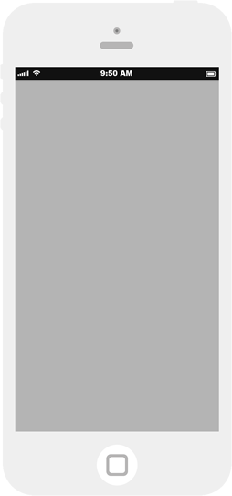
1
Tasks are typed into the input line. Multi-line tasks are accepted.
ToDos
What needs to be done?
1
Double-click a ToDo item to edit it
Created by James Thomas and Ed Chatelain
Part of TodoMVC

Slide 2
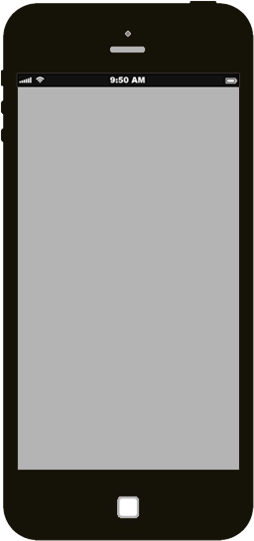
1
Tasks are typed into the input line. Multi-line tasks are accepted.
ToDos
What needs to be done?
1
Double-click a ToDo item to edit it
Created by James Thomas and Ed Chatelain
Part of TodoMVC

Slide 3
1
New task appended to the ToDo list
2
Status bar shows the number of currently active items.
All ToDo items are being displayed indicated by bold text: All
Grey checkmark to the left of task indicates task is active.
ToDos
What needs to be done?
First task
1
2
1 item left All Active Completed
Double-click a ToDo item to edit it
Created by James Thomas and Ed Chatelain
Part of TodoMVC

Slide 4
1
As new tasks are added the active item count updates
ToDos
What needs to be done?
First task
Second task
Third task
1 Item Left All Active Completed
1
3 items left All Active Completed
Double-click a ToDo item to edit it
Created by James Thomas and Ed Chatelain
Part of TodoMVC

Slide 5
1
Complete a task by clicking on the light grey check mark.
The green checkmark and crossed out task text indicate the task is complete.
If there are any completed tasks, the Clear Completed status item appears.
ToDos
2
What needs to be done?
1
First task
Second task
Third task
1 Item Left All Active Completed
2
2 items left All Active Completed Clear Completed (1)
Double-click a ToDo item to edit it
Created by James Thomas and Ed Chatelain
Part of TodoMVC

Slide 6
1
Click on the word “Completed” on the status line to view completed tasks only. Note: Text is bolded to indicate current view selection.
ToDos
What needs to be done?
First task
1
2 item left All Active Completed Clear Completed (1)
Double-click a ToDo item to edit it
Created by James Thomas and Ed Chatelain
Part of TodoMVC

Slide 7
1
Click on the word “Active” on the status line to view Active tasks only. Note: Text is bolded to indicate current view selection.
ToDos
What needs to be done?
Second task
Third task
2 items left All Active Completed Clear Completed (1)
1
Double-click a ToDo item to edit it
Created by James Thomas and Ed Chatelain
Part of TodoMVC

Slide 8
1
All is selected in the status line (click) so both completed and active tasks are displayed.
ToDos
What needs to be done?
First task
Second task
Third task
1 Item Left All Active Completed
2 items left All Active Completed Clear Completed (1)
1
Double-click a ToDo item to edit it
Created by James Thomas and Ed Chatelain
Part of TodoMVC

Slide 9
1
Click on the checkbox in the input task line to complete all tasks. Click again to toggle all tasks from complete to active.
ToDos
1
What needs to be done?
First task
Second task
Third task
1 Item Left All Active Completed
0 items left All Active Completed Clear Completed (3)
Double-click a ToDo item to edit it
Created by James Thomas and Ed Chatelain
Part of TodoMVC

Slide 10
1
Click on a the checkmark to the left of a class to toggle its status.
2
Click anywhere on a task and the red X appears.
Click on the X to delete the task.
ToDos
What needs to be done?
First task
Second task
Third task X
1
2
1 Item Left All Active Completed
1 item left All Active Completed Clear Completed (2)
Double-click a ToDo item to edit it
Created by James Thomas and Ed Chatelain
Part of TodoMVC

Slide 11
1
“All” is selected but the “Third task” is not displayed because it has been deleted.
2
Click on Clear Completed to delete all completed tasks.
ToDos
What needs to be done?
First task
Second task
2
0 items left All Active Completed Clear Completed (2)
Double-click a ToDo item to edit it
Created by James Thomas and Ed Chatelain
Part of TodoMVC

Slide 12
ToDos
What needs to be done?
Double-click a ToDo item to edit it
Created by James Thomas and Ed Chatelain
Part of TodoMVC

