Slide 2
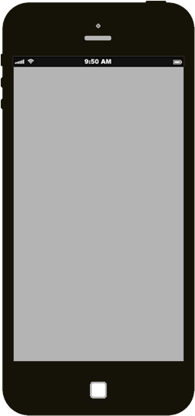
1
Tasks are typed into the input line. Multi-line tasks are accepted.
ToDos
What needs to be done?
1
Double-click a ToDo item to edit it
Created by James Thomas and Ed Chatelain
Part of TodoMVC

