Slide 1
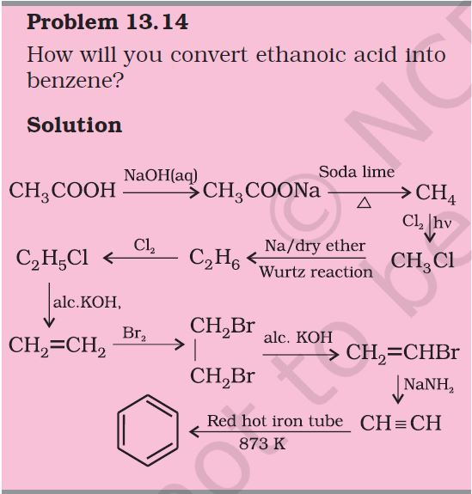
-1-
PYTHON: PROJECT REPORT
Dijkstra’s Shortest path Algorithm for finding Reaction Path for Hydrocarbons
Kreetik Thakur, Samyak Gupta & Aditya Sharma
The problem we chose to solve
On page 396 on the 2nd part of the 11th Grade Chemistry NCERT book, we find the following question that asks us to convert ethanoic acid into benzene using the reactions that we have learned throughout the chapter. The convoluted mess that follows strikes fear in the heart of so many students that we went to ask our Chemistry teacher, Akanksha ma’am if we should be prepared for such a difficult question. She reassured us that the answer was no and that the question is too difficult, even for the average topper. Having the foresight to guess what organic compound leads to what to reach the end product is incredibly difficult, even with a list of reactions before us.
Thus, we decided to find a way to solve any problem of the kind using some simple python code
Figure.1: Super difficult NCERT question
Our solution?
Convert ALL the formulas of the chapter into a Node-based Graph
Ask the user for the reacting compound
Ask the user what compound they want as a product
Use an efficient shortest path finding algorithm to find the solution
Display the path to the user.
01
02
03
04
05

Slide 2
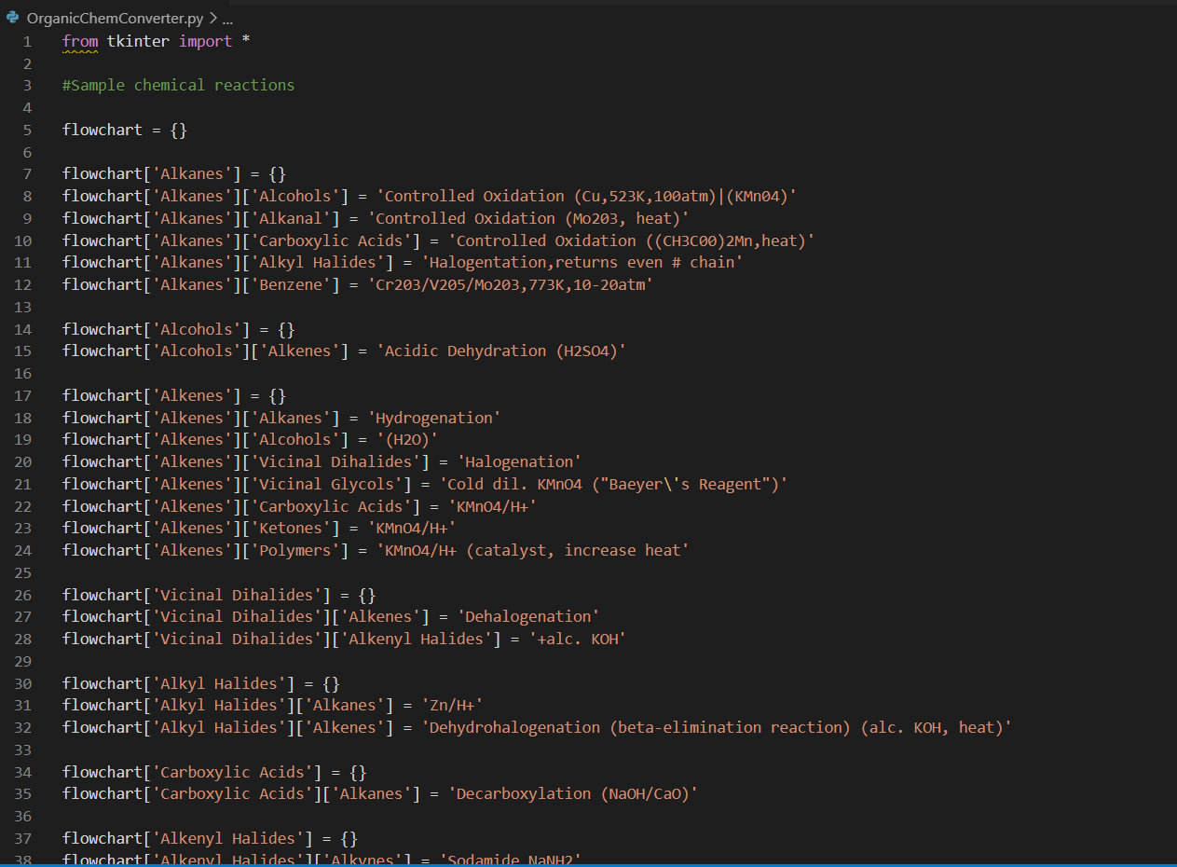
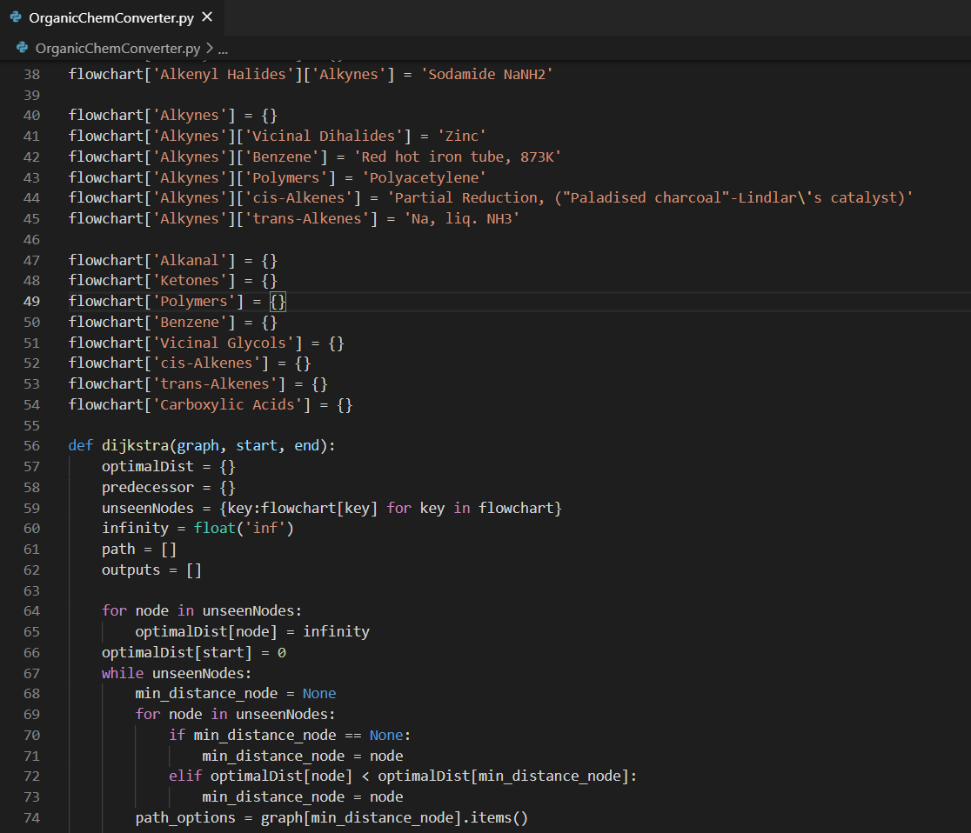
-2-
THE CODE

Slide 3
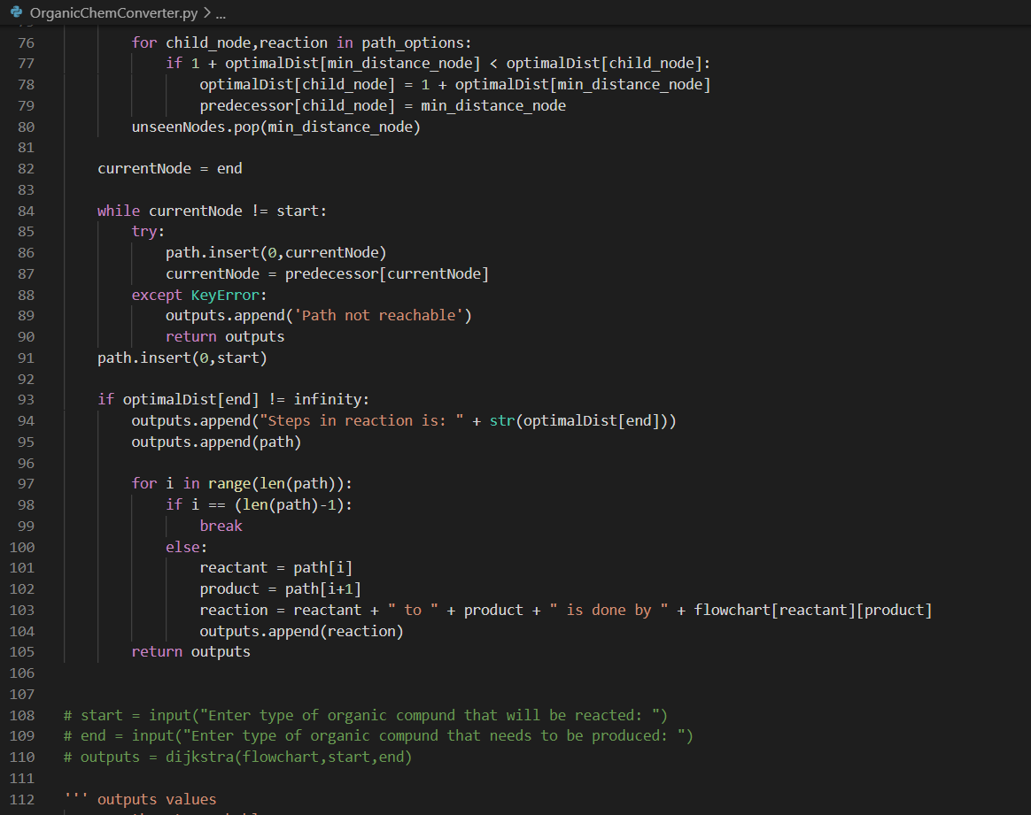
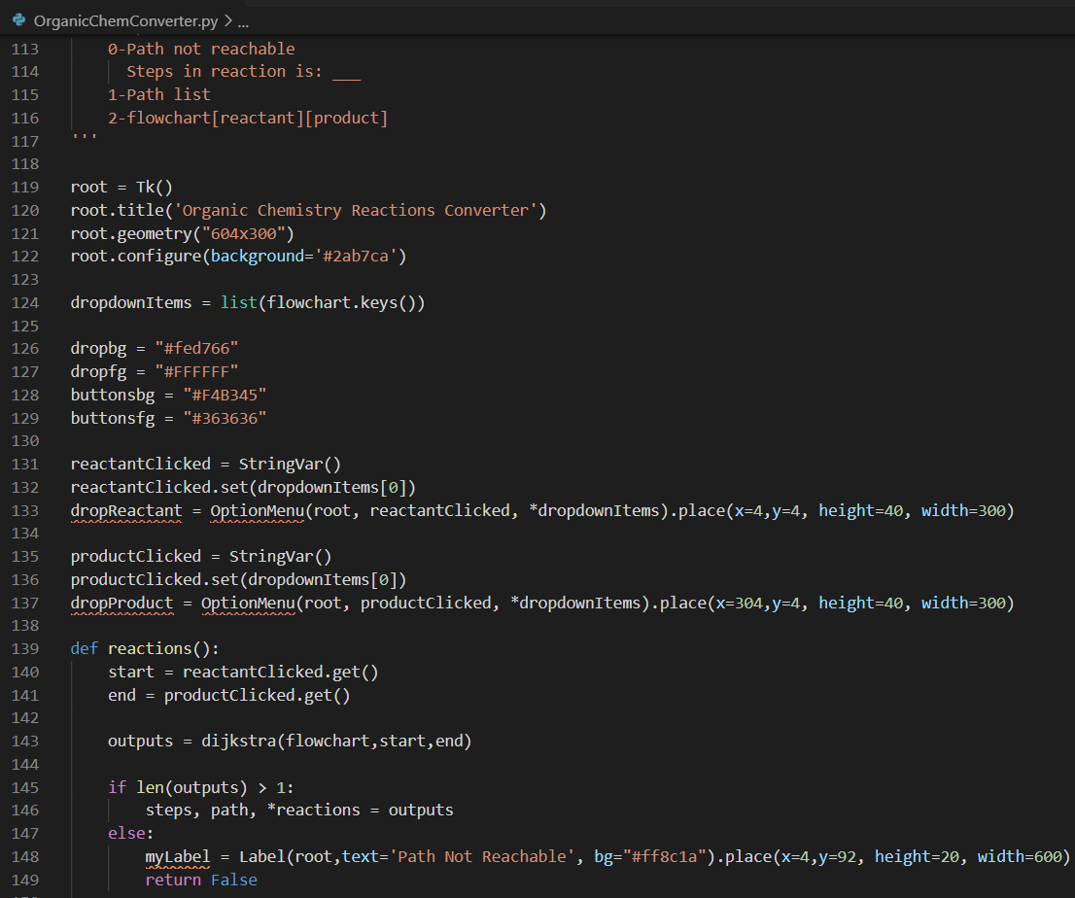
-2-

Slide 4
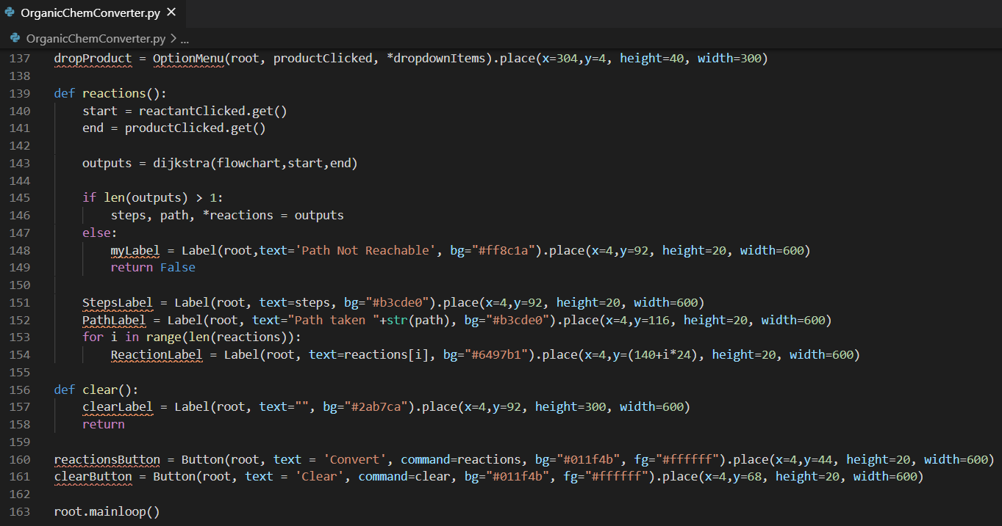
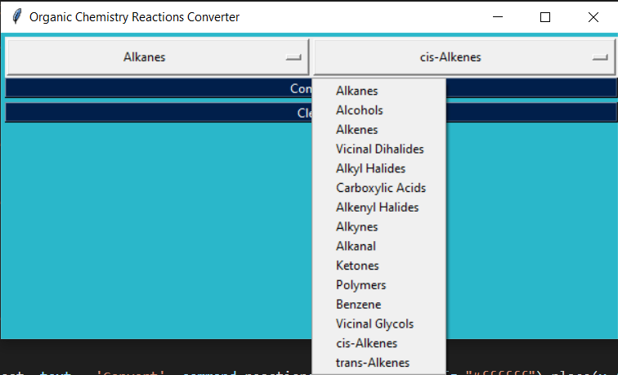
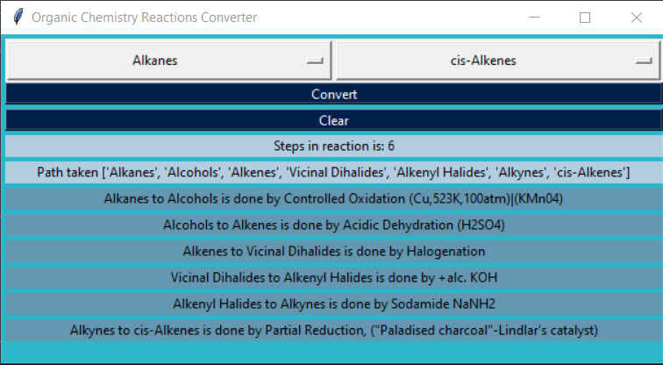
-3-
-3-
THE OUTPUT

Slide 5
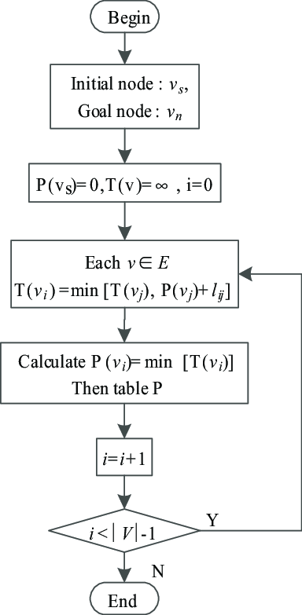
-3-
THE FLOWCHART
P(Vs) : Previous node column
T(v) : Distance from Vs
i: Seen Nodes
Diagram Source: https://www.researchgate.net/figure/Flowchart-of-the-Dijkstra-algorithm_fig1_327982778

Slide 6
-4-
ACKNOWLEDGEMENTS
We’d like to start by thanking CBSE for providing us with the prerequisite knowledge to formulate the question, Akanksha ma’am for explaining the solution and reassuring us that we wouldn’t have to prepare it for the exams.
We’d also like to thank Neha ma’am and Kirti Ma’am for helping us develop better logical and problem solving minds that allowed us to think and find a solution to the problem.
Lastly, we’d like to thank Edsger W. Dijkstra (1930-2002), for coming up with such an elegant solution that continues finding applications even today.

