Slide 1

User Journeys
Logging In
Setting up Services
Adding a Customer
Adding an Appointment
Confirming payment
Accessing Appointment Summary Report
Notes:
All user journeys from ‘Setting up Services’, presume user is logged in
Document is intended to provide an overview of the application

Slide 2
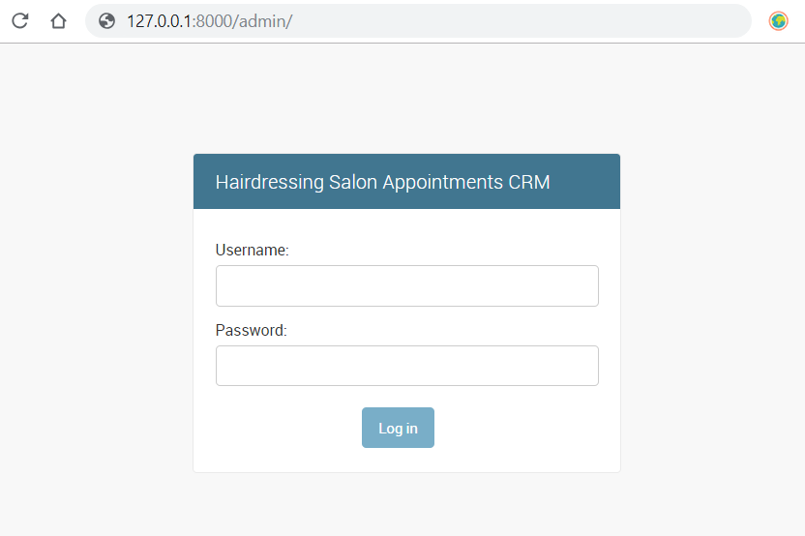
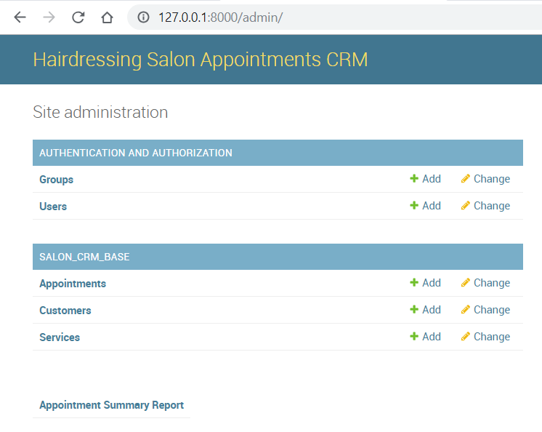
Logging In
Given I am at the login page and I have entered my user name and correct password
When I click on ‘Log In’
Then I will see the admin home page

Slide 3
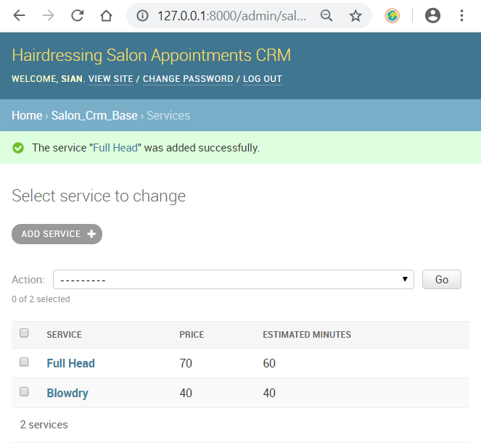
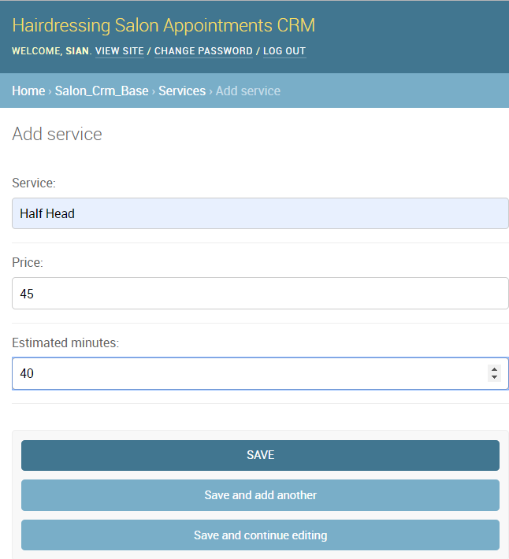
Setting up Services
Given I am at the admin home page and I have clicked on ‘Services’
Then I will see a Services List View
When I click ‘Add Service’ then I will see a Services Detail View
Then I can proceed to specify details and click ‘Save’ for the service record
Then I will be redirected to the Services List View
NB.
Clicking on a service in the Services List View provides the option to once again edit the details for the service in a Services Detail View as above

Slide 4
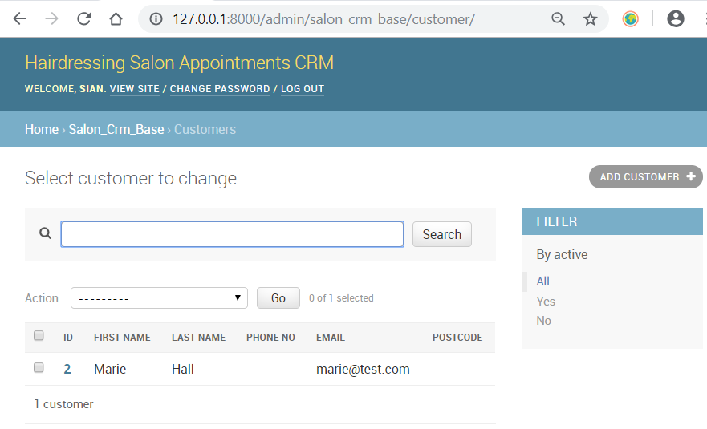
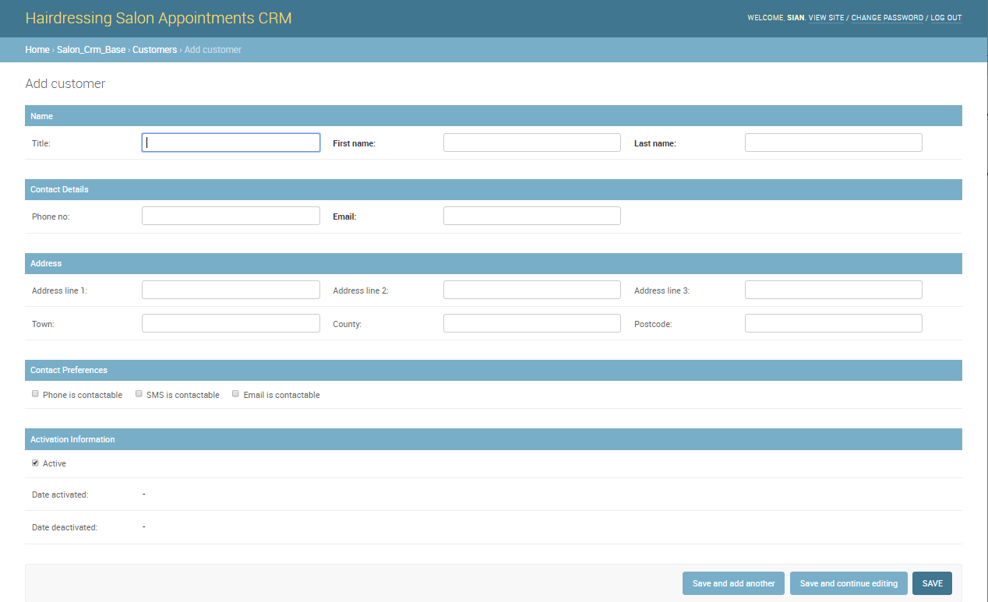
Adding a Customer
Given I am at the admin home page and I have clicked on ‘Customers’
Then I will see a Customers List View
When I click ‘Add Customer’ then I will see a Customer Detail View
Then I can proceed to specify details and click ‘Save’ for the customer record
Then I will be redirected to the Customer List View
NB.
Clicking on a customer in the List View provides the option to once again edit the details
Fields e.g. for name and email are compulsory to help enforce unique constraints for the database

Slide 5
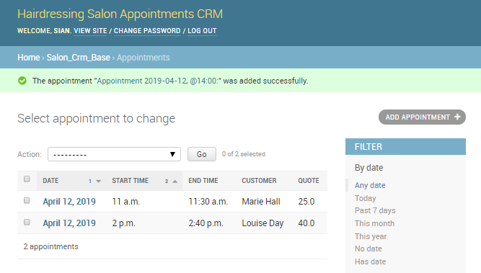
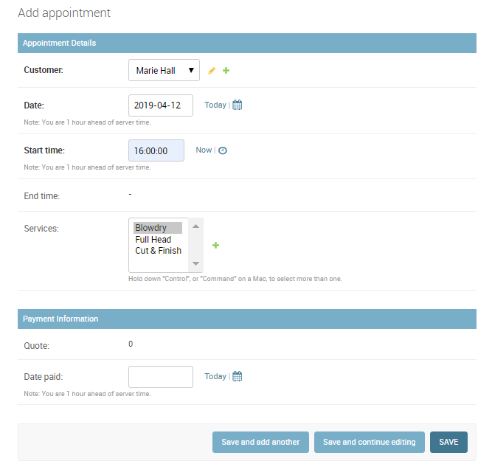
Adding an Appointment
Given I am at the admin home page and I have clicked on ‘Appointments’
Then I will see a Appointments List View
When I click ‘Add Appointment’ then I will see an Appointment Detail View
Then I can proceed to specify details and click ‘Save’ for the appointment record
Then I will be redirected to the Appointment List View
And will see the quote and end time updated for the appointment
NB.
Clicking on a appointment in the List View provides the option to once again edit the details
Please note logic to validate clashing appointment times in the list view would be an additional feature

Slide 6
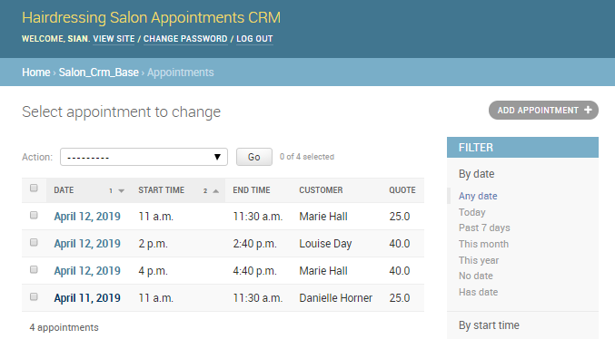
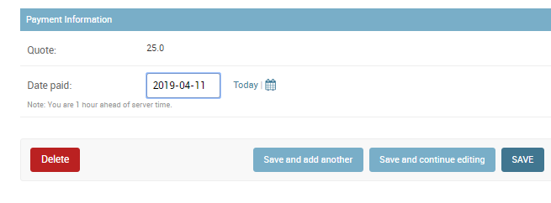
Confirming Payment
Given I am at the Appointments List View
When I click on an existing appointment with a quote
Then I will see the Appointment Detail View
Given the customer has paid
Then I can proceed to update the Date paid field in the Detail View and click ‘Save’
Then I will be redirected to the Appointment List View
NB.
This has implications for helping track paid and forecasted income in the Appointment Summary Report

Slide 7
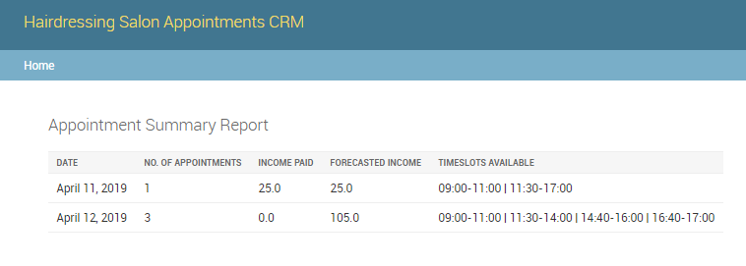
Accessing Appointment Summary Report
Given I am at the admin home page and I have clicked on ‘Appointment Summary Report’
Then I will see a table as above
This provides an overview of expected income and the number of appointments and free timeslots by the day
NB.
Please note providing filters ‘By date’ would be an additional feature

