Slide 1
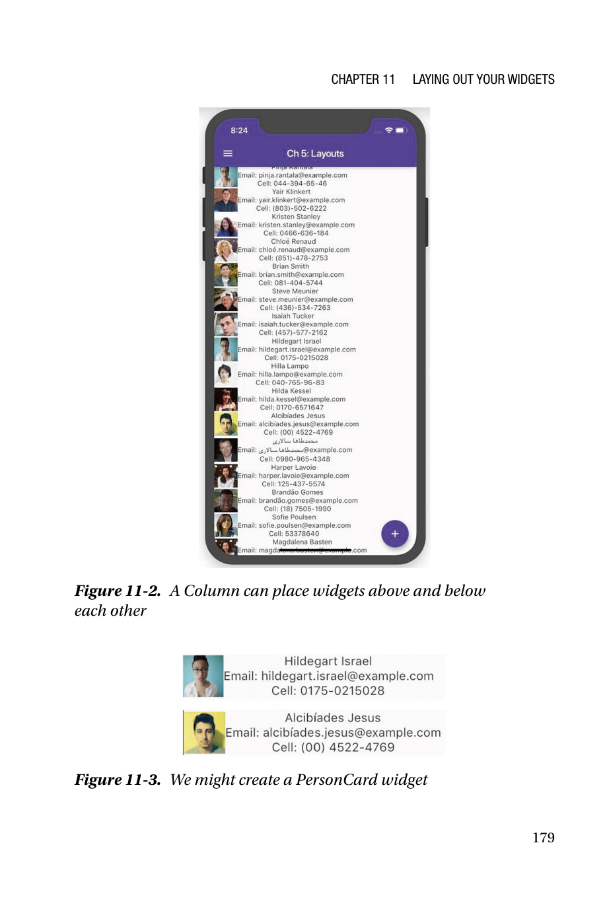
Flutter Layout
Chapters 11 & 12
Laying Out Your Widgets • Positioning Widgets
For third-year Computer Science students
Focused on scene layout, constraints, Row/Column, responsive design, Flex, and MediaQuery.
Goal of the lecture: move from “trial-and-error UI” to a mental model of how Flutter actually sizes and positions widgets.
Flutter App Development • Chapters 11–12 • Slide 1
Notes:
[Sources] - Rap Payne, Flutter App Development: How to Write for iOS and Android at Once, Chapters 11–12, uploaded PDF in this chat.

Slide 2
Learning outcomes
What students should be able to do after this lecture
Explain the five-step roadmap the book uses for layout work: scene structure, positioning, overflow handling, extra space, and fine tuning.
Use MaterialApp, Scaffold, AppBar, and SafeArea correctly when building the outer structure of a Flutter screen.
Reason about Flutter's layout algorithm using constraints, preferred size, greedy widgets, and parent-child negotiation.
Diagnose and fix the “unbounded height” family of layout errors instead of guessing blindly.
Choose between Row, Column, Flex, and MediaQuery for responsive scene composition.
Apply book examples to realistic mobile UI layouts.
Lecture flow
Part I — Chapter 11: how Flutter lays out an entire scene
Part II — Layout algorithm and the unbounded-height problem
Part III — Chapter 12: Row, Column, responsive design, Flex, MediaQuery
Part IV — Quick check: questions for class discussion
Flutter App Development • Chapters 11–12 • Slide 2
Notes:
[Sources] - Rap Payne, Flutter App Development: How to Write for iOS and Android at Once, Chapters 11–12, uploaded PDF in this chat.

Slide 3
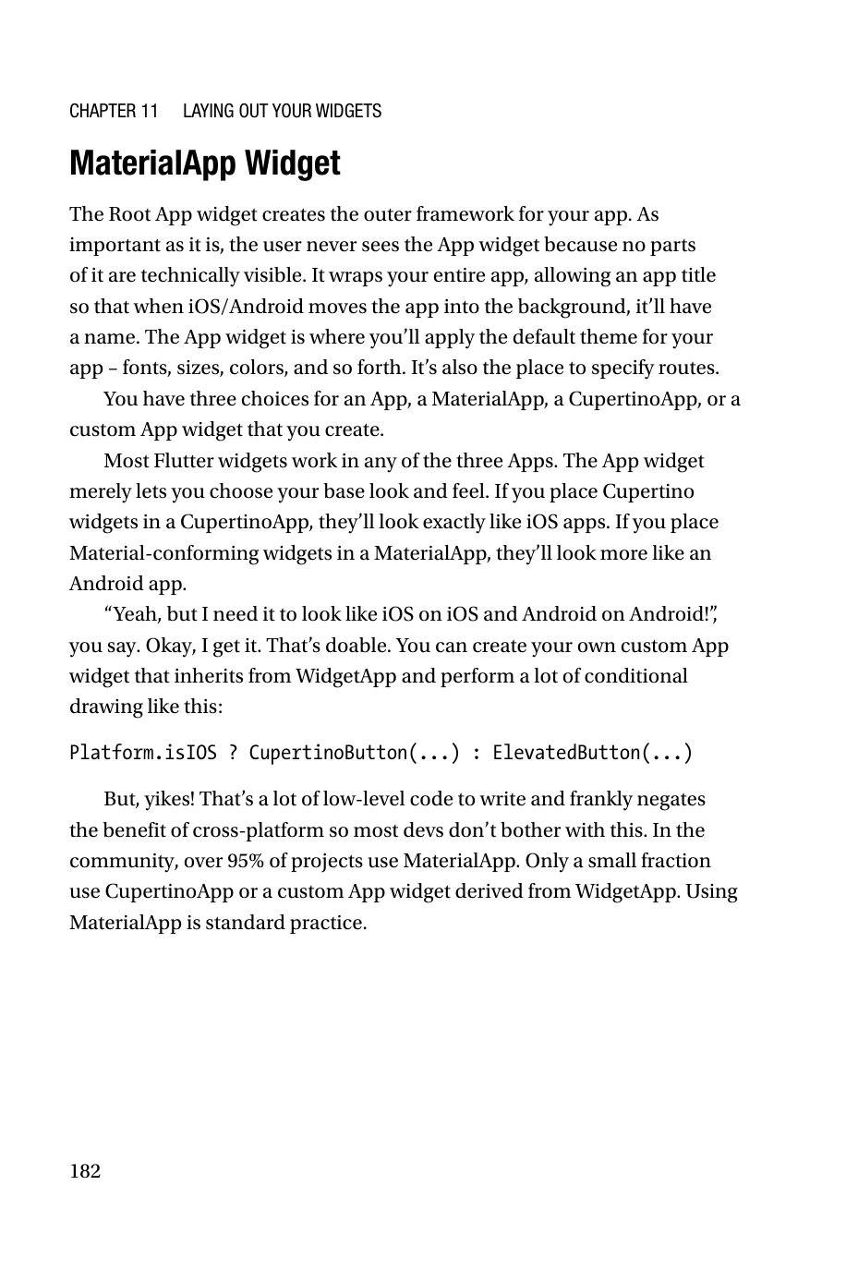
CHAPTER 11
Laying Out
Your Widgets
The chapter shifts from basic widget usage to the engineering logic of screen structure. The key idea is that Flutter layout becomes predictable once you understand constraints and the role of the outer scene widgets.
Notes:
[Sources] - Rap Payne, Flutter App Development: How to Write for iOS and Android at Once, Chapters 11–12, uploaded PDF in this chat.

Slide 4
The layout roadmap in the book
Five steps that organize the entire layout section
1
Layout the entire scene
2
Position widgets relative to each other
3
Handle overflow when widgets do not fit
4
Handle extra space when screens are larger than needed
5
Fine-tune positioning with padding, margin, and alignment
Chapters 11 and 12 cover steps 1 and 2. Later chapters continue with overflow, extra space, and fine tuning.
Flutter App Development • Chapters 11–12 • Slide 4
Notes:
[Sources] - Rap Payne, Flutter App Development: How to Write for iOS and Android at Once, Chapters 11–12, uploaded PDF in this chat.

Slide 5
Step 1 — Lay out the whole scene
Why screen structure is more than decoration
The book argues that apps should not surprise users. Familiar structure makes interfaces feel simpler and more usable.
Users expect top-level affordances such as a title bar, status area, navigation patterns, and predictable action placement.
In Flutter, those conventions are not “magic”; they are modeled through specific widgets that define the scene skeleton.
At this stage, we are not arranging every small widget yet. We are deciding the outer frame within which all later layout happens.
Flutter App Development • Chapters 11–12 • Slide 5
Notes:
[Sources] - Rap Payne, Flutter App Development: How to Write for iOS and Android at Once, Chapters 11–12, uploaded PDF in this chat.

Slide 6
MaterialApp vs CupertinoApp vs WidgetApp
Choosing the root app wrapper
Aspect
MaterialApp
CupertinoApp
WidgetApp
Conforms to
Material Design
Apple HIG
No preset standard
Look & feel
Google/Android style
iOS style
Generic base class
Real-world use
Standard choice for most apps
Mostly iOS-first apps
Used for custom app wrappers
When to use
Cross-platform default
Platform-specific iOS feel
Heavy custom behavior
The book explicitly notes that most community projects use MaterialApp, because conditional platform-specific rendering often defeats the simplicity of cross-platform development.
Flutter App Development • Chapters 11–12 • Slide 6
Notes:
[Sources] - Rap Payne, Flutter App Development: How to Write for iOS and Android at Once, Chapters 11–12, uploaded PDF in this chat.

Slide 7
What MaterialApp actually does
Outer invisible framework for the entire application
Wraps the whole app so the operating system sees it as one coherent application.
Provides the place to set app title, default theme, and routes.
Defines the visual baseline for Material-style widgets.
Is usually the root of the render tree that later passes constraints down to the rest of the UI.
Book-style root app example
1 return MaterialApp( 2 home: MainWidget(), 3 title: 'My Cool App', 4 theme: _themeDefinedElsewhere, 5 routes: { 6 '/scene1': (ctx) => MyWidget1(), 7 '/scene2': (ctx) => MyWidget2(), 8 }, 9 debugShowCheckedModeBanner: false, 10 );
Flutter App Development • Chapters 11–12 • Slide 7
Notes:
[Sources] - Rap Payne, Flutter App Development: How to Write for iOS and Android at Once, Chapters 11–12, uploaded PDF in this chat.

Slide 8
Scaffold: the visible framework of a scene
Think of it as the standard shell for one screen
Scaffold can provide
Scaffold pattern
1 return Scaffold( 2 appBar: MyAppBar(), 3 drawer: MyNavigationDrawer(), 4 body: TheRealContent(), 5 floatingActionButton: 6 FloatingActionButton( 7 onPressed: () {}, 8 child: const Icon(Icons.add), 9 ), 10 bottomSheet: MyBottomSheet(), 11 );
AppBar for title and actions
Body area for actual content
Navigation drawer or bottom navigation
FloatingActionButton for prominent actions
Bottom sheet for contextual content
Flutter App Development • Chapters 11–12 • Slide 8
Notes:
[Sources] - Rap Payne, Flutter App Development: How to Write for iOS and Android at Once, Chapters 11–12, uploaded PDF in this chat.

Slide 9
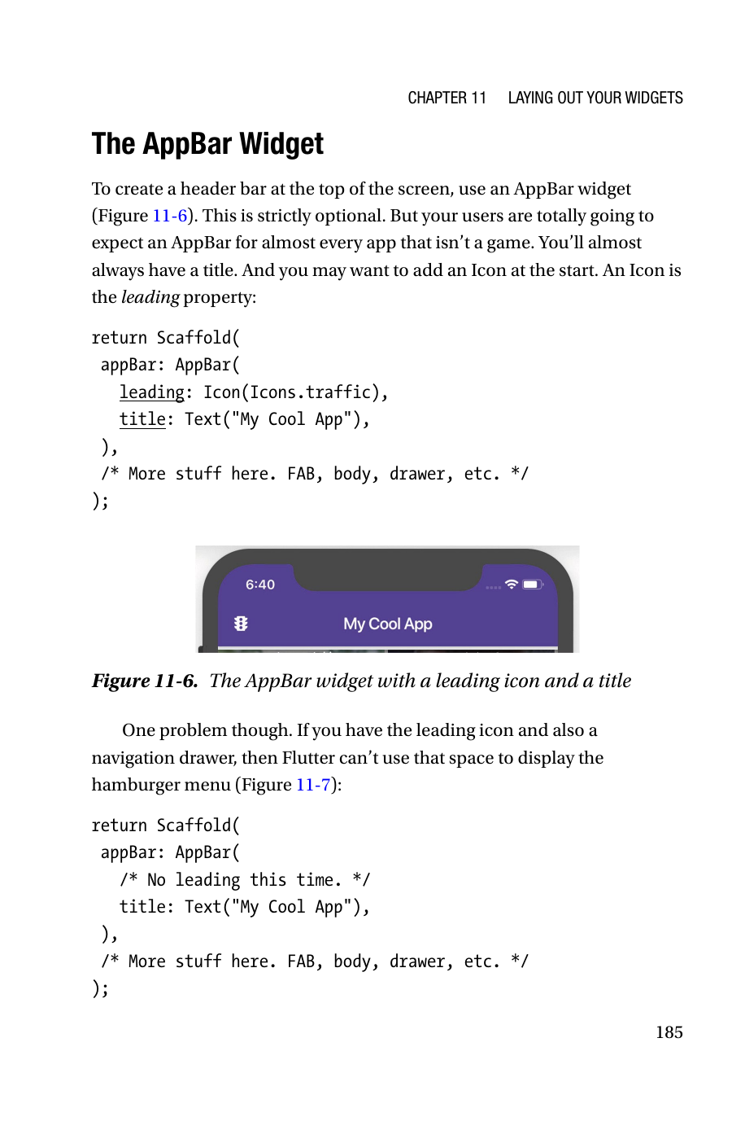
AppBar and the “leading” slot
Tiny details that shape the user's sense of structure
For most non-game apps, users expect a visible AppBar.
The title tells users where they are in the app.
The leading property usually holds a back icon, custom icon, or—when a drawer exists—the hamburger menu.
The book notes that if you have a drawer, omitting a custom leading icon lets the scaffold present the drawer affordance naturally.
Minimal AppBar
1 appBar: AppBar( 2 leading: Icon(Icons.traffic), 3 title: Text('My Cool App'), 4 ),
Flutter App Development • Chapters 11–12 • Slide 9
Notes:
[Sources] - Rap Payne, Flutter App Development: How to Write for iOS and Android at Once, Chapters 11–12, uploaded PDF in this chat.

Slide 10
SafeArea: protect content from notches and status bars
Physical screens are not perfect rectangles
Rounded corners, camera cutouts, and system status bars can overlap your body content if you ignore them.
SafeArea adds padding based on the device's unsafe regions, so the body stays visible and tappable.
The recommended pattern in the chapter is Scaffold → body → SafeArea → actual scene body.
SafeArea inside Scaffold
1 return Scaffold( 2 drawer: LayoutDrawer(), 3 body: SafeArea( 4 child: MyNormalBody(), 5 ), 6 floatingActionButton: 7 FloatingActionButton( 8 onPressed: () {}, 9 child: Icon(Icons.next), 10 ), 11 );
Flutter App Development • Chapters 11–12 • Slide 10
Notes:
[Sources] - Rap Payne, Flutter App Development: How to Write for iOS and Android at Once, Chapters 11–12, uploaded PDF in this chat.

Slide 11
A reliable scene-building checklist
A practical pattern students can reuse in labs
1. Start with MaterialApp at the root.
2. Put one Scaffold per major scene.
3. Add AppBar only if the scene benefits from title/actions.
4. Wrap body content in SafeArea when edges can clash with hardware or system UI.
5. Only after the outer shell is stable should you start positioning inner widgets with Row/Column/Flex.
Why this matters: if the shell is weak, inner layout becomes fragile and debugging explodes in complexity.
Flutter App Development • Chapters 11–12 • Slide 11
Notes:
[Sources] - Rap Payne, Flutter App Development: How to Write for iOS and Android at Once, Chapters 11–12, uploaded PDF in this chat.

Slide 12
Flutter’s layout algorithm
The chapter’s key conceptual leap
Flutter layout is not random. It is a negotiation between what a child wants and what its parent allows.
The framework traverses the widget tree from the top, passing BoxConstraints down.
At the leaves, widgets express the size they would prefer (their RenderBox behavior).
While going back up the tree, Flutter reconciles those preferred sizes with the constraints of parents and ancestors.
Mental model
Constraints go down.
Preferred sizes come up.
Final layout is the intersection of both.
Once students internalize this, many “mysterious” layout bugs suddenly become explainable.
Flutter App Development • Chapters 11–12 • Slide 12
Notes:
[Sources] - Rap Payne, Flutter App Development: How to Write for iOS and Android at Once, Chapters 11–12, uploaded PDF in this chat.

Slide 13
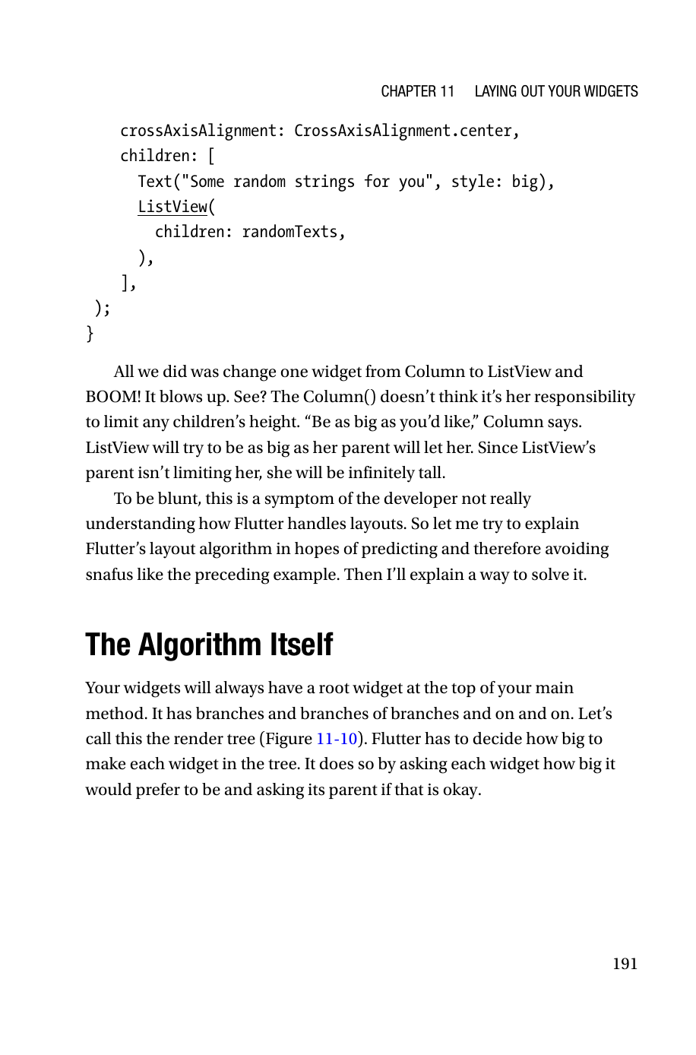
How constraint negotiation works
Top-down constraints, bottom-up sizing
Root widget
(BoxConstraints)
Parent widget
Child widget
Leaf widget
1) Pass max width / max height down the tree
2) Ask leaves how large they prefer to be
3) Reconcile size on the way back up
If the preferred size is too large, Flutter clips or throws; if too small, extra space may remain.
Flutter App Development • Chapters 11–12 • Slide 13
Notes:
[Sources] - Rap Payne, Flutter App Development: How to Write for iOS and Android at Once, Chapters 11–12, uploaded PDF in this chat.

Slide 14
The widget tree is the layout conversation
Chapter 11 Figure 11-10 in context
Every scene ultimately becomes a tree of layout decisions.
High-level widgets such as MaterialApp and Scaffold constrain major regions first.
Lower-level widgets—ListView, Row, Column, Padding, Image, Text—must fit inside those constraints.
No parent has a final size until all of its children have negotiated their own size.
That last sentence is crucial: Flutter layout is recursive, not a single one-pass placement algorithm.
Flutter App Development • Chapters 11–12 • Slide 14
Notes:
[Sources] - Rap Payne, Flutter App Development: How to Write for iOS and Android at Once, Chapters 11–12, uploaded PDF in this chat.

Slide 15
Greedy vs non-greedy widgets
Why some widgets cause far more trouble than others
Non-greedy behavior
Greedy behavior
A typical Column is happy to size only as much as its children require.
Text often sizes itself to its content.
These widgets rarely demand all available space by default.
Scrollable widgets such as ListView want to expand in the scrolling direction.
If their parent does not limit them, they may ask for “infinite” room.
That is the conceptual root of the unbounded-height problem.
Flutter App Development • Chapters 11–12 • Slide 15
Notes:
[Sources] - Rap Payne, Flutter App Development: How to Write for iOS and Android at Once, Chapters 11–12, uploaded PDF in this chat.

Slide 16
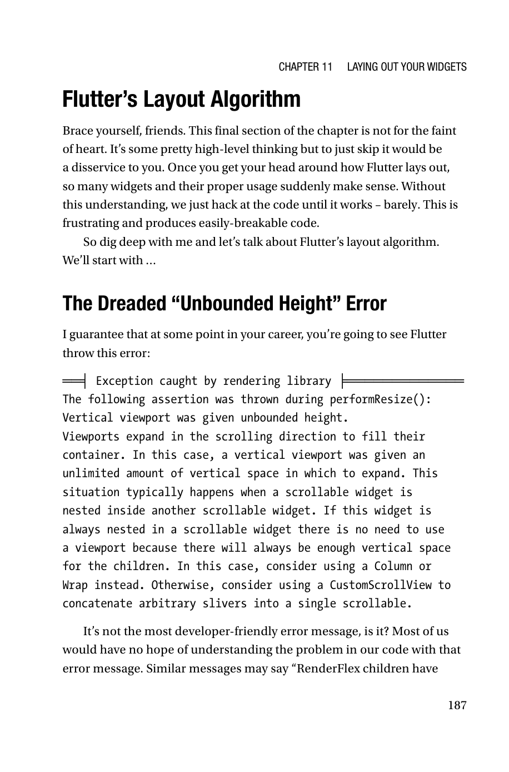
The dreaded “unbounded height” error
One of the most important Flutter layout bugs to understand
The core message is not that Flutter is broken—it is that a child wants more space than any ancestor is willing to bound.
A vertical viewport such as ListView expands in the scroll direction.
If you place it inside a parent that says “be as big as you want,” the result becomes logically infinite height.
The framework then throws because it cannot produce a valid finite layout.
Flutter App Development • Chapters 11–12 • Slide 16
Notes:
[Sources] - Rap Payne, Flutter App Development: How to Write for iOS and Android at Once, Chapters 11–12, uploaded PDF in this chat.

Slide 17
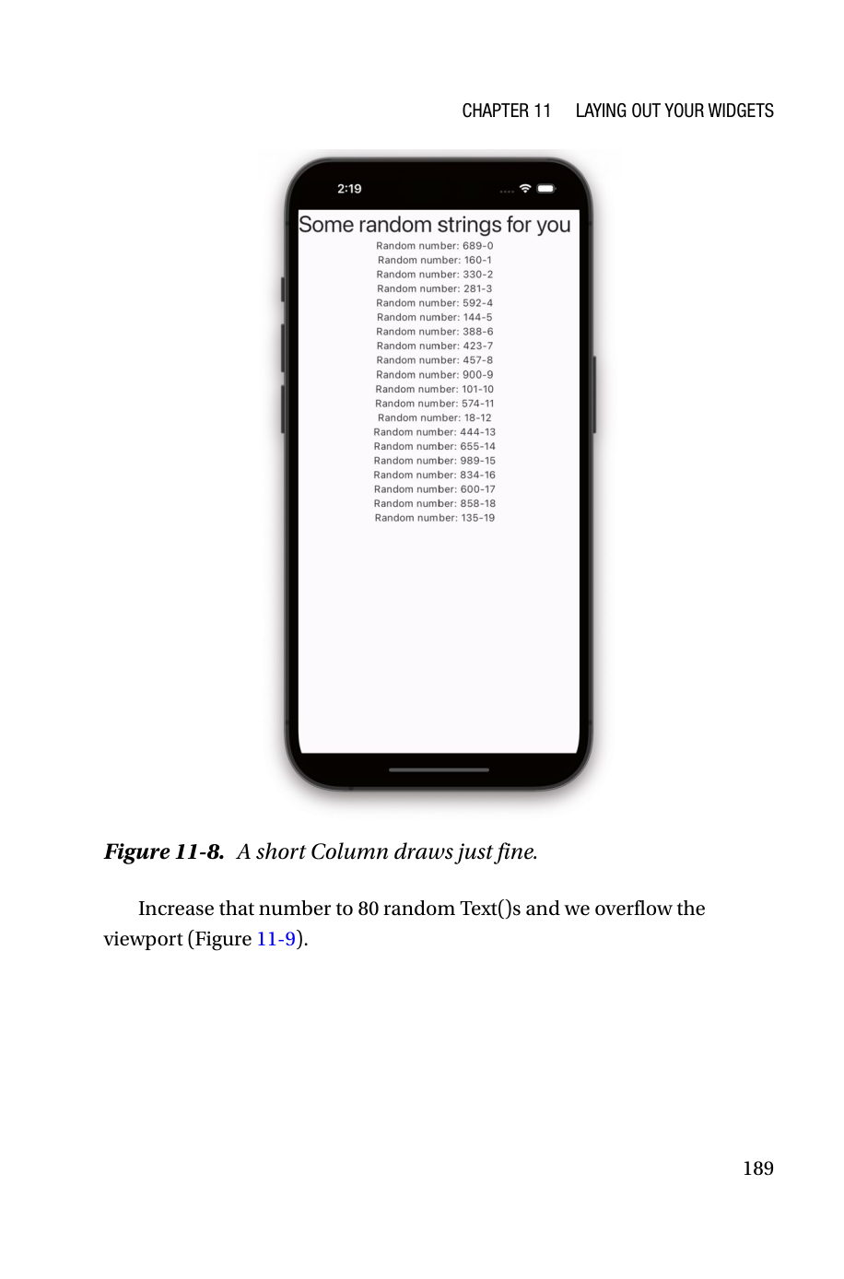
Overflow is different from unbounded height
Too many children can overflow even without a runtime exception
A Column with a few Text widgets is fine.
A Column with 80 generated Text widgets can draw past the bottom of the screen.
That visual overflow is ugly, but it is still not the same bug as infinite height.
Students should distinguish: overflow = content exceeds viewport; unbounded height = parent failed to impose constraints on a greedy child.
Flutter App Development • Chapters 11–12 • Slide 17
Notes:
[Sources] - Rap Payne, Flutter App Development: How to Write for iOS and Android at Once, Chapters 11–12, uploaded PDF in this chat.

Slide 18
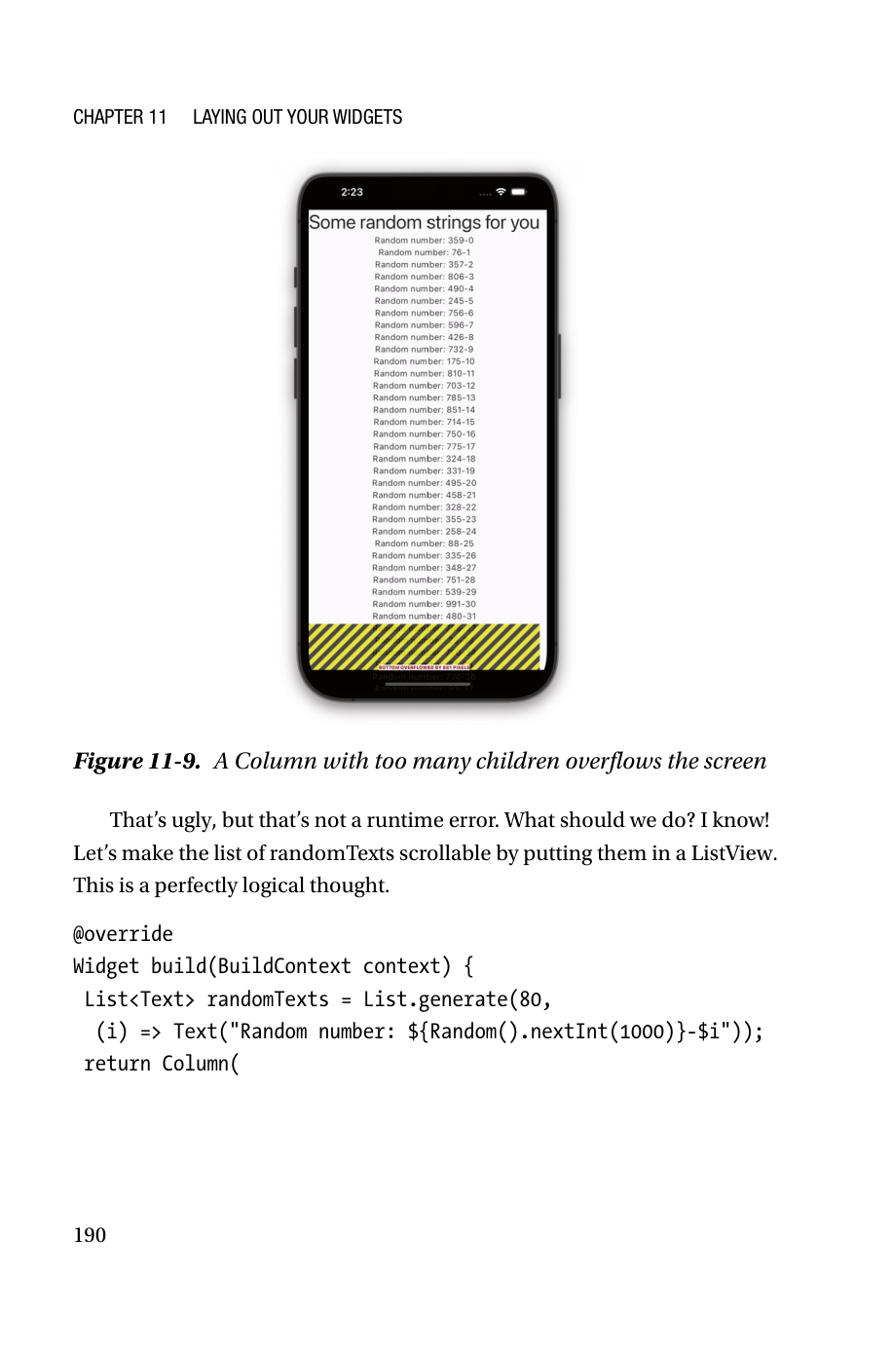
Why “just use ListView” can backfire
The classic bad fix from the chapter
Naive replacement
1 return Column( 2 crossAxisAlignment: CrossAxisAlignment.center, 3 children: [ 4 Text('Some random strings for you', style: big), 5 ListView( 6 children: randomTexts, 7 ), 8 ], 9 );
The intention is reasonable: make the list scrollable.
But Column does not limit the child's height.
ListView is greedy and tries to grow vertically as far as it can.
Therefore the fix causes a harder error than the original overflow.
Flutter App Development • Chapters 11–12 • Slide 18
Notes:
[Sources] - Rap Payne, Flutter App Development: How to Write for iOS and Android at Once, Chapters 11–12, uploaded PDF in this chat.

Slide 19
Practical fixes for the problem
What the parent must do: stop the child from growing forever
Wrap ListView in Expanded
Lets the parent allocate the remaining finite space in a Flex layout.
Wrap it in SizedBox
Locks the height to an explicit finite value.
Use LimitedBox
Provides maxWidth / maxHeight without hard-coding one exact size.
Swap parent/child roles when appropriate
A Column can live inside a ListView more safely than the reverse.
Engineering lesson: fix the constraint system, not just the symptom.
Flutter App Development • Chapters 11–12 • Slide 19
Notes:
[Sources] - Rap Payne, Flutter App Development: How to Write for iOS and Android at Once, Chapters 11–12, uploaded PDF in this chat.

Slide 20
Chapter 11 recap
What students should retain before moving to positioning
MaterialApp defines the outer application framework, while Scaffold defines the visible shell of a scene.
AppBar and SafeArea are not cosmetic—they encode device and UX conventions.
Flutter layout is driven by constraints flowing down and preferred sizes flowing up.
Greedy widgets must be bounded by parents.
Understanding that mental model is the foundation for all later layout work.
Flutter App Development • Chapters 11–12 • Slide 20
Notes:
[Sources] - Rap Payne, Flutter App Development: How to Write for iOS and Android at Once, Chapters 11–12, uploaded PDF in this chat.

Slide 21
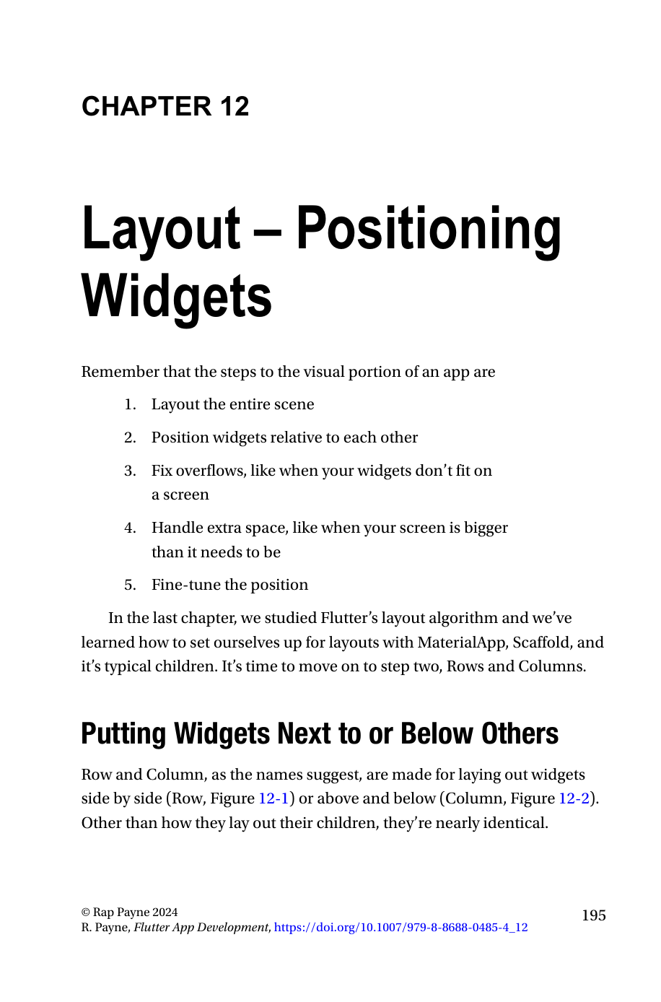
CHAPTER 12
Layout —
Positioning Widgets
After the outer shell is in place, the next question is spatial composition: which widgets sit side by side, which stack vertically, and how should the arrangement adapt to different devices and orientations?
Notes:
[Sources] - Rap Payne, Flutter App Development: How to Write for iOS and Android at Once, Chapters 11–12, uploaded PDF in this chat.

Slide 22
Row: placing widgets side by side
Main axis = horizontal, cross axis = vertical
Row is the default choice when sibling widgets should appear left-to-right.
Children are rendered in the order listed in the children array.
This widget is ideal for media-plus-text cards, action bars, icon groups, and split regions.
In a Row, the main axis runs horizontally and the cross axis runs vertically.
Minimal Row
1 Row( 2 children: <Widget>[ 3 SomeWidget(), 4 SomeWidget(), 5 SomeWidget(), 6 ], 7 )
Flutter App Development • Chapters 11–12 • Slide 22
Notes:
[Sources] - Rap Payne, Flutter App Development: How to Write for iOS and Android at Once, Chapters 11–12, uploaded PDF in this chat.

Slide 23
Column: stacking widgets vertically
Main axis = vertical, cross axis = horizontal
Column is the default choice when elements should appear above and below each other.
It mirrors Row conceptually: same children property, same order, different main axis.
Most mobile screens are dominated by Columns because the viewport is naturally taller than it is wide.
However, Columns often need help when children become too tall or when one child is scrollable.
Main axis
Cross axis
1 Column( 2 children: <Widget>[ 3 SomeWidget(), 4 SomeWidget(), 5 SomeWidget(), 6 ], 7 )
Minimal Column
Flutter App Development • Chapters 11–12 • Slide 23
Notes:
[Sources] - Rap Payne, Flutter App Development: How to Write for iOS and Android at Once, Chapters 11–12, uploaded PDF in this chat.

Slide 24
Nested Rows and Columns build real screens
Simple primitives compose into rich interfaces
A Row can hold the image next to a text region.
Inside that Row, a Column can stack name, role, metadata, and action labels.
This composition pattern scales naturally: rows inside columns, columns inside rows, as many levels as needed.
PersonCard pattern from the chapter
1 Row( 2 children: [ 3 Image(...), 4 Column( 5 children: [ 6 Text(name), 7 Text(role), 8 Text(email), 9 ], 10 ), 11 ], 12 )
Nested composition
Flutter App Development • Chapters 11–12 • Slide 24
Notes:
[Sources] - Rap Payne, Flutter App Development: How to Write for iOS and Android at Once, Chapters 11–12, uploaded PDF in this chat.

Slide 25
Ordering and composability
Rows and Columns are small ideas with large consequences
Children appear in exactly the order you add them. This makes the layout tree highly explicit.
Because both widgets accept arrays of children, they are easy to refactor and test.
You can quickly decompose one messy scene into reusable pieces such as PersonCard, ProfileHeader, or ActionBar.
In practice, Row and Column become the first layout tools you reach for before exploring more specialized widgets.
Flutter App Development • Chapters 11–12 • Slide 25
Notes:
[Sources] - Rap Payne, Flutter App Development: How to Write for iOS and Android at Once, Chapters 11–12, uploaded PDF in this chat.

Slide 26
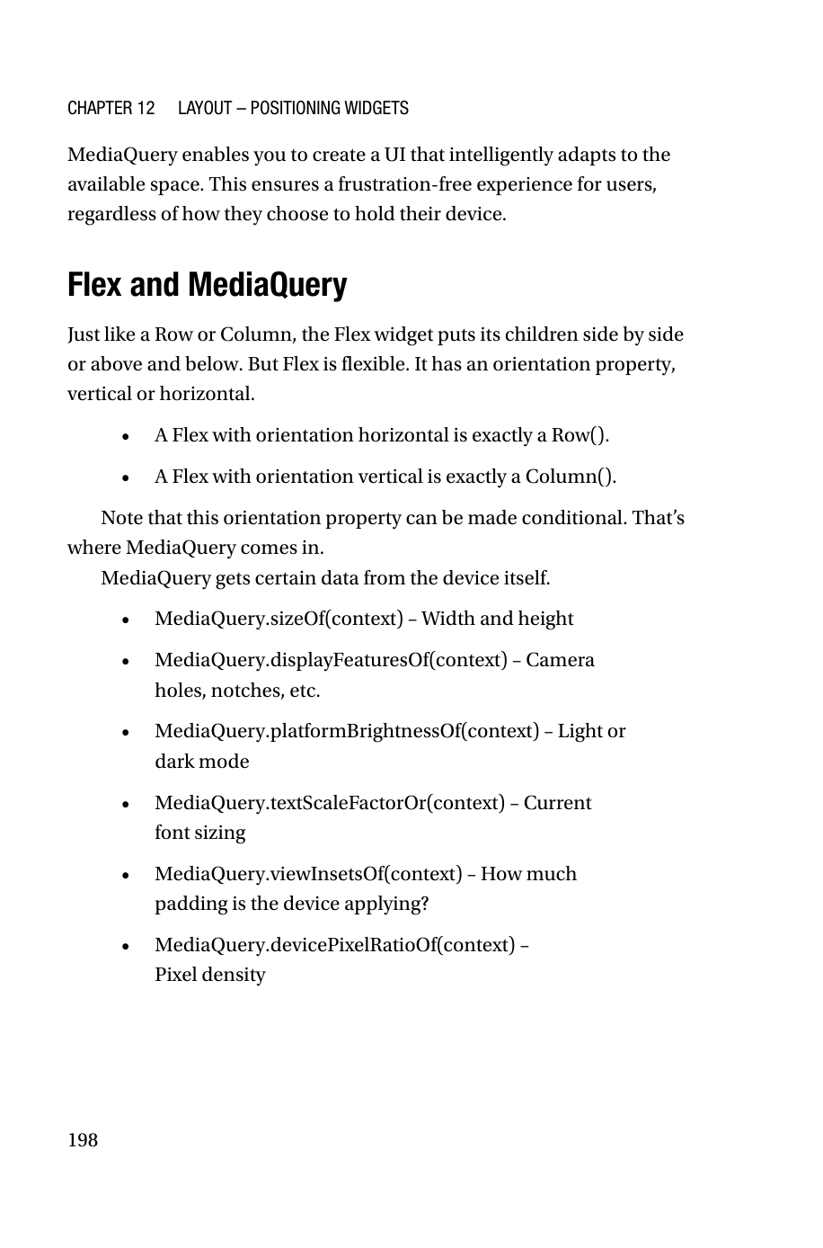
Responsive design in Flutter
A mobile interface should adapt, not merely stretch
Responsive design was born from the need to support many screen sizes and orientations.
In Flutter, the same problem appears whenever a user rotates the device, uses a tablet, or has a display cutout.
A layout that works beautifully in portrait may become cramped, overflowed, or visually awkward in landscape.
The goal is not just “fit”; it is preserving readability, tapability, and information hierarchy.
Flutter App Development • Chapters 11–12 • Slide 26
Notes:
[Sources] - Rap Payne, Flutter App Development: How to Write for iOS and Android at Once, Chapters 11–12, uploaded PDF in this chat.

Slide 27
Portrait vs landscape thinking
Same data, different best arrangement
Portrait
Landscape / split view
A good responsive layout often changes structure, not just scale.
Flutter App Development • Chapters 11–12 • Slide 27
Notes:
[Sources] - Rap Payne, Flutter App Development: How to Write for iOS and Android at Once, Chapters 11–12, uploaded PDF in this chat.

Slide 28
Flex: the orientation can become dynamic
One widget that can behave like Row or Column
Flex arranges children along a main axis, just like Row and Column.
If direction is horizontal, it behaves like a Row.
If direction is vertical, it behaves like a Column.
Its real value appears when direction becomes conditional based on device state.
Flex(direction: ...)
horizontal
vertical
Row equivalent
Column equivalent
Single abstraction for responsive switching
Flutter App Development • Chapters 11–12 • Slide 28
Notes:
[Sources] - Rap Payne, Flutter App Development: How to Write for iOS and Android at Once, Chapters 11–12, uploaded PDF in this chat.

Slide 29
MediaQuery: read the device context
Ask the environment before deciding the layout
MediaQuery.sizeOf(context) gives width and height.
MediaQuery.displayFeaturesOf(context) exposes cutouts such as notches or camera holes.
MediaQuery.orientationOf(context) tells you whether the device is in portrait or landscape.
The chapter emphasizes orientation as the trigger for conditional Flex direction.
Read device state
1 final orientation = 2 MediaQuery.orientationOf(context); 3 4 final isLandscape = 5 orientation == Orientation.landscape;
Flutter App Development • Chapters 11–12 • Slide 29
Notes:
[Sources] - Rap Payne, Flutter App Development: How to Write for iOS and Android at Once, Chapters 11–12, uploaded PDF in this chat.

Slide 30
Responsive layout example with Flex + MediaQuery
This is the central design pattern of Chapter 12
Conditional orientation
In portrait, widgets stack vertically to respect narrow width.
In landscape, widgets sit side by side to exploit horizontal space.
This pattern is more robust than manually duplicating two unrelated screens.
Students can extend it with Expanded, Flexible, spacing, and breakpoint logic.
1 final isLandscape = 2 MediaQuery.orientationOf(context) == 3 Orientation.landscape; 4 5 return Flex( 6 direction: isLandscape 7 ? Axis.horizontal 8 : Axis.vertical, 9 children: [ 10 SidebarWidget(), 11 ContentWidget(), 12 ], 13 );
Flutter App Development • Chapters 11–12 • Slide 30
Notes:
[Sources] - Rap Payne, Flutter App Development: How to Write for iOS and Android at Once, Chapters 11–12, uploaded PDF in this chat.

Slide 31
Case study: list + details screen
How students can apply the chapter beyond toy examples
Portrait
Landscape / tablet
Top: search/filter
Middle: list of items
Bottom: details pushed to next route or modal
Left pane: list of items
Right pane: live detail view
Same content, better use of horizontal real estate
The point is not to memorize one layout. The point is to develop a rule-based way of switching structure when device constraints change.
Flutter App Development • Chapters 11–12 • Slide 31
Notes:
[Sources] - Rap Payne, Flutter App Development: How to Write for iOS and Android at Once, Chapters 11–12, uploaded PDF in this chat.

Slide 32
Design heuristics from these chapters
Rules of thumb worth carrying into projects
Build the outer shell before polishing inner details.
Assume every scrollable widget needs a bounded parent.
Use Row/Column first; only move to more specialized layout widgets when the mental model is clear.
Make responsiveness structural, not cosmetic.
If a layout bug looks mysterious, inspect the constraints.
Flutter App Development • Chapters 11–12 • Slide 32
Notes:
[Sources] - Rap Payne, Flutter App Development: How to Write for iOS and Android at Once, Chapters 11–12, uploaded PDF in this chat.

Slide 33
Common anti-patterns and their symptoms
What students should stop doing
Anti-pattern
Likely symptom
Putting ListView directly inside an unconstrained Column
Unbounded height / RenderViewport errors
Trying random wrappers until the screen “looks okay”
Fragile code that breaks when one child changes
Ignoring SafeArea on modern devices
Clipped buttons or unreadable content near notches
Designing only for portrait and hoping landscape will work
Buttons crowd together, text overflows, or panes waste space
Flutter App Development • Chapters 11–12 • Slide 33
Notes:
[Sources] - Rap Payne, Flutter App Development: How to Write for iOS and Android at Once, Chapters 11–12, uploaded PDF in this chat.

Slide 34
How Chapters 11–12 connect to the next layout chapters
This lecture is only the first half of the layout story
Chapter 11 gives the scene shell and the constraint mental model.
Chapter 12 gives the first positioning tools: Row, Column, Flex, and MediaQuery.
Chapter 13 then focuses on overflow repair, Chapter 14 on extra space, and Chapter 15 on fine-tuning.
In other words, these chapters do not solve every layout problem—but they give the conceptual foundation for solving all the later ones.
Flutter App Development • Chapters 11–12 • Slide 34
Notes:
[Sources] - Rap Payne, Flutter App Development: How to Write for iOS and Android at Once, Chapters 11–12, uploaded PDF in this chat.

Slide 35
Mini exercise for class
From theory to an implementable layout decision
Task
Design a “student directory” scene with profile photo, name, department, contact actions, and a details area. Decide which widgets belong to the outer shell and which belong to the inner positioning layer.
What you must justify
Why MaterialApp / Scaffold are the correct outer wrappers
Where SafeArea is needed
Whether portrait should use Column and landscape should use Flex/Row
How you would avoid unbounded-height errors if the details pane becomes scrollable
Flutter App Development • Chapters 11–12 • Slide 35
Notes:
[Sources] - Rap Payne, Flutter App Development: How to Write for iOS and Android at Once, Chapters 11–12, uploaded PDF in this chat.

Slide 36
Quick check: did we actually learn the lecture?
Use these as in-class questions, quiz prompts, or exit-ticket discussion
1. What is the difference between MaterialApp and Scaffold in terms of layout responsibility?
2. Why does a ListView inside an unconstrained Column trigger an “unbounded height” error?
3. In Flutter’s layout algorithm, what flows downward and what flows upward?
4. What is the practical role of SafeArea on modern phones?
5. When would you prefer Flex + MediaQuery instead of a fixed Row or a fixed Column?
6. How is overflow different from unbounded height?
Flutter App Development • Chapters 11–12 • Slide 36
Notes:
[Sources] - Rap Payne, Flutter App Development: How to Write for iOS and Android at Once, Chapters 11–12, uploaded PDF in this chat.

Slide 37
One-slide cheat sheet
The mental model to remember before your next Flutter lab
Outer shell: MaterialApp → Scaffold → AppBar / body / FAB / drawer → SafeArea where needed.
Constraint rule: parents limit; children request.
Greedy child + no bounding parent = trouble.
Positioning tools: Row (horizontal), Column (vertical), Flex (dynamic orientation).
Responsiveness: inspect the device context with MediaQuery, then change structure when necessary.
Flutter App Development • Chapters 11–12 • Slide 37
Notes:
[Sources] - Rap Payne, Flutter App Development: How to Write for iOS and Android at Once, Chapters 11–12, uploaded PDF in this chat.

Slide 38
Closing thought
Good Flutter layout is not guesswork.
Once you understand constraints, scene shells, and responsive structure, you stop fighting the framework and start designing with it.
Next step: implement one responsive scene yourself and debug it by reading constraints instead of experimenting blindly.
Flutter App Development • Chapters 11–12 • Slide 38
Notes:
[Sources] - Rap Payne, Flutter App Development: How to Write for iOS and Android at Once, Chapters 11–12, uploaded PDF in this chat.

