Slide 1
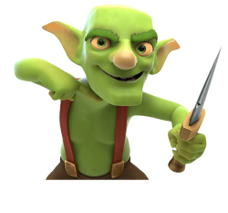

Flutter Game
Development
Step-by-Step Tutorial
Goblin Slayer Game
FLUTTER
DART
GAME DEV
vs
3rd Year Students • Computer Science

Slide 2
🎮 Game Overview – What We're Building
LEVEL 1 — Goblin
LEVEL 2 — Android Boss
Boss shoots lasers at player
Laser speed ↑ as boss health ↓
Player has ❤❤❤ 3 lives
3 hits → Game Over screen
Defeat boss → Victory screen
Tap 'Shoot' to deal 20 HP damage
Green health bar → red below 50%
Goblin has 100 HP
Dead → show dead image
Buttons: Next Level / Restart

Slide 3
📁 Step 1 – Project Setup & Folder Structure
STEP 1
FOLDER TREE
pubspec.yaml
goblin_game/
├── lib/
│ ├── main.dart
│ ├── game_screen.dart
│ ├── level1_screen.dart
│ ├── level2_screen.dart
│ └── models/
│ └── game_state.dart
├── assets/
│ ├── goblin-alive.webp
│ └── goblin-dead.jpg
└── pubspec.yaml
name: goblin_game
flutter:
uses-material-design: true
assets:
- assets/goblin-alive.webp
- assets/goblin-dead.jpg
import 'package:flutter/material.dart';
import 'game_screen.dart';
void main() => runApp(const MyApp());
class MyApp extends StatelessWidget {
const MyApp({super.key});
@override
Widget build(BuildContext context) {
return MaterialApp(
title: 'Goblin Slayer',
theme: ThemeData.dark(),
home: const GameScreen(),
);
}
}
main.dart

Slide 4
🧠 Step 2 – Game State Model (game_state.dart)
STEP 2
// Represents which level/screen is active
enum GameLevel { level1, level2 }
// Represents the current game status
enum GameStatus { playing, gameOver, victory }
// Holds all global game state — passed down to child widgets
class GameState {
int level; // current level (1 or 2)
int playerLives; // lives remaining (starts at 3)
GameStatus status; // playing / gameOver / victory
GameState({
this.level = 1,
this.playerLives = 3,
this.status = GameStatus.playing,
});
// Convenience: player is still alive
bool get isAlive => playerLives > 0;
// Reduce player life by 1; switch to gameOver if none left
void takeDamage() {
playerLives--;
if (playerLives <= 0) status = GameStatus.gameOver;
}
}
models/game_state.dart

Slide 5
🎮 Step 3 – GameScreen: The Level Controller (game_screen.dart)
STEP 3
class GameScreen extends StatefulWidget {
const GameScreen({super.key});
@override State<GameScreen> createState() => _GameScreenState();
}
class _GameScreenState extends State<GameScreen> {
final GameState _state = GameState(); // single source of truth
void _nextLevel() => setState(() => _state.level = 2);
void _restartGame()=> setState(() {
_state.level = 1;
_state.playerLives = 3;
_state.status = GameStatus.playing;
});
@override
Widget build(BuildContext context) {
// Show the appropriate screen based on game state
if (_state.status == GameStatus.gameOver)
return GameOverScreen(onRestart: _restartGame);
if (_state.status == GameStatus.victory)
return VictoryScreen(onRestart: _restartGame);
if (_state.level == 1)
return Level1Screen(onNextLevel: _nextLevel,
onRestart: _restartGame);
return Level2Screen(
gameState: _state,
onWin: () => setState(() => _state.status = GameStatus.victory),
onGameOver: () => setState(() => _state.status = GameStatus.gameOver),
);
}
}
game_screen.dart

Slide 6
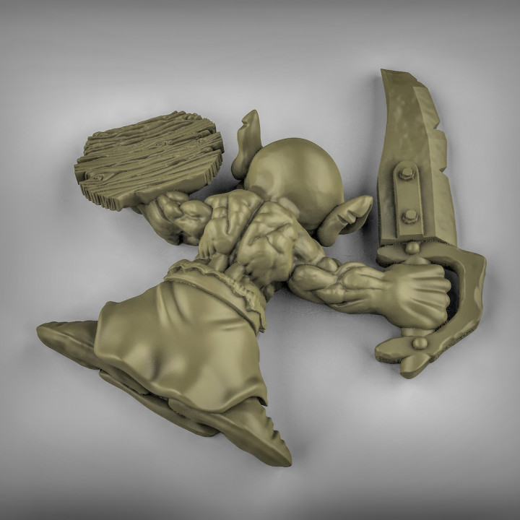
👾 Step 4 – Level 1: Goblin Screen (level1_screen.dart)
STEP 4
class Level1Screen extends StatefulWidget {
final VoidCallback onNextLevel;
final VoidCallback onRestart;
const Level1Screen({required this.onNextLevel,
required this.onRestart, super.key});
@override State<Level1Screen> createState() => _Level1State();
}
class _Level1State extends State<Level1Screen> {
int goblinHp = 100;
bool get isDead => goblinHp <= 0;
void _shoot() => setState(() {
goblinHp = (goblinHp - 20).clamp(0, 100);
});
@override
Widget build(BuildContext context) => Scaffold(
backgroundColor: const Color(0xFF0D1117),
appBar: AppBar(title: const Text('Level 1 – Goblin'),
backgroundColor: const Color(0xFF161B22)),
body: Center(child: Column(
mainAxisAlignment: MainAxisAlignment.center,
children: [
// Goblin image switches when dead
Image.asset(isDead?'assets/goblin-dead.jpg'
:'assets/goblin-alive.webp',
width: 200, height: 200),
const SizedBox(height: 16),
_buildHealthBar(),
const SizedBox(height: 16),
_buildActionButtons(),
],
)),
);
level1_screen.dart
alive
dead

Slide 7
❤️ Step 4 cont – Health Bar & Action Buttons
STEP 4
Widget _buildActionButtons() {
if (!isDead) {
// Still fighting
return ElevatedButton.icon(
onPressed: _shoot,
icon: const Icon(Icons.gps_fixed),
label: const Text('Shoot Goblin'),
style: ElevatedButton.styleFrom(
backgroundColor: Colors.redAccent,
foregroundColor: Colors.white,
padding: const EdgeInsets.symmetric(
horizontal: 32, vertical: 14),
textStyle: const TextStyle(fontSize: 18),
),
);
}
// Goblin is dead → show two options
return Row(
mainAxisAlignment: MainAxisAlignment.center,
children: [
ElevatedButton(
onPressed: widget.onNextLevel,
child: const Text('Next Level ➡'),
),
const SizedBox(width: 16),
OutlinedButton(
onPressed: widget.onRestart,
child: const Text('Restart'),
),
],
);
}
_buildHealthBar()
_buildActionButtons()
Widget _buildHealthBar() {
double pct = goblinHp / 100;
return Padding(
padding: const EdgeInsets.symmetric(
horizontal: 32),
child: Column(children: [
Text(
isDead ? 'Goblin Defeated! 💀'
: 'HP: $goblinHp / 100',
style: TextStyle(
color: isDead ? Colors.red
: Colors.white,
fontSize: 18, fontWeight: FontWeight.bold,
),
),
const SizedBox(height: 8),
LinearProgressIndicator(
value: pct,
minHeight: 18,
backgroundColor: Colors.grey[800],
valueColor: AlwaysStoppedAnimation(
goblinHp > 50
? Colors.green
: Colors.redAccent,
),
),
]),
);
}

Slide 8
❤️❤️❤️ Step 5 – Player Lives Widget
STEP 5
CONCEPT
// Reusable widget to display hearts
class PlayerLivesWidget extends StatelessWidget {
final int lives; // current lives (0-3)
final int maxLives; // default 3
const PlayerLivesWidget(
{required this.lives, this.maxLives = 3, super.key});
@override
Widget build(BuildContext context) {
return Row(
mainAxisAlignment: MainAxisAlignment.center,
children: List.generate(maxLives, (index) {
final alive = index < lives;
return Padding(
padding: const EdgeInsets.symmetric(horizontal: 4),
child: Icon(
alive ? Icons.favorite : Icons.favorite_border,
color: alive ? Colors.redAccent : Colors.grey,
size: 32,
),
);
}),
);
}
}
// Usage inside Level2Screen build():
PlayerLivesWidget(lives: gameState.playerLives)
PlayerLivesWidget
Player Lives
❤
❤
❤
3 Lives at game start
Hit by laser → lose 1 life
❤
❤
🖤
0 lives → Game Over
🖤🖤🖤

Slide 9
🤖 Step 6 – Level 2: Boss Screen Setup (level2_screen.dart)
STEP 6
level2_screen.dart – state fields
class Level2Screen extends StatefulWidget {
final GameState gameState;
final VoidCallback onWin;
final VoidCallback onGameOver;
const Level2Screen({required this.gameState,
required this.onWin, required this.onGameOver, super.key});
@override State<Level2Screen> createState() => _Level2State();
}
class _Level2State extends State<Level2Screen>
with SingleTickerProviderStateMixin {
// ── Boss state ─────────────────────────────
int bossHp = 200; // Boss starts with 200 HP
final int maxBossHp = 200;
bool get bossIsDead => bossHp <= 0;
// ── Laser state ────────────────────────────
Timer? _laserTimer; // fires lasers periodically
bool _laserVisible = false; // is a laser on screen?
double _laserY = 0.2; // laser Y position (0=top)
double _laserX = 0.5; // laser X position (0=left)
// Laser speed increases as boss health drops
// At 100% HP → 1.5s between shots
// At 0% HP → 0.4s between shots
Duration get _laserInterval {
final pct = bossHp / maxBossHp; // 1.0 → 0.0
final ms = 400 + (pct * 1100).toInt();
return Duration(milliseconds: ms);
}
@override
void initState() {
super.initState();
_startLaserTimer();
}
Boss: 200 HP ⚡ Speed formula: delay = 400ms + (hpPct × 1100ms) Fast at low HP!

Slide 10
⚡ Step 7 – Laser System & Collision Detection
STEP 7
Laser Timer & Shooting
Hit Detection & Player Shooting
void _startLaserTimer() {
_laserTimer?.cancel();
_laserTimer = Timer.periodic(_laserInterval, (_) {
if (!mounted) return;
// Restart timer with updated speed
_startLaserTimer();
_fireLaser();
});
}
void _fireLaser() {
setState(() {
_laserVisible = true;
// Random X position for variety
_laserX = 0.2 + Random().nextDouble() * 0.6;
_laserY = 0.15; // starts near top (boss)
});
// Animate laser moving DOWN toward player
const step = Duration(milliseconds: 30);
Timer.periodic(step, (t) {
if (!mounted) { t.cancel(); return; }
setState(() => _laserY += 0.04);
if (_laserY >= 0.85) { // laser reached player
t.cancel();
_checkHit();
}
});
}
void _checkHit() {
// Player is at fixed bottom-center
// Hit if laser X is within ±0.15 of center
final hit = (_laserX - 0.5).abs() < 0.15;
setState(() {
_laserVisible = false;
if (hit) {
widget.gameState.takeDamage();
if (!widget.gameState.isAlive) {
_laserTimer?.cancel();
widget.onGameOver();
}
}
});
}
// Player taps to shoot boss
void _shootBoss() {
if (bossIsDead) return;
setState(() {
bossHp = (bossHp - 25).clamp(0, maxBossHp);
if (bossIsDead) {
_laserTimer?.cancel();
widget.onWin(); // 🏆 Victory!
}
});
}
@override
void dispose() {
_laserTimer?.cancel(); // ⚠️ Always cancel timers!
super.dispose();
}

Slide 11
🖼️ Step 8 – Level 2 Build Method & Laser Rendering
STEP 8
Level2Screen build()
@override
Widget build(BuildContext context) {
final pct = bossHp / maxBossHp;
return Scaffold(
backgroundColor: const Color(0xFF0D1117),
appBar: AppBar(
title: const Text('Level 2 – Android Boss'),
backgroundColor: const Color(0xFF161B22),
),
body: Stack(children: [ // Stack lets us overlay the laser on top
// ── Main column content ──────────────────────────────────────
Center(child: Column(mainAxisAlignment: MainAxisAlignment.center,
children: [
const Text('⚡ BOSS', style: TextStyle(color: Colors.redAccent, fontSize: 22, fontWeight: FontWeight.bold)),
Image.asset('assets/boss.jpg', width: 160, height: 160), // boss image
Padding(
padding: const EdgeInsets.symmetric(horizontal: 32, vertical: 8),
child: LinearProgressIndicator(
value: pct, minHeight: 14,
backgroundColor: Colors.grey[800],
valueColor: AlwaysStoppedAnimation(pct > 0.5 ? Colors.orange : Colors.red),
),
),
Text('Boss HP: $bossHp / $maxBossHp', style: const TextStyle(color: Colors.white)),
const SizedBox(height: 12),
PlayerLivesWidget(lives: widget.gameState.playerLives), // ❤❤❤
const SizedBox(height: 20),
ElevatedButton.icon(
onPressed: _shootBoss,
icon: const Icon(Icons.bolt),
label: const Text('Fire!'),
style: ElevatedButton.styleFrom(backgroundColor: Colors.deepOrangeAccent),
),
],
)),
// ── Laser overlay ─────────────────────────────────────────
if (_laserVisible)
Positioned(
left: MediaQuery.of(context).size.width * _laserX,
top: MediaQuery.of(context).size.height * _laserY,
child: Container(width: 6, height: 50,
decoration: BoxDecoration(
color: Colors.cyanAccent,
borderRadius: BorderRadius.circular(3),
boxShadow: [BoxShadow(color: Colors.cyan.withOpacity(0.8), blurRadius: 12)],
)),
),
]),
);
}

Slide 12
🏆 Step 9 – Game Over & Victory Screens
STEP 9
GameOverScreen
VictoryScreen
class GameOverScreen extends StatelessWidget {
final VoidCallback onRestart;
const GameOverScreen(
{required this.onRestart, super.key});
@override
Widget build(BuildContext context) =>
Scaffold(
backgroundColor: const Color(0xFF0D0D0D),
body: Center(child: Column(
mainAxisAlignment: MainAxisAlignment.center,
children: [
const Text('💀',
style: TextStyle(fontSize: 80)),
const SizedBox(height: 16),
const Text('GAME OVER',
style: TextStyle(
color: Colors.redAccent,
fontSize: 40,
fontWeight: FontWeight.bold,
letterSpacing: 4,
)),
const SizedBox(height: 32),
ElevatedButton.icon(
onPressed: onRestart,
icon: const Icon(Icons.replay),
label: const Text('Play Again'),
style: ElevatedButton.styleFrom(
backgroundColor: Colors.redAccent,
),
),
],
)),
);
}
class VictoryScreen extends StatelessWidget {
final VoidCallback onRestart;
const VictoryScreen(
{required this.onRestart, super.key});
@override
Widget build(BuildContext context) =>
Scaffold(
backgroundColor: const Color(0xFF0A1628),
body: Center(child: Column(
mainAxisAlignment: MainAxisAlignment.center,
children: [
const Text('🏆',
style: TextStyle(fontSize: 80)),
const SizedBox(height: 16),
const Text('YOU WIN!',
style: TextStyle(
color: Colors.greenAccent,
fontSize: 42,
fontWeight: FontWeight.bold,
letterSpacing: 4,
)),
const SizedBox(height: 8),
const Text('The Android Boss is defeated!',
style: TextStyle(
color: Colors.white70, fontSize: 16)),
const SizedBox(height: 32),
ElevatedButton.icon(
onPressed: onRestart,
icon: const Icon(Icons.replay),
label: const Text('Play Again'),
style: ElevatedButton.styleFrom(
backgroundColor: Colors.greenAccent,
foregroundColor: Colors.black,
),
),
],
)),
);
}

Slide 13
🔄 Game Flow Diagram – Complete Picture
APP START
GameScreen
Level 1 Screen
Shoot × 5
No (keep
shooting)
Goblin Dead?
Yes ✓
Level 2 Screen
3 lives lost
Boss defeated
GAME OVER 💀
VICTORY 🏆

Slide 14
📚 Flutter Concepts Used in This Project
setState()
Timer.periodic()
Triggers widget rebuild; use for goblin HP, lives, laser position
Repeating timer for laser firing; always cancel in dispose()
Stack + Positioned
Enum (GameStatus)
Laser overlay on top of game content — powerful layout combo
Represent game state as playing / gameOver / victory cleanly
VoidCallback
AnimationController
Pass functions between parent/child (e.g. onWin, onGameOver)
Optional: smooth laser movement instead of Timer.periodic

Slide 15
What We
Built
Try It Online:
zapp.run
✅ Two-level Flutter game
✅ Goblin with HP bar & images
✅ Next Level / Restart flow
✅ Player lives (3 hearts) system
✅ Boss with scaling laser speed
✅ Game Over & Victory screens
✅ Clean state management
Extend The Game:
→ Add sound with audioplayers
→ Animations (Hero / Lottie)
→ High score with SharedPreferences
→ Level 3 with different enemy
→ Multiplayer with Firebase
Good luck — keep building! 🚀

