Slide 1
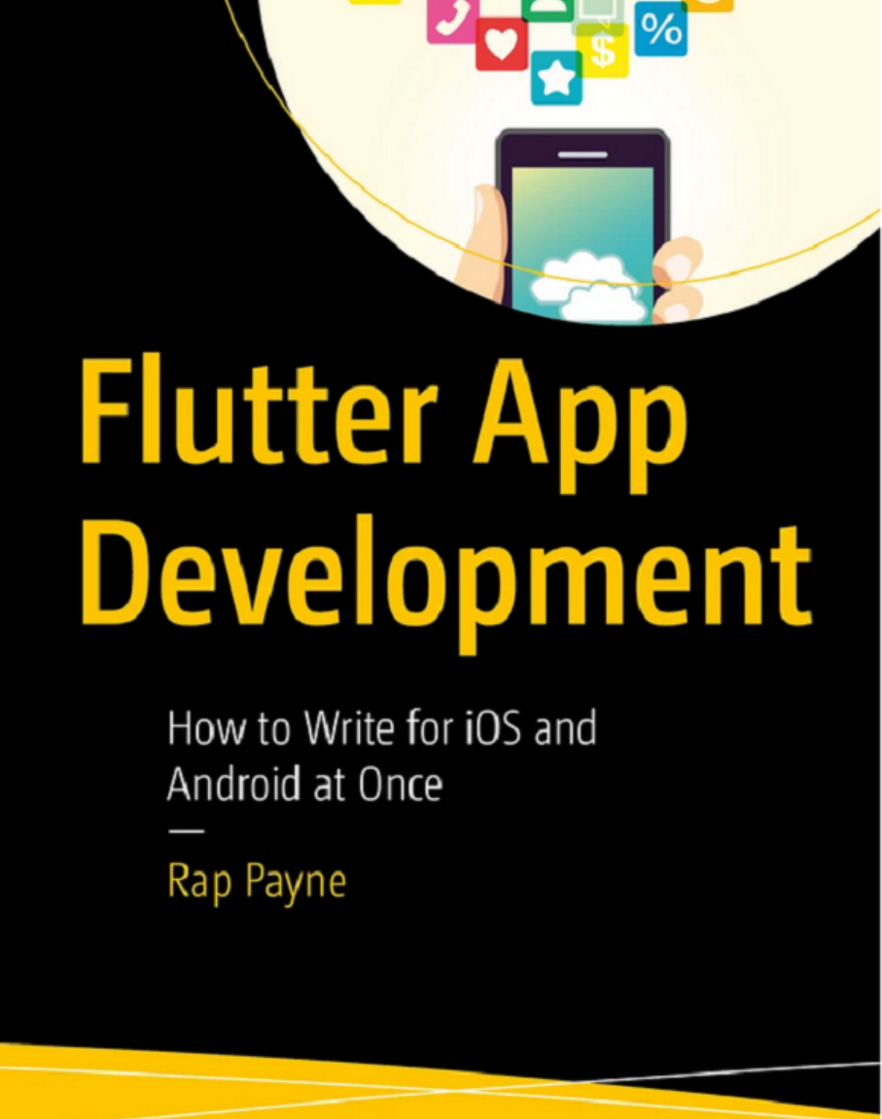
FLUTTER LAYOUT MASTERCLASS
1
Flutter Layout
Fixing Overflows
and Filling Extra Space
Professional lecture deck for third-year computer engineering students
Based on Chapter 13 and Chapter 14 of Flutter App Development (Rap Payne, 2024).
Focus: responsive layouts, constraints, overflow recovery, and intelligent space allocation
40-slide instructional presentation
Flutter layout lecture deck
Notes:
[Sources] - Primary source: user-provided PDF of Rap Payne, Flutter App Development, cover page and Chapters 13-14, pp. 201-228. [/Sources]

Slide 2
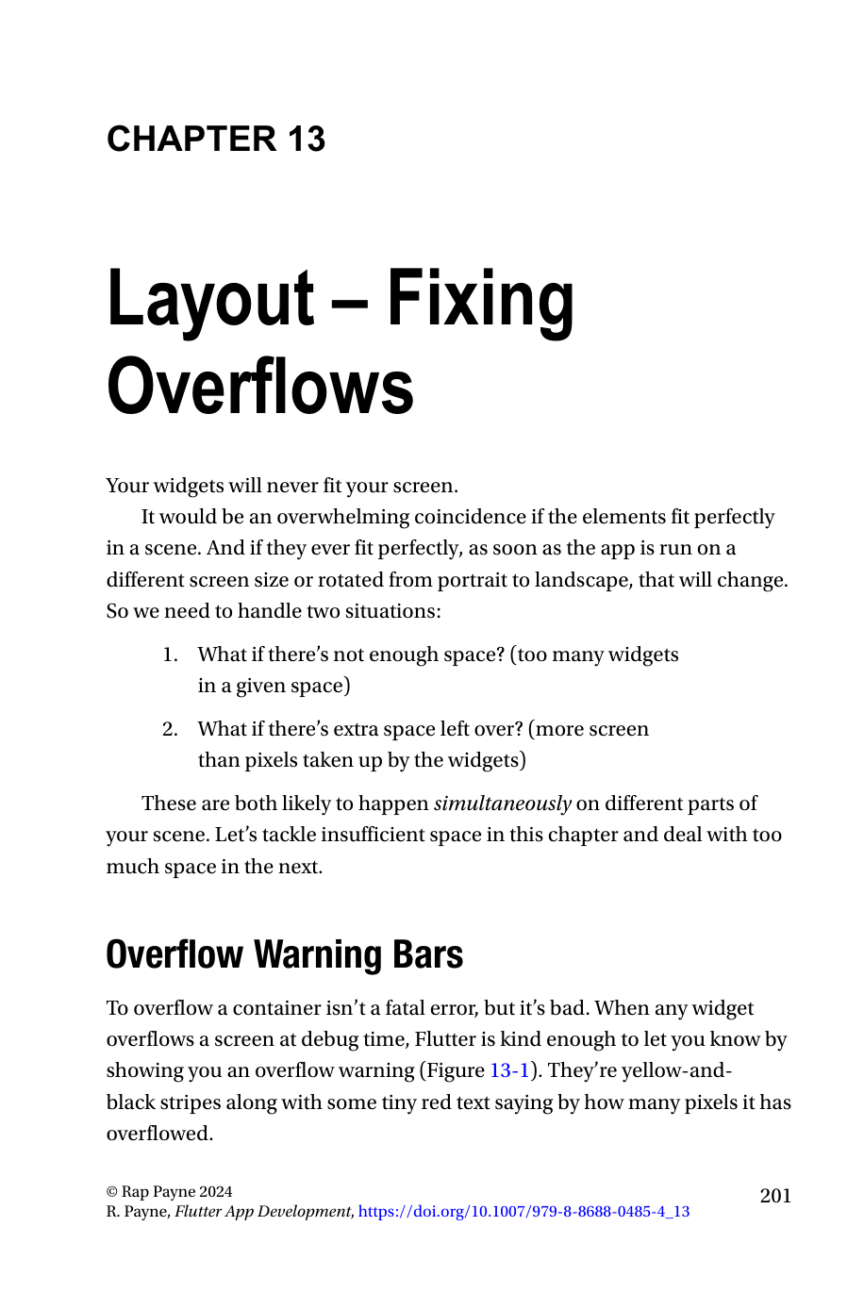
SCOPE AND AUDIENCE
2
Source, scope, and expected background
Why these chapters matter in a production Flutter workflow
The book positions Chapter 13 as the answer to “what do we do when we are trying to draw more than fits on the screen?” and Chapter 14 as the complement: “what do we do when there is less content than screen space?”
These chapters sit inside a five-step layout process: layout the scene, position widgets, fix overflows, fill extra space, and then fine-tune positioning.
The author explicitly targets developers who already know an object-oriented language and want practical Flutter engineering patterns rather than theory alone.
For third-year computer engineers, the useful lens is constraint-driven design: every widget tree is solving a geometry problem under changing display conditions.
Flutter layout lecture deck
Notes:
[Sources] - Rap Payne, Flutter App Development, audience and chapter scope on pages xxi-xxiv and chapter openings on pp. 201 and 219 of the provided PDF. [/Sources]

Slide 3
CONTEXT
3
The five-step Flutter layout pipeline
This sequence is pedagogically important: overflow fixes only make sense after you understand how widgets are already being positioned.
Likewise, space-filling rules are not cosmetic. They are a second-stage optimization applied after correctness has been restored.
In exam terms: solve for fit first, aesthetics second.
Chapters 13 and 14 cover steps 3 and 4
Step | Intent | Representative widgets
1 | Layout the whole scene | MaterialApp, Scaffold, AppBar, SafeArea
2 | Position widgets relative to each other | Row, Column, Flex, MediaQuery
3 | Fix overflows when content exceeds constraints | Wrap, Flexible, FittedBox, SingleChildScrollView, ListView, GridView
4 | Fill extra space elegantly | mainAxisAlignment, crossAxisAlignment, IntrinsicWidth, Expanded, Spacer, SizedBox
5 | Fine-tune placement | Padding, Margin, Alignment, Container decorations
Key engineering idea: every layout problem is a constraints problem, not a pixel-painting problem.
Flutter layout lecture deck
Notes:
[Sources] - Based on the five-step layout process summarized in Chapter 11 and reiterated at the opening of Chapter 14, provided PDF pp. 177-181 and 219-220. [/Sources]

Slide 4
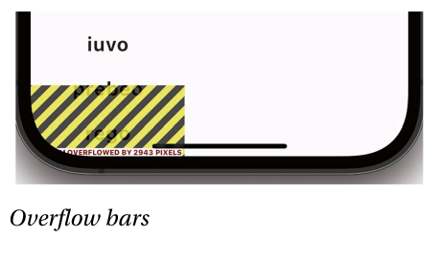
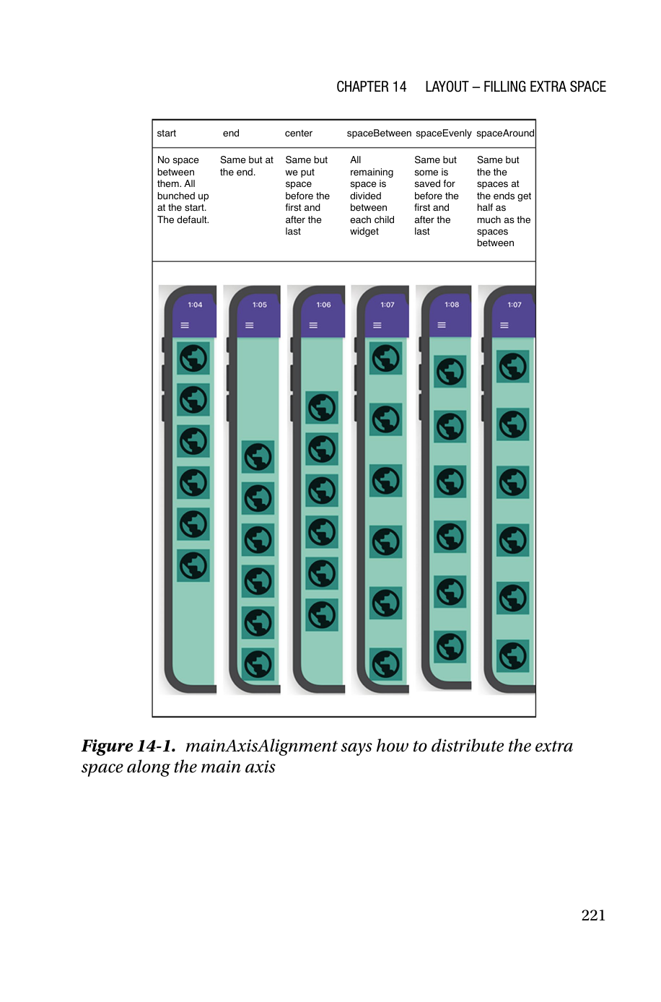
ROADMAP
4
Two complementary failure modes in layout
Overflow and leftover space often occur in different regions of the same scene
Condition | Symptom in UI | Primary question | Typical recovery
Insufficient space | Yellow/black warning bars in debug, clipped content in release | Which content must remain visible and interactive? | Wrap it, compress it, or make it scroll
Excess space | Loose composition, awkward gaps, uneven rhythm | Where should the free room be allocated? | Align, stretch, expand, or insert controlled whitespace
Flutter does not “guess” the best visual answer. It reports the geometry issue and then relies on the developer to encode the right policy.
The right policy depends on content semantics: words wrap naturally; photos often scale; records, feeds, and catalogs usually scroll.
Flutter layout lecture deck
Notes:
[Sources] - Primary material from Chapter 13 overflow warning bars and Chapter 14 alignment discussion, provided PDF pp. 202 and 221-222. [/Sources]

Slide 5
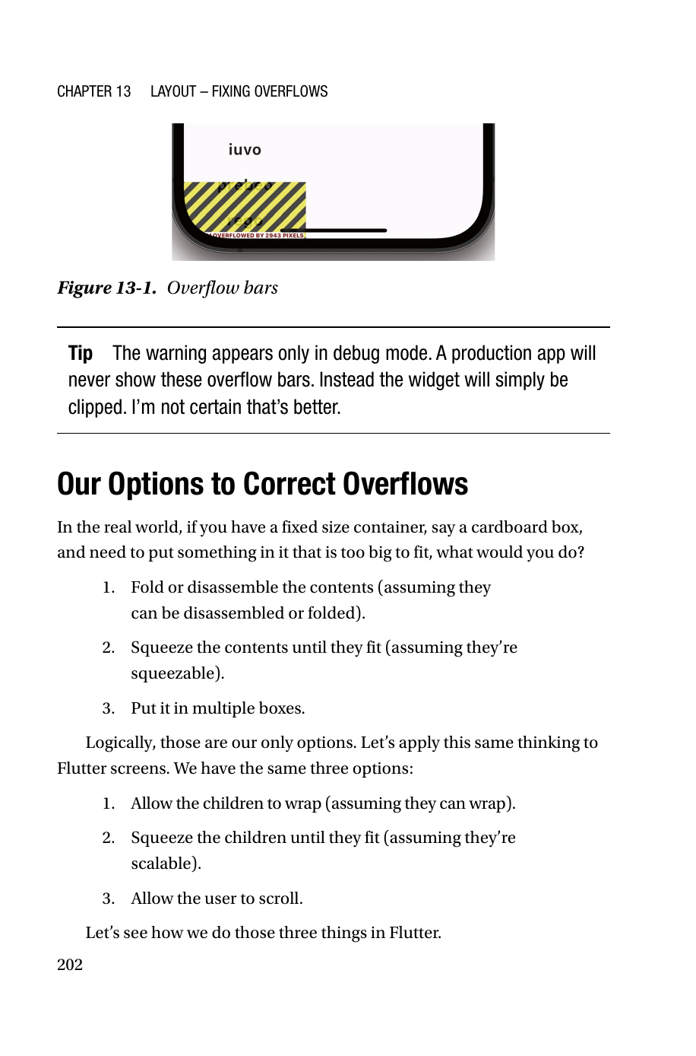
CHAPTER 13
5
Overflow warning bars are a diagnostic, not a crash
Flutter warns loudly in debug mode when a widget paints outside its box
The author is explicit: an overflow is “not a fatal error, but it’s bad.” In debug mode Flutter overlays yellow-and-black stripes plus the number of overflowed pixels.
In release builds, the app does not show the warning bars. The overflowing widget is simply clipped, which can hide data or remove interaction affordances.
Therefore the warning is a design-time observability feature. Treat it the same way you would treat a compiler warning about undefined behavior: not immediately fatal, but unsafe to ignore.
For students: the key mistake is assuming that “works on my phone” means the layout is solved. Rotation, text scaling, localization, and smaller screens invalidate that assumption.
Flutter layout lecture deck
Notes:
[Sources] - Rap Payne, Flutter App Development, Chapter 13 “Overflow Warning Bars,” provided PDF pp. 201-202; figure shown from page 202. [/Sources]

Slide 6
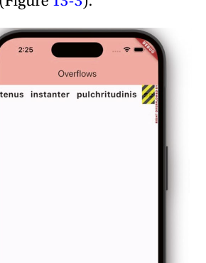
CHAPTER 13
6
Why overflows are normal in real systems
A responsive UI is expected to encounter constraint mismatches
Mental model: content demand > available constraint budget = overflow
The chapter starts with a blunt premise: “Your widgets will never fit your screen.” The point is not pessimism; it is variability. A perfect fit on one device is a coincidence, not a stable property.
Overflows emerge because constraints change across device classes, orientations, system text scales, and data sizes. A static widget tree is executed against dynamic constraints.
This makes Flutter layout closer to constraint solving than pixel design. Every Row, Column, Flex, or scrollable must encode what should happen when demand exceeds supply.
Engineering consequence: always design a fallback policy before the bug report arrives. A layout without a fallback policy is incomplete.
Flutter layout lecture deck
Notes:
[Sources] - Chapter 13 opening discussion in provided PDF p. 201 and sample overflow example on p. 204. [/Sources]

Slide 7
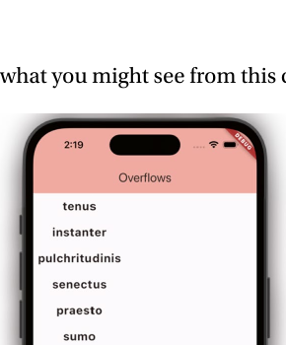
CHAPTER 13
7
The sample problem: same data, different container
A Column works; the same children in a Row overflow
1 Widget build(BuildContext context) { 2 var wordWidgets = words.map((w) => Word(w)).toList(); 3 return Column( 4 children: wordWidgets, 5 ); 6 }
The child list is identical.
Only the axis changes.
Rows consume horizontal budget; Columns consume vertical budget.
Constraint direction determines failure mode.
1 Widget build(BuildContext context) { 2 var wordWidgets = words.map((w) => Word(w)).toList(); 3 return Row( 4 children: wordWidgets, 5 ); 6 }
Flutter layout lecture deck
Notes:
[Sources] - Sample code and figures from Chapter 13 “A Sample Problem to Solve,” provided PDF pp. 203-204. [/Sources]

Slide 8
CHAPTER 13
8
The book’s three canonical overflow remedies
Flutter screens get the same three options you would apply to a physical box
Physical analogy | Flutter translation | Question to ask
Fold or disassemble contents | Allow children to wrap | Can this content legally break across lines or rows?
Squeeze contents until they fit | Use Flexible or FittedBox | Can this content compress without losing meaning or usability?
Put it in multiple boxes | Allow scrolling | Is sequential access acceptable for the user task?
This framing is strong because it is semantic, not widget-first. Start by deciding what your content is allowed to do; only then pick the widget that encodes that permission.
Flutter layout lecture deck
Notes:
[Sources] - Chapter 13 “Our Options to Correct Overflows,” provided PDF p. 202. [/Sources]

Slide 9
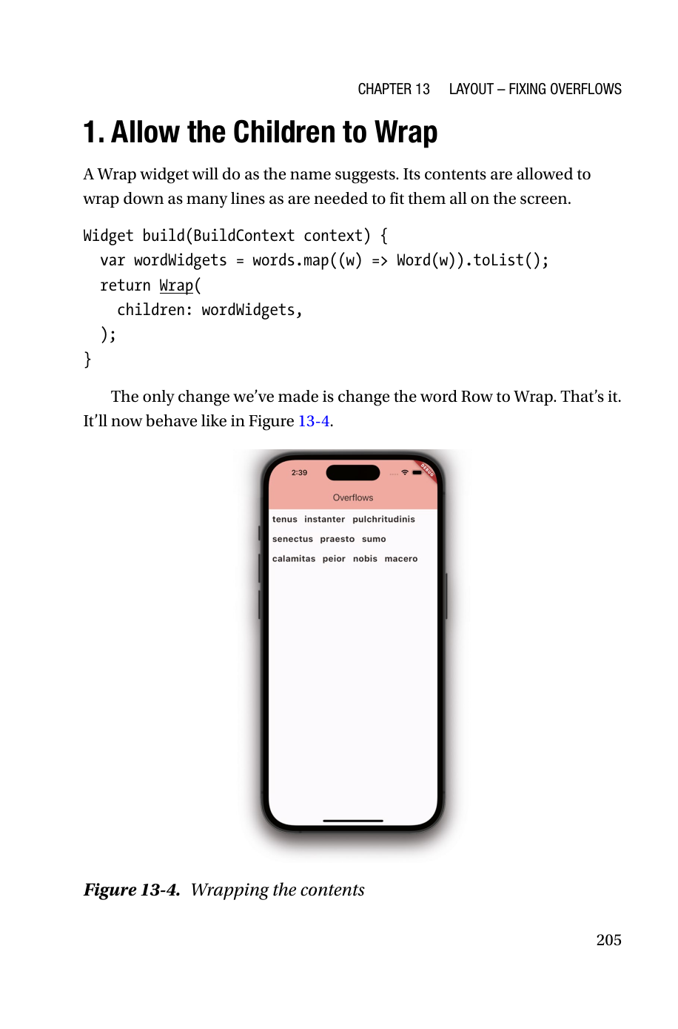
WRAP STRATEGY
9
Strategy 1 - Allow the children to wrap
Use Wrap when the content can reflow naturally into multiple runs
The Wrap widget is the most semantically natural answer for collections of short, independent items such as words, tags, chips, skills, or filter pills.
Only one structural change is required in the example: replace Row with Wrap. Flutter then moves children to a new run when the current run cannot fit another child.
Wrap preserves visibility without shrinking typography or forcing scrolling, so information scent remains high and the interaction is still direct.
However, Wrap changes the geometry of the scene. Downstream widgets must tolerate the new height created by additional runs.
1 return Wrap( 2 children: wordWidgets, 3 );
Flutter layout lecture deck
Notes:
[Sources] - Chapter 13 “Allow the Children to Wrap,” provided PDF p. 205. [/Sources]

Slide 10
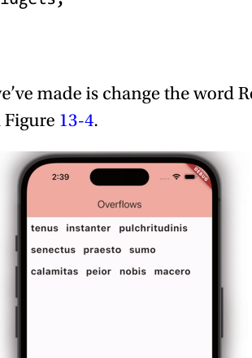
WRAP STRATEGY
10
Wrap is ideal for discrete, flow-like UI elements
Think in terms of content semantics, not just syntax
Good fit for Wrap | Poor fit for Wrap
Words, tags, chips, badges | Dense forms where row alignment matters
Photo thumbnails or small cards that may tile | Controls that must stay in one scan line
Adaptive toolbars with optional actions | Large paragraphs better handled by scrolling
Wrap is effectively a non-scrolling reflow container. It optimizes visibility at the cost of increased scene height.
For engineering decisions, ask whether the user benefits from seeing “more at once” or from preserving a strict alignment model.
Flutter layout lecture deck
Notes:
[Sources] - Wrap example and discussion in Chapter 13, provided PDF pp. 205-206. [/Sources]

Slide 11
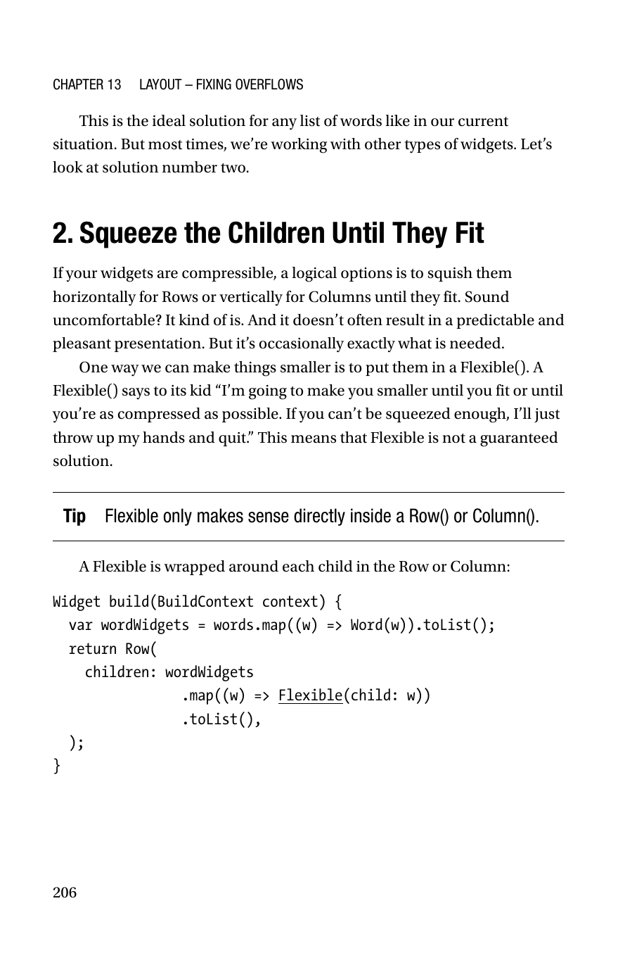
FLEXIBLE STRATEGY
11
Strategy 2 - Squeeze the children until they fit
Flexible asks the child to compress along the main axis
Flexible is appropriate only when the child can tolerate compression. The chapter emphasizes that this is often uncomfortable and visually unpredictable, but sometimes exactly necessary.
In a Row, Flexible compresses horizontally; in a Column, vertically. The parent remains a Row or Column, but each child is wrapped in Flexible.
The author explicitly warns that Flexible is not guaranteed to solve the issue. If the child cannot shrink enough, overflow can still occur.
Exam takeaway: Flexible is a negotiation widget, not a magic “fix layout” widget.
1 return Row( 2 children: wordWidgets 3 .map((w) => Flexible(child: w)) 4 .toList(), 5 );
Flutter layout lecture deck
Notes:
[Sources] - Chapter 13 “Squeeze the Children Until They Fit,” provided PDF pp. 206-207. [/Sources]

Slide 12
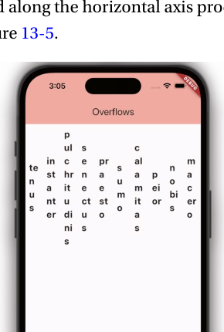
FLEXIBLE STRATEGY
12
Direct consequences of Flexible
Compression changes internal line breaking and therefore the information hierarchy
When text widgets are compressed, Flutter may wrap them inside each compressed child. The scene fits, but the reading pattern changes from linear scan to stacked scan.
This matters for usability. A compressed toolbar might still “fit” technically while becoming cognitively expensive to parse.
The author also notes a rule worth memorizing: Flexible only makes sense directly inside a Row or Column, because those are the flex parents that know how to allocate the remaining main-axis budget.
Use Flexible when preserving one container is more important than preserving each child’s preferred size.
Compression trades predictability for fit.
Flutter layout lecture deck
Notes:
[Sources] - Flexible example and explanatory text in Chapter 13, provided PDF pp. 206-207. [/Sources]

Slide 13
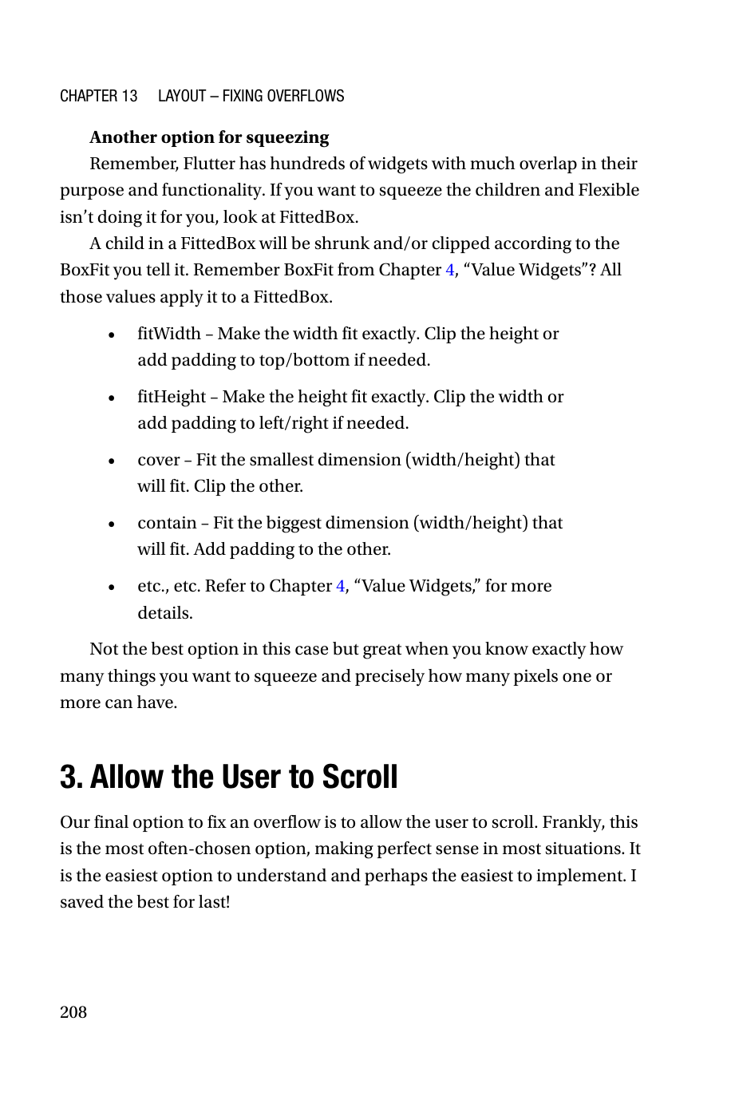
FLEXIBLE ALTERNATIVES
13
FittedBox is the more aggressive scaling alternative
It shrinks and/or clips a child according to BoxFit rules
If Flexible does not compress the child in a satisfactory way, the chapter suggests looking at FittedBox.
Unlike Flexible, FittedBox is explicit about how the child should be scaled or clipped. Relevant BoxFit modes include fitWidth, fitHeight, cover, and contain.
FittedBox is powerful when you know the exact viewport budget and can accept clipping or letterboxing. It is much less suitable for arbitrary text-heavy content where readability is the first requirement.
BoxFit mode | What it optimizes | Typical risk
fitWidth | Exact width match | Vertical clipping or padding
fitHeight | Exact height match | Horizontal clipping or padding
cover | Fill by smallest fitting dimension | One dimension clipped
contain | Keep full child visible | Unused space added
Flutter layout lecture deck
Notes:
[Sources] - Chapter 13 “Another option for squeezing,” provided PDF p. 208. [/Sources]

Slide 14
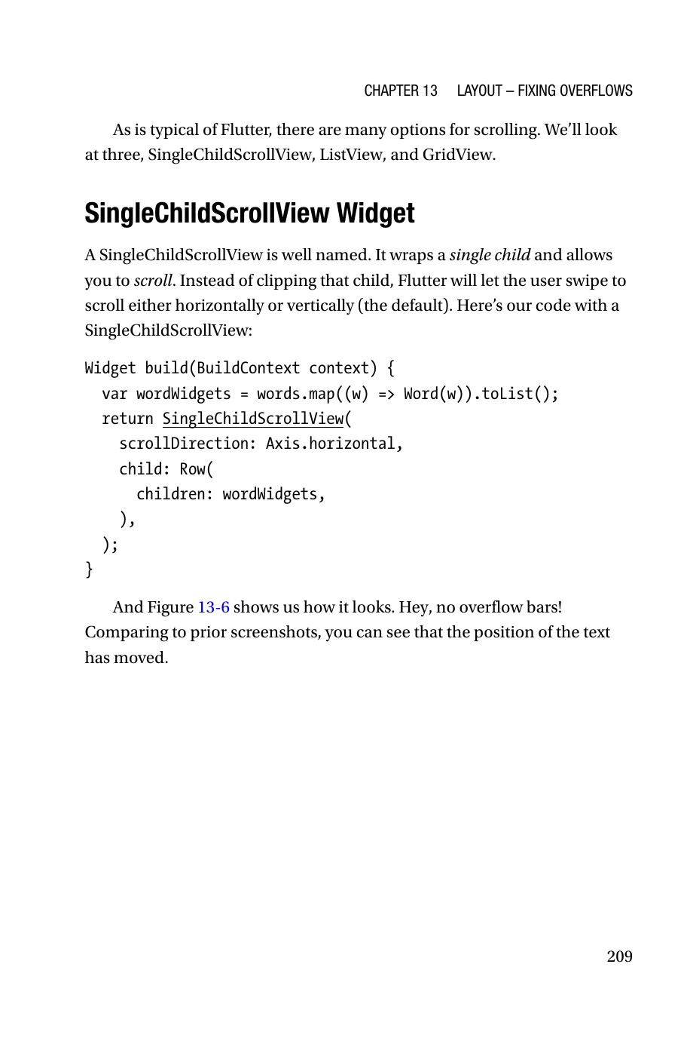
SCROLLING
14
Strategy 3 - Allow the user to scroll
The most common and often the best production answer
The chapter calls scrolling the easiest option to understand and often the most sensible. Instead of forcing all content into one viewport, you give the user a navigation path through the content.
This is not a surrender. It is a deliberate human-computer interaction decision: preserve content fidelity and accept sequential access.
Flutter offers many scrollable widgets, but the chapter concentrates on three that cover most practical needs: SingleChildScrollView, ListView, and GridView.
Rule of thumb: if the content is inherently long or open-ended, scrolling is usually the correct abstraction.
Flutter layout lecture deck
Notes:
[Sources] - Chapter 13 “Allow the User to Scroll,” provided PDF pp. 208-209. [/Sources]

Slide 15
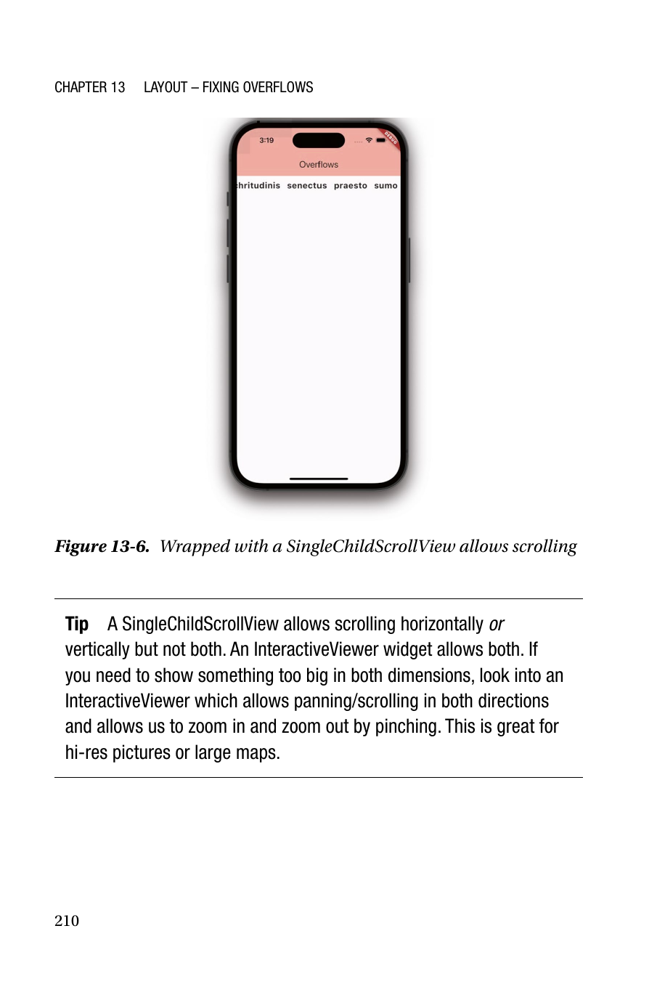
SINGLECHILDSCROLLVIEW
15
SingleChildScrollView - one child, one scroll axis
Best for a single composite child that must remain intact
1 return SingleChildScrollView( 2 scrollDirection: Axis.horizontal, 3 child: Row( 4 children: wordWidgets, 5 ), 6 );
The widget wraps exactly one child and then exposes horizontal or vertical scrolling over that child. In the example, the Row remains the child, but now the viewport can pan horizontally.
The chapter notes an important limitation: SingleChildScrollView scrolls in one axis, not both. For bi-directional panning you would need a different interaction model such as InteractiveViewer.
Use this when the subtree is conceptually a single artifact - for example, a form, a wide row, or a long column.
Flutter layout lecture deck
Notes:
[Sources] - Chapter 13 “SingleChildScrollView Widget,” provided PDF pp. 209-210. [/Sources]

Slide 16
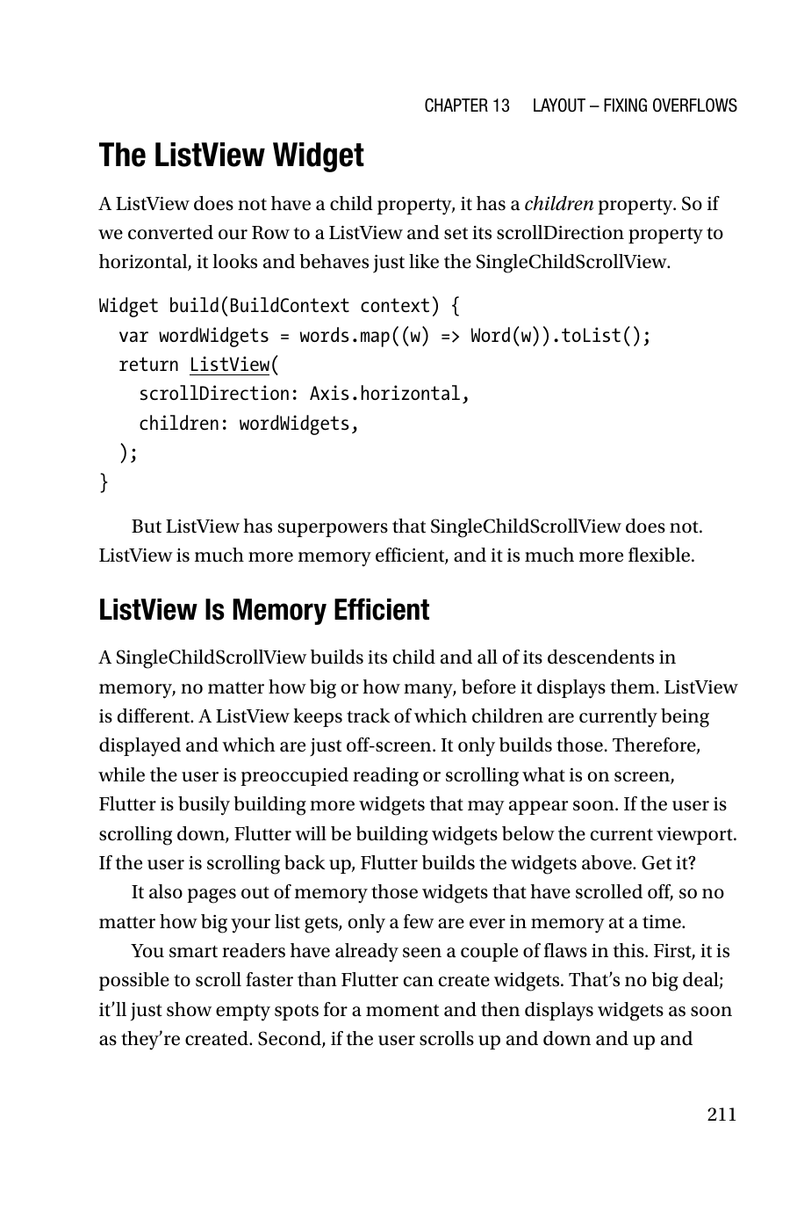
LISTVIEW
16
ListView looks similar, but the semantics are different
children property plus built-in scrolling behavior
1 return ListView( 2 scrollDirection: Axis.horizontal, 3 children: wordWidgets, 4 );
At the API surface, ListView can resemble SingleChildScrollView because both can display horizontally or vertically scrollable content.
But ListView is not just “a scroll wrapper.” It is a list container designed specifically for sequences of items and therefore comes with stronger performance and construction patterns.
The chapter’s wording is useful: ListView has superpowers that SingleChildScrollView does not.
Flutter layout lecture deck
Notes:
[Sources] - Chapter 13 “The ListView Widget,” provided PDF p. 211. [/Sources]

Slide 17
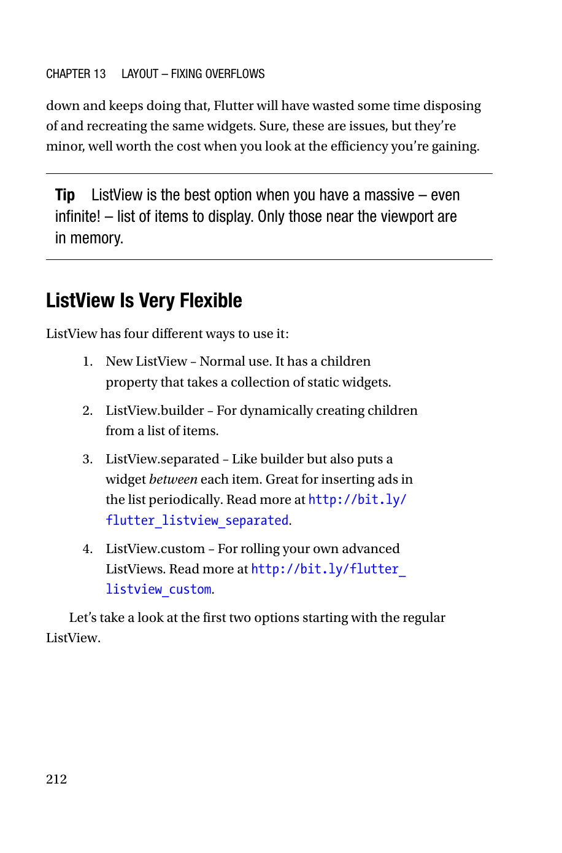
LISTVIEW INTERNALS
17
Why ListView is memory efficient
Container | Build strategy | Scales to huge lists?
SingleChildScrollView | Build whole subtree eagerly | Poorly
ListView | Build near viewport lazily | Yes
Only widgets near the viewport are built and retained
The book contrasts ListView with SingleChildScrollView by explaining allocation strategy. SingleChildScrollView builds its child and all descendants up front, regardless of size.
ListView tracks the viewport and only builds items currently visible or just off-screen. As the user scrolls, Flutter creates upcoming widgets and can page out widgets that have moved away.
This is a classic systems trade-off: a small amount of runtime churn buys substantial memory savings and scalability.
The chapter’s headline guidance is worth remembering verbatim: ListView is the best option when you have a massive, even infinite, list.
Flutter layout lecture deck
Notes:
[Sources] - Chapter 13 “ListView Is Memory Efficient,” provided PDF pp. 211-212. [/Sources]

Slide 18
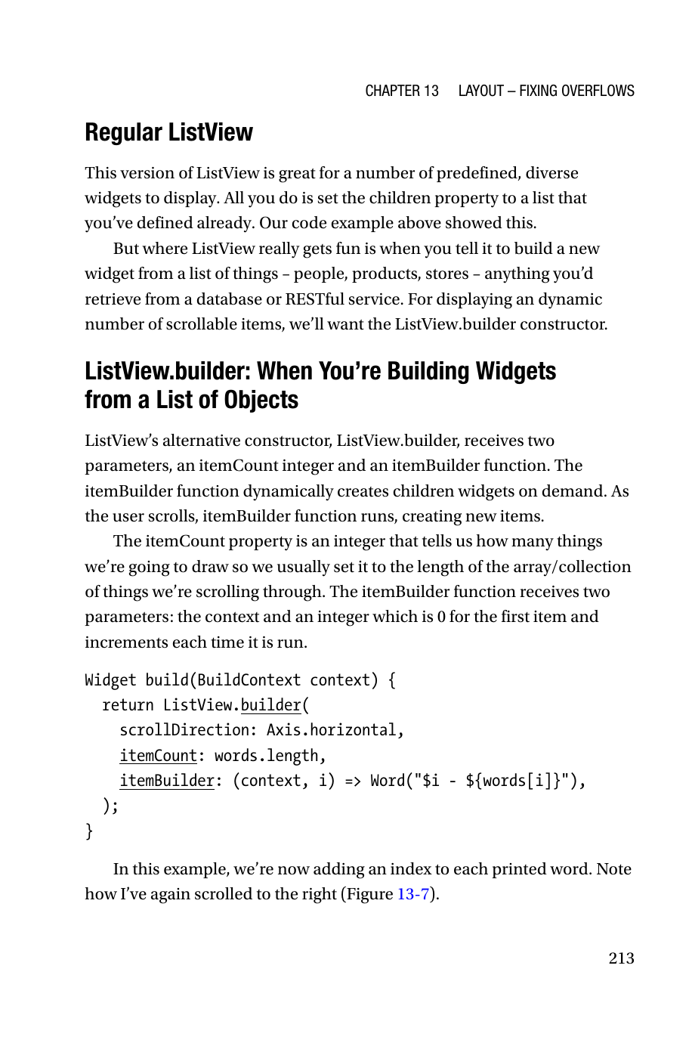
LISTVIEW PATTERNS
18
Four ways to use ListView
Choose the constructor that matches how items are produced
Variant | Use case | Why it exists
ListView | Predefined static widgets | Simplest API when children already exist
ListView.builder | Generate widgets from data on demand | Best general solution for dynamic collections
ListView.separated | Insert a widget between items | Useful for dividers or periodic ads
ListView.custom | Advanced custom sliver behavior | Specialized control path
From a software architecture perspective, the constructors encode different production strategies: static composition, lazy generation, decorated generation, and custom sliver delegation.
Flutter layout lecture deck
Notes:
[Sources] - Chapter 13 “ListView Is Very Flexible” and “ListView.builder,” provided PDF pp. 212-213. [/Sources]

Slide 19
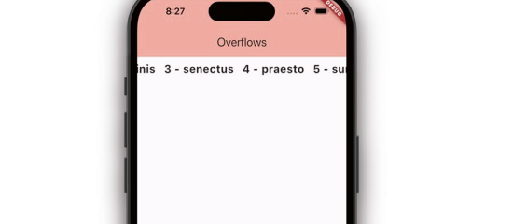
LISTVIEW.BUILDER
19
ListView.builder - the data-driven list constructor
Widget creation is delegated to itemBuilder(context, index)
1 return ListView.builder( 2 scrollDirection: Axis.horizontal, 3 itemCount: words.length, 4 itemBuilder: (context, i) => 5 Word("$i - ${words[i]}"), 6 );
The builder pattern separates data storage from widget instantiation. itemCount declares the cardinality; itemBuilder is the factory function that maps index to widget.
For computer engineers, this is an important abstraction boundary: a list view is not storing widgets as the primary asset; it is storing a recipe for generating them.
This enables lazy construction, better memory behavior, and straightforward integration with remote or database-backed collections.
Flutter layout lecture deck
Notes:
[Sources] - Chapter 13 “ListView.builder,” provided PDF pp. 213-214. [/Sources]

Slide 20
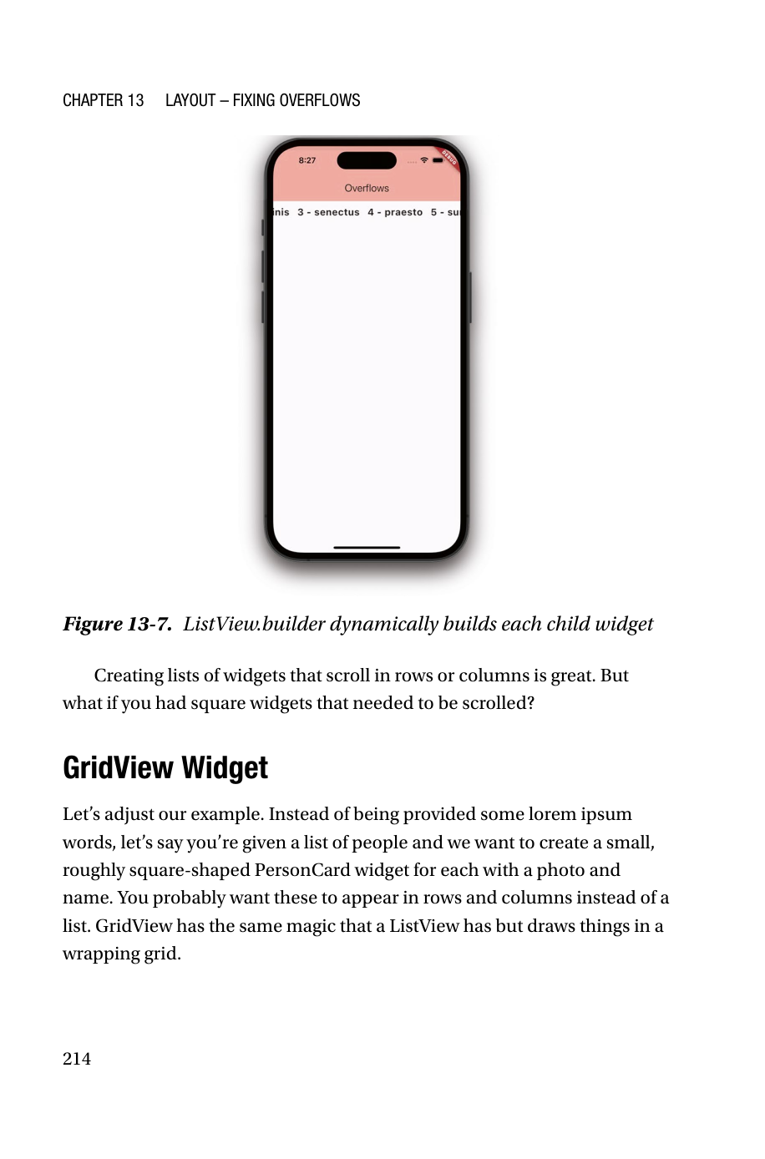
GRIDVIEW
20
GridView - scrolling for roughly square or tiled content
Use it when one-dimensional lists are the wrong visual model
The chapter introduces GridView through a practical shift in data shape: instead of a list of words, imagine a collection of PersonCard widgets with photo and name.
The design requirement changes. Users typically want to scan such items in rows and columns rather than one long linear list. GridView gives the same “lazy scrollable collection” idea as ListView but in a wrapping grid.
The biggest win is that Flutter handles both the tiling and the scrolling policy for you.
Flutter layout lecture deck
Notes:
[Sources] - Chapter 13 “GridView Widget,” provided PDF p. 214. [/Sources]

Slide 21

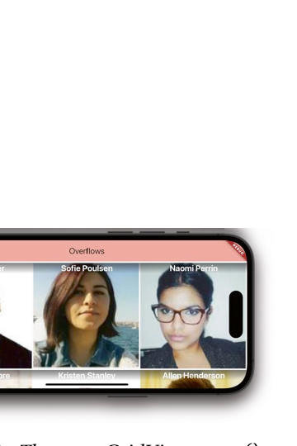
GRIDVIEW.EXTENT
21
GridView.extent - specify the maximum child width
Column count adapts to available width and orientation
1 return GridView.extent( 2 maxCrossAxisExtent: 300.0, 3 children: _peopleList 4 .map<Widget>((p) => PersonCard(p)) 5 .toList(), 6 );
The term extent refers to the maximum cross-axis size of a child. GridView decides how many items can fit per row and then shrinks them equally until the row fits the available width.
As a result, orientation changes naturally alter the number of tiles per row. This is a responsive design mechanism, not merely a convenience constructor.
Flutter layout lecture deck
Notes:
[Sources] - Chapter 13 “GridView.extent()”, provided PDF pp. 215-216 and Figures 13-8/13-9. [/Sources]

Slide 22
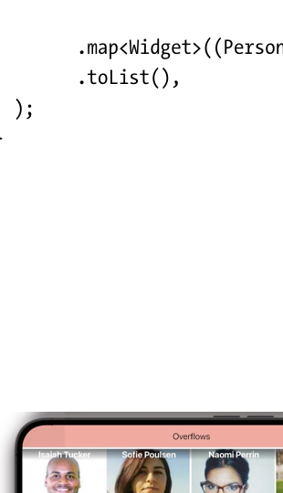
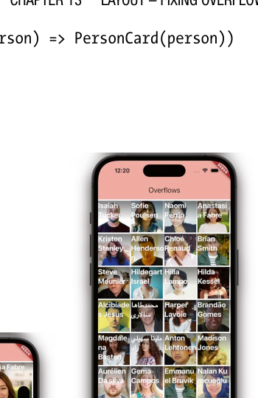
GRIDVIEW.COUNT
22
GridView.count - specify the number of columns
Tile size becomes dependent on a fixed crossAxisCount
1 return GridView.count( 2 crossAxisCount: 4, 3 children: _peopleList 4 .map<Widget>((p) => PersonCard(p)) 5 .toList(), 6 );
Unlike extent(), count() fixes the number of columns regardless of orientation. Flutter then resizes the children so exactly that many fit across the row.
This is useful when the application needs a stable visual rhythm - for example, a known dashboard grid or a controlled gallery layout.
Choose count() when column cardinality is the requirement; choose extent() when maximum tile width is the requirement.
Flutter layout lecture deck
Notes:
[Sources] - Chapter 13 “GridView.count()”, provided PDF pp. 216-217 and Figures 13-10/13-11. [/Sources]

Slide 23
DECISION MATRIX
23
How to choose among wrap, squeeze, and scroll
A design policy matrix for engineering decisions
Question | If YES | If NO
Can items naturally break into multiple runs? | Prefer Wrap | Check compression or scrolling
Can each child shrink without losing meaning/usability? | Consider Flexible or FittedBox | Do not compress; prefer wrap or scrolling
Is the collection potentially large or unbounded? | Prefer ListView/GridView | Static composition may be fine
Must the user compare multiple items at once? | Favor Wrap or GridView | Sequential scroll may be acceptable
Is fixed alignment more important than showing all items at once? | Favor scrolling containers | Wrap may be superior
Best exam answer: justify the widget by content behavior, not by memorized names.
Flutter layout lecture deck
Notes:
[Sources] - Synthesized from Chapter 13 strategies and examples, provided PDF pp. 202-217. [/Sources]

Slide 24
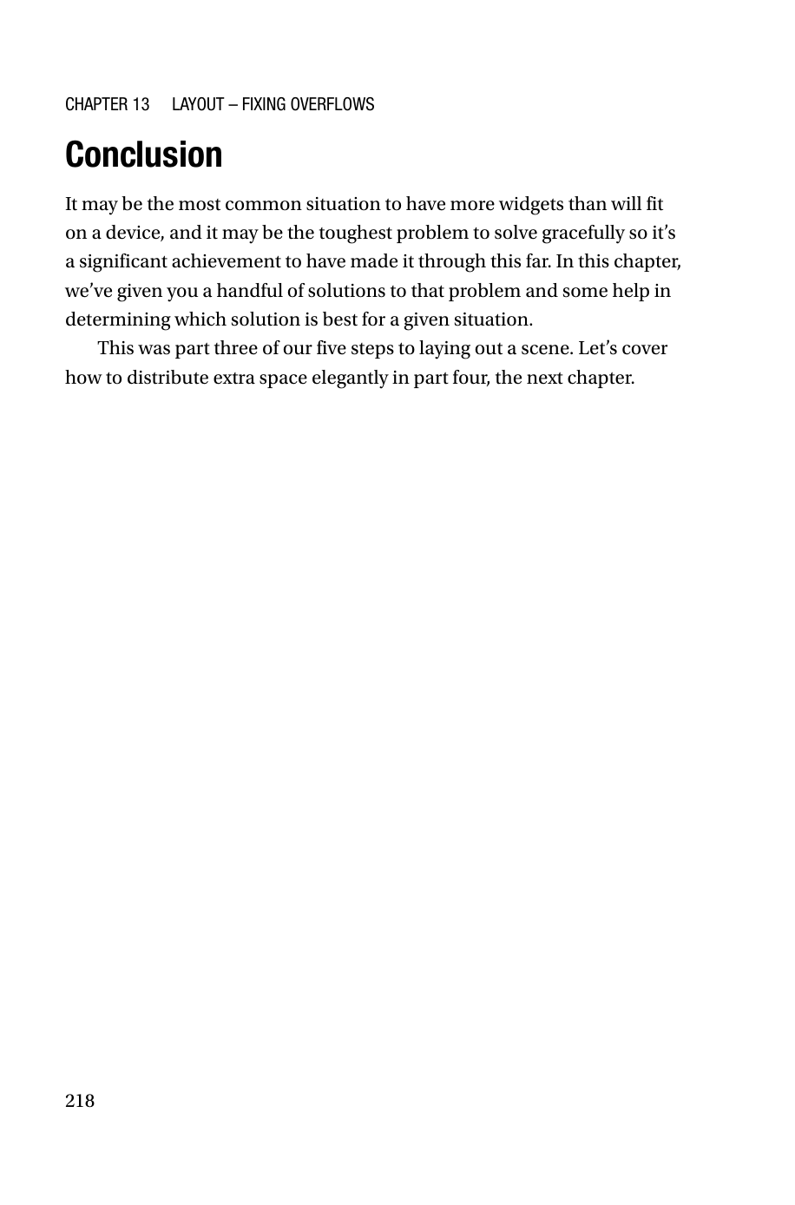
CHAPTER 13 RECAP
24
Chapter 13 summary - overflow control as a constraints policy
What students should retain after the first half of the lecture
Overflow warnings are development-time evidence that the widget tree’s geometry policy is incomplete.
The three canonical remedies are reflow (Wrap), compression (Flexible/FittedBox), and sequential access (scrolling containers).
SingleChildScrollView is a simple one-child wrapper; ListView and GridView are collection-centric and far better for large or dynamic datasets.
ListView.builder is the default engineering pattern for data-backed lists because it separates item generation from layout and enables lazy construction.
GridView.extent and GridView.count solve different design intents: adaptive maximum tile width versus fixed column count.
Transition question: once the layout fits, how should the leftover room be distributed?
Flutter layout lecture deck
Notes:
[Sources] - Summary synthesized from Chapter 13 conclusion and preceding sections, provided PDF p. 218 and pp. 202-217. [/Sources]

Slide 25
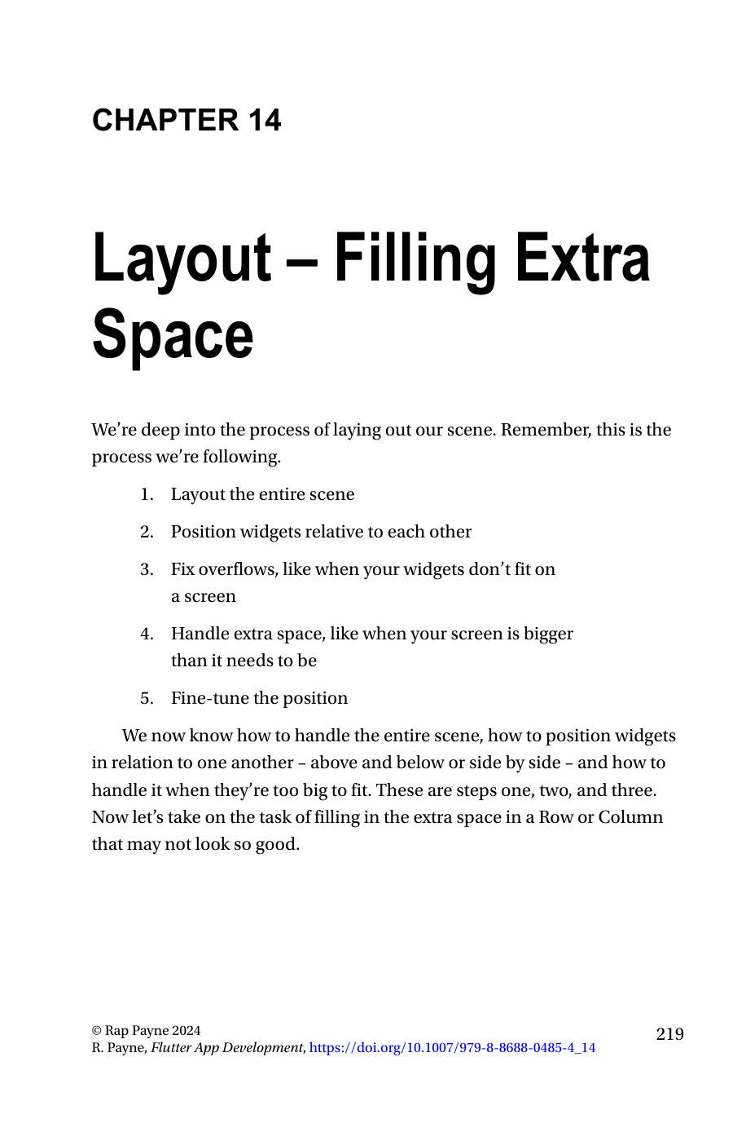
CHAPTER 14
25
Chapter 14 - the opposite problem: too much room
A well-fitting scene can still look poor if free space is not allocated intentionally
Chapter 14 continues the same layout workflow. After the scene fits, the next task is handling the unused room that remains inside Rows and Columns.
The problem is usually not correctness but aesthetics, readability, and visual hierarchy. Free space affects grouping, rhythm, scan path, and balance.
The chapter first addresses alignment-based distribution with mainAxisAlignment and crossAxisAlignment, then more structural controls such as IntrinsicWidth and Expanded.
Flutter layout lecture deck
Notes:
[Sources] - Chapter 14 opening page, provided PDF p. 219. [/Sources]

Slide 26
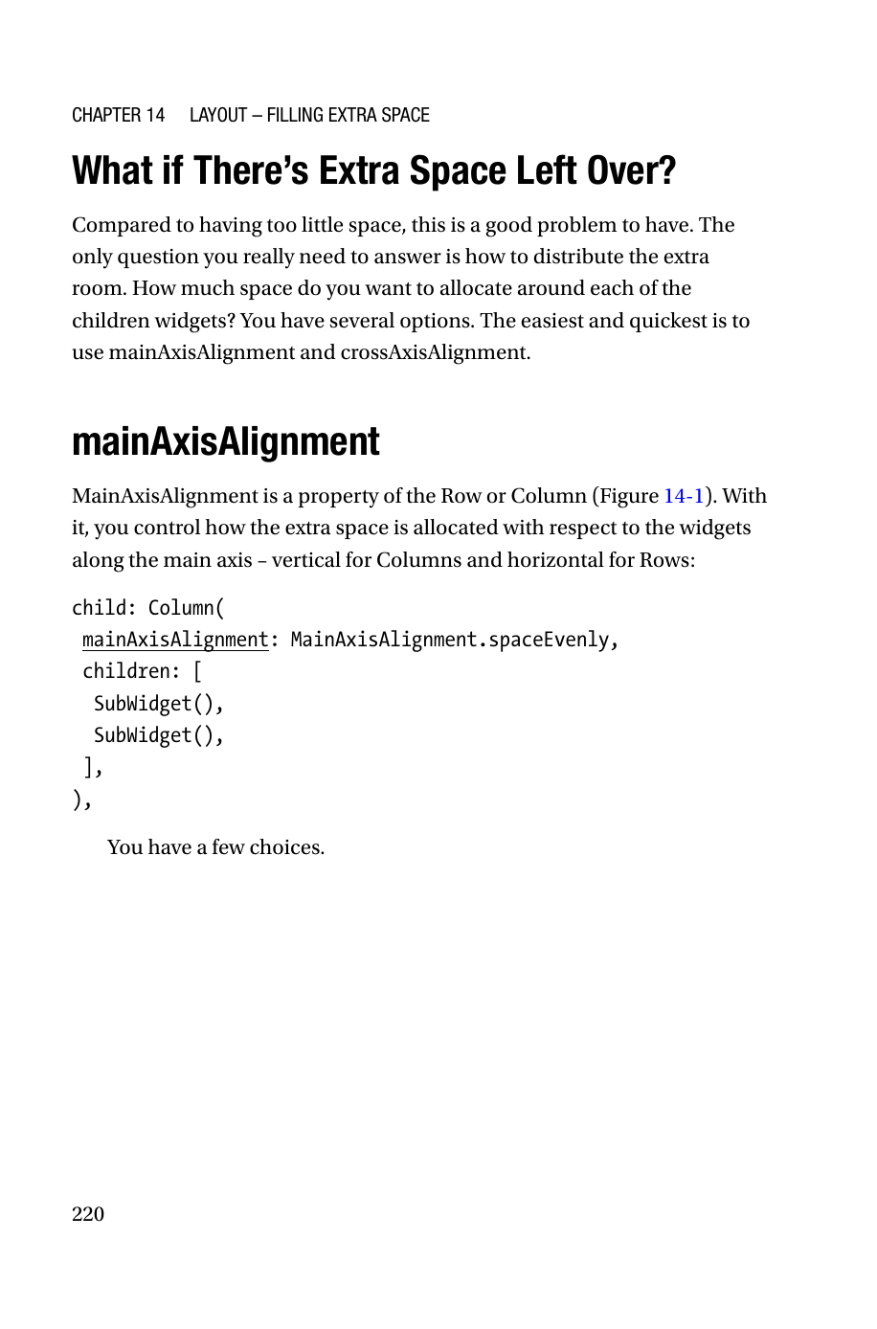
SPACE DISTRIBUTION
26
What exactly is “extra space”?
Unused budget along the main axis or cross axis of a flex container
In a Row or Column, children consume some amount of the available constraint budget. If the parent still has unallocated room after laying them out, that room must be distributed somehow.
The first question is axis-specific. Is the free room along the main axis - horizontal in a Row, vertical in a Column - or along the cross axis because children differ in size?
The chapter starts with the simplest answer: use alignment properties on the flex parent before reaching for heavier structural widgets.
Flutter layout lecture deck
Notes:
[Sources] - Chapter 14 “What if There’s Extra Space Left Over?” and beginning of mainAxisAlignment discussion, provided PDF p. 220. [/Sources]

Slide 27
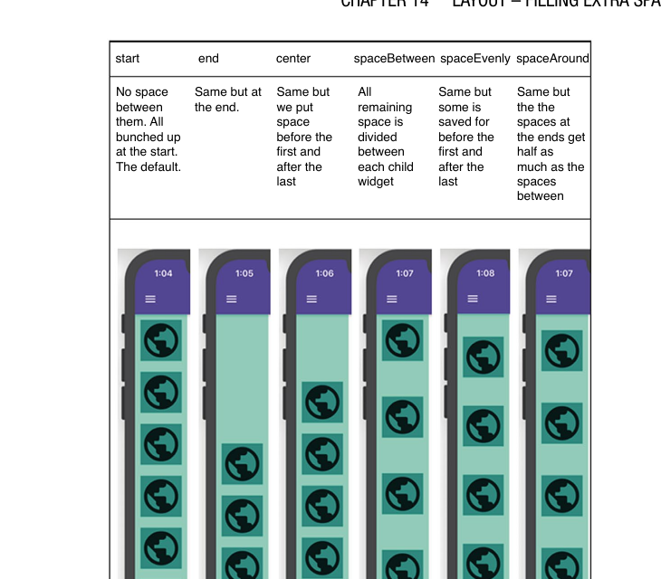
MAINAXISALIGNMENT
27
mainAxisAlignment controls free space on the main axis
Vertical in a Column, horizontal in a Row
1 Column( 2 mainAxisAlignment: MainAxisAlignment.spaceEvenly, 3 children: [ 4 SubWidget(), 5 SubWidget(), 6 ], 7 )
This property belongs to the flex parent, not to the children. It determines where the remaining slack budget is inserted after the children have received their own sizes.
The chapter’s examples show that the modes are not cosmetic synonyms. They encode different spacing contracts between the start edge, the end edge, and the gaps between children.
For interviews and exams: always say which axis you are talking about.
Flutter layout lecture deck
Notes:
[Sources] - Chapter 14 “mainAxisAlignment,” provided PDF pp. 220-221 and Figure 14-1. [/Sources]

Slide 28
MAIN AXIS ALIGNMENT MODES
28
Interpreting the six mainAxisAlignment modes
Each mode redistributes the same leftover space differently
Mode | Distribution logic | Typical use
start | No gap before first; pack at the start | Default dense stacking
end | Pack at the end | Bottom-anchored or right-anchored groups
center | Group in the middle | Balanced compact clusters
spaceBetween | All free room goes between children | Menus and equal separators
spaceEvenly | Equal space before, between, and after | Symmetric presentations
spaceAround | Internal gaps are twice the edge gaps | Soft breathing room around each child
Notice the subtle but important difference between spaceAround and spaceEvenly: edge spacing is half-sized in spaceAround.
Flutter layout lecture deck
Notes:
[Sources] - Chapter 14 Figure 14-1 and its explanation, provided PDF p. 221. [/Sources]

Slide 29
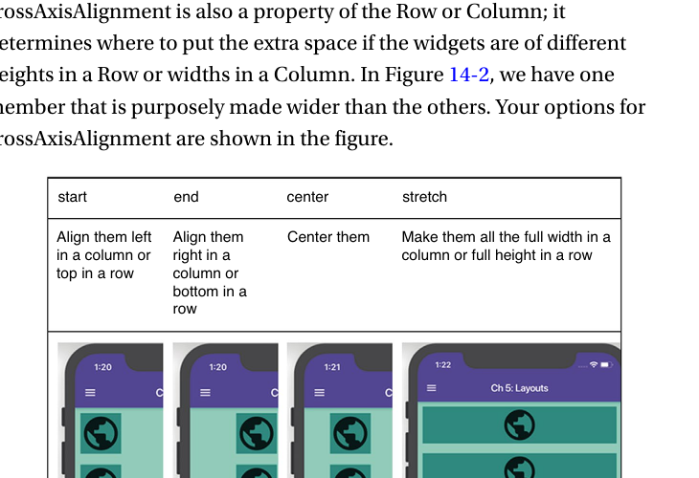
CROSSAXISALIGNMENT
29
crossAxisAlignment controls free space on the cross axis
It matters when children have different widths in a Column or heights in a Row
Where mainAxisAlignment redistributes leftover room between children, crossAxisAlignment decides how children sit relative to each other on the perpendicular axis.
If children are not all the same size, this decision changes visual balance dramatically. A wide child inside a Column or a tall child inside a Row becomes the reference point that reveals the policy.
The modes discussed here are start, end, center, and stretch; the chapter also briefly mentions baseline for Rows containing text of different heights.
Flutter layout lecture deck
Notes:
[Sources] - Chapter 14 “crossAxisAlignment,” provided PDF p. 222 and Figure 14-2. [/Sources]

Slide 30
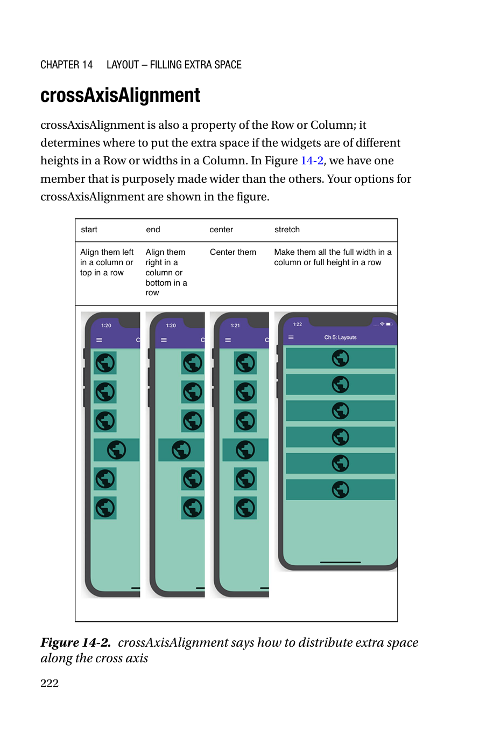
CROSSAXISALIGNMENT MODES
30
Choosing among start, end, center, stretch, and baseline
The choice affects readability and alignment discipline
Mode | Effect | Common implication
start | Align children to left in Column or top in Row | Ragged far edge
end | Align to right in Column or bottom in Row | Useful for right-weighted compositions
center | Center each child on the cross axis | Good for neutral compositions
stretch | Force full cross-axis size | Useful before IntrinsicWidth or for full-width controls
baseline | Align text baselines in Rows | Only meaningful for text of different heights
Baseline is the specialist mode: excellent for typographic polish, irrelevant for most non-text widgets.
Flutter layout lecture deck
Notes:
[Sources] - Chapter 14 discussion of crossAxisAlignment and baseline, provided PDF pp. 222-223. [/Sources]

Slide 31
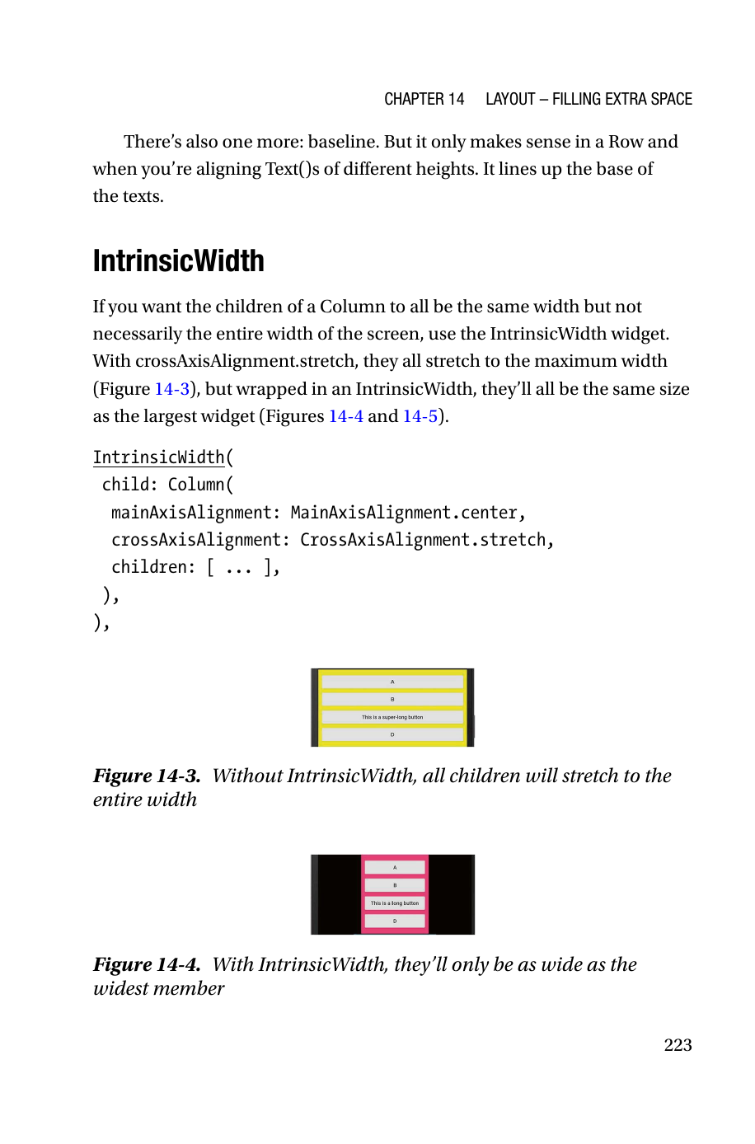
INTRINSIC WIDTH
31
Intrinsic Width - equalize widths without stretching to the full screen
Use it with crossAxisAlignment.stretch when you want all children as wide as the widest child
1 IntrinsicWidth( 2 child: Column( 3 mainAxisAlignment: MainAxisAlignment.center, 4 crossAxisAlignment: CrossAxisAlignment.stretch, 5 children: [ ... ], 6 ), 7 )
Without IntrinsicWidth, stretch makes each child expand to the entire available width. With IntrinsicWidth wrapped around the Column, the common width becomes the width of the largest child instead.
This is a subtle but elegant tool for forms, menus, and grouped controls that should look aligned but not absurdly wide.
Flutter layout lecture deck
Notes:
[Sources] - Chapter 14 “IntrinsicWidth,” provided PDF p. 223 and Figures 14-3/14-4. [/Sources]

Slide 32
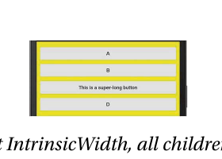
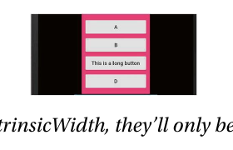
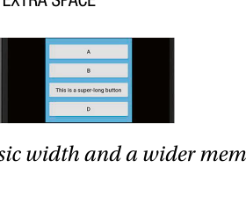
INTRINSICWIDTH
32
Before/after effect of IntrinsicWidth
The widest child becomes the common width reference
Figure 14-3 shows the stretch-only case: all children occupy the full width of the screen region.
Figure 14-4 adds IntrinsicWidth, reducing the group to the width of the current widest child.
Figure 14-5 then increases one child’s natural width, and every sibling grows to match that new maximum. This proves that the controlling dimension is intrinsic child width, not parent width.
In systems terms, IntrinsicWidth asks Flutter to query children for preferred size before finalizing the parent geometry.
Flutter layout lecture deck
Notes:
[Sources] - Chapter 14 Figures 14-3, 14-4, and 14-5, provided PDF pp. 223-224. [/Sources]

Slide 33
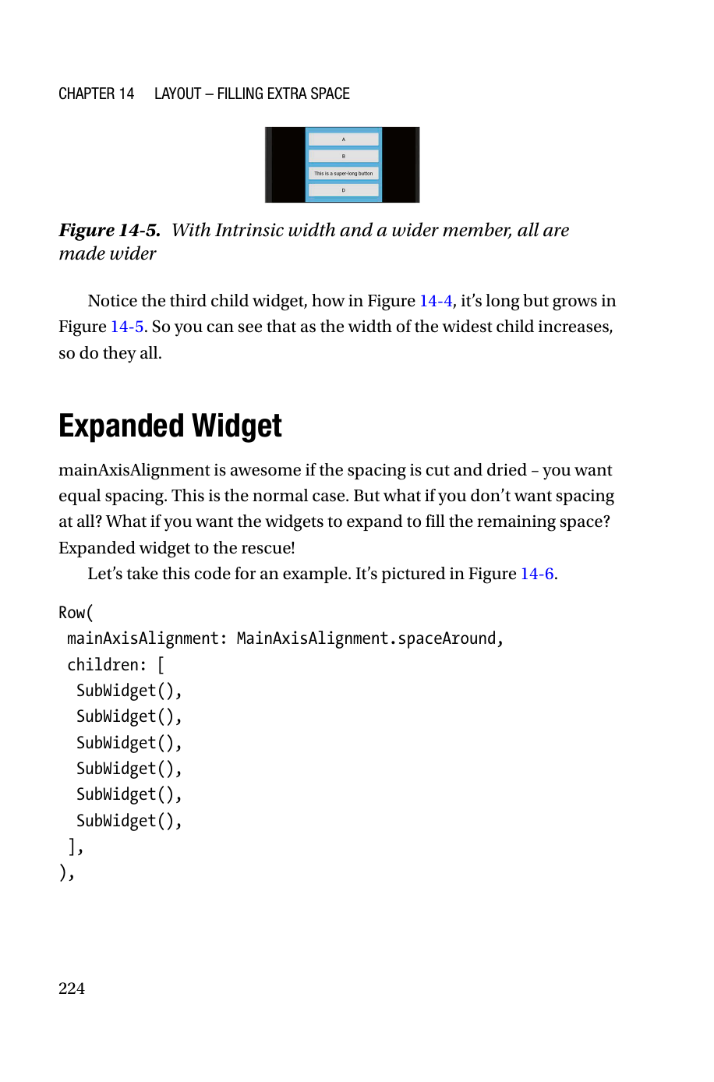
EXPANDED
33
Expanded is the structural answer to leftover room
Instead of inserting gaps, let specific children consume the slack
The chapter transitions from alignment-based spacing to a more structural idea: sometimes you do not want empty space at all. You want a child to grow and occupy it.
Wrapping a Row or Column child in Expanded makes that child flexible along the main axis. Any free room is assigned to the Expanded children rather than left as a gap controlled by mainAxisAlignment.
This changes the semantics of the layout from “space around widgets” to “widgets absorb available capacity.”
Flutter layout lecture deck
Notes:
[Sources] - Chapter 14 “Expanded Widget,” provided PDF p. 224. [/Sources]

Slide 34
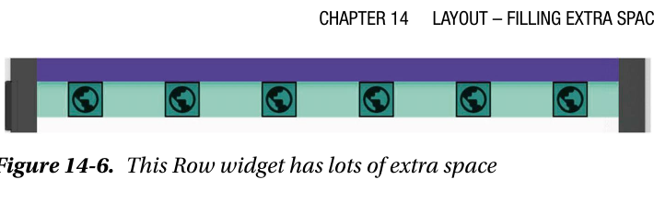
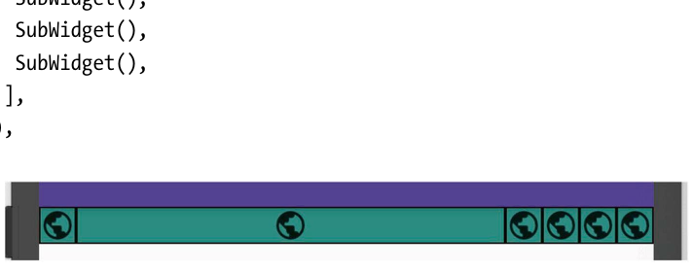
EXPANDED
34
One Expanded child gobbles all free space
Once the slack is consumed, mainAxisAlignment no longer matters
1 Row( 2 mainAxisAlignment: MainAxisAlignment.spaceAround, 3 children: [ 4 SubWidget(), 5 Expanded(child: SubWidget()), 6 SubWidget(), 7 SubWidget(), 8 SubWidget(), 9 SubWidget(), 10 ], 11 )
The chapter explicitly notes that after one child is wrapped in Expanded, the previous mainAxisAlignment setting makes no visible difference because the free space has been fully consumed.
This is a useful debugging clue: if alignment seems “ignored,” check whether an Expanded has already spent the budget.
Flutter layout lecture deck
Notes:
[Sources] - Chapter 14 Figures 14-6 and 14-7, provided PDF pp. 224-225. [/Sources]

Slide 35
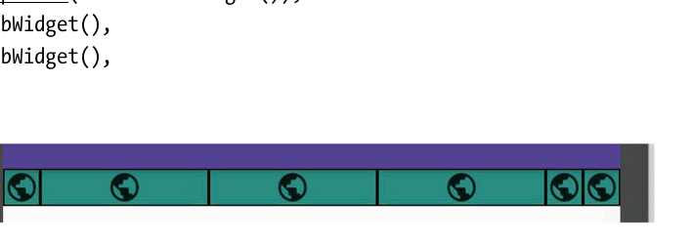
EXPANDED
35
Multiple Expanded children divide the available slack
Default flex = 1 means equal shares
1 Row( 2 children: [ 3 SubWidget(), 4 Expanded(child: SubWidget()), 5 Expanded(child: SubWidget()), 6 Expanded(child: SubWidget()), 7 SubWidget(), 8 SubWidget(), 9 ], 10 )
When three children are Expanded with the default flex factor of 1, the parent first sizes the rigid widgets and then divides the remaining room equally among the flexible widgets.
The second child becomes smaller than in the previous slide because it is no longer the sole consumer of the leftover budget.
Flutter layout lecture deck
Notes:
[Sources] - Chapter 14 Figure 14-8 and discussion, provided PDF p. 226. [/Sources]

Slide 36
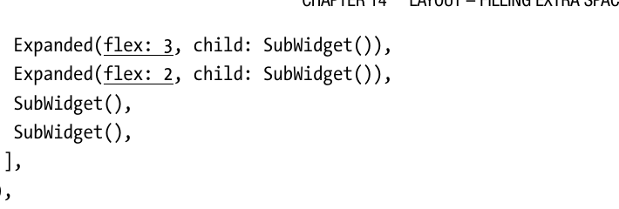
FLEX FACTOR
36
flex is a weighting system for space allocation
Free space is distributed proportionally after rigid children are sized
Total flex = 6.
Only leftover space is divided this way.
Rigid widgets are measured first.
1 Row( 2 children: [ 3 SubWidget(), 4 Expanded(flex: 1, child: SubWidget()), 5 Expanded(flex: 3, child: SubWidget()), 6 Expanded(flex: 2, child: SubWidget()), 7 SubWidget(), 8 SubWidget(), 9 ], 10 )
Expanded child | Flex | Relative share
A | 1 | 1/6 of free space
B | 3 | 3/6 of free space
C | 2 | 2/6 of free space
Flutter layout lecture deck
Notes:
[Sources] - Chapter 14 Figure 14-9 and flex explanation, provided PDF pp. 226-227. [/Sources]

Slide 37
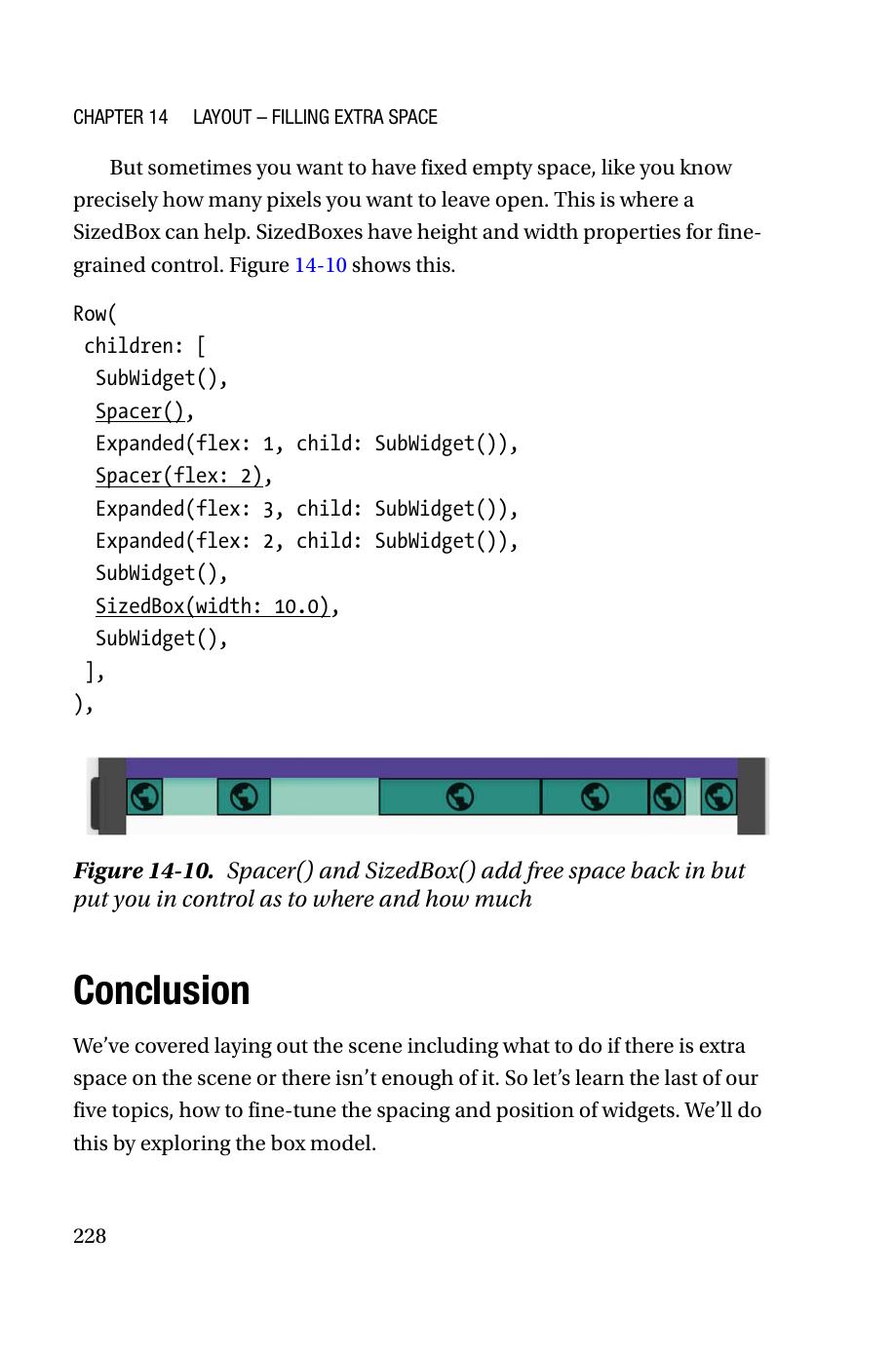
OPEN SPACE
37
Spacer and SizedBox add empty room back in under your control
Use proportional gaps with Spacer and fixed gaps with SizedBox
The chapter’s next refinement is subtle but important. Sometimes you want the precision of Expanded-based distribution, but you still want some empty room in the composition.
Spacer behaves like an Expanded whose content is empty; therefore it participates in flex allocation and is ideal for proportional whitespace.
SizedBox, by contrast, reserves a fixed width or height and is therefore the correct tool for deliberate pixel-precise gaps such as 8 px, 12 px, or 16 px spacing tokens.
1 Row( 2 children: [ 3 SubWidget(), Spacer(), 4 Expanded(flex: 1, child: SubWidget()), 5 Spacer(flex: 2), 6 Expanded(flex: 3, child: SubWidget()), 7 Expanded(flex: 2, child: SubWidget()), 8 SubWidget(), SizedBox(width: 10.0), SubWidget(), 9 ], 10 )
Flutter layout lecture deck
Notes:
[Sources] - Chapter 14 “Open Space with Expandeds” and Figure 14-10, provided PDF pp. 227-228. [/Sources]

Slide 38
DECISION GUIDE
38
Which Chapter 14 tool should you reach for?
A quick decision guide for space allocation
Goal | Primary tool | Reason
Pack or distribute existing children evenly | mainAxisAlignment | Moves slack between children without resizing them
Align differently sized children on the perpendicular axis | crossAxisAlignment | Controls cross-axis placement or stretching
Make a control group share the width of the widest control | IntrinsicWidth + stretch | Normalizes group width elegantly
Let selected children consume free capacity | Expanded | Resizes children rather than inserting gaps
Insert proportional whitespace | Spacer | Flex-based empty space
Insert fixed whitespace token | SizedBox | Deterministic gap size
Engineer’s shortcut: choose between moving space, consuming space, or reserving space.
Flutter layout lecture deck
Notes:
[Sources] - Synthesized from Chapter 14, provided PDF pp. 220-228. [/Sources]

Slide 39
INTEGRATED RECIPE
39
Putting Chapters 13 and 14 together in a realistic design recipe
A robust mental algorithm for responsive Flutter scenes
Step 1: choose the layout axis and baseline geometry with Row, Column, Flex, or Grid.
Step 2: ask what should happen when constraints become too small. Reflow if content is naturally discrete, compress only if semantics survive, otherwise scroll.
Step 3: after fit is restored, ask what should happen when constraints become too large. Redistribute empty room with alignment, let selected children grow with Expanded, or add intentional whitespace with Spacer/SizedBox.
Step 4: re-test under rotation, varied data cardinality, and accessibility text scaling. A production layout is not complete until it survives all three.
Flutter layout lecture deck
Notes:
[Sources] - Integrated synthesis from Chapters 13 and 14 using examples on provided PDF pp. 205, 211, and 221-228. [/Sources]

Slide 40
FINAL REVIEW
40
Final recap and study prompts
Use these questions to test conceptual mastery
Prompt | What a strong answer should mention
Why are overflow bars useful if the app still runs? | Debug-only diagnostic, hidden clipping risk in release, constraint policy still unresolved
When is Wrap better than ListView? | Need simultaneous visibility and natural reflow of discrete items
Why is ListView.builder preferred for remote data? | Lazy construction, data-to-widget factory separation, scalability
How do Expanded and Spacer differ? | Both flex-based; Expanded contains content, Spacer is empty space
When would IntrinsicWidth be more appropriate than stretch alone? | Need consistent control widths without wasting full-screen width
Recommended practice lab: rebuild the same UI three ways - Wrap, ListView.builder, and GridView.extent - then explain the trade-offs.
Flutter layout lecture deck
Notes:
[Sources] - Final recap synthesized from user-provided book chapters 13 and 14, pp. 201-228. [/Sources]

