Slide 1
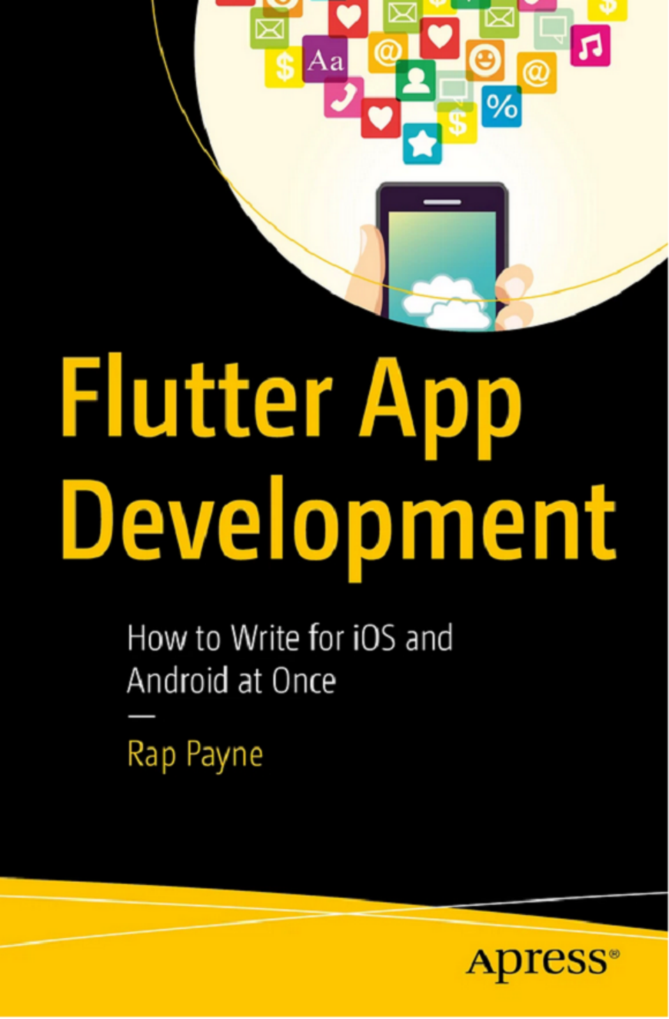
Chapter 5
Responding to Gestures
Built-in buttons, Dismissible, and GestureDetector patterns
Flutter App Development (Rap Payne, 2024)
Notes:
[Sources] - Rap Payne, "Flutter App Development: How to Write for iOS and Android at Once" (Apress, 2024), Chapter 5. [/Sources]

Slide 2
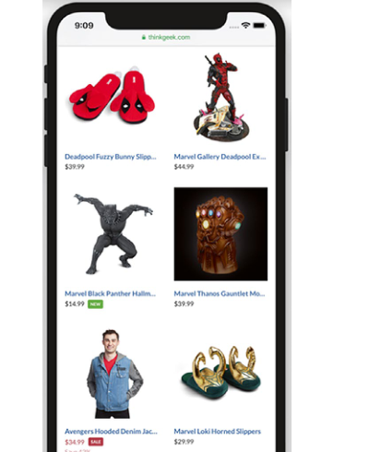
Why gestures matter in Flutter UI
Chapter 5 frames gestures as the bridge from UI to behavior.
Two categories of gesture handling
Example UI with many gestures
Built-in widgets: gestures are “pre-baked” (e.g., buttons know how to be pressed).
Custom widgets: you decide gestures + behaviors, then implement them with GestureDetector.Common gestures: tap, double-tap, long press, swipe (drag), pinch (scale).
Notes:
[Sources] - Rap Payne (2024), Chapter 5, pp. 70–71 (Figure 5-1 and opening framing). [/Sources]

Slide 3
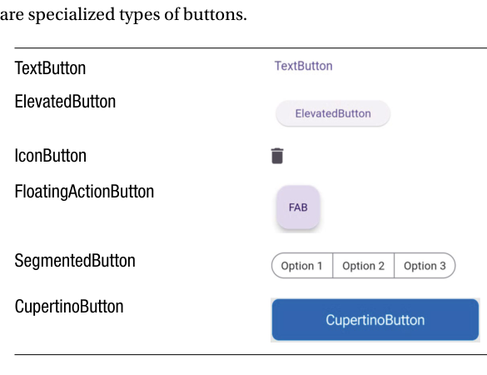
Built-in gestures: the Button family
Buttons are designed to respond to presses via onPressed.
Key idea
Specialized button widgets
Button widgets “know” their purpose: be pressed and run a callback.Every button exposes an onPressed function that returns void.Different button types are just specialized UX presentations.
IconButton(
icon: const Icon(Icons.delete),
// The callback function must return void
onPressed: () => print("tapped"),
)
Common “press” widgets
TextButton • ElevatedButton • IconButton • FloatingActionButton • SegmentedButton • CupertinoButton
Notes:
[Sources] - Rap Payne (2024), Chapter 5, pp. 70–72 (Meet the Button Family; Figure 5-2; onPressed usage). [/Sources]

Slide 4
Buttons in detail: Elevated vs flat buttons
Choose based on visual emphasis and platform conventions.
ElevatedButton
TextButton
IconButton
Appears to “float” above the page.
Use it when you want a strong call-to-action.
A subtle, flat button.
Good for secondary actions (e.g., BACK, UNDO).
Like TextButton but with an icon.
Use when the icon is universally understood (delete, edit, share…).
ElevatedButton(
onPressed: () => {},
child: const Text("ElevatedButton"),
),
TextButton(
onPressed: () => {},
child: const Text("TextButton"),
),
IconButton(
icon: const Icon(Icons.delete),
onPressed: () => {},
),
Notes:
[Sources] - Rap Payne (2024), Chapter 5, pp. 72–73 (ElevatedButton; TextButton and IconButton examples). [/Sources]

Slide 5
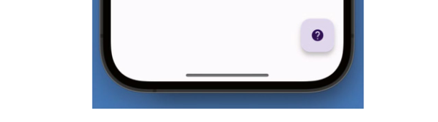
FloatingActionButton (FAB)
A prominent workflow “next step” button, typically in the lower-right.
Why FABs are useful
Figure 5-3 (cropped): FAB in the UI
Highly visible: gives users a clear “do the thing” affordance.Usually tied to the primary action in a screen’s workflow.Often provided via Scaffold.floatingActionButton.
Widget build(BuildContext context) {
return Scaffold(
appBar: ...,
body: ...,
floatingActionButton: FloatingActionButton(
child: const Icon(Icons.help),
onPressed: (){},
),
);
}
Scaffold integration
In Material apps, FABs are considered one of the key scaffold regions (appBar, body, floatingActionButton).
Notes:
[Sources] - Rap Payne (2024), Chapter 5, p. 73 (Figure 5-3; FAB usage within Scaffold). [/Sources]

Slide 6
SegmentedButton
Multiple related options presented as a single control.
What it’s for
Key properties to remember
A group of buttons treated as one unit.
• Allow single-selection or multi-selection
• Great for filters, modes, and toggles
The onSelectionChanged callback typically updates state.
• selected: the current value(s)
• segments: the choices (label + value)
• emptySelectionAllowed / multiSelectionEnabled
SegmentedButton(
emptySelectionAllowed: true,
multiSelectionEnabled: true,
selected: selectedValue, // current selection
onSelectionChanged: (value) =>
setState(() => selectedValue = value),
segments: const [
ButtonSegment(label: Text('Option 1'), value: 'option1'),
ButtonSegment(label: Text('Option 2'), value: 'option2'),
ButtonSegment(label: Text('Option 3'), value: 'option3'),
],
),
Design tip
Use a SegmentedButton when your options are mutually related and you want them to read as a single control (instead of several independent buttons).
Notes:
[Sources] - Rap Payne (2024), Chapter 5, pp. 73–74 (SegmentedButton example and discussion). [/Sources]

Slide 7
More built-ins: CupertinoButton and Dismissible
Platform styling + swipe-to-dismiss behavior.
CupertinoButton (iOS style)
Dismissible example
Looks great on iPhones. If you use Cupertino widgets, you’ll often wrap your app in CupertinoApp instead of MaterialApp.
Remember to import:
Dismissible(
// Blue if swiped right, red if swiped left
background: Container(color: Colors.blue),
secondaryBackground: Container(color: Colors.red),
onDismissed: (direction) =>
print("You swiped $direction"),
child: SomeWidget(),
);
import 'package:flutter/cupertino.dart';
Dismissible (swipe gesture)
Created for one purpose: respond to a swipe. Wrap a widget with Dismissible to handle “swipe it away” interactions.
Typical pattern: set background / secondaryBackground and handle onDismissed(direction).
Tip: If you want swipe behavior without dismissal, use GestureDetector instead.
Notes:
[Sources] - Rap Payne (2024), Chapter 5, pp. 74–75 (CupertinoButton guidance and import; Dismissible definition + example). [/Sources]

Slide 8
When built-ins aren’t enough
Custom widgets need custom gestures—and you get to invent them.
Motivation
Design gestures like a mini-API
Built-in widgets understand certain gestures because their developers coded those behaviors.
Your own widgets must do the same—but you can go beyond simple presses.
1) Choose gestures users will discover naturally.2) Make each gesture map to a clear, predictable action.3) Keep interactions consistent across the app.
Tap
LongPress
Core gesture vocabulary
Tap: press (includes double-tap)
LongPress: hold for ~1–2 seconds
Scale: pinch/unpinch (separate fingers)
Drag: swipe
Note: Pan is similar to Drag; many apps can treat them alike.
Scale
Drag
Notes:
[Sources] - Rap Payne (2024), Chapter 5, p. 75 (Custom gestures motivation and gesture types table; note about Pan vs Drag). [/Sources]

Slide 9
GestureDetector: a practical workflow
A repeatable 4-step approach for adding gestures to custom widgets.
The 4 steps
Wrapping a widget with GestureDetector
1. Decide on your gestures and behaviors
2. Create your custom widget as normal
3. Add a GestureDetector widget (wrap or nest)
4. Associate each gesture event with its behavior
return ListView(
children: _peopleObjects
.map((person) =>
GestureDetector(
child: Person(person: person),
)
).toList(),
);
Gesture → action (example design)
GestureDetector is invisible—it only listens for events.
Gesture
Action
Swipe right
Add them to the nice list
Implementation mindset
Treat gestures like API endpoints: design first, then wire each event handler to a clearly named method.
Swipe left
Add them to the naughty list
Pinch (reverse-pinch)
Insert a new person
Long press
Delete that person
Notes:
[Sources] - Rap Payne (2024), Chapter 5, pp. 75–78 (Steps 1–4; Step 1 gesture/action table; wrapping each Person with GestureDetector). [/Sources]

Slide 10
GestureDetector events: quick reference
Pick the event callback that matches the gesture you designed.
Why this matters
GestureDetector supports many events (including advanced *Start/*End/*Cancel variants). To stay sane, map each UX gesture to a small set of callbacks.
Gesture
Event(s) to use
Tap (press)
onTap
Double-tap
onDoubleTap
Long press
onLongPress
Side-to-side swipe
onHorizontalDragUpdate, Start, End
Up-and-down swipe
onVerticalDragUpdate, Start, End
Diagonal swipe
onPanUpdate, Start, End
Pinch
onScaleUpdate, Start, End
Tip: Start/Update/End patterns are ideal when direction, velocity, or distance matters (like swipes).
Notes:
[Sources] - Rap Payne (2024), Chapter 5, p. 78 (Step 4 table mapping gestures to GestureDetector callbacks). [/Sources]

Slide 11
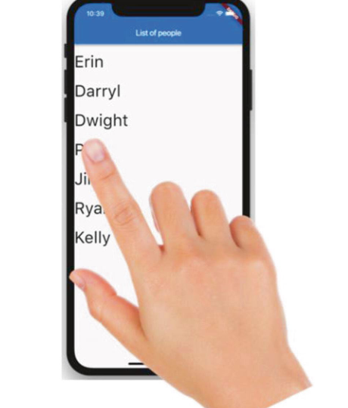
Example 1: Reacting to a long press
Use onLongPress to trigger actions that should not fire on simple taps.
Figure 5-4 (cropped)
Behavior
A long press ignores quick taps and fires after the user presses for a longer time (about a second or two). In the example, the long press deletes a person from a list.
GestureDetector(
child: Person(person: person),
onLongPress: () {
_people.remove(person);
print("Deleted ${person['first']}" );
},
);
Use long-press for “destructive or advanced” actions to reduce accidental triggers.
Notes:
[Sources] - Rap Payne (2024), Chapter 5, pp. 78–79 (Example 1; Figure 5-4; onLongPress handler). [/Sources]

Slide 12
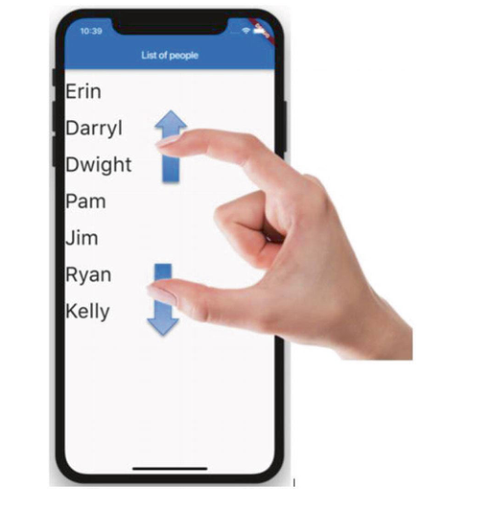
Example 2: Pinching to add a new item
Use scale (pinch/unpinch) events and the scale property.
Behavior
Figure 5-5 (cropped)
Detect whether the user is pinching in or pinching out. A pinch-out (unpinch) indicates “make room” and can mean insert a new item between two existing ones.
Implementation
Scale events provide an event object with a scale value.
If scale > 1.0, it’s a pinch-out. The example triggers insertion when scale exceeds 2.0.
onScaleUpdate: (e) {
if (e.scale > 2.0)
addPerson(context);
},
Notes:
[Sources] - Rap Payne (2024), Chapter 5, pp. 80–81 (Example 2; Figure 5-5; scale-based pinch-out logic). [/Sources]

Slide 13
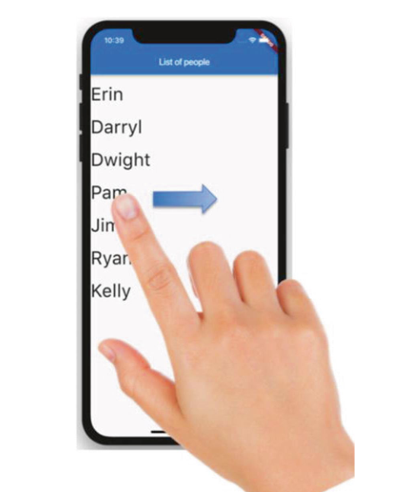
Example 3: Swiping left or right
Use horizontal drag events to detect direction and trigger different actions.
Figure 5-6 (cropped)
How direction is determined
Horizontal drags ignore Y-direction.
Save the start X position, then compare it to the current X position during updates.
On drag end, decide whether it was a left or right swipe.
double swipeStartX = 0;
String swipeDirection = "";
return GestureDetector(
child: Person(person: person),
onHorizontalDragStart: (e) {
swipeStartX = e.globalPosition.dx;
},
onHorizontalDragUpdate: (e) {
swipeDirection =
(e.globalPosition.dx > swipeStartX) ? "Right" : "Left";
},
onHorizontalDragEnd: (e) {
if (swipeDirection == "Right")
updatePerson(person, status: "nice");
else
updatePerson(person, status: "naughty");
},
);
Notes:
[Sources] - Rap Payne (2024), Chapter 5, pp. 81–82 (Example 3; Figure 5-6; horizontal drag start/update/end logic). [/Sources]

Slide 14
Conclusion & takeaways
Putting it all together for responsive, intuitive Flutter UX.
What to remember from Chapter 5
• Built-in widgets (buttons, dismissibles) come with common gestures already implemented.
• For custom widgets, use GestureDetector to listen for gestures and run behavior code.
• Match the gesture to the right callback (tap, long press, horizontal drag, scale…).
• Gestures are designed to be intuitive for users and predictable for developers.
• Event handlers can be async and use await when appropriate.
Practical tip: keep gesture handlers small—delegate to well-named methods (and test on real devices).
Notes:
[Sources] - Rap Payne (2024), Chapter 5, p. 83 (Conclusion: gestures are intuitive; event handlers may be async and use await). [/Sources]

