Slide 1
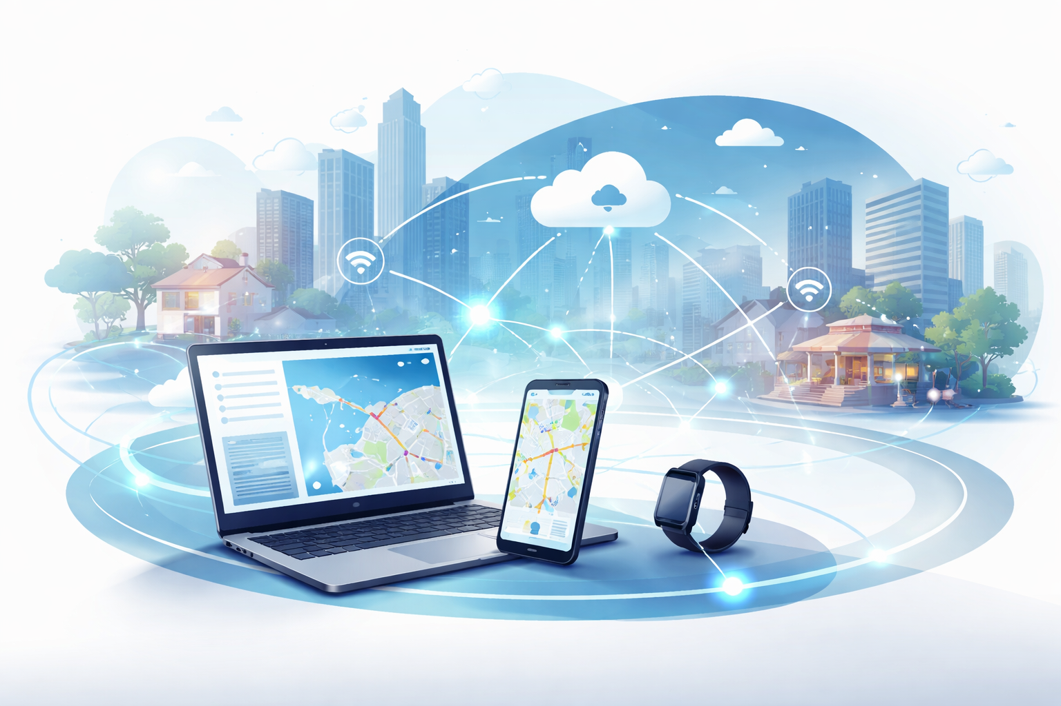
Mobile Computing
A professional master-level lecture based on the TechTarget definition of mobile computing, expanded with current standards and practice.
Core themes
• mobile vs nomadic use
• system architecture
• advantages and limits
• security and AI
• future directions
Audience
Master students in computer science, networking, cybersecurity, information systems, and software engineering.
Nomadic & Mobile Computing · Master-level deck
1
Notes:
[Sources] - TechTarget, “What is mobile computing?” https://www.techtarget.com/searchmobilecomputing/definition/nomadic-computing - Visual: AI-generated illustration created for this deck using OpenAI image generation (2026).

Slide 2
How to use this deck
Framed as a graduate seminar or 60–90 minute lecture with room for discussion
Define mobile computing precisely and distinguish it from nomadic computing.
Decompose a mobile system into infrastructure, hardware, software, and operational policies.
Evaluate application domains, device choices, and connectivity assumptions.
Reason about performance, power, security, privacy, and human factors.
Connect the source article to modern developments such as 5G-Advanced, edge computing, and on-device AI.
Slide map
1. Definitions
2. Architecture
3. Usage domains
4. Technology enablers
5. Advantages and limitations
6. Security and AI
7. Future outlook
Nomadic & Mobile Computing · Master-level deck
2
Notes:
[Sources] - Deck structure is original, grounded in the TechTarget article and supplemented by 3GPP, NIST, Android Developers, OWASP MASVS, and Apple Core ML documentation.

Slide 3
Definition: mobile computing and nomadic computing
The source article uses “nomadic computing” for relocatable but stationary-in-use access
Mobile computing
Access to computation, information, and related capabilities while the user is mobile or in motion; the user is not restricted to a fixed geographic location.
Mobility axis
High motion
smartphone navigation
logistics handheld
wearables
Nomadic computing
Access using equipment that can be relocated as needed, but the device is stationary while in operation — for example, a portable computer used from one temporary location at a time.
Relocatable but fixed-in-use
laptop in hotel
portable workstation
field tent PC
Nomadic & Mobile Computing · Master-level deck
3
Notes:
[Sources] - TechTarget definition lines 60–61: mobile access in motion vs nomadic access using relocatable but stationary equipment. - URL: https://www.techtarget.com/searchmobilecomputing/definition/nomadic-computing

Slide 4
How mobile computing works
At minimum, the system couples a portable device, a wireless connection, and local/remote data services
Mobile device
laptop, tablet, smartphone, wearable, specialized vertical device
Wireless access
Wi-Fi, 4G/5G, Bluetooth, NFC, GNSS-assisted services
Local state
flash storage, local cache, battery-backed operation, offline access
Shared resources
cloud apps, enterprise systems, content services, collaborative data
The article emphasizes that local data can still be used without a network connection.
Mobile devices are battery-powered and may also use AC power in fixed settings.
Modern mobile work typically blends disconnected capability with access to shared cloud resources.
Nomadic & Mobile Computing · Master-level deck
4
Notes:
[Sources] - TechTarget lines 67–69: device + Wi-Fi/cellular + local data + cloud/shared resources + rechargeable batteries. - URL: https://www.techtarget.com/searchmobilecomputing/definition/nomadic-computing

Slide 5
Schema: the three core components
A direct conceptual extraction from the source page
1. Mobile infrastructure
Wireless networks, wireless protocols, data formats, and the connectivity fabric that lets devices communicate.
2. Mobile hardware
The physical device and its supporting peripherals: phones, tablets, laptops, wearables, chargers, accessories, and domain-specific handhelds.
3. Mobile software
Operating systems, mobile apps, browsers, e-commerce clients, and enterprise workflows that run on top of the device and network stack.
Interpretation for master students
This decomposition is useful because it separates protocol-level problems, device-level constraints, and application-level design decisions.
Nomadic & Mobile Computing · Master-level deck
5
Notes:
[Sources] - TechTarget lines 84–89 explicitly define mobile infrastructure, hardware, and software as the major parts of mobile computing. - URL: https://www.techtarget.com/searchmobilecomputing/definition/nomadic-computing

Slide 6
Device categories and enterprise software patterns
The source page highlights both general-purpose devices and configurable enterprise mobile apps
Laptops
Best for content creation, multi-window work, keyboards, and richer local productivity.
Tablets
Often preferred for content consumption, lightweight field work, and touch-first workflows.
Smartphones
Pocket-sized general-purpose computers and communication devices with the highest ubiquity.
Wearables
Context-rich, sensor-heavy, and especially important in health and fitness settings.
Vertical devices
Medical, telemetry, surveillance, security, and control devices tailored to specific processes.
Low-code mobile apps
The source article’s schema notes that enterprises increasingly use configurable low-code mobile apps to deliver needs such as push notifications and rapid workflow support without full custom development.
Nomadic & Mobile Computing · Master-level deck
6
Notes:
[Sources] - TechTarget lines 69–70 discuss device fit by process and user need. - TechTarget lines 90–92 mention low-code mobile apps enabling enterprises to quickly configure mobile apps with features such as push notifications. - URL: https://www.techtarget.com/searchmobilecomputing/definition/nomadic-computing

Slide 7
Why mobile computing is used
The article frames mobility as convenience, continuity, and untethered access
Business users stay connected while traveling, working remotely, or operating away from traditional office infrastructure.
Consumers use mobile systems for internet access, communications, web browsing, mobile apps, and streaming media.
Wearables and sensor-rich devices create new forms of contextual data collection, especially in health and fitness settings.
Mobile computing also underpins IoT, where sensors and connected devices communicate without direct human intervention.
Value proposition
Untether the user from location, power, and physical network dependency — while still preserving access to data and services.
Master-level observation
“Convenience” is not trivial: it is an emergent property produced by batteries, radios, protocols, UX design, and backend availability.
Nomadic & Mobile Computing · Master-level deck
7
Notes:
[Sources] - TechTarget lines 71–83 explain why mobile computing is used across work, consumer behavior, wearables, and IoT. - URL: https://www.techtarget.com/searchmobilecomputing/definition/nomadic-computing

Slide 8
Usage domains from the source article
The page spans consumer, enterprise, logistics, and IoT-centric scenarios
Consumer use
communication, entertainment, banking, bill pay, fitness, media consumption
Remote work
collaboration, access to work resources, travel productivity, remote continuity
Delivery and field service
tracking, verification, field management, support operations
IoT and smart systems
autonomous sensing, supply-chain tracking, vehicle guidance, telemetry
Analytical reading
The interesting shift is from “portable personal device” to “distributed mobile ecosystem” — where many endpoints may have no direct human operator at all.
Nomadic & Mobile Computing · Master-level deck
8
Notes:
[Sources] - TechTarget lines 94–97 enumerate consumer use, remote work, and IoT examples including self-driving vehicles and supply-chain sensing. - URL: https://www.techtarget.com/searchmobilecomputing/definition/nomadic-computing

Slide 9
Technology enablers in contemporary mobile computing
The source article highlights better radios, storage, displays, batteries, and cloud integration
Low-power mobile processors trade absolute performance for smaller size and lower energy demand.
Wi-Fi and 5G now support latency and throughput levels sufficient for most mainstream mobile applications.
Flash-based solid-state storage makes devices lighter and more resistant to shock than older hard-drive designs.
Modern displays and touch interfaces dominate mobile UX but also consume significant battery power.
Cloud and local storage are now combined routinely, creating hybrid execution and hybrid state models.
Supplemental context
3GPP states that Release 18 is the first 5G-Advanced release, extending the practical network foundation for richer mobile workloads.
Systems implication
As radios improve, bottlenecks shift upward: app startup, UX design, sync logic, security posture, and model placement become more visible.
Nomadic & Mobile Computing · Master-level deck
9
Notes:
[Sources] - TechTarget lines 98–104 describe mobile processors, Wi-Fi, 5G, touch displays, and flash storage. - 3GPP, “Release 18,” https://www.3gpp.org/specifications-technologies/releases/release-18

Slide 10
Advantages of mobile computing
Portability is only the surface; the deeper advantage is continuous, context-rich access
Portability
Affordability
Wireless communication
Data and context
Ubiquitous interaction
Smaller devices, no fixed cable, usable across changing contexts and locations.
Smartphones increasingly function as primary access devices and are often cheaper than desktop alternatives.
Phone, video, messaging, and app-mediated real-time connectivity are built in.
Devices can record location, behavior, and biometric signals in real time.
The user can act, observe, consume, and communicate almost anywhere.
Critical reading
The article correctly identifies convenience, but for graduate students the stronger formulation is this: mobile systems compress the gap between physical context and digital action.
Nomadic & Mobile Computing · Master-level deck
10
Notes:
[Sources] - TechTarget lines 105–112 list portability, affordability, wireless communications, and data collection as major advantages. - URL: https://www.techtarget.com/searchmobilecomputing/definition/nomadic-computing

Slide 11
Limitations and trade-offs
A professional deck must balance the advantages with operational and ethical limits
Power
Battery life remains a persistent constraint, especially under GPS, streaming, heavy compute, or poor-signal conditions.
Connectivity
Coverage quality is uneven; some locations still have weak or absent signal.
Data security
Traveling users may carry sensitive corporate or personal data on vulnerable devices.
Dependence
Convenience can lead to unhealthy overreliance or compulsive usage patterns.
Distraction
Mobile usage can be dangerous in high-risk environments such as driving or construction.
These are not isolated problems. Power, connectivity, and security interact: poor signal can increase battery drain; background retries can increase both drain and risk exposure.
Therefore, good mobile design is about trade-off control rather than feature accumulation.
Nomadic & Mobile Computing · Master-level deck
11
Notes:
[Sources] - TechTarget lines 113–120 list power, connectivity, data security, dependence, and distraction as major limitations. - URL: https://www.techtarget.com/searchmobilecomputing/definition/nomadic-computing

Slide 12
Schema: mobile security risks and governance
Inspired by the source page’s mobile security diagram and strengthened with NIST and OWASP guidance
Insecure network or rogue Wi-Fi
Lost or stolen device
Backend/API weakness
Mobile security posture
Malicious or over-privileged app
Weak policy / unmanaged BYOD
Control families
• device management
• sandboxing and app verification
• strong identity and auth
• encrypted storage and transport
• policy for BYOD / COPE / MDM
Security problems
• phishing attacks
• brute force attacks
• low level Wi-fi protection
• encryption problems
• signal problems
Nomadic & Mobile Computing · Master-level deck
12
Notes:
[Sources] - TechTarget lines 121–123 mention a diagram outlining top mobile security threats. - NIST SP 800-124 Rev. 2, https://csrc.nist.gov/pubs/sp/800/124/r2/final - OWASP MASVS, https://mas.owasp.org/MASVS/

Slide 13
Evolution of mobile computing
From modem-era remote access to smartphones, tablets, and cloud-centric ecosystems
1970s
remote terminals
Late 1970s–1980s
portable PCs
1990s
laptops + PDAs
2000s
smartphone era
2010s+
tablets and cloud-centric mobile
dial-up access, CRT terminals, early portable terminals
Osborne 1, Compaq Portable, AC power, floppy disks, nomadic use
notebooks, internal/add-on Wi-Fi, better batteries, personal organizers
BlackBerry, iPhone 2007, Android 2008, mobile OS ecosystems
iPad, larger touch devices, cloud apps, app stores, hybrid storage
Nomadic & Mobile Computing · Master-level deck
13
Notes:
[Sources] - TechTarget lines 124–131 summarize the evolution from dial-up terminals and portable PCs to laptops, PDAs, smartphones, and tablets. - URL: https://www.techtarget.com/searchmobilecomputing/definition/nomadic-computing

Slide 14
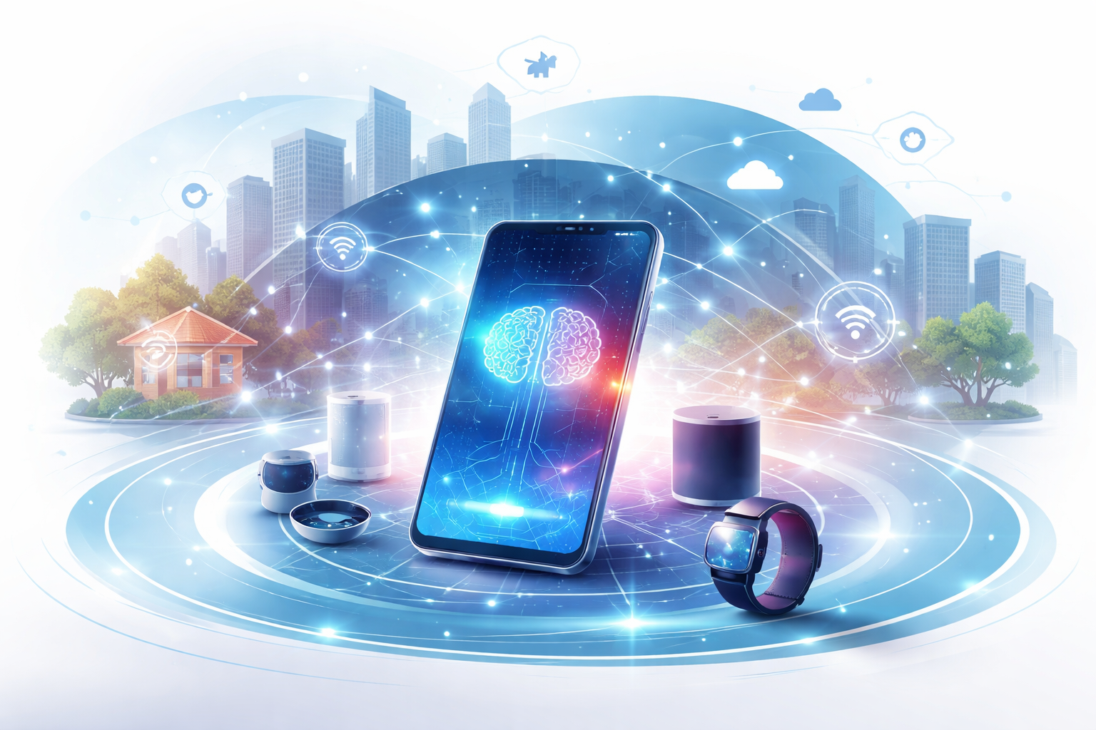
The effect of artificial intelligence on mobile computing
The source article highlights AI as an amplifier of UX, security, language, and reliability
AI improves user experience through adaptive interfaces, better analytics, and personalization.
Security benefits include biometric authentication and stronger anomaly detection.
Hands-free interaction improves through speech recognition and real-time language support.
AI can improve reliability and efficiency, including battery management and predictive assistance.
Healthcare and wearables are especially important application areas for mobile AI.
Nomadic & Mobile Computing · Master-level deck
14
Notes:
[Sources] - TechTarget lines 132–135 discuss AI-driven improvements to interfaces, security, speech recognition, translation, battery management, and healthcare applications. - Apple Developer, “Core ML,” https://developer.apple.com/machine-learning/core-ml/ - Visual: AI-generated illustration created for this deck using OpenAI image generation (2026).

Slide 15
The future of mobile computing
The article is explicit: the architecture is becoming more cloud-centric, edge-aware, AI-enhanced, and IoT-connected
Cloud-centric mobile architecture
Edge computing
closer execution, lower latency, regional processing
5G / 5G-Advanced
higher-capability wireless substrate for richer services
IoT ecosystem
nonhuman endpoints, sensors, telemetry, autonomous coordination
AI everywhere
model-assisted UX, security, scheduling, translation, and sensing
Nomadic & Mobile Computing · Master-level deck
15
Notes:
[Sources] - TechTarget lines 136–140 describe mobile computing as increasingly cloud-centric, with growing roles for edge computing, IoT, 5G, and AI. - 3GPP Release 18 materials provide current standards context for the network evolution dimension. - URL: https://www.techtarget.com/searchmobilecomputing/definition/nomadic-computing

Slide 16
Discussion prompts for master students
Use these to turn the definition article into a deeper systems conversation
1. Architecture
When should a mobile system keep logic on-device instead of pushing it to the cloud or edge?
2. Security
What changes when employees use personal devices for enterprise work under BYOD rather than managed corporate devices?
3. Human factors
How should systems adapt when mobile convenience turns into distraction or unhealthy dependence?
4. Data and ethics
How much contextual or biometric data is justified by a mobile service’s value proposition?
5. Research direction
Will the next leap come more from better networks, better on-device AI, or better software architecture?
6. Systems realism
How should we benchmark mobile systems under heterogeneous devices, geographies, and signal conditions?
Nomadic & Mobile Computing · Master-level deck
16
Notes:
[Sources] - Discussion questions are original synthesis based on the source article and supplemental standards/practice material.

Slide 17
Key takeaways and selected references
A compact closeout slide for class or seminar discussion
Mobile computing is broader than smartphones: it includes relocatable nomadic use, always-connected in-motion use, and machine-to-machine mobile ecosystems.
The article’s three-part schema — infrastructure, hardware, software — is a strong starting point for systems analysis.
The main design tensions are convenience vs limits: power, connectivity, security, dependence, and distraction.
Current developments in 5G-Advanced, edge computing, and on-device AI intensify rather than remove classic mobile trade-offs.
Selected references
• TechTarget mobile computing definition
• 3GPP Release 18
• NIST SP 800-124 Rev. 2
• OWASP MASVS
• Android Developers performance docs
• Apple Core ML docs
Final lens
For advanced students, the right question is rarely “What is mobile computing?” alone. It is: “What system properties make mobile computing robust, safe, efficient, and useful in the real world?”
Nomadic & Mobile Computing · Master-level deck
17
Notes:
[Sources] - TechTarget: https://www.techtarget.com/searchmobilecomputing/definition/nomadic-computing - 3GPP Release 18: https://www.3gpp.org/specifications-technologies/releases/release-18 - NIST SP 800-124 Rev. 2: https://csrc.nist.gov/pubs/sp/800/124/r2/final - OWASP MASVS: https://mas.owasp.org/MASVS/ - Android Developers Baseline Profiles: https://developer.android.com/topic/performance/baselineprofiles/overview - Apple Core ML: https://developer.apple.com/machine-learning/core-ml/

