Slide 1
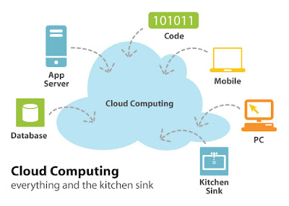
Lecture 3
MCC Architecture Design,
Key Techniques, and Challenges
Master-level presentation for first-year Computer Engineering students
Coverage
Cloud and MCC architectures, hybrid-cloud management, optimization mechanisms, security challenges, solutions, exercises, and glossary.
Based on Meikang Qiu & Keke Gai, Mobile Cloud Computing: Models, Implementation, and Security (CRC Press, 2017)
Notes:
[Sources] - Uploaded file: mobile-cloud-computing-models-implementation-and-security.pdf - Chapter 4: “MCC Architecture Design, Key Techniques, and Challenges,” pp. 61–78 of the book; key content spans PDF pages 95–111. - Title slide uses cropped Figure 4.2 (PDF page 64).

Slide 2
What this chapter is designed to teach
Architecture design, management logic, optimization, and security in MCC
Learning objectives
Technical emphasis
After this chapter, students should be able to explain the layered cloud architecture, distinguish mobile-cloud from cloud-only architecture, reason about hybrid-cloud resource management, and critique security trade-offs.
The chapter is not merely descriptive. It uses architecture diagrams, a resource-allocation example, interface-level management patterns, and a small performance comparison to motivate design choices.
4.2 Four-layer cloud computing architecture
4.3 Architecture of mobile cloud computing and hybrid-cloud rationale
4.4 Distributed-cloud management strategies and the hybrid cloud resource manager
4.5 Optimization mechanisms in hybrid clouds
4.6 Security challenges and representative solutions
4.8–4.9 Exercises and glossary for consolidation
Notes:
[Sources] - Uploaded file: mobile-cloud-computing-models-implementation-and-security.pdf - Chapter 4: “MCC Architecture Design, Key Techniques, and Challenges,” pp. 61–78 of the book; key content spans PDF pages 95–111. - Learning outcomes summarized from Chapter 4 introduction and chapter organization (PDF pages 62–63).

Slide 3
Chapter map
A conceptual progression from structure to operation to assurance
1. Architecture baseline
2. MCC architecture
3. Hybrid-cloud management
4. Optimization
5. Security
Cloud computing architecture with four layers
Mobile device + network + cloud + virtualization
Workload factoring, FCBs, resource manager, generic interfaces
Task scheduling and performance-aware management
Threats, trust, multi-tenancy, encryption, access control
Pedagogical note
The chapter moves from static structure to runtime orchestration and ends with the trust and protection issues that emerge once computation becomes mobile, shared, and service-driven.
Notes:
[Sources] - Uploaded file: mobile-cloud-computing-models-implementation-and-security.pdf - Chapter 4: “MCC Architecture Design, Key Techniques, and Challenges,” pp. 61–78 of the book; key content spans PDF pages 95–111. - Chapter sequence synthesized from sections 4.2–4.9 and the introduction to Chapter 4 (PDF pages 62–63).

Slide 4
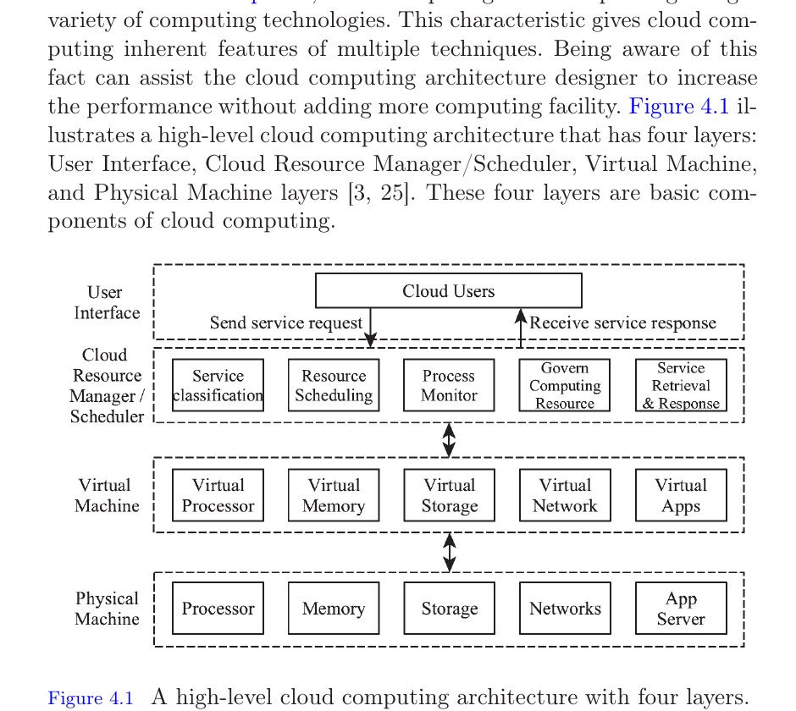
Section 4.2 — Cloud computing architecture
The chapter begins with a generic cloud architecture before extending it to mobility
Cloud computing integrates multiple computing technologies; architecture design must exploit that heterogeneity instead of masking it.
The chapter presents a high-level architecture with four layers: User Interface, Cloud Resource Manager/Scheduler, Virtual Machine, and Physical Machine.
This baseline helps explain how mobile cloud computing reuses cloud abstractions while adding wireless access and mobile-device constraints.
Design implication
Architectural awareness can improve performance without necessarily adding more hardware capacity.
Figure 4.1 (cropped from p. 63)
Notes:
[Sources] - Uploaded file: mobile-cloud-computing-models-implementation-and-security.pdf - Chapter 4: “MCC Architecture Design, Key Techniques, and Challenges,” pp. 61–78 of the book; key content spans PDF pages 95–111. - Content and asset from Section 4.2 and Figure 4.1 (PDF page 63).

Slide 5
Figure 4.1 decomposed — responsibilities of the four layers
Layer | Primary role in the architecture
User Interface | Receives service requests and presents service responses to the cloud user.
Cloud Resource Manager / Scheduler | Classifies services, schedules resources, monitors processes, governs resources, and handles retrieval/response.
Virtual Machine | Represents service contents via virtualized processor, memory, storage, network, and applications.
Physical Machine | Executes the actual computation using processors, memory, storage, networks, and application servers.
Interpretation
Requests travel downward from user-facing logic toward physical execution; responses travel upward after virtualized services complete.
Figure 4.1
Notes:
[Sources] - Uploaded file: mobile-cloud-computing-models-implementation-and-security.pdf - Chapter 4: “MCC Architecture Design, Key Techniques, and Challenges,” pp. 61–78 of the book; key content spans PDF pages 95–111. - Layer responsibilities paraphrase the discussion immediately below Figure 4.1 (PDF pages 63–64).

Slide 6
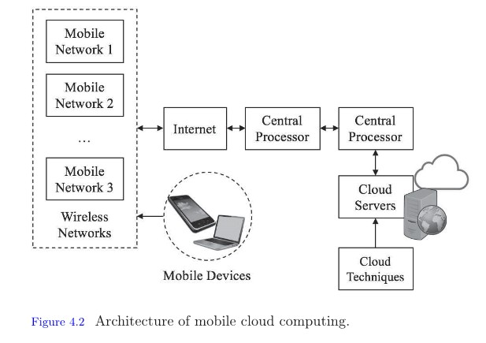
Section 4.3 — Architecture of mobile cloud computing (MCC)
MCC extends cloud architecture with mobile devices, wireless networks, and Internet-mediated service access
Definition
Mobile Cloud Computing Architecture is the structure for designing, developing, and implementing MCC solutions.
Deploying MCC requires three supportive aspects: mobile computing, mobile Internet, and cloud computing.
Mobile devices and Internet communication protocols are prerequisites for service access.
Wireless networks provide multiple access paths; central processors and network servers connect requests to remote cloud resources.
Key enabling technologies
The text explicitly names virtualization, the parallel programming model, and mass distributed storage as three technologies that support cloud-side implementation.
Notes:
[Sources] - Uploaded file: mobile-cloud-computing-models-implementation-and-security.pdf - Chapter 4: “MCC Architecture Design, Key Techniques, and Challenges,” pp. 61–78 of the book; key content spans PDF pages 95–111. - Definition and prerequisites from Section 4.3.1; asset from Figure 4.2 (PDF pages 64–65).

Slide 7
Cloud architecture vs. mobile-cloud architecture
Dimension | Conventional cloud architecture | Mobile cloud architecture
Primary access point | User interface on a client system | Mobile device over wireless networks and mobile Internet
Additional infrastructure | Cloud scheduler, VMs, physical servers | Mobile networks, central processors, mobile protocols, cloud techniques
Critical dependency | Virtualization and resource scheduling | Wireless connectivity + protocol interoperability + cloud execution
Typical challenge | Efficient allocation of virtualized resources | Latency, connectivity variability, and device constraints
Takeaway
MCC is not a replacement for cloud architecture; it is a deployment architecture that adds mobility-centric access and transport mechanisms to the cloud execution stack.
Notes:
[Sources] - Uploaded file: mobile-cloud-computing-models-implementation-and-security.pdf - Chapter 4: “MCC Architecture Design, Key Techniques, and Challenges,” pp. 61–78 of the book; key content spans PDF pages 95–111. - Comparison synthesized from Section 4.2 versus Section 4.3.1 (PDF pages 63–65).

Slide 8
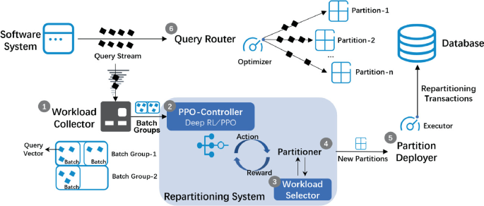
Section 4.3.2 — Why hybrid cloud architecture?
The chapter frames hybrid deployment as a design response to workload, cost, and scalability
Enterprises use hybrid deployment to balance the benefits and drawbacks of different cloud service deployments.
High performance is a major motivation, but designers also consider Total Cost of Ownership (TCO).
TCO is defined here as the direct and indirect consumption of a system investment.
Selecting design dimensions — for example workload or execution time — becomes part of architecture design.
Two explicit advantages
1) Higher-level scalability through flexible combinations of deployment options.
2) Better return on investment through a larger resource pool and adjustable resource configuration.
Figure 4.3 (hybrid-cloud model)
Notes:
[Sources] - Uploaded file: mobile-cloud-computing-models-implementation-and-security.pdf - Chapter 4: “MCC Architecture Design, Key Techniques, and Challenges,” pp. 61–78 of the book; key content spans PDF pages 95–111. - Motivation and benefits from Section 4.3.2; asset from Figure 4.3 (PDF pages 65–66).

Slide 9
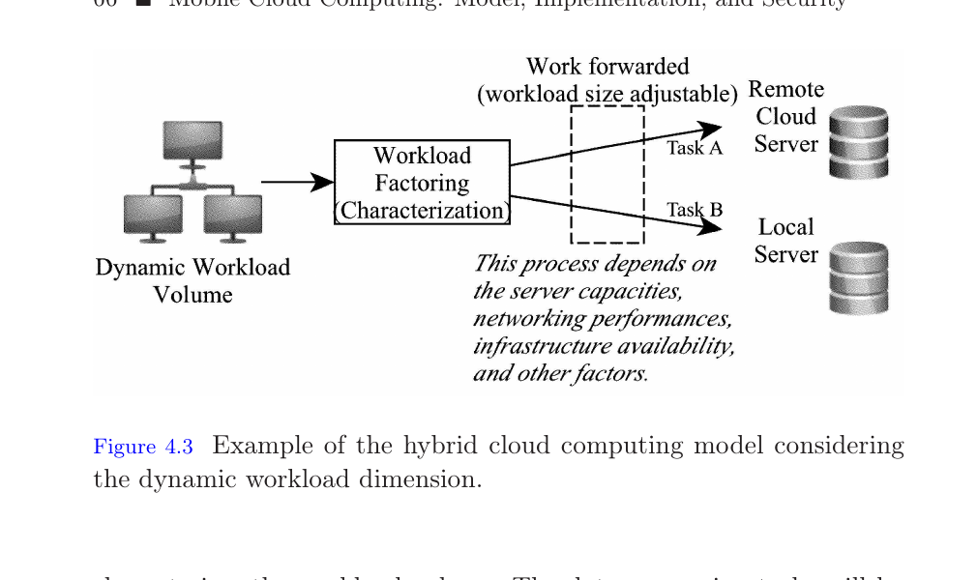
Figure 4.3 — Dynamic workload as the partitioning signal
The model first characterizes workload volume.
Tasks are then forwarded either to remote cloud servers or to local servers.
The forwarding decision depends on server capacities, networking performance, infrastructure availability, and related factors.
Conceptually, the model splits the overall workload into at least two parts (Task A and Task B).
Design intuition
Hybrid architecture acts as an adaptive routing layer for work placement, not just as a backup arrangement.
Figure 4.3
Notes:
[Sources] - Uploaded file: mobile-cloud-computing-models-implementation-and-security.pdf - Chapter 4: “MCC Architecture Design, Key Techniques, and Challenges,” pp. 61–78 of the book; key content spans PDF pages 95–111. - Interpretation of Figure 4.3 and surrounding text in Section 4.3.2 (PDF page 66).

Slide 10
Worked example — two servers with different time and cost profiles
Server | Time per data | Cost per data
Remote cloud server | 5 | 3
Local cloud server | 2 | 7
Input workload: 10 data items.
Remote server is slower but cheaper.
Local server is faster but more expensive.
Goal: assign the 10 items to satisfy the service request and compare multiple assignment settings.
Four settings examined in the chapter
Setting 1: all 10 to remote
Setting 2: all 10 to local
Setting 3: 5 remote + 5 local
Setting 4: minimum cost subject to a timing constraint of 30
Notes:
[Sources] - Uploaded file: mobile-cloud-computing-models-implementation-and-security.pdf - Chapter 4: “MCC Architecture Design, Key Techniques, and Challenges,” pp. 61–78 of the book; key content spans PDF pages 95–111. - Example and Table 4.1 from Section 4.3.2 (PDF pages 66–67).

Slide 11
Analytical model for the example
Variables
As x increases, time rises because more work is sent to the slower remote server.
As x increases, cost falls because more work is sent to the cheaper remote server.
The timing constraint T ≤ 30 implies 3x + 20 ≤ 30, so x ≤ 10/3.
Hence the cost-minimizing feasible integer assignment is x = 3 remote items and 7 local items, giving T = 29 and C = 58.
Let x = number of data items assigned to the remote server. Then (10 − x) go to the local server.
Time model
T = 5x + 2(10 − x) = 3x + 20
Cost model
C = 3x + 7(10 − x) = −4x + 70
Interpretation
Hybrid-cloud optimization here is a constrained trade-off problem, not a one-dimensional minimization.
Notes:
[Sources] - Uploaded file: mobile-cloud-computing-models-implementation-and-security.pdf - Chapter 4: “MCC Architecture Design, Key Techniques, and Challenges,” pp. 61–78 of the book; key content spans PDF pages 95–111. - Equation system comes directly from the worked example in Section 4.3.2 (PDF page 67).

Slide 12
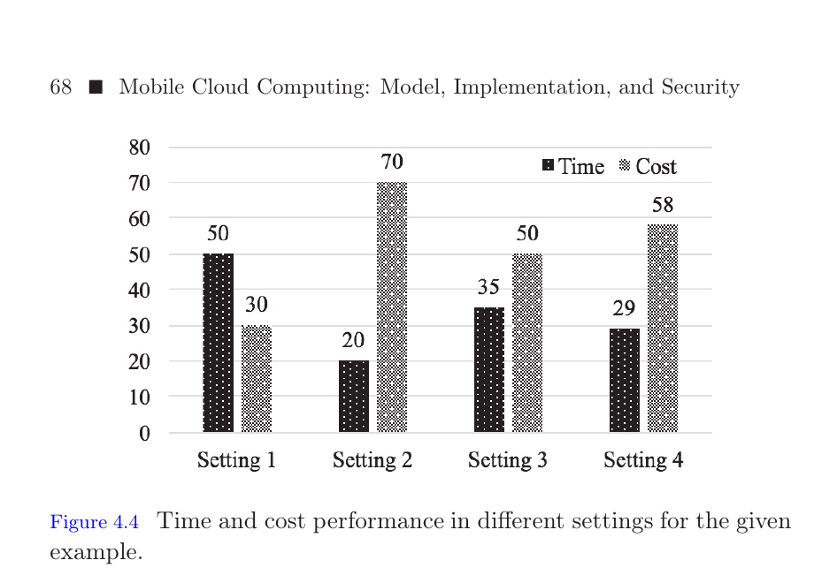
Figure 4.4 — comparing time and cost across four settings
Setting 1 (all remote): time 50, cost 30.
Setting 2 (all local): time 20, cost 70.
Setting 3 (5/5 split): time 35, cost 50.
Setting 4 (optimal under T ≤ 30): time 29, cost 58.
Engineering lesson
The “best” deployment depends on the system objective. Cheapest, fastest, and constrained-optimal are not the same operating point.
Figure 4.4
Notes:
[Sources] - Uploaded file: mobile-cloud-computing-models-implementation-and-security.pdf - Chapter 4: “MCC Architecture Design, Key Techniques, and Challenges,” pp. 61–78 of the book; key content spans PDF pages 95–111. - Figure 4.4 and interpretation from the worked example in Section 4.3.2 (PDF page 68).

Slide 13
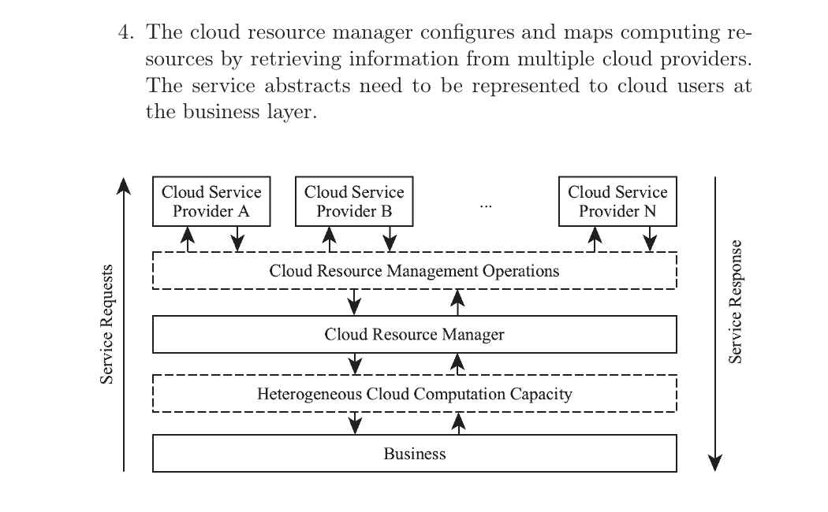
Section 4.4 — Management strategies for distributed clouds
The chapter introduces an operational architecture for resource management that supports fault-tolerant cloud computing.
Its operating principle uses abstract computational resources from which function blocks are formed.
Management operations are then scheduled or organized using information about those function blocks.
Definition: Function Block (FCB)
A Function Block is a certain function achieved by a specific cloud resource in distributed cloud computing.
Definition: Cloud Resource Manager
A layer that accomplishes resource information retrieval, task assignment, computation-process display, communication interconnection, and operation surveillance.
Figure 4.5
Notes:
[Sources] - Uploaded file: mobile-cloud-computing-models-implementation-and-security.pdf - Chapter 4: “MCC Architecture Design, Key Techniques, and Challenges,” pp. 61–78 of the book; key content spans PDF pages 95–111. - Definitions and management overview from Section 4.4; asset from Figure 4.5 (PDF pages 67–69).

Slide 14
Resource-management subprocesses identified in the chapter
1. Identify FCBs
2. Observe operating states
3. Expose computation progress
Discern each provider’s capacity and service offerings.
Collect information about start, end, query, assignment, and processing states.
Display process timing and make required/used cloud resources visible for scalability control.
4. Configure and map resources
Retrieve information from multiple providers and represent service abstractions to users at the business layer.
Figure 4.5 summarized
Notes:
[Sources] - Uploaded file: mobile-cloud-computing-models-implementation-and-security.pdf - Chapter 4: “MCC Architecture Design, Key Techniques, and Challenges,” pp. 61–78 of the book; key content spans PDF pages 95–111. - The four subprocesses are listed in Section 4.4 around Figure 4.5 (PDF pages 68–69).

Slide 15
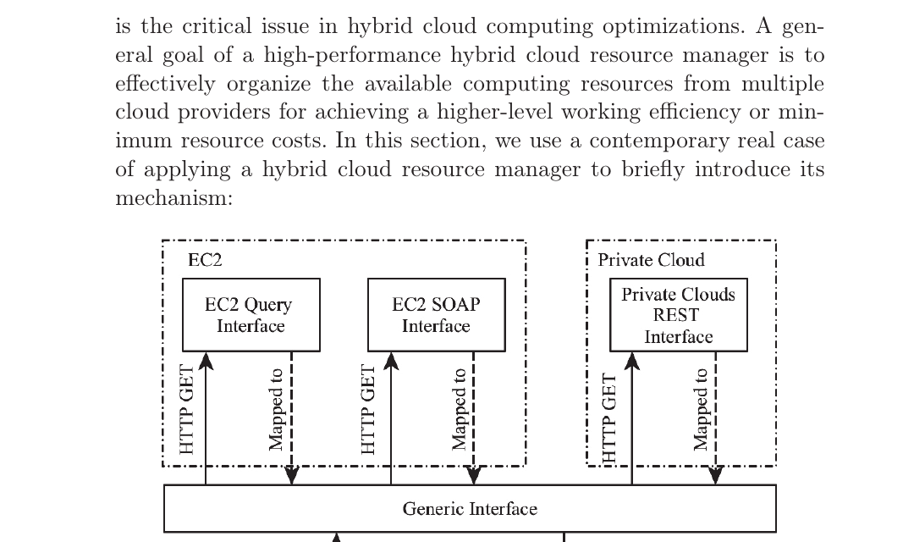
Section 4.4.1 — Hybrid Cloud Resource Manager (HCRM)
The HCRM is a typical resource manager for a group of different cloud providers that offer similar or related services.
Its general goal is to organize available resources for higher efficiency or minimum resource cost.
The chapter uses Amazon EC2 as a contemporary case to illustrate how a hybrid manager maps multiple interfaces into one operational logic.
Core functions
Organize • Interconnect • Monitor • Facilitate operations
Figure 4.6
Notes:
[Sources] - Uploaded file: mobile-cloud-computing-models-implementation-and-security.pdf - Chapter 4: “MCC Architecture Design, Key Techniques, and Challenges,” pp. 61–78 of the book; key content spans PDF pages 95–111. - Definition and objective from Section 4.4.1; asset from Figure 4.6 (PDF pages 69–70).

Slide 16
Amazon EC2 case study — interface mapping pattern
Interface | How the chapter says it is used
EC2 Query | Applies a query string to the URL where the cloud resource manager is deployed; operations are triggered via HTTP GET.
EC2 SOAP | Similar operation to Query, but the actual parameters required by the operations differ.
Private-cloud REST | Assigns a global identifier/URI to each local resource and manipulates resources through HTTP.
Generic Interface | The manager-side manipulative interface to which the other interfaces are mapped.
Key architectural idea
Normalize diverse provider interfaces into one generic interface so the resource manager can administer both EC2 and private-cloud resources.
Figure 4.6
Notes:
[Sources] - Uploaded file: mobile-cloud-computing-models-implementation-and-security.pdf - Chapter 4: “MCC Architecture Design, Key Techniques, and Challenges,” pp. 61–78 of the book; key content spans PDF pages 95–111. - Mechanism summarized from Section 4.4.1 and 4.4.2 (PDF pages 70–71).

Slide 17
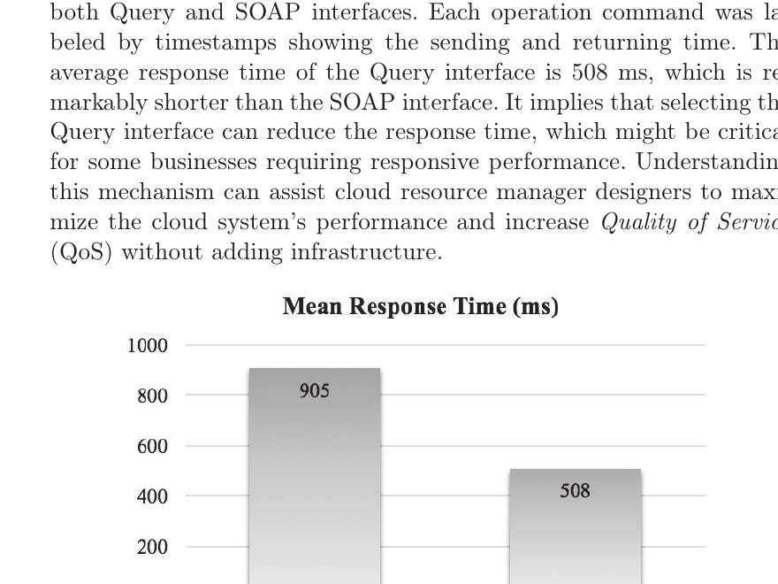
Section 4.4.2 — How manipulation improves performance
Different interfaces have different performance characteristics.
A hybrid cloud resource manager can exploit this by selecting the interface that best matches the operation and the business requirement.
This raises Quality of Service (QoS) without adding infrastructure, because the gain comes from better orchestration rather than more hardware.
Decision principle
The manager does not merely route calls; it chooses among functionally similar interfaces based on responsiveness and operational fit.
Figure 4.7
Notes:
[Sources] - Uploaded file: mobile-cloud-computing-models-implementation-and-security.pdf - Chapter 4: “MCC Architecture Design, Key Techniques, and Challenges,” pp. 61–78 of the book; key content spans PDF pages 95–111. - Performance discussion from Section 4.4.2; asset from Figure 4.7 (PDF page 72).

Slide 18
Figure 4.7 — Query vs. SOAP response time
Experiment in the chapter
1000 identical management operation commands were sent through both Query and SOAP interfaces, and timestamps were used to measure response time.
SOAP interface average response time: 905 ms
Query interface average response time: 508 ms
Difference: 397 ms (~44% lower latency for Query in this example)
Interpretation
When responsiveness matters, interface selection becomes a performance lever inside the resource manager.
Figure 4.7
Notes:
[Sources] - Uploaded file: mobile-cloud-computing-models-implementation-and-security.pdf - Chapter 4: “MCC Architecture Design, Key Techniques, and Challenges,” pp. 61–78 of the book; key content spans PDF pages 95–111. - Numeric values and interpretation from Section 4.4.2 around Figure 4.7 (PDF page 72).

Slide 19
Section 4.5 — Optimization mechanisms of hybrid cloud computing
The chapter emphasizes that optimization matters mainly to architecture designers and service providers who aim to deliver higher-level service.
It briefly surveys workload-aware task assignment in IaaS across heterogeneous clouds or data centers.
One example mentioned is dynamic cloud min-min scheduling for preemptable tasks.
The manager stores execution parameters and updates them according to execution feedback.
Why this matters
Optimization turns heterogeneous infrastructure into a managed system whose performance can improve over time using recorded execution data.
Forward link
The chapter signals that later chapters will develop these optimization methods in more detail.
Scheduling criteria explicitly named
Earliest resource available time + earliest finish time
Notes:
[Sources] - Uploaded file: mobile-cloud-computing-models-implementation-and-security.pdf - Chapter 4: “MCC Architecture Design, Key Techniques, and Challenges,” pp. 61–78 of the book; key content spans PDF pages 95–111. - Section 4.5 overview on optimization and scheduling (PDF page 73).

Slide 20
Section 4.6 — Security challenges in mobile clouds
Framing question
Are there security issues in mobile clouds that differ from traditional security concerns?
Security lens
MCC inherits classic cloud threats and adds risks linked to mobility, wireless transmission, and provider-mediated control.
The chapter focuses on the technical perspective while acknowledging both operational and technical threats.
It identifies five main challenge areas: operational abuse on the cloud side, vulnerability caused by non-encryption, trust and multi-tenancy issues, intrusions in wireless networks, and customer loss of control.
These challenges arise because computation, storage, identity management, and network access are no longer fully under the customer’s control.
Notes:
[Sources] - Uploaded file: mobile-cloud-computing-models-implementation-and-security.pdf - Chapter 4: “MCC Architecture Design, Key Techniques, and Challenges,” pp. 61–78 of the book; key content spans PDF pages 95–111. - Security overview and challenge list from Section 4.6.1 (PDF pages 73–75).

Slide 21
Challenge 1 — Operational abuse on the cloud side
Enterprises worry about data security and privacy even when vendors promise security levels comparable to on-premises systems.
Cloud models create a structural problem: data are hosted, processed, or stored remotely, and users may not know where the servers are.
Provider employees can potentially access sensitive information or critical system data, turning privacy concern into a deployment obstacle.
Why mobility aggravates it
Mobile services often collect, process, and synchronize personal or context-rich data, increasing the sensitivity of provider-side access.
Key point
Trust in the provider becomes part of the security model, not an optional assumption.
Notes:
[Sources] - Uploaded file: mobile-cloud-computing-models-implementation-and-security.pdf - Chapter 4: “MCC Architecture Design, Key Techniques, and Challenges,” pp. 61–78 of the book; key content spans PDF pages 95–111. - Operational abuse discussion from Section 4.6.1 (PDF page 74).

Slide 22
Challenge 2 — Vulnerability caused by non-encryption
Outside the cloud, owners can encrypt data to limit unauthorized use.
In cloud scenarios, many operations are difficult to perform directly on encrypted data.
For processing purposes, cloud-side memory typically needs access to original data, creating exposure.
The chapter cites Amazon EC2 as a useful service option but notes that the data themselves are not automatically secure.
Research implication
This motivates cryptographic approaches that preserve utility while reducing exposure — later represented by Fully Homomorphic Encryption (FHE).
Tension
Operational usefulness often conflicts with confidentiality because computation needs intelligible data.
Notes:
[Sources] - Uploaded file: mobile-cloud-computing-models-implementation-and-security.pdf - Chapter 4: “MCC Architecture Design, Key Techniques, and Challenges,” pp. 61–78 of the book; key content spans PDF pages 95–111. - Non-encryption vulnerability discussion in Section 4.6.1 and solution hint in Section 4.6.2 (PDF pages 74 and 76).

Slide 23
Challenge 3 — Trust issues and multi-tenancy
Multi-tenancy lets multiple customers share the same software application or resource pool, often through virtualization.
The main trust challenge is isolating tenants that have opposing goals or risk profiles.
Because multiple independent users may share the same physical infrastructure, an adversary can have legitimate tenant status unless detected.
Architectural lesson
Virtualization is an efficiency mechanism and a security boundary at the same time.
Security risk
Resource sharing improves utilization, but it also makes isolation failure a first-order threat.
Notes:
[Sources] - Uploaded file: mobile-cloud-computing-models-implementation-and-security.pdf - Chapter 4: “MCC Architecture Design, Key Techniques, and Challenges,” pp. 61–78 of the book; key content spans PDF pages 95–111. - Trust and multi-tenancy discussion from Section 4.6.1 (PDF pages 74–75).

Slide 24
Challenges 4 and 5 — Wireless intrusions and customer loss of control
Wireless intrusions
Availability and security depend heavily on provider mechanisms.
Customers cannot fully control their own data security once services are outsourced.
Mobile settings compound the problem because access often depends on third-party mobile and wireless infrastructure.
During wireless transmission, adversaries may use jamming, monitoring, DoS, or man-in-the-middle attacks. Many threats emerge specifically when wireless networks are used for cloud applications.
Customer loss of control
Identity management and security mechanisms are operated on the cloud side, leaving customers with limited ability to configure access rules and policies.
Meta-point
MCC security is partly a governance problem: who controls identity, policy, and visibility?
Notes:
[Sources] - Uploaded file: mobile-cloud-computing-models-implementation-and-security.pdf - Chapter 4: “MCC Architecture Design, Key Techniques, and Challenges,” pp. 61–78 of the book; key content spans PDF pages 95–111. - Wireless intrusion and customer loss-of-control discussions from Section 4.6.1 (PDF page 75).

Slide 25
Section 4.6.2 — Security solutions overview
Solution family | How the chapter positions it
Access control methods | Define rules that grant or reject requests; focus on authorization, authentication, approval, and auditing.
Data encryption | Protect data from leakage; must fit cloud requirements and operating constraints.
Trust management | Use trust entities and credentials to support secure decision-making; often linked to access control.
Other solutions | IDS, Cloud Dependability Models, SSL, and SLA are listed as additional approaches.
Named examples
MBAC, ABAC, RBAC, IBA, and FHE are explicitly mentioned in the text.
Notes:
[Sources] - Uploaded file: mobile-cloud-computing-models-implementation-and-security.pdf - Chapter 4: “MCC Architecture Design, Key Techniques, and Challenges,” pp. 61–78 of the book; key content spans PDF pages 95–111. - Security solutions overview from Section 4.6.2 (PDF pages 75–76).

Slide 26
Access control and trust management in an MCC context
Access control determines whether a user request is granted or rejected for system protection.
The chapter emphasizes authorization, authentication, access approval, and auditing as key access-control concerns.
Trust management complements this by using social trust entities and cryptographic credentials to support secure decisions.
Why these matter in mobile clouds
The system must decide not only who the user is, but also whether a device, session, tenant, or context should be trusted across distributed infrastructure.
Models listed in the chapter
MBAC • ABAC • RBAC • Identity-Based Authentication (IBA)
Notes:
[Sources] - Uploaded file: mobile-cloud-computing-models-implementation-and-security.pdf - Chapter 4: “MCC Architecture Design, Key Techniques, and Challenges,” pp. 61–78 of the book; key content spans PDF pages 95–111. - Access-control and trust-management content from Section 4.6.2 (PDF page 76).

Slide 27
Encryption and supporting security controls
Data encryption is presented as the process of encoding and decoding data to reduce information leakage.
The text highlights Fully Homomorphic Encryption (FHE) as an example, although it is described as still being in the exploring stage.
Other practical controls listed are IDS, Cloud Dependability Models (CDM), SSL, and Service Level Agreements (SLA).
Layered defense logic
No single mechanism solves all MCC risks: confidentiality, detection, dependability, transport protection, and contractual assurance all contribute.
Engineering balance
Protection must be compatible with cloud operating requirements; otherwise security can block useful computation.
Notes:
[Sources] - Uploaded file: mobile-cloud-computing-models-implementation-and-security.pdf - Chapter 4: “MCC Architecture Design, Key Techniques, and Challenges,” pp. 61–78 of the book; key content spans PDF pages 95–111. - Encryption and additional solutions from Section 4.6.2 (PDF page 76).

Slide 28
Section 4.7 — Chapter synthesis
Architecture design in MCC is influenced by workload, resource pool composition, interface heterogeneity, and security constraints.
Hybrid-cloud resource management is a central optimization problem because it determines how distributed resources are exposed and exploited.
Security is not external to architecture; it shapes deployment decisions, trust boundaries, and what customers can actually control.
4.1
4.3
One-sentence synthesis
MCC architecture is the coordinated design of access, computation, allocation, and protection across mobile and cloud layers.
4.5
4.7
Notes:
[Sources] - Uploaded file: mobile-cloud-computing-models-implementation-and-security.pdf - Chapter 4: “MCC Architecture Design, Key Techniques, and Challenges,” pp. 61–78 of the book; key content spans PDF pages 95–111. - Summary is based on Section 4.7 and the surrounding chapter logic (PDF pages 76–77).

Slide 29
Section 4.8 — Exercises for students
What is a general goal of a high-performance hybrid cloud resource manager?
Briefly describe a four-layer cloud computing architecture.
Briefly describe the architecture of mobile cloud computing.
When and why do we need the hybrid cloud computing architecture?
What is operational abuse on the cloud side considering security in mobile clouds?
What are trust and multi-tenancy issues in cloud computing?
What issues can be caused by customer loss of control?
Applied exercise
Assign 20 data items to a remote and a local server (Table 4.2) to minimize total cost under a timing constraint of 150; explain the steps.
Server | Time per data | Cost per data
Remote cloud server | 10 | 5
Local cloud server | 5 | 8
Notes:
[Sources] - Uploaded file: mobile-cloud-computing-models-implementation-and-security.pdf - Chapter 4: “MCC Architecture Design, Key Techniques, and Challenges,” pp. 61–78 of the book; key content spans PDF pages 95–111. - Exercise list and Table 4.2 from Section 4.8 (PDF page 77).

Slide 30
Section 4.9 — Glossary
Term | Meaning in Chapter 4
Cloud Resource Manager | Layer that performs resource retrieval, task assignment, process display, communication interconnection, and surveillance.
Function Block | A certain function achieved by a specific cloud resource in distributed cloud computing.
Generic Interface | The manipulative interface operated by the cloud resource manager.
Hybrid Cloud Resource Manager | Manager that organizes, interconnects, monitors, and facilitates operations for different cloud providers.
Mobile Cloud Computing Architecture | Structure for designing, developing, and implementing MCC solutions.
Total Cost of Ownership | Estimate of direct and indirect consumption of a system investment.
Uniform Resource Identifier | String of characters identifying the resource name that enables network interactions.
Notes:
[Sources] - Uploaded file: mobile-cloud-computing-models-implementation-and-security.pdf - Chapter 4: “MCC Architecture Design, Key Techniques, and Challenges,” pp. 61–78 of the book; key content spans PDF pages 95–111. - Glossary terms from Section 4.9 (PDF page 78).

Slide 31
Master-level discussion prompts
Use these to extend the chapter into seminar discussion or tutorial work
How would you redesign Figure 4.3 if edge computing nodes were added between mobile devices and the remote cloud?
Which risks in Section 4.6 are primarily architectural, and which are primarily operational or policy-driven?
Can interface-aware management decisions (Query vs. SOAP vs. REST) be embedded into a scheduler as a QoS optimization signal?
How would the worked example change if energy, bandwidth, or data locality were added as optimization dimensions?
Instructor note
These prompts are not verbatim chapter content, but they are faithful extensions appropriate for first-year Master’s students in Computer Engineering.
Notes:
[Sources] - Uploaded file: mobile-cloud-computing-models-implementation-and-security.pdf - Chapter 4: “MCC Architecture Design, Key Techniques, and Challenges,” pp. 61–78 of the book; key content spans PDF pages 95–111. - This slide extends Chapter 4 for the requested Master-level audience; it is an instructional elaboration rather than a direct book extract.

Slide 32
End of Lecture 3
MCC Architecture Design, Key Techniques, and Challenges
Recommended next step: connect these architectural ideas to later chapters on optimization and security.
Hybrid-cloud management
Performance-aware interface selection
Notes:
[Sources] - Uploaded file: mobile-cloud-computing-models-implementation-and-security.pdf - Chapter 4: “MCC Architecture Design, Key Techniques, and Challenges,” pp. 61–78 of the book; key content spans PDF pages 95–111. - Closing slide uses Figures 4.6 and 4.7 as recap visuals (PDF pages 70 and 72).

