Slide 1

Notes:
make picture of ctrl + view

Slide 2
Javascript basics
Notes:
make picture of ctrl + view

Slide 3
What do we know about javascript?
It runs in browsers
Makes web pages dynamic
Interpreted, not compiled

Slide 4
ECMAScript
specification for the Javascript language

Slide 5
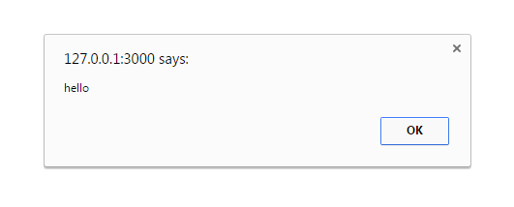

What do we know about javascript?
alert('hello');
console.log('the quick brown fox...');

Slide 6
Javascript
Basics

Slide 7
object-oriented or functional?
Notes:
make picture of ctrl + view

Slide 8
var sex = addPersonData.sex; if (rt == 'DESCENDANT') { $scope.clanFieldDisabled = sex; } else if (rt == 'PREDECESSOR') { $scope.clanFieldDisabled = true; } else if (rt == 'SIBLING') { $scope.clanFieldDisabled = true; } else if (rt == 'ACTUAL_MARRIAGE' || rt == 'BROKEN_MARRIAGE') { $scope.clanFieldDisabled = false; }
Notes:
make picture of ctrl + view

Slide 9
execute outside browser?
Notes:
make picture of ctrl + view

Slide 10
multithreading in javascript?
Notes:
make picture of ctrl + view

