Slide 1
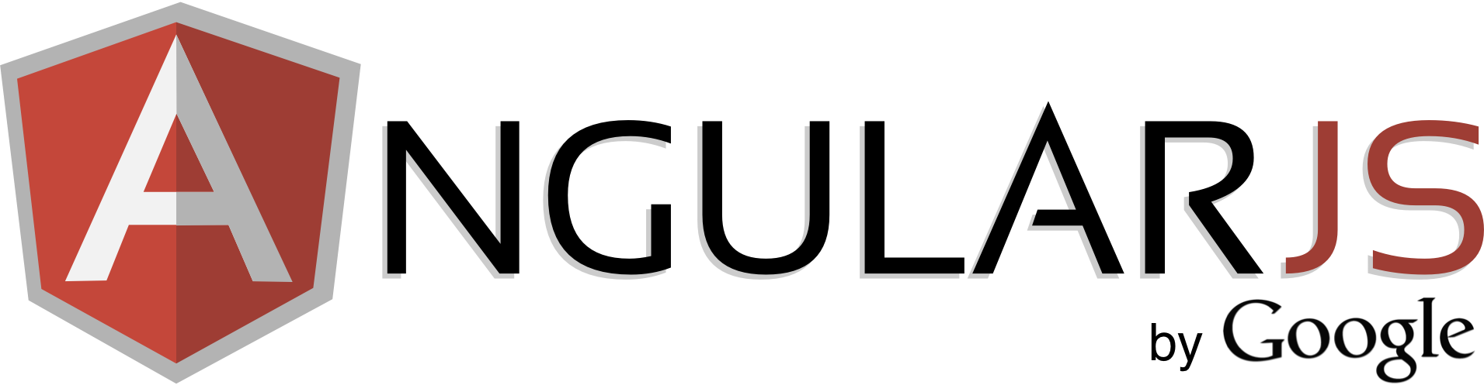
inside

Slide 2
QnA
How does angular work with sessions?
there is only 1 HTTP session per ng-app
if control is required (login, logout) wo page refresh – this should be done manually
( local storage, cookies are possible ways to store data over page refresh )
does angular use some libraries of itself?
yes, angular uses jQuery lite for DOM-modifications
angular.element(document.querySelector(‘#id’))
how to create custom exceptions like in JSF
in js it’s possible to create custom error – need to inherit Error object and throw it
in angular there is $exceptionHandler which by default logs the errors to console (can override)
what are ng benefits comparing with other web frameworks?
probably I’ll make a short overview
what are best practices? what is under the hood of angular?
Good question
Notes:
make picture of ctrl + view

Slide 3
Modules
create model with 2 arguments
Module is just a container
angular.module(‘app', []);
Module
controller
get the created model with 1 arg
var module = angular.module('app');
service
directive
call controller function on module instance
angular.module('app').controller('ctrl', function($scope) { $scope.name = 'Alexey'; });
…

Slide 4
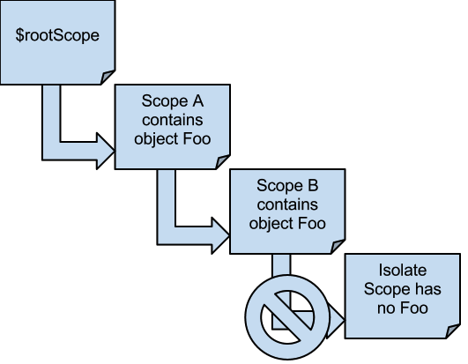
Scope inheritance
parent scope props are inherited in child scope
…unless it’s an isolated scope
scopes are inherited using prototype
there is always a $rootScope
can see scope hierarchy in some tool
Notes:
ng-if creates a child scope

Slide 5
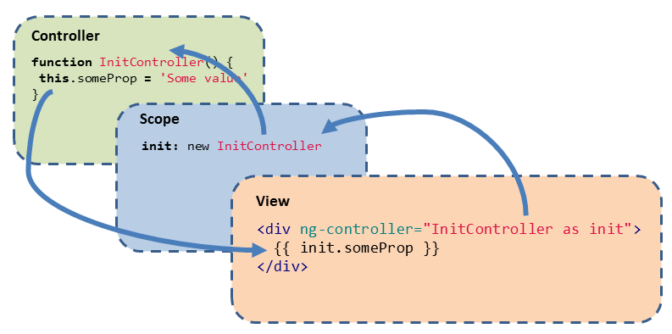
ctrl as ct
dilema: use this or $scope ??
Notes:
make picture of ctrl + view

Slide 6
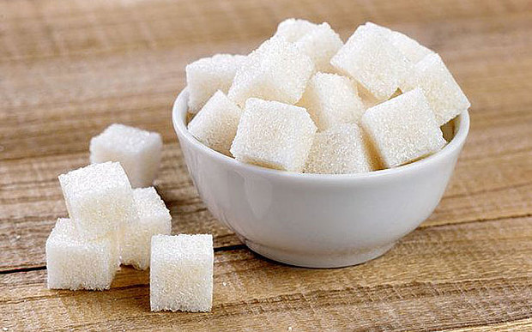
service / factory
service is a constructor fn
factory returns object as API
(also accepts es6 classes)
app.factory('myFactory', function() { // factory returns an object // you can run some code before return { sayHello : function(name) { return "Hi " + name + "!"; } } });
app.service('myService', function() { // service is just a constructor function // that will be called with 'new' this.sayHello = function(name) { return "Hi " + name + "!"; }; });
Notes:
make picture of ctrl + view

Slide 7
Application lifecycle
Bootstrap
HTML compilation
Runtime

Slide 8
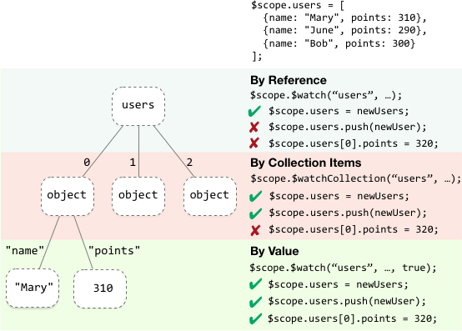
$$watchers
each $scope has collection of watchers
watchExpression
watch function
deep watch?
Notes:
make picture of ctrl + view

Slide 9
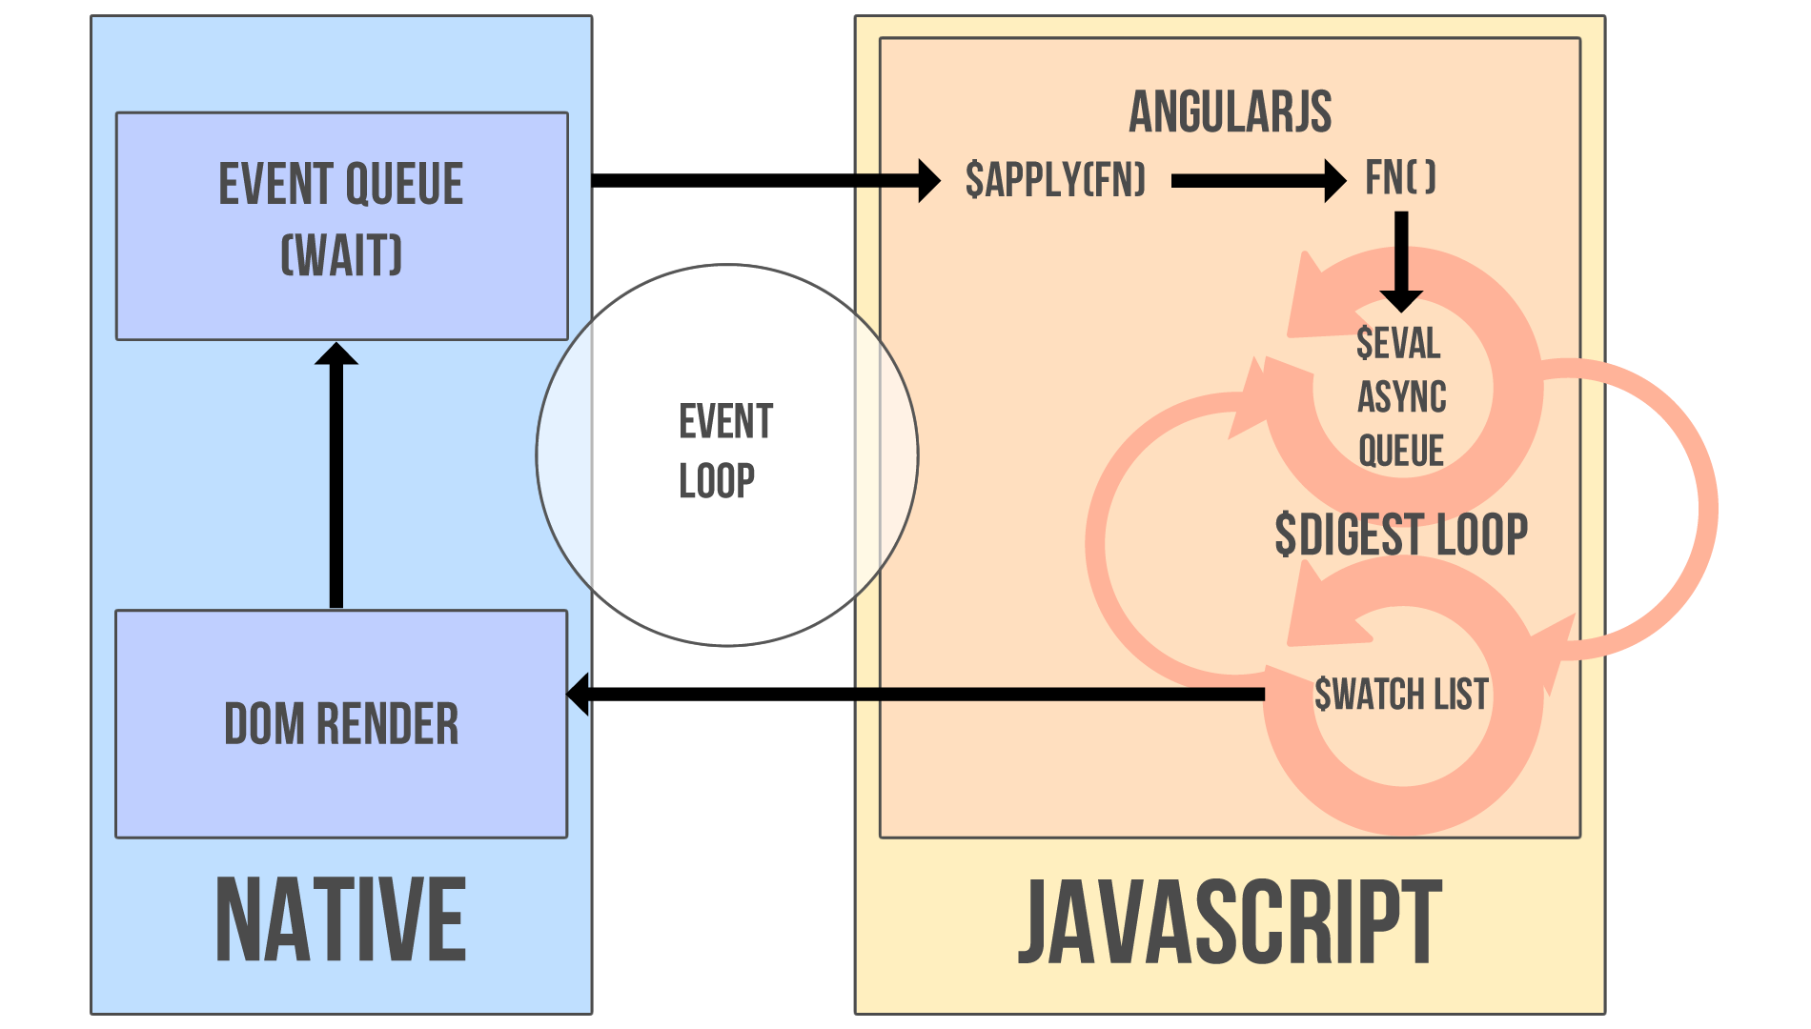
$digest cycle
Notes:
digest runs “transactionally”, re-renders instantly all DOM

Slide 10
dirty checking
dirty checking is done “in 1 transaction” of digest cycle
opposed to change listeners in KnockoutJS or Backbone which could create inconsistent state
(but with dependency tracking it’s ok)
Notes:
Misco’s answer
http://stackoverflow.com/questions/9682092/how-does-data-binding-work-in-angularjs/9693933#9693933

Slide 11
$apply
all $scope functions run in apply context
used if some code is executed outside angular
function $apply(expr) { try { return $eval(expr); } catch (e) { $exceptionHandler(e); } finally { $root.$digest(); } }
always runs from top
(because ng doesn’t know what you’re doing)
!important angular changes DOM elements in template
(not bare strings transformed to DOM elements)
Notes:
make picture of ctrl + view

Slide 12
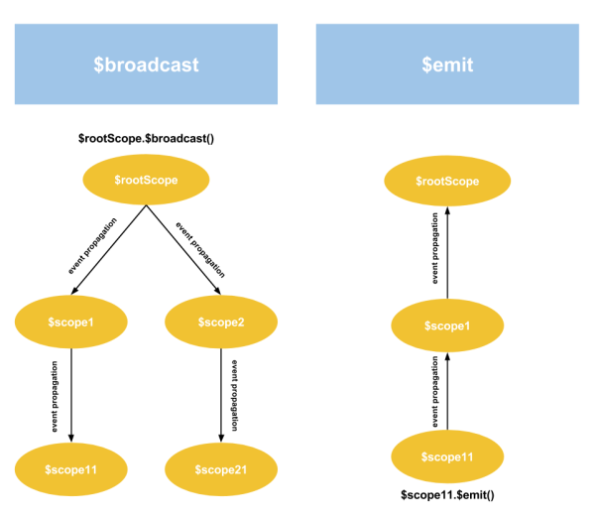
internal events
Notes:
make picture of ctrl + view

Slide 13
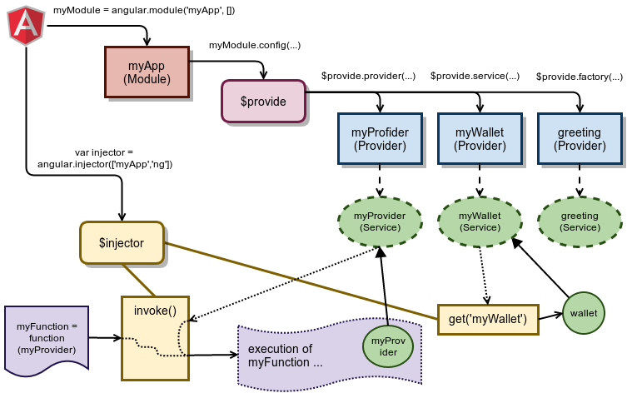
[Dependency injection]
Notes:
make picture of ctrl + view

Slide 14
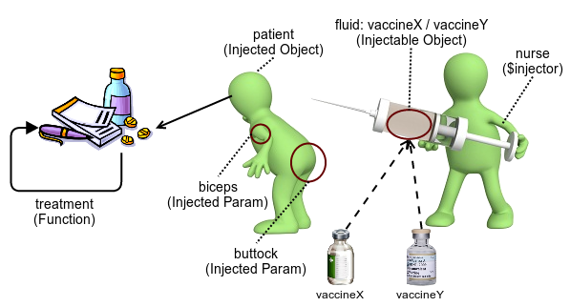
[Dependency injection]
(vietnamese guy’s look of di)
Notes:
vietnam

