Slide 1

directives

Slide 2

The 2nd heart of angular
(1st is 2-way data binding)
Notes:
what are directives, how to find them

Slide 3
What is directive
DOM augmentation
markers for DOM that tells Angular compiler to add custom behavior to element
build-in
custom
<html ng-app="app">
<my-directive></my-directive>
<input ng-model="name">
<app> <menu> <item some-prop="value1"></item> </menu>
<!-- directive: log-job-proposal --> <content> <visual-block data="data1"/> </content> </app>
<a></a>
no href is required
<input>
validation patterns
Notes:
create randomNumber directive, directive function has injector params, show link parameters, log the element,

Slide 4
Purpose
directives have multiple purposes
direct – re-using common parts
Templating
reverse, using transclude – making re-usable wrappers
either simple or angular
Adding custom behavior to elements
all you need to know about directives is in official documentation

Slide 5
Templating
register a directive
use either “template” or “templateUrl”
! directive is registered with camelCase but usually used with kebab-case
App.directive('myDirective', function() {
<my-directive></my-directive>
or any other normalized name:
<div my-directive></div> <div my_directive></div> <div data-my-directive></div> <div x-my-directive></div> <div my:directive></div>
or even as a class or comment:
<div class="my-directive"></div> <!-- directive: my-directive -->
no DOM changes in this case
Notes:
directive should match a selector, flow.js – create custom directive, directive is a $injector function, returns factory, show template, templateUrl, restrict: ‘ECMA’

Slide 6

directives inherit the scope from container
…until we isolate the scope
isolated scope has $parent which is NOT it’s prototype
unless we say scope: true – in this case prototype
Notes:
add interpolation {{ name }} into directive, show that it has the same scope as parent, then isolate scope

Slide 7
Exposing directive API
isolated scope can have bindings with parent scope via attributes
<my-directive name="name"></my-directive>
there are different types of bindings
scope: { name: '=' },
scope: { name: '<' },
2-way
1-way
scope: { name: '@' },
scope: { name: ‘&' },
string interpolation
function
scope: { name: '?=' },
optional
it’s not easy to remember, read the good docs
Notes:
add interpolation {{ name }} into directive, show that it has the same scope as parent, then isolate scope: scope false (default), scope true – prototype
function& - example with admin page, save btn and many parts

Slide 8
you can also put directives inside directives
<my-parent> <my-directive name="name"></my-directive> </my-parent>
a directive may require another one
require: ['^myParent']
link: function(scope, element, attributes, controllers) {
required directives (controllers) are available in link fn
require can be optional as well and can search in different depths
'^','^^','?^^'
require can be:
string – single directive dependency
array – multiple dependencies
object – name / value where name – dependency name, value – depth parameter
require is a way for directives to share data without API
Notes:
put my-parent in my-directive, require it, link is required, catch exception, add ^, require ngModel and ^,^^,?^^
add parentProperty to parent controller, get it in link of child;

Slide 9
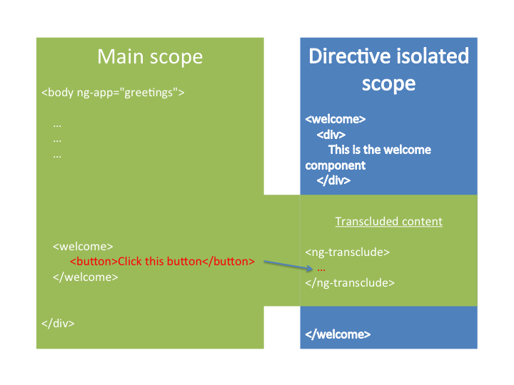
Transclude
writing wrapping templates
Notes:
transclude parent, add the <h4>Parent property</h4>, use ctrlAs, add template <ng-transclude>, in child <input ng-model=“parentProp”> - 1way binding problem, bind to scope rather that to ct
show tabs example
can we bind directly to controller this?

Slide 10

link function is a best-fit for registering $watchers and manipulating DOM
link: function(scope, element, attrs, controller) { scope.$watch(attrs.max, function (val) { element.find('span').text(Math.random() * val); }); }
$watch is also possible on attributes passed to directives
scope.$watch
attrs.$observe
(watches model)
(watches DOM)
! use $observe to “watch” the DOM attributes with interpolation {{ }}
interpolated attributes are undefined during linking, so we need to $watch / $observe
read this answer to better understand watch and observe
Notes:
create randomNumber with dommanipulate.html, isolate scope, watch for attrs.max, observe for ‘max’ and {{max}}

Slide 11
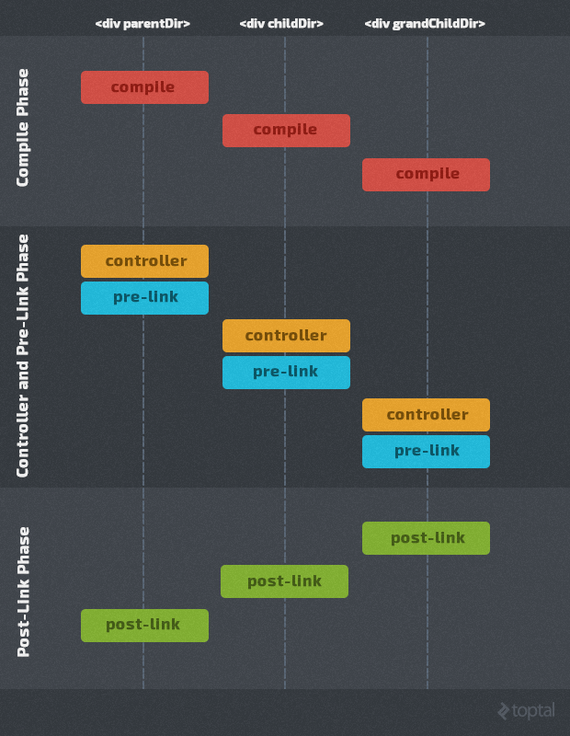
compile parent and all children
controller fn + pre-link for parent and down to children
post-link from children up to parent
after all post link the digest cycle will run and resolve the expressions
{{ expression }}
yay!
Notes:
show lifecycle.html, link is actually post-link, the priority of directives, expressions should be watched or 2-way bounded

Slide 12
Compile
the process of analyzing all directives in template and attaching them to HTML
it’s possible to add directives / expressions dynamically during the compilation phase
App.directive('compileTest', function() { return { scope: {}, compile: function(el, attrs) { el.append("{{ name }} {{ 1+ 2}}"); return { post: function(scope, el, attrs) { el.append("<br><i>{{ name }}</i>") } } }, } });
but during link phase the {{ name }} wont be interpolated anymore

Slide 13

component
“sweet” directive which has bound controller and view
App.directive('person', function () { return { scope: { person: '=data', } controller: function () { }, bindToController: true, controllerAs: 'ctrl', templateUrl: '{{ctrl.person.name}}' } });
App.component('person', { bindings: { person: '=data' }, controller: function() { }, templateUrl: ‘{{$ctrl.person.name}}' });
Angular2 is concentrated on components
lifecycle hooks:
$onInit
$onChanges
$onDestroy
@Component({ selector: ‘person', }) export class Person { }
read the docs
Notes:
write person component, it’s not a factory fn, bindToController replaced with bindings, can still use scope, scope is isolated by default

Slide 14
Homework!
https://docs.angularjs.org/guide
Notes:
https://docs.angularjs.org/guide

