Slide 1

Javascript basics
Notes:
make picture of ctrl + view

Slide 2
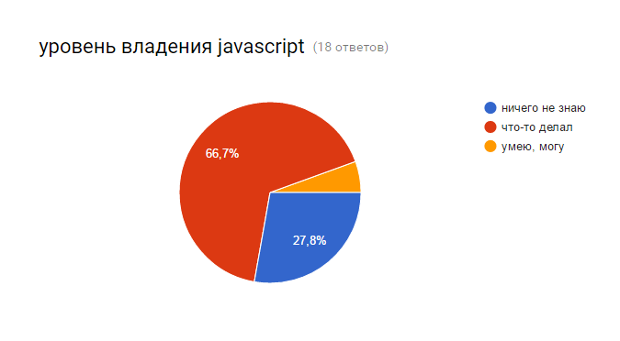

Slide 3
Why learn javascript?
1. Hot market
2. Bound to web.. and web is everywhere
3. Beginner Friendliness
Fantastic Community
Notes:
about 600 notable programming languages for now, why js?
but most javascript questions lead to stackoverflow

Slide 4
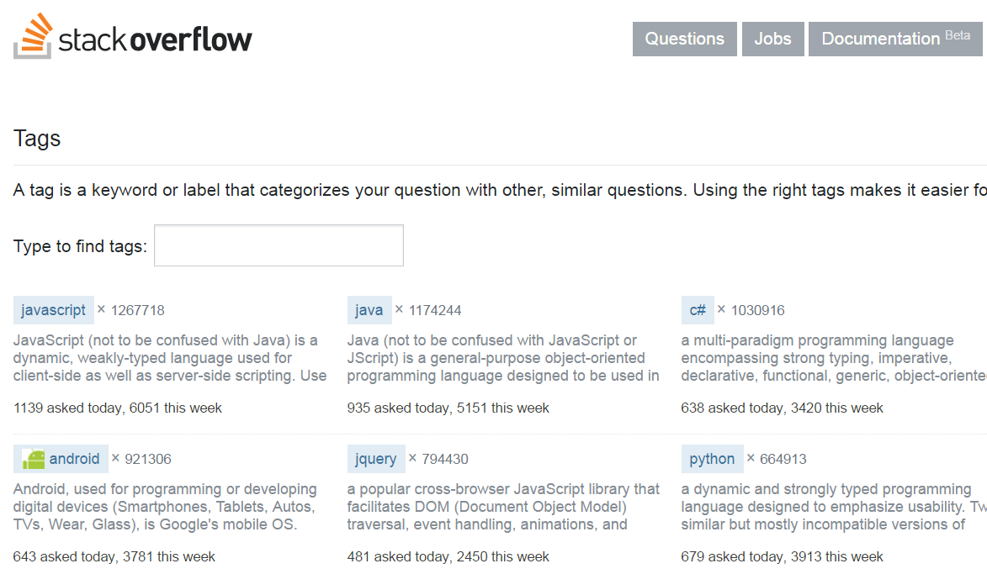

Slide 5

What do we know about javascript?
It runs in browsers
“
It’s something that always breaks
Makes web pages dynamic
Need to support multiple browsers
Interpreted, not compiled
Object-oriented or functional ?
Does it have an engine? VM?
var a = {}; // create a new object
a.b = 'hello';
is it ok?
SpiderMonkey, Rhino, Chakra… v8
?
?
?
var a = function() {};
a.b = 'hello';
?
and this??
?
Garbage collector?
?
?
?
functions are first class citizens
(with it’s own problems)
Multithreaded?
no, but it could be
Notes:
lets see why javascript is what it is
https://en.wikipedia.org/wiki/JavaScript_engine
spider monkey – first interpreter, V8 compiles to machine code

Slide 6
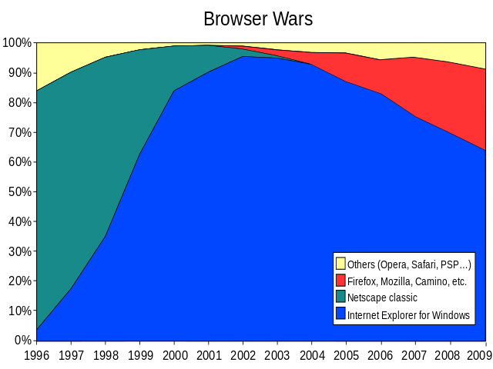




1995
Mocha
LiveScript
Brendan Eich
JavaScript
Smalltalk, Lisp, Scheme, C
ECMAScript = js spec
es1
es2
es3
es4
1997
1998
1999
es3.1
es5
es6
…
Douglas Crockford
2009
2015
ajax
Notes:
https://en.wikipedia.org/wiki/Douglas_Crockford
https://en.wikipedia.org/wiki/ECMAScript
https://en.wikipedia.org/wiki/Ajax_(programming)
https://www.w3.org/community/webed/wiki/A_Short_History_of_JavaScript
https://en.wikipedia.org/wiki/Mozilla

Slide 7
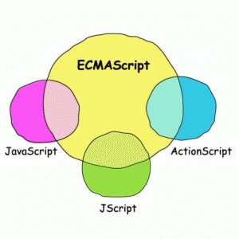
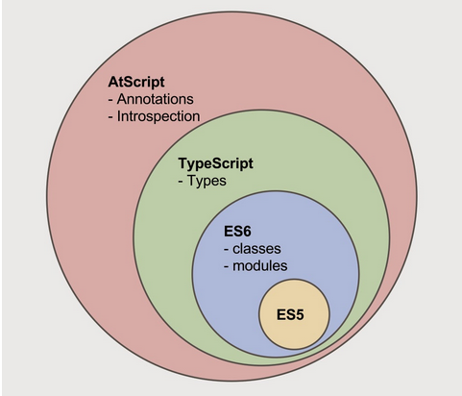
ECMAScript
specification for the JavaScript language
Notes:
lets make a little test over js

Slide 8
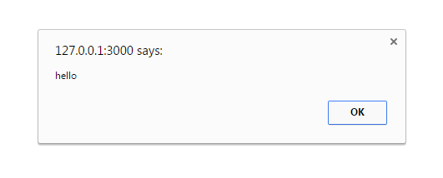




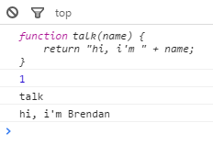


alert('hello');
console.log('the quick brown fox...');
console.log(42 / "asdf");
var o = { num: 42 }; delete o; console.log(o);
var o = {}; console.log(o); console.log(o.toString());
function talk(name) { return "hi, i'm " + name; } console.log(talk); console.log(talk.length); console.log(talk.name); console.log(talk("Brendan"));
function a() { console.log(this.toString()); } a();
var fnArray = []; for (var i=0; i<10; i++) { fnArray.push(function() { console.log('i=' + i); }); } fnArray[5]();
(actually depends on environment)
Notes:
https://developer.mozilla.org/en-US/docs/Web/JavaScript/Reference/Operators/delete
http://stackoverflow.com/questions/767486/how-do-you-check-if-a-variable-is-an-array-in-javascript

Slide 9
the types in javascript
typeof is used to determine type
Six data types that are primitives:
Boolean
Null
Undefined
Number (8 bytes)
String (2 byte)
Symbol (new in ECMAScript 6)
…and Object
// Numbers typeof 37 === 'number'; typeof Infinity === 'number'; typeof NaN === 'number'; // Despite being "Not-A-Number" // Strings typeof "bla" === 'string'; // Booleans typeof true === 'boolean'; // Symbols typeof Symbol('foo') === 'symbol' // Undefined typeof undefined === 'undefined'; typeof notdefined === 'undefined'; // Objects typeof {a:1} === 'object'; // use Array.isArray or Object.prototype.toString.call // to differentiate regular objects from arrays typeof [1, 2, 4] === 'object'; typeof new Date() === 'object'; // Functions typeof function(){} === 'function';
+Infinity, -Infinity, and NaN
Function type??
nah, function is also an Object
var fn = new Function("return 'hello';"); console.log(fn());
== !== ===
=== will not do the type conversion like ==
'' == '0'; // false 0 == ''; // true 0 == '0'; // true 0 == false; // true null == undefined; // true
'' === '0'; // false 0 === ''; // false 0 === '0'; // false 0 === false; // false null === undefined; // false
Notes:
https://developer.mozilla.org/en-US/docs/Web/JavaScript/Data_structures

Slide 10

Another quiz
var fooFn = function(){ function bar() { return 3; } return bar(); function bar() { return 8; } }; console.log(fooFn());
var fooFn = function () { function bar() { return 3; } // defined function bar() { return 8; } // re-defined return bar(); }; console.log(fooFn());
2. function expression
1. function declaration
hoisted
function bar is hoisted during interpretation
(function and local variables declarations are always hoisted)
var bar = function() { console.log('bar'); }; foo(); function foo() { console.log('foo'); } bar();
// declaration var bar; function foo() { console.log('foo'); } // execution bar = function() { console.log('bar'); }; foo(); bar();
Notes:
btw functions and variables have very close relationships

Slide 11


Function-level scoping
not block-scoping
function a() { var carName = 'BMW'; } a(); console.log(carName);
function a() { carName = 'BMW'; } a(); console.log(this.carName);
now carName is a var of global scope
carName is a var of “a” fn
but here is tricky…
var carName = 'Audi'; function a() { var carName = 'BMW'; console.log(carName); console.log(this.carName); } a();
wat?

Slide 12
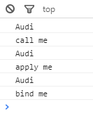
“This” is not a game
when function executes it gets this – a value of object that invokes the function
var carName = 'Audi'; function a() { var carName = 'BMW'; console.log(carName); console.log(this.carName); } a();
Audi is in window
window
function is invoked in window global scope
this here is window object (in browser)
apply, call and bind allows to change this
function a(arg1, arg2) { console.log(this.carName); console.log(arg1 + ' ' + arg2); } var scope = { carName: 'Audi' }; a.call(scope, 'call', 'me'); a.apply(scope, ['apply', 'me']); var bound = a.bind(scope, 'bind', 'me'); bound();
Notes:
http://javascriptissexy.com/understand-javascripts-this-with-clarity-and-master-it/

Slide 13
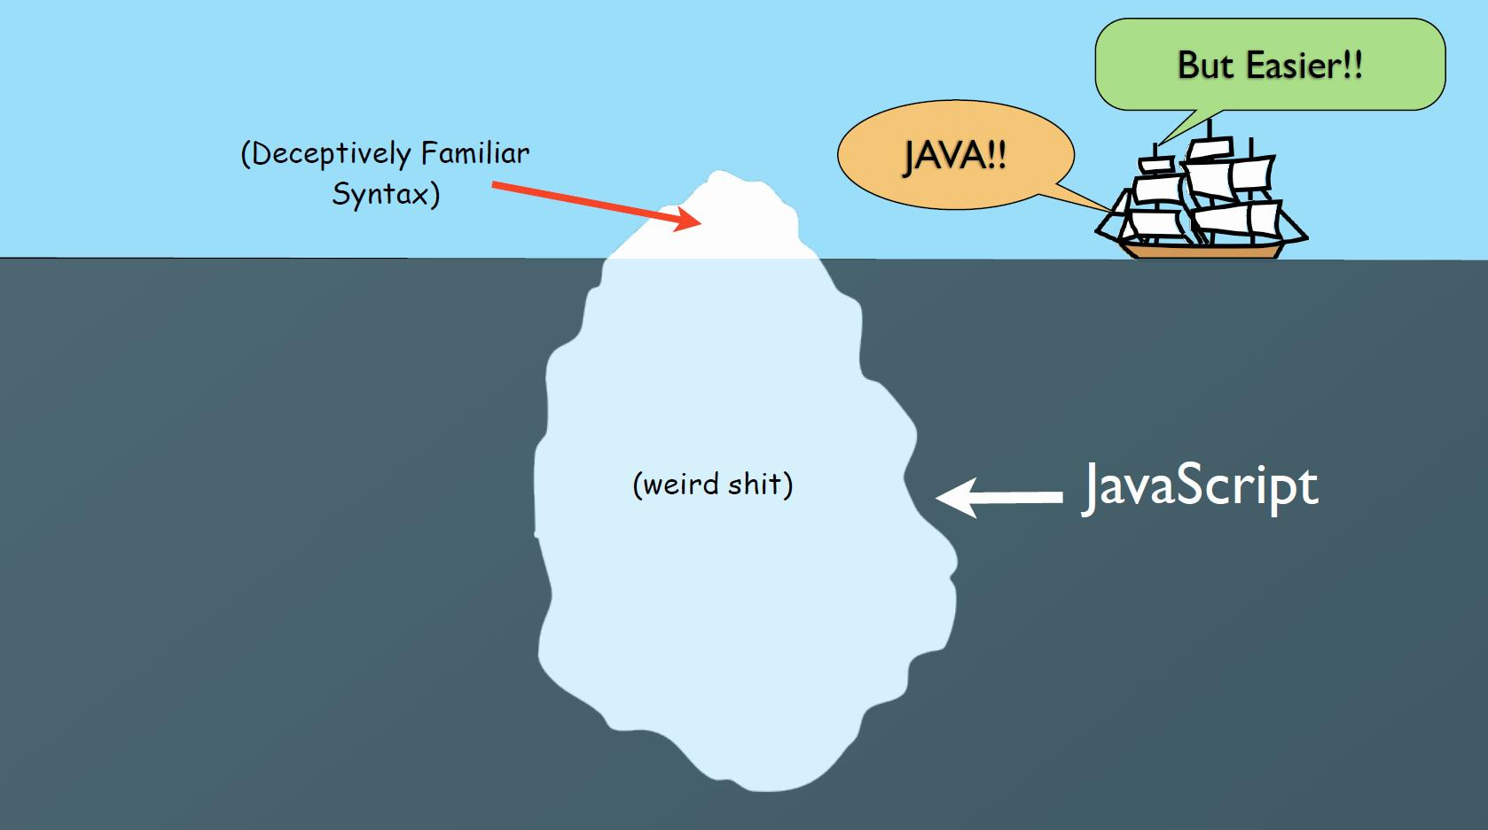

Slide 14
IIFE
the GREAT hack
function foo() { var a = 8; (function () { console.log('some privacy'); var b = 42; console.log(b); }()); console.log(a); console.log(b); // no b } foo();
“
parentheses creates function expression instead of declaration
var counter = (function() { var i = 0; return { get: function() { return i; }, inc: function() { return ++i; }, set: function(value) { i = value return i; } } }()); console.log(counter.get()); console.log(counter.set(3)); console.log(counter.inc());
use “iffy” for block-scoping
use “iffy” as a closure

Slide 15
there is new operator in javascript
function User(name) { this.name = name; } var b = new User('Brendan');
console.log(b.name); // Brendan
constructor fn
new object is created inheriting User prototype
constructor fn User is invoked, this is bound
User fn can return or not return the result
the prototype is a special object like class Class in java
…unline java you can modify the prototype in runtime
can even hack existing prototype
User.prototype.greet = function() { return "Hi, " + this.name; }; console.log(b.greet()); // Hi, Brendan
var o = {}; console.log(o.toString()); // [object Object] Object.prototype.toString = function() { return 'hack'; }; console.log(o.toString()); // hack var d = new Date(); console.log(d.toString()); // Thu Nov 10 ...
monkey patching
prototype chain

Slide 16
Actually there are 2 OOP
class-based
prototype-based
object
object
object
class
object
object
object
object
in javascript there are objects and functions
Object object is the top hierarchy
Each fn has a prototype
var o = new Object();
Function is prototype for each fn
and each object too
var fn = new Function("return 'hello';");
although Function’s prototype is Object

Slide 17
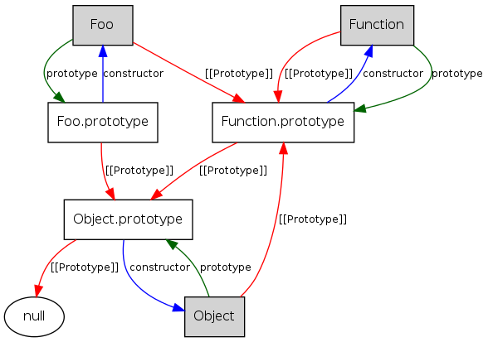
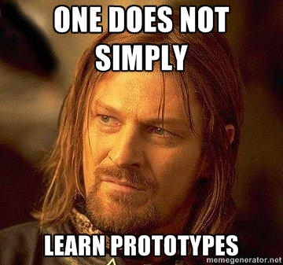
Prototype relations

Slide 18
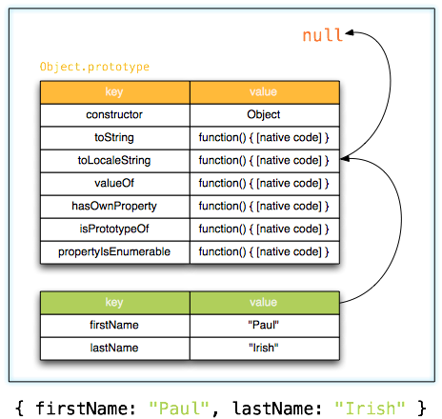

when you create object
Object object has some build-in methods
var o = { firstName: "Paul", lastName: "Irish" };
behind the scene is
prototype
var o = Object.create(null); Object.defineProperty(o, 'firstName', { value: "Paul", writable: true, enumerable: true, configurable: true }); Object.defineProperty(o, 'lastName', { value: "Irish" });
properties
usually clone is required
var clone = Object.assign(o);
developer of the year 2014 - google chrome
- bower
- jQuery
for deep clone use JSON
var deepClone = JSON.parse(JSON.stringify(o));
Notes:
writable throws error only in strict mode
https://developer.mozilla.org/en-US/docs/Web/JavaScript/Reference/Global_Objects/Object

Slide 19
function User(name) { this.name = name; this.greet = function () { return "Hi, I'm " + this.name; } }
inheritance
function User(name) { this.name = name; this.greet = function () { return "Hi, I'm " + this.name; } } function JiraUser(id) { this.id = id; this.login = function () { console.log("login " + this.name); } } JiraUser.prototype = new User(); JiraUser.prototype.constructor = JiraUser; var brendan = new JiraUser(123); brendan.name = 'Brendan'; brendan.login(); brendan.greet(); console.log(brendan);
create classes
(prototypes)
OOP
encapsulation
function User(name) { var greet = function () { return "Hi, I'm " + name; }; return { greet: greet } } var brendan = new User("Brendan"); console.log(brendan.greet()); console.log(brendan.name);
closure

Slide 20
It’s better with es6
"use strict";
class User { constructor(name) { this.name = name; } } class JiraUser extends User { constructor(name, id) { super(name); this.id = id; } } var brendan = new JiraUser("Brendan", 123); console.log(brendan);
“
classes yay! but still prototype
"use strict"; class User { constructor(name) { this.name = name; } get fullName() { return "Sir " + this.name; } static hasName(user) { return user.name !== undefined; } } var brendan = new User("Brendan"); console.log(brendan.fullName); console.log(User.hasName(brendan));
get/set and also static
some environments (Node) require strict mode
Notes:
http://kangax.github.io/compat-table/es6/

Slide 21
“use strict”;
"use strict"; a = 'a';
"use strict"; var carName = "Audi"; function a() { console.log(this.carName); } a(); // TypeError var obj = new a(); // undefined
"use strict"; var o = {}; delete o;
in strict mode only constructors have this
"use strict"; eval("var x = 2"); console.log(x);
“
strict mode is a way of disabling backward-compatibility

Slide 22
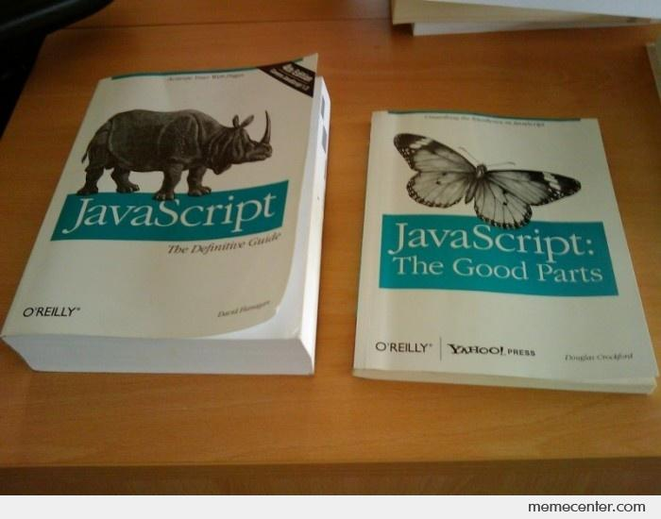
It’s not that bad
David Flanagan
Douglas Crockford
There are good parts
Notes:
can program without knowing all that things, it’s just easier to understand, debug and oraganise the filenames, functions if you know the theory
usually we use javascript in procedural style; in procedural we have functions which invoke other functions; we also have some starting point to start invoking functions

Slide 23
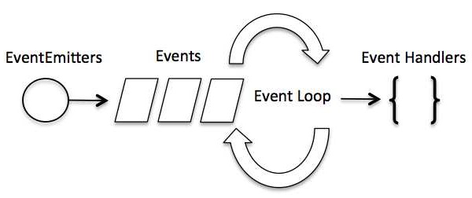
Don’t call us – we will call you back
callback = function with delayed execution
“
there is no wait() or Thread.sleep()
make callback instead of waiting
function getData(callback) { console.log('long process start...'); setTimeout(function() { console.log('...long process end'); callback(); }, 2000); } getData(function(data) { console.log('The data is: ' + data); });
callback definition
callback body
instead all code is executed in a predictable order in scope of a event handler function
http://callbackhell.com/
callbacks is the only way to organize the function execution dependency

Slide 24

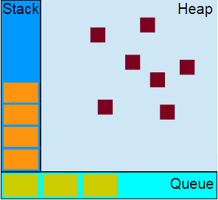
Single threaded, never blocking
memory for objects
js engine model
functions call stack
starts from handler function
in queue and goes down
runs-to-completion
cannot be stopped like in java, every function runs till end and nothing can stop it
message queue / event loop
setTimeout / setInterval and events
FPS !important

Slide 25
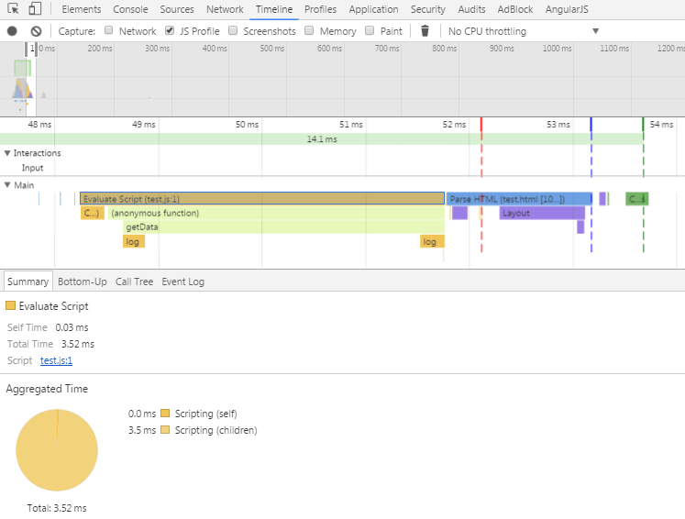
function getData(callback) { console.log('long process start...'); setTimeout(function() { console.log('...long process end'); callback(); }, 2000); } getData(function(data) { console.log('The data is: ' + data); });
14.1 ms is a good frame
about 71 FPS
message queue
our script
the function execution time should be small
FPS > 24 = OK
execution time

Slide 26
Other es6 features
block-scoping with let
block-scoped function definition
+
{ let a = 'a' } console.log(a); // ReferenceError
{ function a() {} } a(); // ReferenceError
arrow functions
Maps and Sets
var arr = [1,2,3]; arr = arr.map(num => num*2); console.log(arr); // [2,4,6]
let m = new Map(); m.set('banana', 7); console.log(m.get('banana')); // 7 let s = new Set(); s.add('banana'); s.add('apple'); s.add('banana'); console.log(s.size); // 2
default parameters
function a(x, y = 2, z = 3) { return x * y * z; } console.log(a(1)); // 6
rest parameters (varargs)
Proxies, Reflections, array-matching, computed property names, better regex and many more…
function a(x, ...y) { return x * y.length } console.log(a(1,1,2,3,4)); // 4
Notes:
http://es6-features.org/#BlockScopedVariables

Slide 27
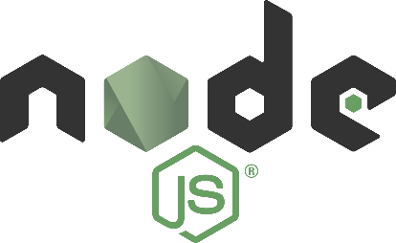
One of the most interesting things:
Modules
(though not supported by browsers yet)
// lib/math.js export function sum (x, y) { return x + y } export var pi = 3.141593 // someApp.js import * as math from "lib/math" console.log("2π = " + math.sum(math.pi, math.pi)) // otherApp.js import { sum, pi } from "lib/math" console.log("2π = " + sum(pi, pi))
But modules are core of
Notes:
http://es6-features.org/#BlockScopedVariables
https://nodejs.org/api/modules.html

Slide 28
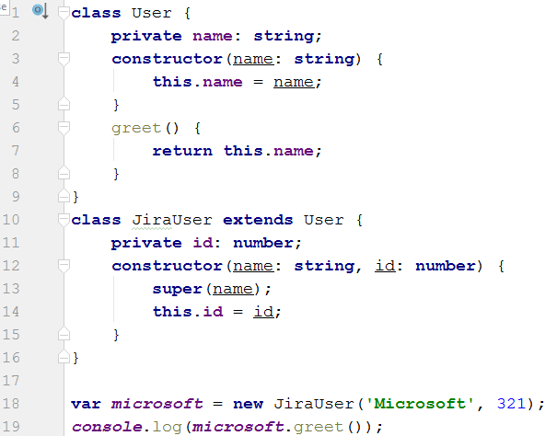

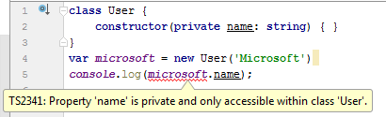
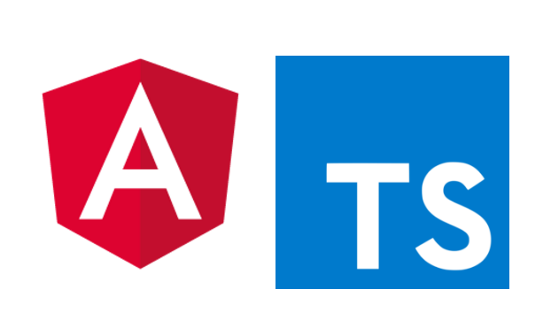
TypeScript
JavaScript that scales with types
allows to write javascript as java
ts compiler (transpiler) helps as in java
access modifiers

Slide 29
Future
reserved keywords
implements
interface
package
private
protected
public
static
yield

Slide 30
It’s not all
but enough to think about
…next station – AngularJS

