Slide 1
Javascript
Basics

Slide 2
object-oriented or functional?
Notes:
make picture of ctrl + view

Slide 3
execute outside browser?
Notes:
make picture of ctrl + view

Slide 4
multithreading in javascript?
Notes:
make picture of ctrl + view

Slide 5
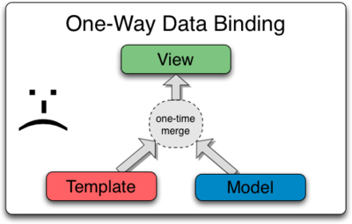
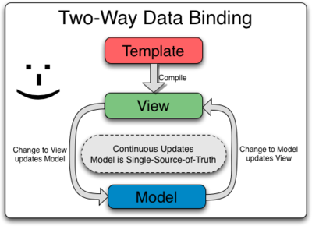
Notes:
make picture of ctrl + view

Slide 6
MVVM
JS – model
HTML – view
$scope – view model – shared object between view and model
Notes:
make picture of ctrl + view

Slide 7
Controllers
Notes:
make picture of ctrl + view

Slide 8
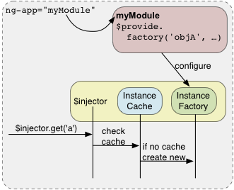
[Dependency injection]
Notes:
make picture of ctrl + view

Slide 9
$scope
In an AngularJS application, the controller and view share an object called a scope
scope has two-way data binding
$rootScope is always created on app start
Notes:
make picture of ctrl + view

Slide 10
$ build-in services
services are lazy-initialized
build-in services always start with $
Notes:
make picture of ctrl + view

Slide 11
Application lifecycle
starts the app, creates $rootScope
“compiles” the DOM, searches for directives
creates the scopes tree that “mirrors” the DOM

Slide 12
Modules
create model with 2 arguments
angular.module(‘app', []);
get the created model with 1 arg
var module = angular.module('app');
call controller function on module instance
angular.module('app').controller('ctrl', function($scope) { $scope.name = 'Alexey'; });

Slide 13
Directives
separated scopes are useful when writing reusable components (like XHTML templates)
these components are called directives

Slide 14

Directives are hard

Slide 15
Scope inheritance
parent scope vars in inherited in child scope
unless it’s an isolated scope
scopes are inherited using prototype
Notes:
ng-if creates a child scope

Slide 16
HTML 5
<applet> removed (<object> instead)

Slide 17
Javascript
Java?
Scripting?
Notes:
Nothing to do with java
Not a scripting lang anymore

Slide 18
Semantics
extends HTML with clarity
custom behavioral notations (directives)
Notes:
Nothing to do with java
Not a scripting lang anymore

Slide 19
Angular 1 vs 2
(what people say)
2 is too raw
1 can be upgraded using ngForward
2 has better performance
1 will still be supported
2 uses TS and ES6
Notes:
Nothing to do with java
Not a scripting lang anymore

