Slide 1

directives

Slide 2

The 2nd heart of angular
(1st is 2-way data binding)

Slide 3
Purpose
directives have multiple purposes
direct – re-using common parts
Templating
reverse, using transclude – making re-usable wrappers
either simple or angular
Adding custom behavior to any element
all you need to know about directives is in official documentation

Slide 4
Templating
register a directive
use either “template” or “templateUrl”
! directive is registered with camelCase but usually used with kebab-case
App.directive('myDirective', function() {
<my-directive></my-directive>
or any other normalized name:
<div my-directive></div> <div my_directive></div> <div data-my-directive></div> <div x-my-directive></div> <div my:directive></div>
or even as a class or comment:
<div class="my-directive"></div> <!-- directive: my-directive -->
no DOM changes in this case
Notes:
flow.js – create custom directive, show template, templateUrl, restrict: ‘ECMA’

Slide 5

directives inherit the scope from container
…until we isolate the scope
isolated scope has $parent which is NOT it’s prototype
unless we say scope: true – in this case prototype
Notes:
add interpolation {{ name }} into directive, show that it has the same scope as parent, then isolate scope

Slide 6
Exposing directive API
isolated scope can have bindings with parent scope via attributes
<my-directive name="name"></my-directive>
there are different types of bindings
scope: { name: '=' },
scope: { name: '<' },
2-way
1-way
scope: { name: '@' },
scope: { name: ‘&' },
string interpolation
function
scope: { name: '?=' },
optional
it’s not easy to remember, read the good docs
Notes:
add interpolation {{ name }} into directive, show that it has the same scope as parent, then isolate scope: scope false (default), scope true - prototype

Slide 7
you can also put directives inside directives
<my-parent> <my-directive name="name"></my-directive> </my-parent>
a directive may require another one
require: ['^myParent']
link: function(scope, element, attributes, controllers) {
required directives (controllers) are available in link fn
require can be optional as well and can search in different depths
'^','^^','?^^'
require can be:
string – single directive dependency
array – multiple dependencies
object – name / value where name – dependency name, value – depth parameter
require is a way for directives to share data without API
Notes:
put my-parent in my-directive, require it, link is required, catch exception, add ^, require ngModel and ^,^^,?^^
add parentProperty to parent controller, get it in link of child;

Slide 8
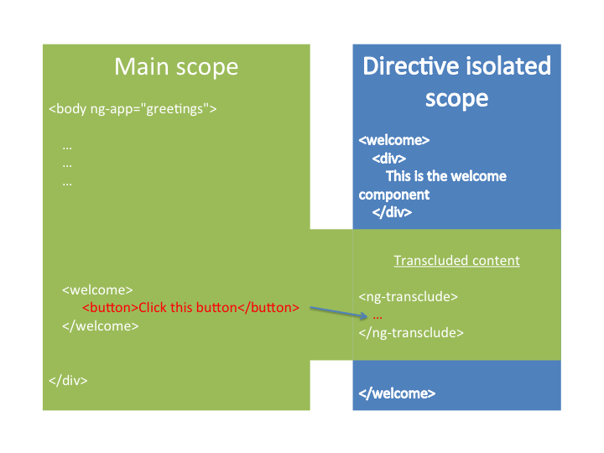
Transclude
wrapping templates
Notes:
transclude parent, add the <h4>Parent property</h4>, use ctrlAs, add template <ng-transclude>, in child <input ng-model=“parentProp”> - 1way binding problem, bind to scope rather that to ct
show tabs example
can we bind directly to controller this?

Slide 9

link function is a best-fit for registering $watchers and manipulating DOM
link: function(scope, element, attrs, controller) { scope.$watch(attrs.max, function (val) { element.find('span').text(Math.random() * val); }); }
$watch is also possible on attributes passed to directives
scope.$watch
attrs.$observe
(watches model)
(watches DOM)
! use $observe to “watch” the DOM attributes with interpolation {{ }}
interpolated attributes are undefined during linking, so we need to $watch / $observe
read this answer to better understand watch and observe
Notes:
create randomNumber with dommanipulate.html, isolate scope, watch for attrs.max, observe for ‘max’ and {{max}}

Slide 10
Compile
surprise, a, form, input, select and others are already directives in angular
Notes:
create randomNumber directive, directive function has injector params, show link parameters, log the element,

Slide 11
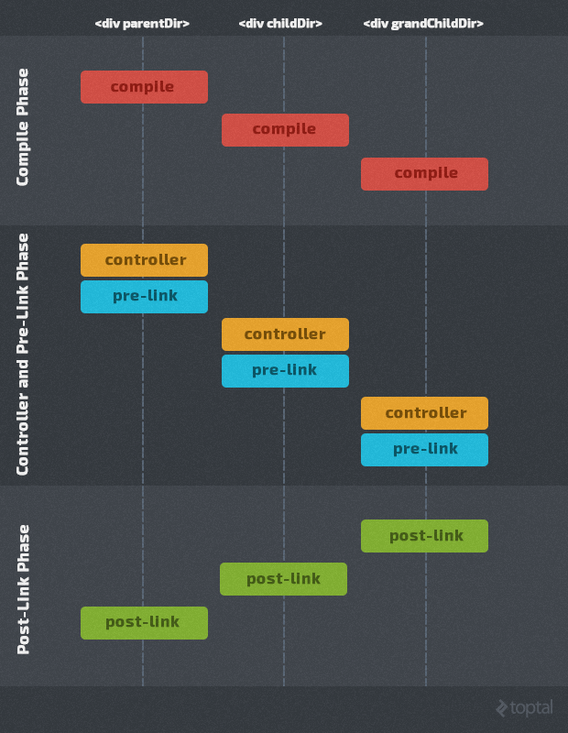
compile parent and all children
controller fn + pre-link for parent and down to children
post-link from children up to parent
after all post link the digest cycle will run and resolve the expressions
{{ expression }}
yay!
Notes:
show lifecycle.html

Slide 12
Build-in directives
surprise, a, form, input, select and others are already directives in angular
Notes:
create randomNumber directive, directive function has injector params, show link parameters, log the element,

Slide 13
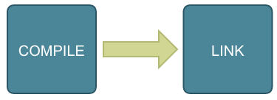
Compile and link
(divide and conquer)
Compiling – analyzing of directives in element and it’s children
Linking – binding of variables in template with $scope
link actually works as “postLink”
can specify priority to handle the compiling and linking order
Need to clean up timers, intervals to prevent memory leaks
Notes:
make picture of ctrl + view

Slide 14
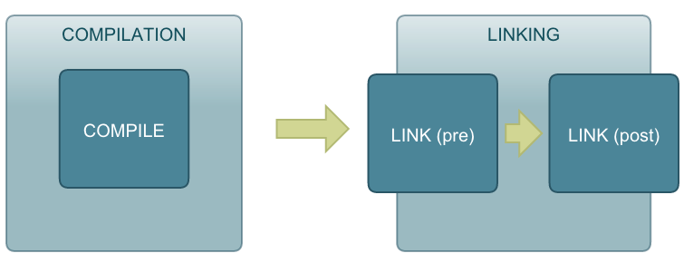
link actually works as “postLink”
(divide and conquer)
Notes:
make picture of ctrl + view

Slide 15
priority of execution
(divide and conquer)
Notes:
make picture of ctrl + view

Slide 16
Override everything
(even usual tags as <p> or <div>)
Compiling – analyzing of directives in element and it’s children
Linking – binding of variables in template with $scope
link actually works as “postLink”
Interpolated attributes are undefined in link, so we need to $observe / $watch them
Link fn is the best place for watchers, not the controller fn
app.service('myService', function() { // service is just a constructor function // that will be called with 'new' this.sayHello = function(name) { return "Hi " + name + "!"; }; });
Notes:
make picture of ctrl + view

Slide 17

component
“sweet” directive which has bound controller and view
app.service('myService', function() { // service is just a constructor function // that will be called with 'new' this.sayHello = function(name) { return "Hi " + name + "!"; }; });
Notes:
make picture of ctrl + view

Slide 18
evaluation order is the following:
linking
(even usual tags as <p> or <div>)
app.service('myService', function() { // service is just a constructor function // that will be called with 'new' this.sayHello = function(name) { return "Hi " + name + "!"; }; });
Notes:
make picture of ctrl + view

Slide 19
Clean up please
$destroy event is triggered when the scope is destroyed
Need to clean up timers, intervals to prevent memory leaks
app.service('myService', function() { // service is just a constructor function // that will be called with 'new' this.sayHello = function(name) { return "Hi " + name + "!"; }; });
Notes:
make picture of ctrl + view

Slide 20
Isolated scope
$destroy event is triggered when the scope is destroyed
Need to clean up timers, intervals to prevent memory leaks
app.service('myService', function() { // service is just a constructor function // that will be called with 'new' this.sayHello = function(name) { return "Hi " + name + "!"; }; });
Notes:
make picture of ctrl + view

Slide 21
lets do this
service is a constructor fn
factory returns object as API
(also accepts es6 classes)
app.factory('myFactory', function() { // factory returns an object // you can run some code before return { sayHello : function(name) { return "Hi " + name + "!"; } } });
app.service('myService', function() { // service is just a constructor function // that will be called with 'new' this.sayHello = function(name) { return "Hi " + name + "!"; }; });
Notes:
make picture of ctrl + view

Slide 22
Application lifecycle
Bootstrap
HTML compilation
Runtime

Slide 23
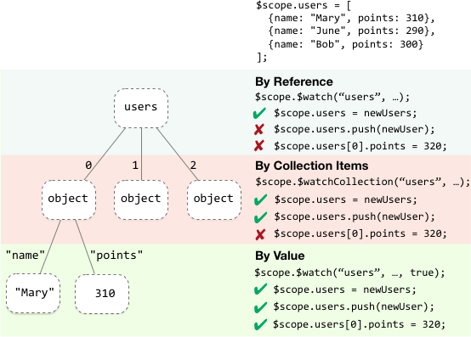
$$watchers
each $scope has collection of watchers
watchExpression
watch function
deep watch?
Notes:
make picture of ctrl + view

Slide 24
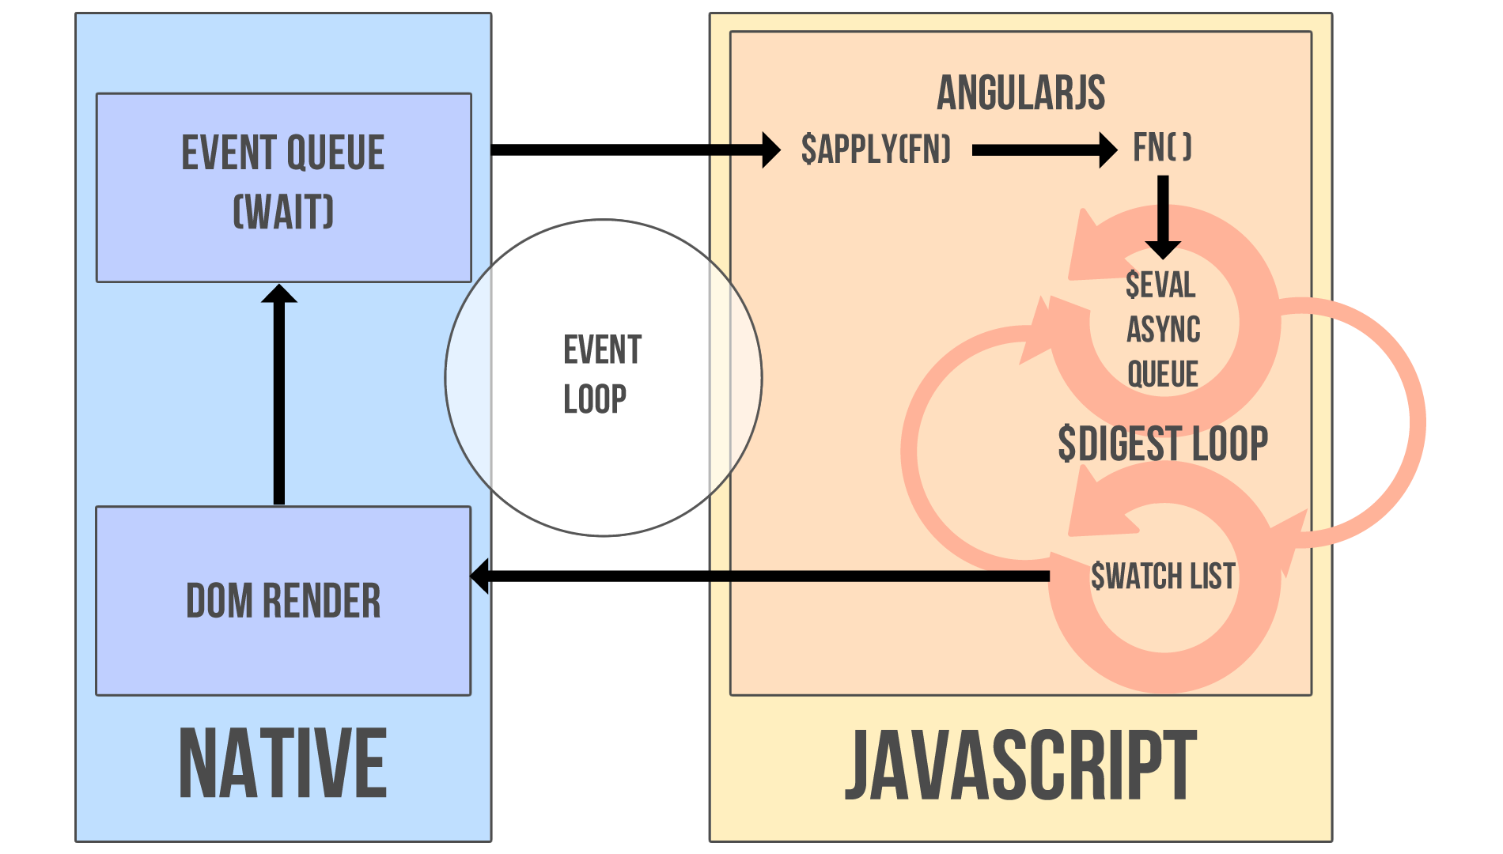
$digest cycle
Notes:
make picture of ctrl + view

Slide 25
dirty checking
dirty checking is done “in 1 transaction” of digest cycle
opposed to change listeners in KnockoutJS or Backbone which could create inconsistent state
(but with dependency tracking it’s ok)
Notes:
make picture of ctrl + view

Slide 26
$apply
all $scope functions run in apply context
used if some code is executed outside angular
function $apply(expr) { try { return $eval(expr); } catch (e) { $exceptionHandler(e); } finally { $root.$digest(); } }
always runs from top
(because ng doesn’t know what you’re doing)
!important angular changes DOM elements in template
(not bare strings transformed to DOM elements)
Notes:
make picture of ctrl + view

Slide 27
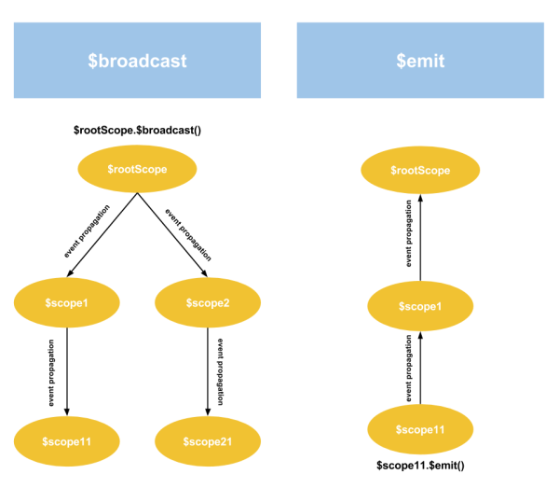
internal events
Notes:
make picture of ctrl + view

Slide 28
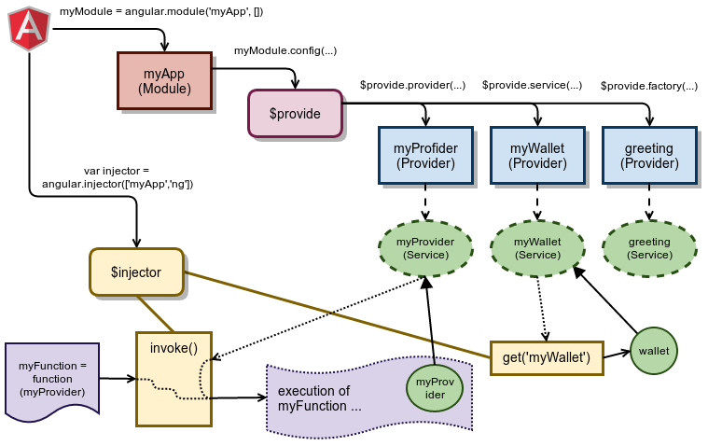
[Dependency injection]
Notes:
make picture of ctrl + view

Slide 29
Homework!
https://docs.angularjs.org/guide
Notes:
https://docs.angularjs.org/guide

