Slide 1

Javascript basics
Notes:
make picture of ctrl + view

Slide 2

What do we know about javascript?
It runs in browsers
ECMAScript = js spec
Makes web pages dynamic
Interpreted, not compiled
Fantastic Community
Interpreted, not compiled
Object-oriented or functional ??
var a = {}; // create a new object
a.b = 'hello';
is it ok?
?
?
?
var a = function() {};
a.b = 'hello';
?
and this??
functions are object
?
?
(first class citizens)
?
?

Slide 3
function Function, object Object
function Function, object Object
function doIfTrue(isTrue, whatToDo) {
if(isTrue) {
whatToDo();
}
}
doIfTrue(true, function() {
alert('hello'); // alerts "world"
});
doIfTrue(false, function() {
alert('world'); // does nothing
});

Slide 4
Scope
function scoping via “var”
function doIfTrue(isTrue, whatToDo) {
if(isTrue) {
whatToDo();
}
}
doIfTrue(true, function() {
alert('hello'); // alerts "world"
});
doIfTrue(false, function() {
alert('world'); // does nothing
});

Slide 5
Don’t call us – we will call you back
callback = function with delayed execution
there is no wait()
make callback instead of waiting
function getData(callback) { console.log('long process start...'); setTimeout(function() { console.log('...long process end'); callback(); }, 2000); } getData(function(data) { console.log('The data is: ' + data); });
http://callbackhell.com/
callbacks is the only way to organize the function execution dependency

Slide 6

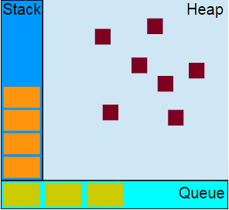
Single threaded, never blocking
memory for objects
js engine model
functions call stack
starts from handler function
in queue and goes down
runs-to-completion
cannot be stopped like in java, every function runs till end and nothing can stop it
message queue / event loop
setTimeout / setInterval and events
FPS !important

Slide 7
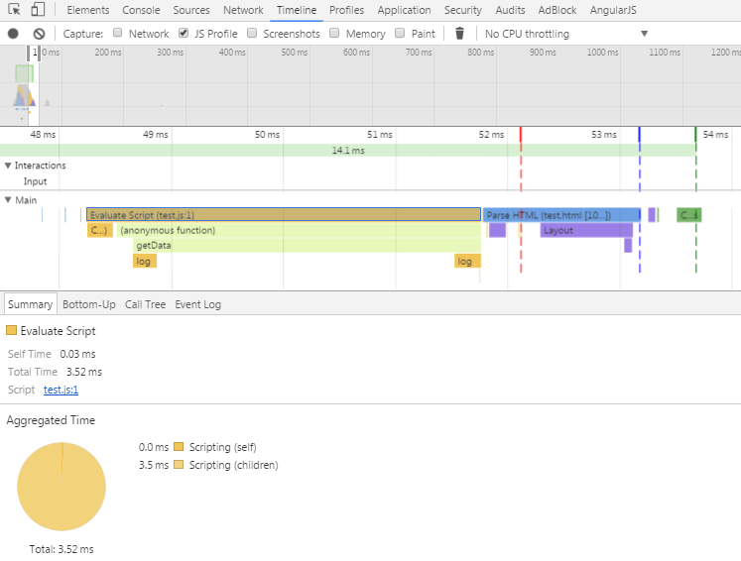
function getData(callback) { console.log('long process start...'); setTimeout(function() { console.log('...long process end'); callback(); }, 2000); } getData(function(data) { console.log('The data is: ' + data); });
14.1 ms is a good frame
about 71 FPS
message queue
our script
the function execution time should be small
FPS > 24 = OK
execution time

Slide 8
JavaScript engine??
special types: null, undefined

Slide 9
== !== ===
special types: null, undefined

Slide 10
Prototype
Every JavaScript object has a prototype

Slide 11
Browser vs Node
special types: null, undefined

Slide 12
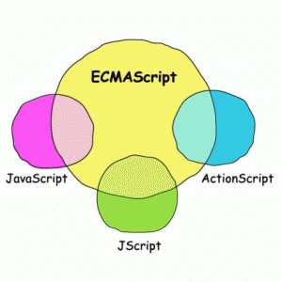
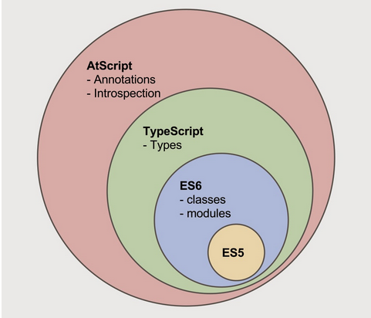
ECMAScript
specification for the Javascript language

Slide 13
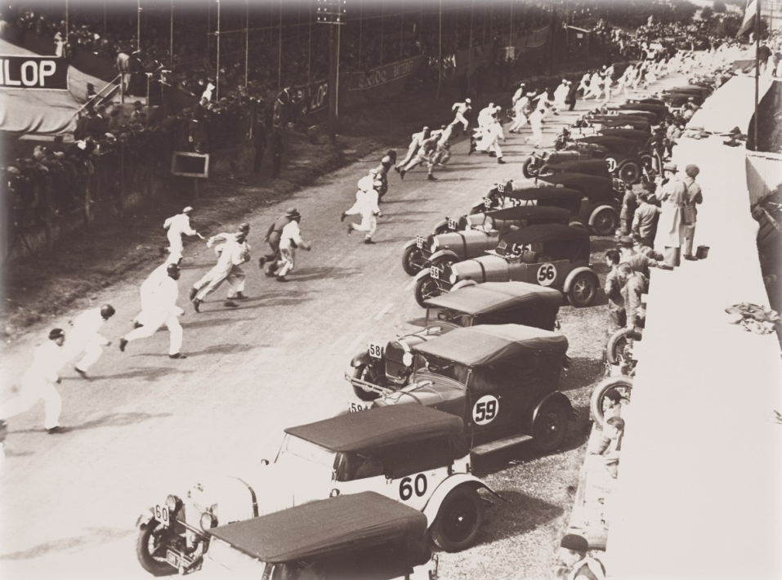
Event queue

Slide 14
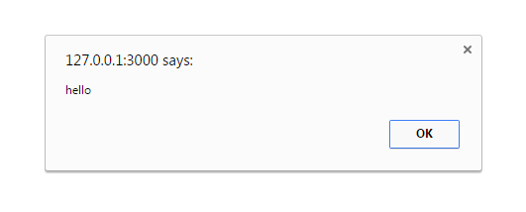

What do we know about javascript?
alert('hello');
console.log('the quick brown fox...');

Slide 15
Javascript
Basics

Slide 16
object-oriented or functional?
Notes:
make picture of ctrl + view

Slide 17
var sex = addPersonData.sex; if (rt == 'DESCENDANT') { $scope.clanFieldDisabled = sex; } else if (rt == 'PREDECESSOR') { $scope.clanFieldDisabled = true; } else if (rt == 'SIBLING') { $scope.clanFieldDisabled = true; } else if (rt == 'ACTUAL_MARRIAGE' || rt == 'BROKEN_MARRIAGE') { $scope.clanFieldDisabled = false; }
Notes:
make picture of ctrl + view

Slide 18
execute outside browser?
Notes:
make picture of ctrl + view

Slide 19
multithreading in javascript?
Notes:
make picture of ctrl + view

