Slide 1
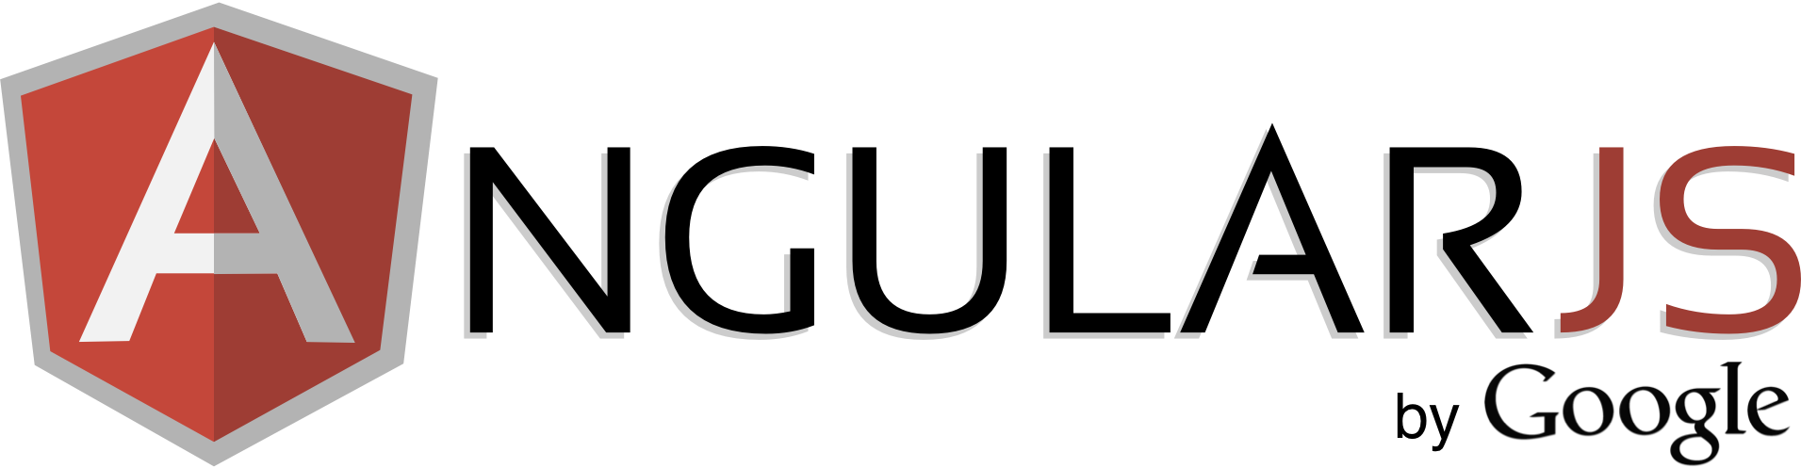
basics

Slide 2
QnA
How does angular work with sessions?
there is only 1 HTTP session per ng-app
if control is required (login, logout) wo page refresh – this should be done manually
( local storage, cookies are possible ways to store data over page refresh )
does angular use some libraries of itself?
yes, angular uses jQuery lite for DOM-modifications
angular.element(document.querySelector(‘#id’))
how to create custom exceptions like in JSF
in js it’s possible to create custom error – need to inherit Error object and throw it
in angular there is $exceptionHandler which by default logs the errors to console (can override)
what are ng benefits comparing with other web frameworks?
probably I’ll make a short overview
what are best practices? what is under the hood of angular?
Good question
Notes:
make picture of ctrl + view

Slide 3
Modules
create model with 2 arguments
angular.module(‘app', []);
get the created model with 1 arg
var module = angular.module('app');
call controller function on module instance
angular.module('app').controller('ctrl', function($scope) { $scope.name = 'Alexey'; });

Slide 4
Application lifecycle
starts the app, creates $rootScope
“compiles” the DOM, searches for directives
creates the scopes tree that “mirrors” the DOM
can see scope hierarchy in some tool

Slide 5
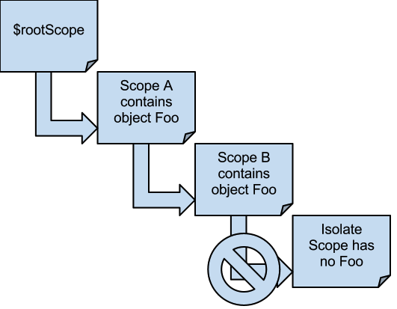
Scope inheritance
parent scope props are inherited in child scope
…unless it’s an isolated scope
scopes are inherited using prototype
there is always a $rootScope
Notes:
ng-if creates a child scope

Slide 6
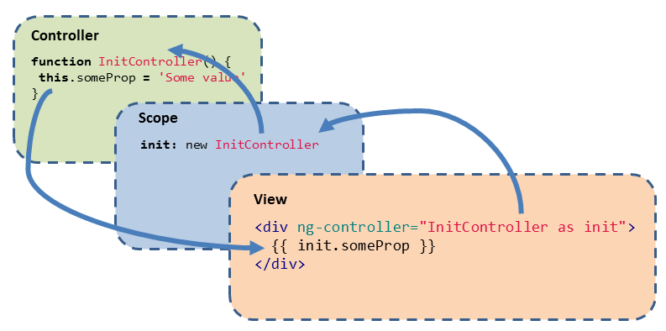
ctrl as ct
dilema: use this or $scope ??
Notes:
make picture of ctrl + view

Slide 7
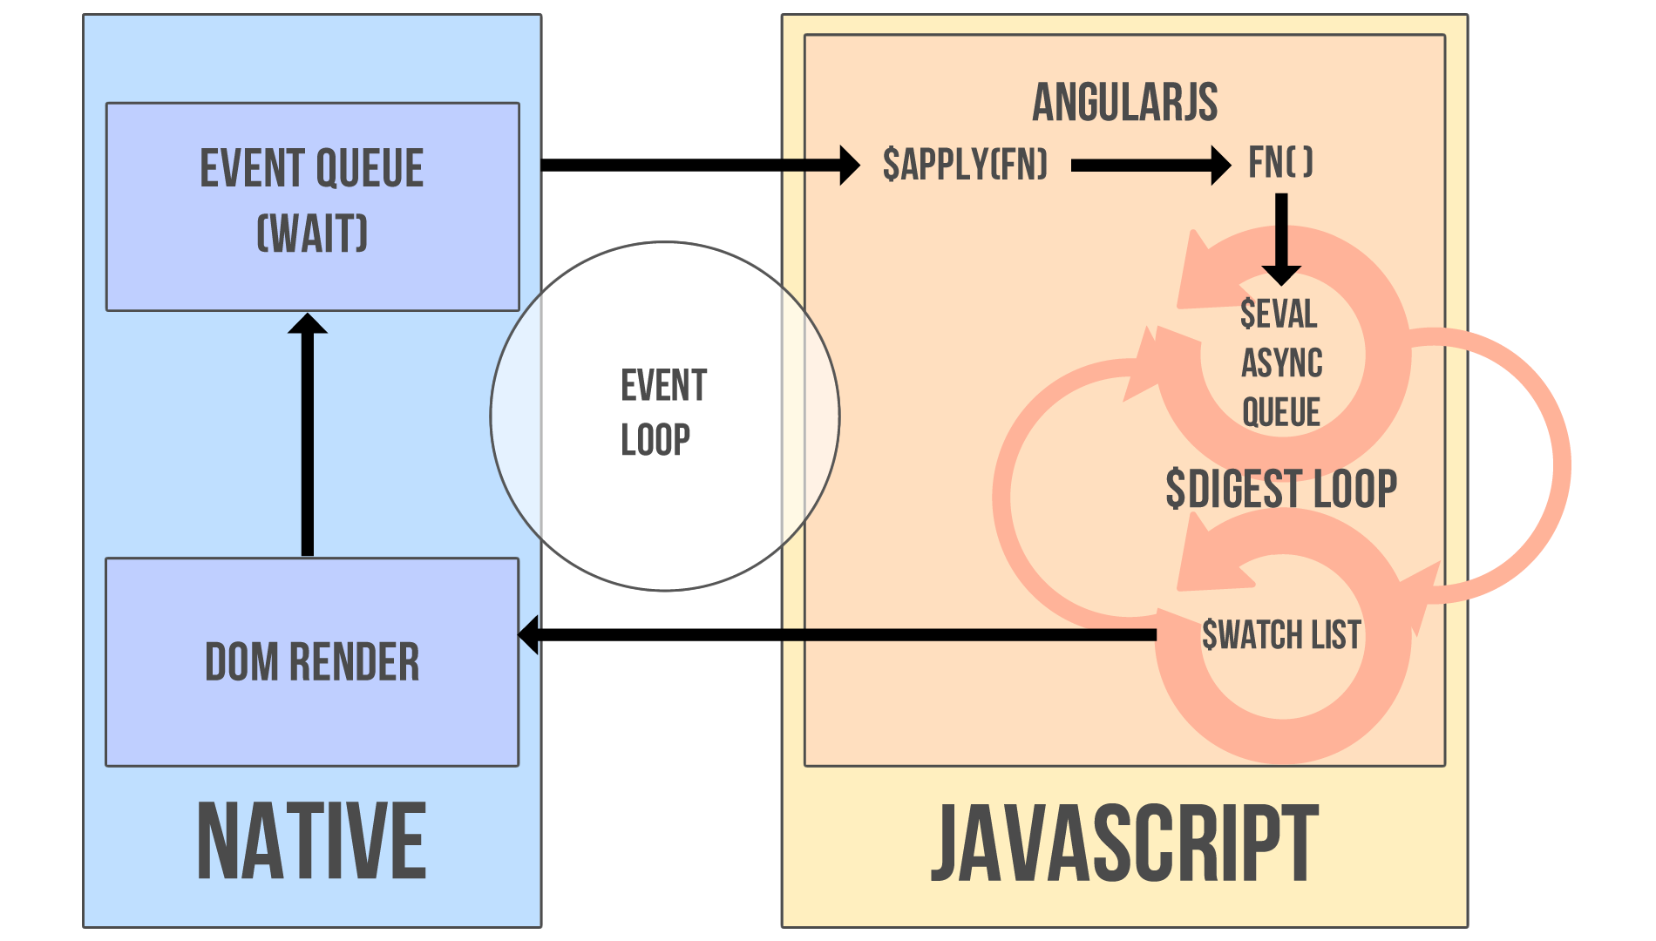
$digest cycle
Notes:
make picture of ctrl + view

Slide 8
dirty checking
dirty checking is done “in 1 transaction” of digest cycle
opposed to change listeners in KnockoutJS or Backbone which could create inconsistent state
(but with dependency tracking it’s ok)
Notes:
make picture of ctrl + view

Slide 9
$apply
all $scope functions run in apply context
used if some code is executed outside angular
function $apply(expr) { try { return $eval(expr); } catch (e) { $exceptionHandler(e); } finally { $root.$digest(); } }
always runs from top
(because ng doesn’t know what you’re doing)
Notes:
make picture of ctrl + view

Slide 10
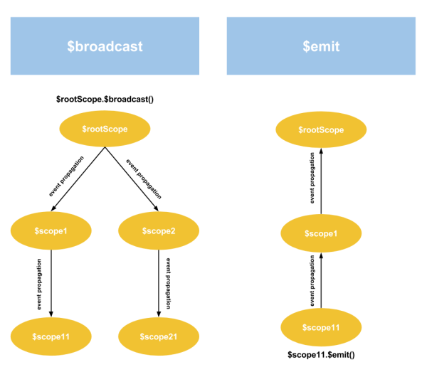
Events propagation
Notes:
make picture of ctrl + view

Slide 11
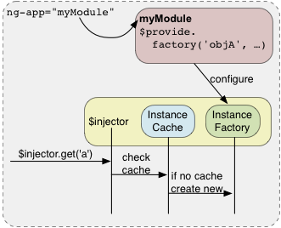
[Dependency injection]
Notes:
make picture of ctrl + view

Slide 12
Module
decouple DOM manipulation from app logic
well structured coding
2-way binding
Does it have an engine? VM?
“
It’s something that always breaks
Notes:
make picture of ctrl + view

Slide 13
Model View Whatever
JS – model
HTML – view
$scope – view model – shared object between view and model
Notes:
make picture of ctrl + view

Slide 14
$scope
In an AngularJS application, the controller and view share an object called a scope
scope has two-way data binding
$rootScope is always created on app start
Notes:
make picture of ctrl + view

Slide 15
$ build-in services
services are lazy-initialized
build-in services always start with $
Notes:
make picture of ctrl + view

Slide 16
Directives
separated scopes are useful when writing reusable components (like XHTML templates)
these components are called directives

Slide 17

Directives are hard

Slide 18
HTML 5
<applet> removed (<object> instead)

Slide 19
Javascript
Java?
Scripting?
Notes:
Nothing to do with java
Not a scripting lang anymore

Slide 20
Semantics
extends HTML with clarity
custom behavioral notations (directives)
Notes:
Nothing to do with java
Not a scripting lang anymore

