Slide 1

basics

Slide 2
Today more showcase
decouple DOM manipulation from app logic
well structured coding
2-way binding
Does it have an engine? VM?
“
It’s something that always breaks
Notes:
make picture of ctrl + view

Slide 3
The Zen of Angular
decouple DOM manipulation from app logic
well structured coding
2-way binding
Does it have an engine? VM?
“
It’s something that always breaks
Notes:
make picture of ctrl + view

Slide 4
Model View Whatever
JS – model
HTML – view
$scope – view model – shared object between view and model
Notes:
make picture of ctrl + view

Slide 5
Model View Whatever
JS – model
HTML – view
$scope – view model – shared object between view and model
Notes:
make picture of ctrl + view

Slide 6
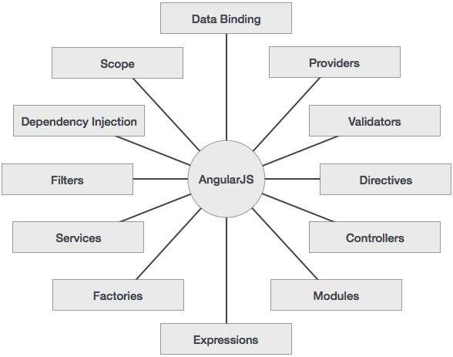
Notes:
make picture of ctrl + view

Slide 7
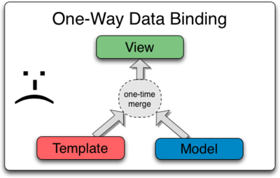
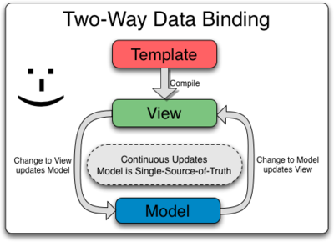
Notes:
make picture of ctrl + view

Slide 8
Controllers
Notes:
make picture of ctrl + view

Slide 9
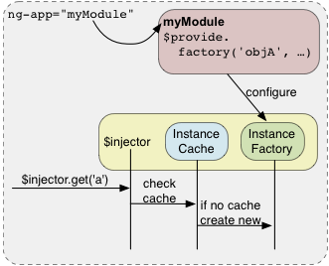
[Dependency injection]
Notes:
make picture of ctrl + view

Slide 10
$scope
In an AngularJS application, the controller and view share an object called a scope
scope has two-way data binding
$rootScope is always created on app start
Notes:
make picture of ctrl + view

Slide 11
$ build-in services
services are lazy-initialized
build-in services always start with $
Notes:
make picture of ctrl + view

Slide 12
Application lifecycle
starts the app, creates $rootScope
“compiles” the DOM, searches for directives
creates the scopes tree that “mirrors” the DOM

Slide 13
Modules
create model with 2 arguments
angular.module(‘app', []);
get the created model with 1 arg
var module = angular.module('app');
call controller function on module instance
angular.module('app').controller('ctrl', function($scope) { $scope.name = 'Alexey'; });

Slide 14
Directives
separated scopes are useful when writing reusable components (like XHTML templates)
these components are called directives

Slide 15

Directives are hard

Slide 16
Scope inheritance
parent scope vars in inherited in child scope
unless it’s an isolated scope
scopes are inherited using prototype
Notes:
ng-if creates a child scope

Slide 17
HTML 5
<applet> removed (<object> instead)

Slide 18
Javascript
Java?
Scripting?
Notes:
Nothing to do with java
Not a scripting lang anymore

Slide 19
Semantics
extends HTML with clarity
custom behavioral notations (directives)
Notes:
Nothing to do with java
Not a scripting lang anymore

Slide 20
Angular 1 vs 2
(what people say)
2 is too raw
1 can be upgraded using ngForward
2 has better performance
1 will still be supported
2 uses TS and ES6
Notes:
Nothing to do with java
Not a scripting lang anymore

