Slide 1

directives

Slide 2

component
“sweet” directive which has bound controller and view
app.service('myService', function() { // service is just a constructor function // that will be called with 'new' this.sayHello = function(name) { return "Hi " + name + "!"; }; });
Notes:
make picture of ctrl + view

Slide 3
Watch and observe
Use $observe to “watch” the DOM attributes with interpolation {{}}
Attributes can be watched until the scope is isolated
Interpolated attributes are undefined in link, so we need to $observe / $watch them
Link fn is the best place for watchers, not the controller fn
app.service('myService', function() { // service is just a constructor function // that will be called with 'new' this.sayHello = function(name) { return "Hi " + name + "!"; }; });
Notes:
make picture of ctrl + view

Slide 4
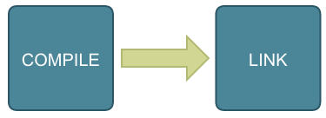
Compile and link
(divide and conquer)
Compiling – analyzing of directives in element and it’s children
Linking – binding of variables in template with $scope
link actually works as “postLink”
Notes:
make picture of ctrl + view

Slide 5
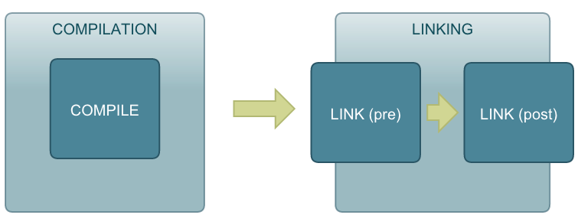
link actually works as “postLink”
(divide and conquer)
Notes:
make picture of ctrl + view

Slide 6
priority of execution
(divide and conquer)
Notes:
make picture of ctrl + view

Slide 7
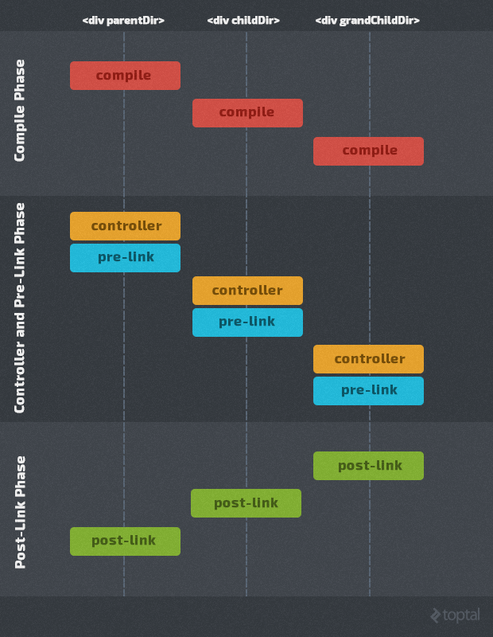
compile parent and all children
controller fn + pre-link for parent and down to children
post-link from children up to parent
Notes:
make picture of ctrl + view

Slide 8
Override everything
(even usual tags as <p> or <div>)
Compiling – analyzing of directives in element and it’s children
Linking – binding of variables in template with $scope
link actually works as “postLink”
Interpolated attributes are undefined in link, so we need to $observe / $watch them
Link fn is the best place for watchers, not the controller fn
app.service('myService', function() { // service is just a constructor function // that will be called with 'new' this.sayHello = function(name) { return "Hi " + name + "!"; }; });
Notes:
make picture of ctrl + view

Slide 9
evaluation order is the following:
linking
(even usual tags as <p> or <div>)
app.service('myService', function() { // service is just a constructor function // that will be called with 'new' this.sayHello = function(name) { return "Hi " + name + "!"; }; });
Notes:
make picture of ctrl + view

Slide 10
Clean up please
$destroy event is triggered when the scope is destroyed
Need to clean up timers, intervals to prevent memory leaks
app.service('myService', function() { // service is just a constructor function // that will be called with 'new' this.sayHello = function(name) { return "Hi " + name + "!"; }; });
Notes:
make picture of ctrl + view

Slide 11
Isolated scope
$destroy event is triggered when the scope is destroyed
Need to clean up timers, intervals to prevent memory leaks
app.service('myService', function() { // service is just a constructor function // that will be called with 'new' this.sayHello = function(name) { return "Hi " + name + "!"; }; });
Notes:
make picture of ctrl + view

Slide 12
Directives for everyone
either simple or angular
Templating
Adding custom behavior to any element
Need to clean up timers, intervals to prevent memory leaks
app.service('myService', function() { // service is just a constructor function // that will be called with 'new' this.sayHello = function(name) { return "Hi " + name + "!"; }; });
Notes:
make picture of ctrl + view

Slide 13
lets do this
service is a constructor fn
factory returns object as API
(also accepts es6 classes)
app.factory('myFactory', function() { // factory returns an object // you can run some code before return { sayHello : function(name) { return "Hi " + name + "!"; } } });
app.service('myService', function() { // service is just a constructor function // that will be called with 'new' this.sayHello = function(name) { return "Hi " + name + "!"; }; });
Notes:
make picture of ctrl + view

Slide 14
Application lifecycle
Bootstrap
HTML compilation
Runtime

Slide 15
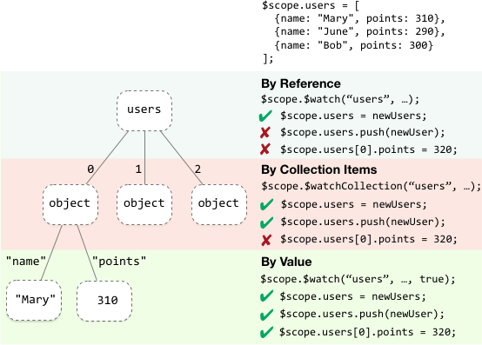
$$watchers
each $scope has collection of watchers
watchExpression
watch function
deep watch?
Notes:
make picture of ctrl + view

Slide 16
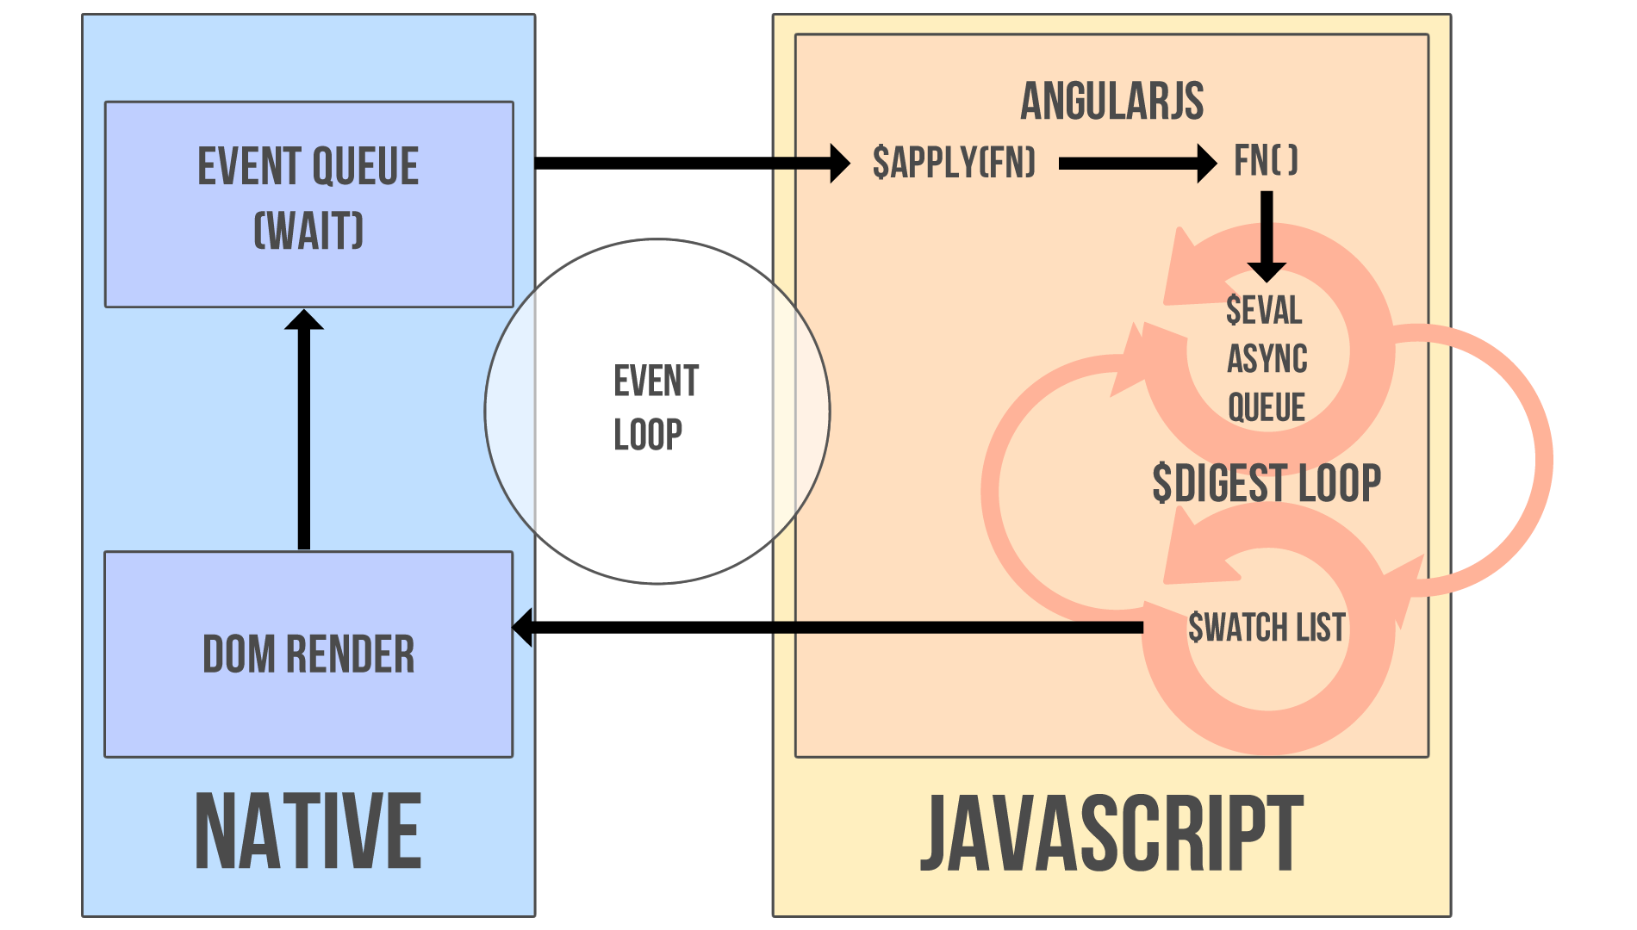
$digest cycle
Notes:
make picture of ctrl + view

Slide 17
dirty checking
dirty checking is done “in 1 transaction” of digest cycle
opposed to change listeners in KnockoutJS or Backbone which could create inconsistent state
(but with dependency tracking it’s ok)
Notes:
make picture of ctrl + view

Slide 18
$apply
all $scope functions run in apply context
used if some code is executed outside angular
function $apply(expr) { try { return $eval(expr); } catch (e) { $exceptionHandler(e); } finally { $root.$digest(); } }
always runs from top
(because ng doesn’t know what you’re doing)
!important angular changes DOM elements in template
(not bare strings transformed to DOM elements)
Notes:
make picture of ctrl + view

Slide 19
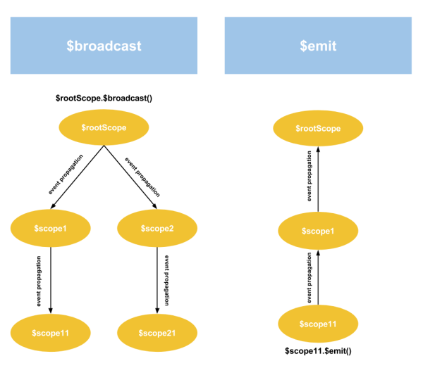
internal events
Notes:
make picture of ctrl + view

Slide 20
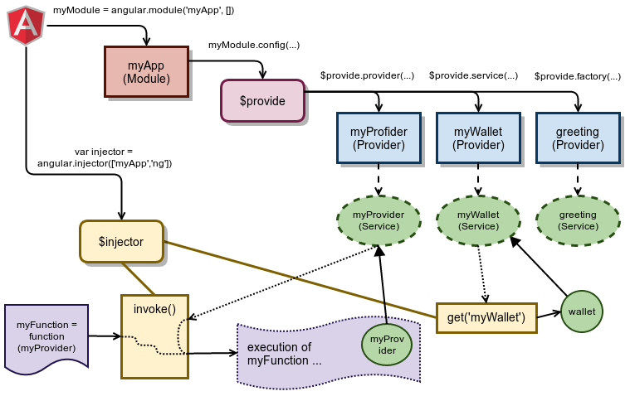
[Dependency injection]
Notes:
make picture of ctrl + view

Slide 21
Homework!
https://docs.angularjs.org/guide
Notes:
https://docs.angularjs.org/guide

