Slide 1
EcoMart
Krescens Kok

Slide 2
Business Problem
EcoMart is an emerging company that is in the marketplace industry.
Their goal is to foster sustainability and environmental consciousness.
EcoMart has a platform where customers can find ethically sourced, sustainable, and eco-friendly products, such as groceries, apparel, home goods, and personal care items.
The business problem to address is improving the scalability of their platform to allow quicker product lookups for customers, supporting their overarching goal of promoting sustainability.

Slide 3
Solution
The solution will be to implement a relational database in third normal form.
The database solution will provide robust security measures
- Encryption
- Access controls
- Audit logging
The solution will ensure data consistency, long-term stability, and reliability of the database implementation.

Slide 4
Postgresql
Relational database system
Stores transactional data (ACID)
Atomicity: Ensures that the entire transaction is successful. If any part of it fails, the whole transaction fails as well (Erhabor & Erhabor, 2025).
Consistency: The data follows the rules and constraints set in the database and tables (Unique keys, foreign keys, etc..) (Erhabor & Erhabor, 2025).
Isolation: Ensures that transactions that are happening at the same time do not interfere with each other (Erhabor & Erhabor, 2025).
Durability: Changes that are made by a transaction are permanently stored and will survive system failures (Erhabor & Erhabor, 2025).
PostgreSQL automatically indexes unique keys and primary keys
Allows for column and row level security, as well as multi-factor authentication
Reliable, with disaster recovery (PostgreSQL: About, n.d.)

Slide 5
Data structure
Currently, the data is in a raw CSV file, so it will need to be ingested into the database and normalized into third normal form to eliminate transitive dependencies.
Transitive dependencies can cause database issues, data redundancy, anomalies, and inconsistencies.
Normalization will be performed on the data to reduce data redundancy by finding the distinct values of region, country, and item types, and separating them into different tables. By doing so, the values will be reusable and storage space will decrease since the values won’t be duplicated in the Sales Records table.
Transitive dependencies will be eliminated, and every non-primary or foreign key column will depend on the primary key of the table by splitting the raw data into multiple tables:
Region
Region_ID
Country
Country_ID
Item types
Item_Type_ID
Sales records
Order_ID
Region_ID
Country_ID
Item_Type_ID

Slide 6
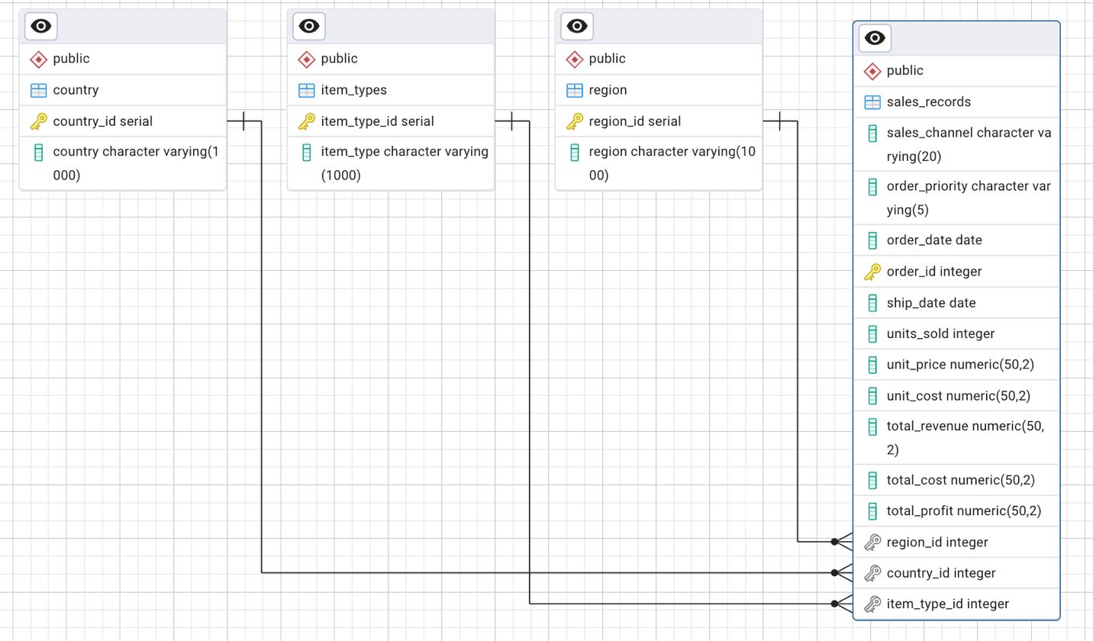
relations
The foreign keys in the main table (sales_records) must exist as a primary key in the other tables or else it is a violation of the foreign key constraint.
Primary keys are not null because they are used to uniquely identify each row
ON DELETE CASCADE: Maintains the integrity of the database by deleting records in the main table if the record is deleted in the other table (Gyamfi, 2025).
Ex: If a region is deleted from the Region table, the primary key no longer exists, and so to maintain the integrity of the database, the records in Sales Orders with the region that was deleted, will also be deleted.
ON UPDATE CASCADE: Also maintains the integrity of the database by updating values in the main table, if the other tables have an update.
Ex: If the primary key of a region is updated, the foreign key column, region_id, in the sales_records table will also be updated to the new primary key

Slide 7
Optimize Performance
By normalizing the table, this will make sure data anomalies will occur less frequently as there is only one place to update information instead of multiple different places.
It will also ensure data integrity as required fields could be implemented so updates or inserts can’t happen unless those fields are included.
This solution will also help with optimizing performance because primary keys are automatically indexed, which allows for faster retrieval times, leading to less CPU usage.
With the primary keys being indexed, it will also allow for faster joins with other tables that contain primary keys, as well as filtering.
PostgreSQL caches frequently accessed data in memory for faster retrieval time later on
By splitting the data into multiple columns, queries can run faster since the tables will be smaller, which will also allow for faster joins or even lookups
If there are changes that need to be made to the tables that contain additional information, such as country or region, instead of changing all the fields in the singular table with all the information, only the country table or region table would need to be updated.

Slide 8
Technical Environment
PgAdmin 4: An open-source graphical user interface that is used for PostgreSQL
Allows users to manage their databases, perform queries, monitor performance, etc…
PostgreSQL: An open-source relational database system
Popular for its reliability and robustness
Can run SQL and JSON queries
Version 17.5
Self hosted

Slide 9
Functionality of Queries
Find the top 3 item types to help determine if they are sustainable and environmentally friendly.
Find the average time between the order date and the ship date.
Order the regions by total_profit ascending to show which regions have the lowest total profit.

Slide 10
How Queries Solve the Business Problem
Find the top 3 item types to help determine if they are sustainable and environmentally friendly: This will also help the business understand what customers are mostly buying and if they are reaching their goal of fostering sustainability and environmental consciousness
Find the average time between the order date and the ship date: This will help the business focus on what they can do to improve, decrease the time, and increase efficiency. By doing so, this could increase their sales and promote their company to continue to foster and promote sustainable products:
Order the regions by total_profit ascending to show which regions have the lowest total profit: This will help the business understand which areas they may need to focus marketing in to increase their sales and profit. By finding the regions that aren’t buying many products, the business can also understand whether or not the region needs more knowledge on eco-friendly products.

Slide 11
references
Erhabor, D., & Erhabor, D. (2025, January 28). ACID transactions and implementation in a PostgreSQL Database | Aviator. Aviator Blog - Automate tedious developer workflows. https://www.aviator.co/blog/acid- transactions-postgresql-database/#
Gyamfi, L. S. (2025, March 27). Postgres ON DELETE CASCADE - A comprehensive guide. DbVisualizer. https://www.dbvis.com/thetable/postgres-on-delete- cascade-a-guide/
PostgreSQL: about. (n.d.). The PostgreSQL Global Development Group. https://www.postgresql.org/about/

