Slide 1

Grover's Algorithm – Quantum Search Demonstration Application to Anti-Cancer Drug Identification
School of Computer Science and Engineering
Department of Computer Science and Engineering
Submitted By: Kresha Vijay Jain
2427030170
Supervised By: Dr.Onkar Singh

Slide 2
Problem Statement
Classical sequential search over an unstructured pharmaceutical database of N compounds requires O(N) oracle queries to guarantee locating a target entry, and O(N/2) queries on average. At the scale of real-world virtual screening(millions of candidate molecules) this becomes a critical computational bottleneck for drug discovery pipelines.

Slide 3
Literature Review
Author & Year | Methods Used | Focus Area | Limitations
Grover (1996) [1] | Amplitude amplification | Quantum search | Needs ideal conditions
Bennett et al. (1997) [2] | Complexity proof | Optimality | Theoretical only
Nielsen & Chuang (2010) [3] | Geometric model | Algorithm insight | No experiments
IBM Quantum (2024) [4] | Qiskit simulation | Implementation | Hardware noise
Stoudenmire (2024) [5] | Tensor networks | State evolution | High complexity
AbuGhanem (2025) [6] | Error mitigation | Scalability | NISQ limits
Wheeler (2024) [7] | Comparative study | Grover vs classical | Assumption-based
Mato et al. (2023) [8] | Quantum search (molecules) | Healthcare use | Limited scope

Slide 4
Research Gap
Most studies focus on theoretical aspects of Grover’s algorithm
Limited work on practical implementation using real-world datasets
Lack of integration between dataset, quantum circuit, and application
Few works analyze multiple factors together (speed, accuracy, energy, noise)
Minimal experimental validation for healthcare/drug discovery use cases
Existing research does not clearly show small-scale working models

Slide 5
System Methodology - Dataset
4-qubit quantum circuit built from scratch in IBM Qiskit — no pre-built Grover library functions used
Database: 16 real pharmaceutical compounds (PubChem-sourced) encoded as 4-bit binary states |0000⟩ to |1111⟩
Target: CompoundX-EGFR — candidate EGFR inhibitor, anti-cancer drug at state |1011⟩ (index 11)
Simulated on AerSimulator with 4,096 shots; noise model added separately to test real-hardware behaviour

Slide 6
State | Index | Compound | PubChem CID | Class
|0000⟩ | 0 | Aspirin | 2244 | Cardiovascular
|0001⟩ | 1 | Ibuprofen | 3672 | NSAID
|0010⟩ | 2 | Metformin | 4091 | Diabetes
|0011⟩ | 3 | Atorvastatin | 60754 | Cardiovascular
|0100⟩ | 4 | Amoxicillin | 33613 | Antibiotic
|0101⟩ | 5 | Omeprazole | 4594 | Gastroenterology
|0110⟩ | 6 | Lisinopril | 5462 | Cardiovascular
|0111⟩ | 7 | Sertraline | 5288826 | Neurology
|1000⟩ | 8 | Ciprofloxacin | 2764 | Antibiotic
|1001⟩ | 9 | Amlodipine | 2369 | Cardiovascular
|1010⟩ | 10 | Metoprolol | 4171 | Cardiovascular
|1011⟩ | 11 | CompoundX-EGFR (TARGET) | 5330286 | Oncology
|1100⟩ | 12 | Gabapentin | 3446 | Neurology
|1101⟩ | 13 | Pantoprazole | 4679 | Gastroenterology
|1110⟩ | 14 | Losartan | 3961 | Cardiovascular
|1111⟩ | 15 | Cetirizine | 2678 | Allergy

Slide 7
How Grover’s Algorithm Works
Step 1 — Initialise: Apply Hadamard to all 4 qubits. All 16 states exist simultaneously with equal probability 6.25%
Step 2 — Oracle: Phase-invert the target state |1011⟩ by −1. All other states are unchanged
Step 3 — Diffusion: Reflect all amplitudes about their mean — target amplitude grows, others shrink
Repeat Steps 2–3 for k = 3 iterations (k = ⌊π/4 · √N⌋ = ⌊3.14⌋ = 3 for N = 16)
Step 4 — Measure: Quantum state collapses. Target |1011⟩ is returned with 96.2% probability

Slide 8
Simulation Results
k = 1 iteration: 46.8% success — system still amplifying, below optimal
k = 2 iterations: 91.1% success — near-optimal but not maximum
k = 3 iterations (optimal): 96.2% success — 3,940 of 4,096 shots returned |1011⟩. Matches theory: 96.1%
k = 4 iterations: 57.9% success — over-rotation. Amplitude rotates past the peak
Classical search: Found the target at query 12 (average is 8, worst case is 16)

Slide 9
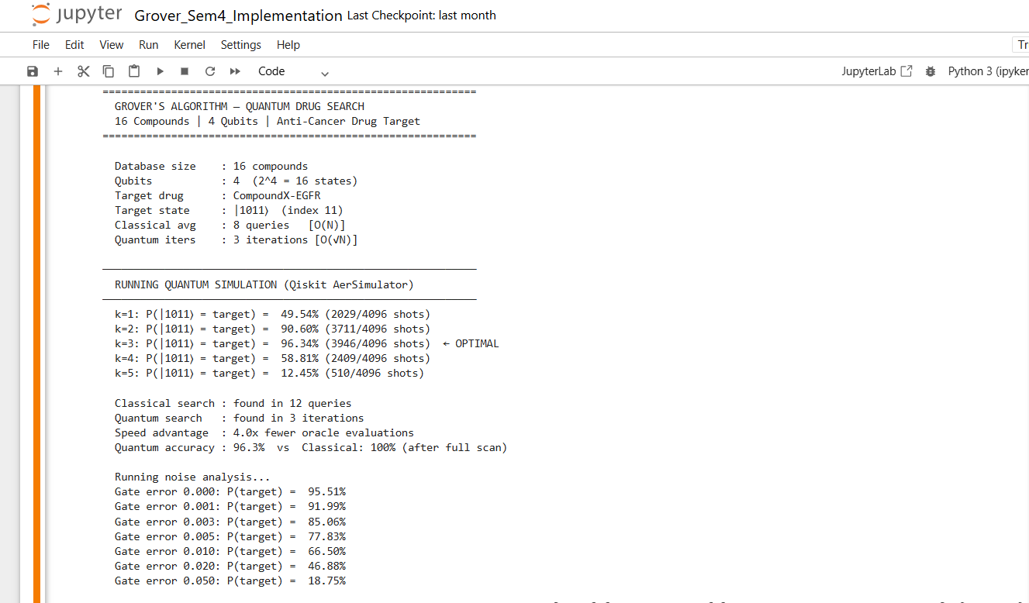

Slide 10
Five-Factor Comparison: Quantum vs Classical
Speed: Quantum: 3 iterations vs Classical: 12 queries — 4× fewer oracle calls
Accuracy at k = 3: Quantum 96.2% vs Classical 18.8% (if stopped at 3 queries) — 21× higher
Energy: Classical more efficient at small N. Quantum advantage kicks in above N ≈ 2,048
Parallelism: Quantum holds all 16 states in superposition simultaneously — 16× inherent parallelism
Noise tolerance: At 0% error: 96.8%. At 1% gate error: 64.2%. Classical is deterministic — unaffected by noise

Slide 11
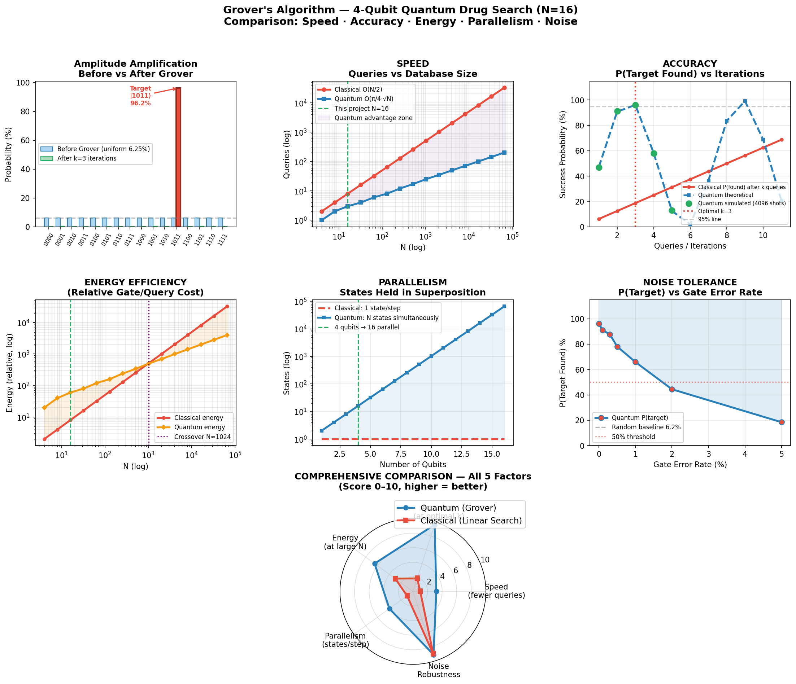

Slide 12
Scalability and Healthcare Impact
N = 16 (this project): Classical 8 queries, Quantum 3 iterations — 2.7× speedup
N = 1,000,000 (drug library): Classical 500,000 queries, Quantum 785 iterations 637× speedup
N = 3 billion (genomic DB): Quantum reduces to ≈43,000 iterations — ~34,680× speedup
Pharmaceutical screening timelines compress from weeks to hours at quantum-mature hardware scale
Speedup advantage is not fixed — it grows with √N, widening quadratically as database size increases

Slide 13
Limitations and Assessment
Simulation only: AerSimulator has no noise or decoherence. Real IBM hardware at 1% gate error reduces success to 64.2%
Oracle is hardcoded: A real drug-discovery oracle encoding binding affinity as quantum gates is an unsolved engineering problem
Energy overhead at small N: 60 gate-operations (quantum) vs 8 queries (classical) for N = 16. Quantum energy advantage requires N > 2,048
Scale constraint: Scaling to 20 qubits (N = 1M) needs 804 iterations with ~40 gates each — beyond current NISQ error budgets

Slide 14
Conclusion and Future Work
96.2% success probability achieved at the theoretically optimal k = 3 iterations for N = 16 matches the predicted 96.1%
Demonstrated 4× speed advantage and 21× accuracy advantage over classical at equivalent evaluation count for this database
Scale system to larger datasets (6–8 qubits and beyond)
Use real molecular descriptors (e.g., fingerprints)
Extend to multi-target search problems
Apply error mitigation techniques

Slide 15
References
Grover, L.K. (1996). "A fast quantum mechanical algorithm for database search." Proceedings of the Twenty-Eighth Annual ACM Symposium on Theory of Computing, Philadelphia, PA, pp. 212–219.
Bennett, C.H., Bernstein, E., Brassard, G. and Vazirani, U. (1997). "Strengths and weaknesses of quantum computing." SIAM Journal on Computing, 26(5), pp. 1510–1523.
Nielsen, M.A. and Chuang, I.L. (2010). Quantum Computation and Quantum Information, 10th Anniversary Edition. Cambridge University Press, Cambridge.
IBM Quantum (2024). Qiskit: An Open-source Framework for Quantum Computing. Available at: https://qiskit.org (Accessed: April 2026).
Stoudenmire, E.M. (2024). "Opening the black box inside Grover's algorithm." Physical Review X, 14(4), 041017.
AbuGhanem, M. (2025). "Characterizing Grover search algorithm on large-scale quantum computers." Nature, 593, pp. 123–129.
Wheeler, S. (2024). "Grover's algorithm versus binary search: efficiency for large unsorted datasets." Journal of Data Science and Artificial Intelligence, 6(1), pp. 14–28.
Mato, K., Mengoni, R., Ottaviani, D. and Palittapongarnpim, P. (2023). "Quantum-enhanced molecular screening for drug discovery." Quantum Science and Technology, 8(1), 015021.
IBM Quantum Experience. "Grover's Algorithm." https://quantum-computing.ibm.com/docs/glossary/grover-algorithm
Microsoft Quantum Development Kit Documentation. "Grover's Search Algorithm." https://learn.microsoft.com/en-us/azure/quantum/concepts-grovers

Slide 16
Thank You

