Slide 1

SEPTEMBER 2025 |
PITCH DECK.

Slide 2


THE PROBLEM
In growing urban areas, students and young professionals often find it difficult to maintain a healthy lifestyle due to time constraints, high costs, and limited access to wellness resources.
Neglecting wellness impacts physical health, productivity, mental well-being, and long-term quality of life. More individuals seek convenient, affordable, and reliable methods to improve their health.

Slide 3


THE SOLUTION
We offer an all-in-one mobile platform that provides personalized wellness plans including meal suggestions, quick home workouts, and guided mental health exercises designed to fit into busy lifestyles and limited budgets.
CONVENIENT
AFFORDABLE
PERSONALIZED
HOLISTIC APPROACH
Everything is accessible in one app no need to juggle multiple services.
Free basic features, with low-cost premium plans for full access.
Plans adjust based on user goals, preferences, and schedules.
Combines physical health, mental well-being, and daily habits.

Slide 4
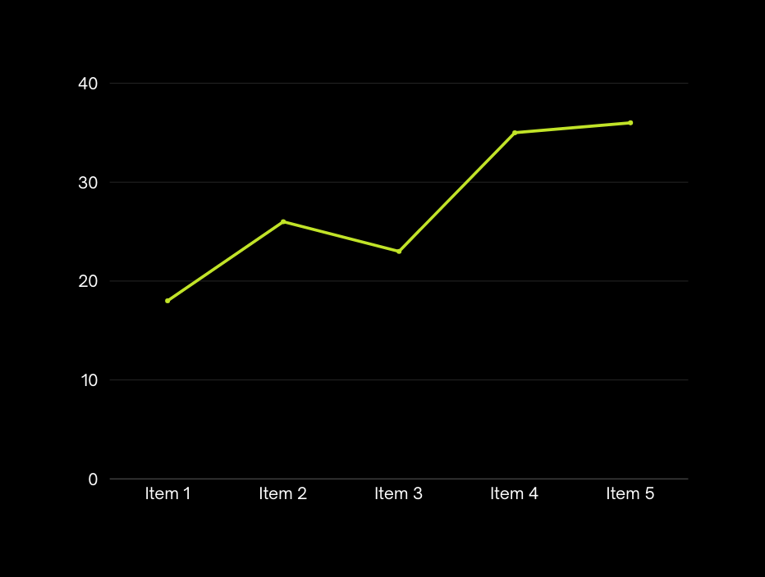
MARKET OPPORTUNITY
The demand for accessible and affordable wellness solutions is expanding quickly as more people prioritize health, especially in urban environments.
THE GLOBAL WELLNESS MARKET IS VALUED AT OVER $4.5 TRILLION, WITH DIGITAL WELLNESS SERVICES GROWING BY 8% ANNUALLY.

Slide 5



The design and functionality are centered around intuitive interaction, making it easy for users to achieve their goals without friction or steep learning curves.
SERVICE OVERVIEW
Onboarding identifies individual needs, while smart features adapt to behavior changes, and real-time feedback maintains user motivation.
Our product is designed to solve specific pain points through a seamless, user-focused experience. It offers a suite of features that directly address the needs of our target audience

Slide 6
REVENUE SOURCES
Offer tiered monthly or annual plans with varying levels of access and premium features.
PRICING STRATEGY
Attract users with free access to basic features and convert them to paying users through compelling premium offerings.
CUSTOMER ACQUISITION
Referral programs incentivize users to spread the word, while partnerships with aligned organizations help extend our reach.
BUSINESS MODEL
To ensure long-term sustainability and growth, our business model is designed to generate multiple streams of revenue while delivering value to users.

Slide 7

COMPETITIVE ADVANTAGE
WHO ARE THE COMPETITORS?
Our competitors include existing solutions in the market that address parts of the problem, whether through standalone tools, manual methods, or platforms with limited focus.
WHAT ARE YOUR STRENGTHS?
We use a personalized system that adapts in real time to user behavior, creating a smarter and more engaging experience.
WHY WILL PEOPLE CHOOSE YOU?
Unlike fragmented alternatives, our platform offers a seamless, end-to-end experience tailored to their daily routines and goals.

Slide 8


FRADEL AND SPIES
MARKET STRATEGY
To successfully introduce our product to the market and gain early traction, we’ve developed a clear go-to-market strategy.
MARKETING CHANNELS
INITIAL LAUNCH PLAN
GROWTH MILESTONES

Slide 9





FRADEL AND SPIES
THANK YOU.
CONTACT US:
+123-456-7890
hello@reallygreatsite.com
www.reallygreatsite.com

