Slide 1

Team Zodiac

Slide 2

Problem Statement :
We would like to craft personalized travel experience for 5.2mn passengers who travel with us monthly, by rapidly making meaningful changes to PaxEx across touchpoints. How can AI and Big Data help IndiGo, the leading low-cost carrier, create ‘one in a million experience’ for every single customer? Also, accelerate personalized ancillary upsell throughout the travel journey of its leisure and business travellers?

Slide 3
Solution Proposed -
The Aim of the project is to create ‘one in a million experience’ for every single customer right from entering the Airport to their departure from the flight.
The project is divided into the following sections –
1. Facial Check In
2. Seat Matching using AI
3. Flight Buddy
4. Ease My Flight

Slide 4
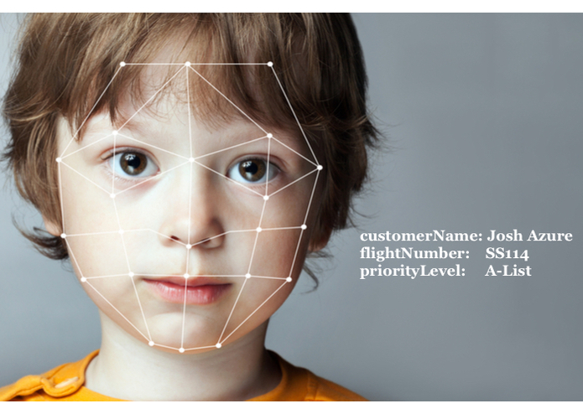
Facial CheckIn Using facial recognition, an airline customers face carries the same information their ticket carries.
Inspiration –
I wanted to offer something new and practical to optimize the experience of boarding a flight for both the customer, as well as the employees, specifically the gate agents.

Slide 5

A customer's picture carries the same information that their ticket would carry, such as their name, flight, and priority level. An employee logs into our app and every picture they take of a customer will return their information. It speeds up the process of getting a flight.
In addition to that, I also accounted for overbooking situations by listing every low priority level customer per flight. Using a last in first out sort list so should there be an x amount of high priority level customers without a seat, I removed the last checked in low priority level customers for the flight, and store those in a list to be reassigned to another flight.

Slide 6
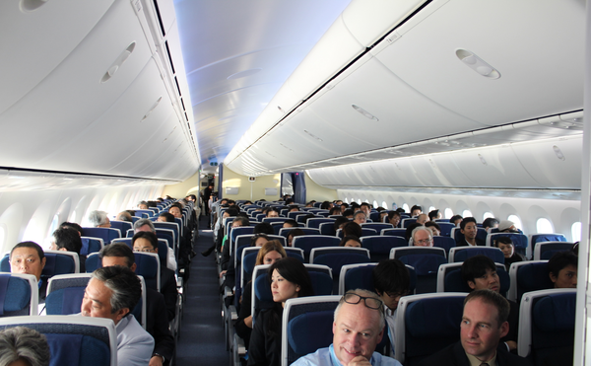
Seat Matching using AI
Airplane seating next to people with similar interest.
It uses an algorithm to match fliers to plane seats, based on their interests, the experience they're looking for (quiet, social, business networking), and position preference (window, aisle, etc).
Users with similar interests and similar desired experience will be seated next to each other so that they can have an enhanced customer experience.
Airlines can also use this seating information to place flight attendants where they could most play towards their strengths, increasing the sense of friendliness and hospitality.

Slide 7
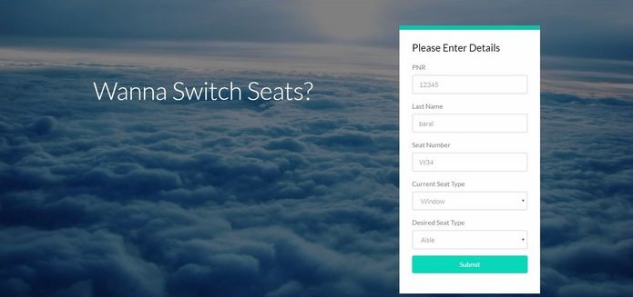
Ease My Flight
Enhancing customer experience and simplifying employees' work by automating seat switch and customer service requests.
First, it authorizes the users using QR code or PNR number. It then puts the seat requests into a back-end pool of requests.
On receiving a new request, the algorithm finds an appropriate match and on a successful one, it notifies the airline's system along with both the users and they can swap their seats.

Slide 8
Flight Buddy – personalized companion for the flight
FlightBuddy is an offline communication platform allowing the ability to communicate with each other and with flight attendants to collect information about their flight and the aircraft.
This communication is available by opening WIFI channels, Bluetooth radios, and any other device within signal range. The message received from these networking signals is re-broadcasted back and as a result causes a daisy chain network.
The application has incorporated various features including showing in-flight entertainment, ordering in-flight drinks and food, messaging other flyers in the same flight, and messaging flight attendants for further assistance.

Slide 9
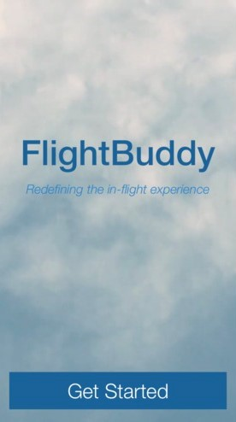
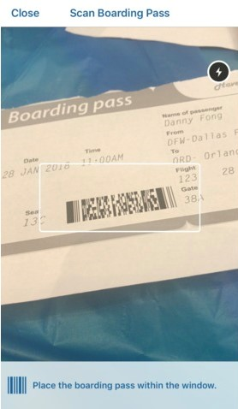
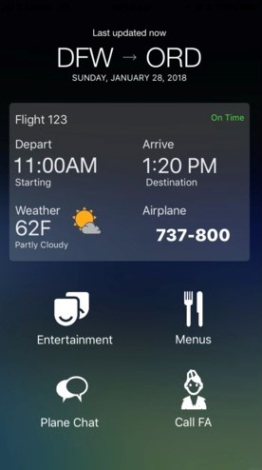
Implementation -
Flight Buddy’s User friendly App Interface.
User scans their ticket QR code and gets logged into the app.
User can then all the details and enjoy the services provided.

Slide 10

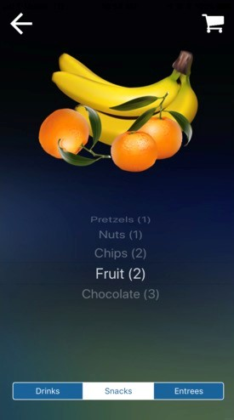
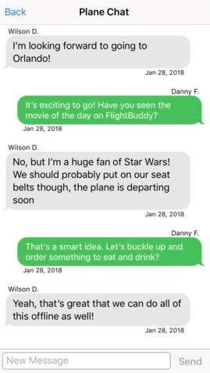
For leisure purposes they will be able to watch movies.
Users can also order food for the app itself.
A plane chat will able all of passengers to communicate.

Slide 11
Tech Stack Used -
1. Facial Check In - Azure Face API , Nodejs
2. Seat Matching using AI – Python, Machine Learning
3. Flight Buddy – Flutter(cross platform app) ,Google firebase
4. Ease My Flight – Nodejs , Html , Css , Sass

Slide 12
Benefits -
Speeding up the boarding process.
Making the flight experience more convenient.
Making the travel experience better and more personalised.
Getting the customers come back to the same Airlines after such an experience.
Also making it more easy for the plane staff to communicate with the passengers in an efficient way.

Slide 13
Thank You
Team Zodiac
Rishabh Malik - rishabhmalik.tech

