Slide 1

Real-time Chat Application
Using Flutter
Prof. Tushar Ubale
AY 2024-25
Ritesh Jamdar | 24206005
Om Brahmavale | 24206008
Sahil Birje | 24206011
Shreesh Nalawade | 24206012
Notes:
1
1

Slide 2
Outline
Introduction
Problem Statement
Literature review
System Design
Technologies and Methodologies
Implementation Screenshots
Conclusion
References
Thank You
Notes:
2
2

Slide 3
Introduction
Cross-platform messenger app built with Flutter & Firebase, ensuring smooth performance on iOS & Android.
Real-time chat system with seamless send & receive message functionality and instant push notifications.
User authentication with secure login and registration, ensuring data privacy and account safety.
Advanced account settings allowing users to block, report, or delete accounts for better security and control.
Notes:
3
3

Slide 4
Problem statement
Universities face challenges in communication due to the lack of a dedicated platform, leading to difficulties in managing university-wide interactions. Social media apps, while commonly used, lack essential academic features and often pose data privacy concerns. Additionally, they contribute to distractions from non-academic content, making it harder for students and faculty to focus on educational discussions.
Notes:
4

Slide 5
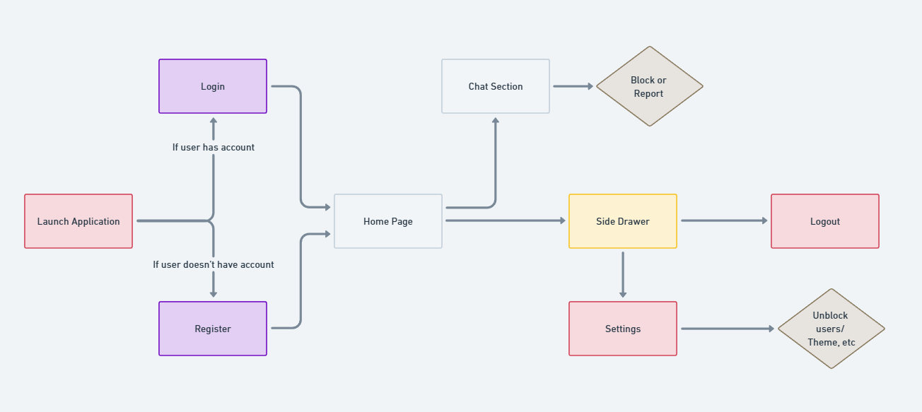
System Design
Notes:
10
10

Slide 6
Literature Survey of the Existing System
1. Survey of Existing Solutions:
Existing real-world messenger applications include WhatsApp, Telegram, and Microsoft Teams, each offering distinct features for communication, security, and user experience.
Features | WhatsApp | Telegram | Microsoft Teams | Proposed Chat App
Platform | iOS, Android, Web | iOS, Android, Web, Desktop | iOS, Android, Web, Desktop | iOS, Android
Authentication | Phone number-based OTP | Phone number & username | Microsoft account | Email/University login
Real-Time Chat | ✅ Yes | ✅ Yes | ✅ Yes | ✅ Yes
Custom Themes | ❌ No (Default UI) | ✅ Yes | ❌ No | ✅ Yes
University Features | ❌ No | ❌ No | ✅ Yes (For enterprises) | ✅ Yes (Academic-focused)
Event Coordination | ❌ No | ❌ No | ✅ Yes | ✅ Yes
Notes:
5
5

Slide 7
Literature Survey of the Existing System
2. Survey of Technologies & Methodologies Used in Existing Solutions:
Technology/Methodology | Used in | Purpose
Flutter | Telegram (partially) | Cross-platform app development
Firebase | WhatsApp, Microsoft Teams | Real-time database & authentication
End-to-End Encryption | WhatsApp, Telegram | Secure messaging
Role-Based Access Control | Microsoft Teams | Admin and user role management
Notes:
8
8

Slide 8
Technologies and Methodologies
Front-end: | Flutter
Back-end: | Firebase
Database | Firestore
Authentication | Firebase Auth
Push Notifications | Firebase Cloud Messaging(FCM)
State Management | Provider/Bloc (Flutter)
Themes | Flutter’s Material Design
Notes:
11
11

Slide 9
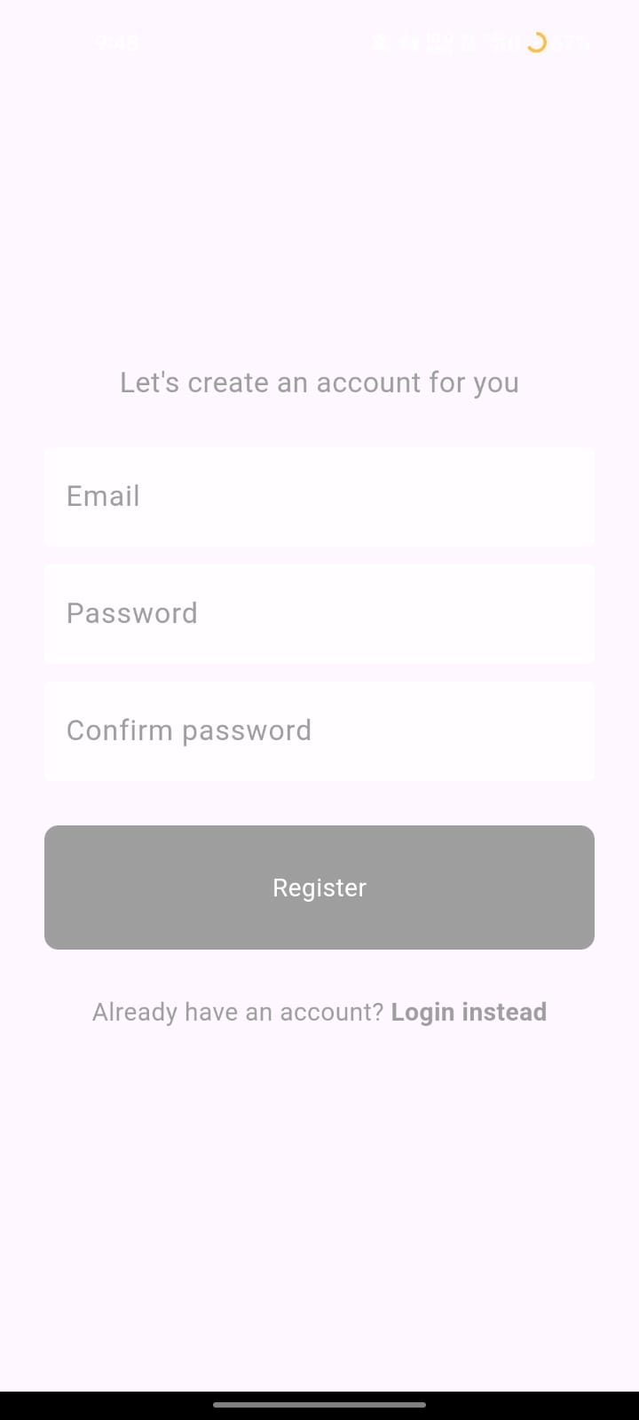
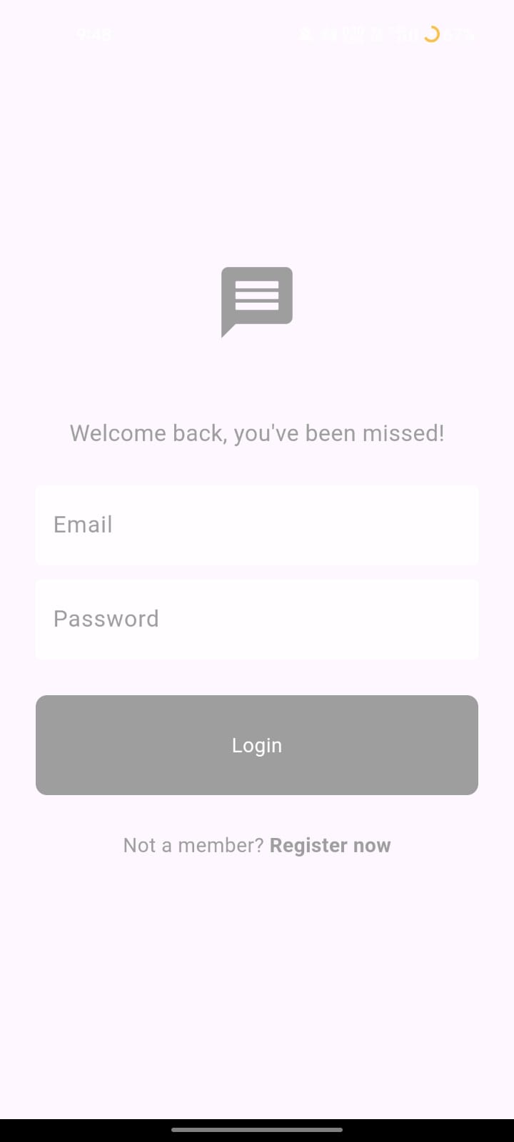
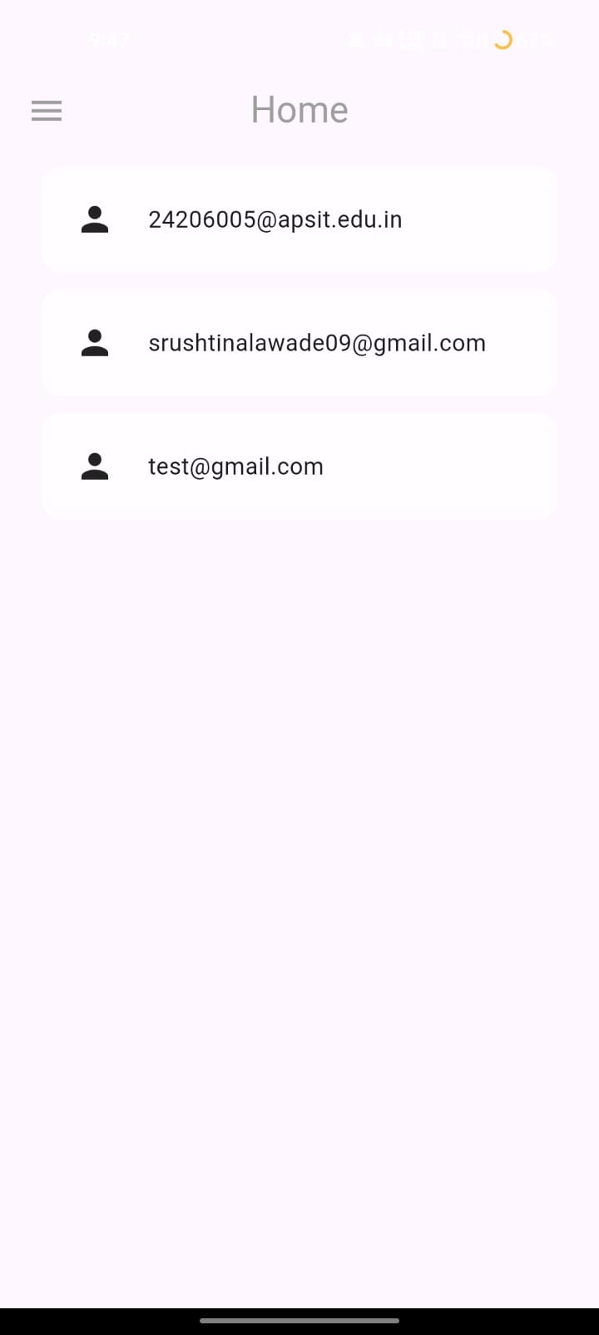
Implementation
Notes:
12
12

Slide 10
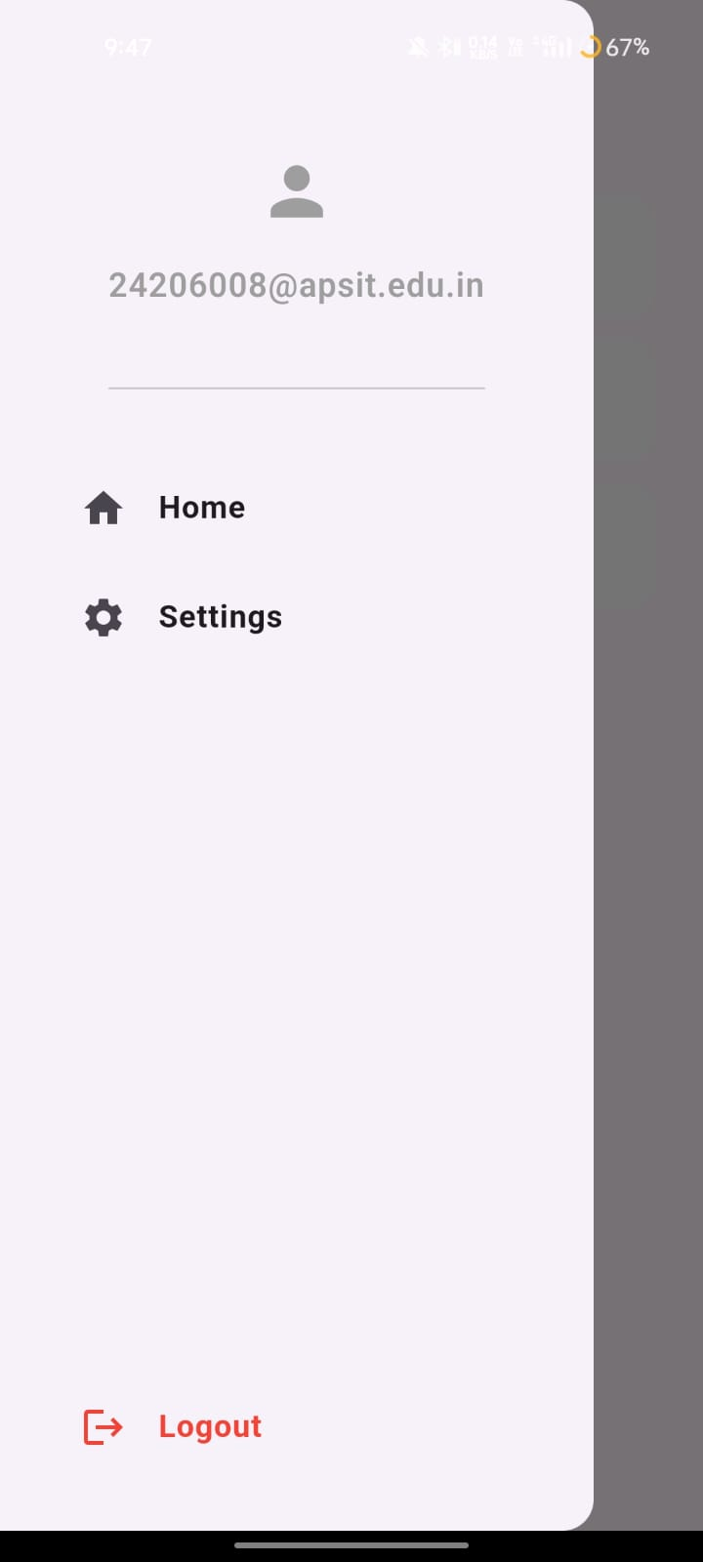
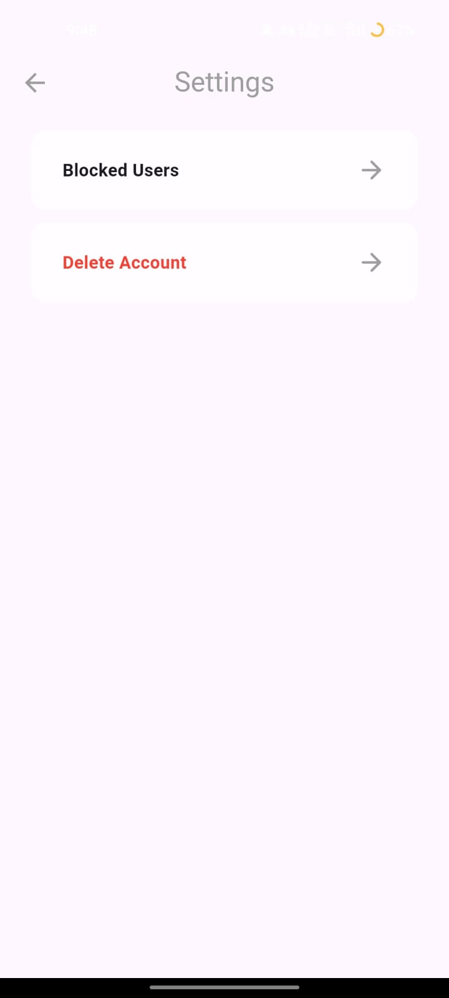
Implementation
Notes:
13
13

Slide 11
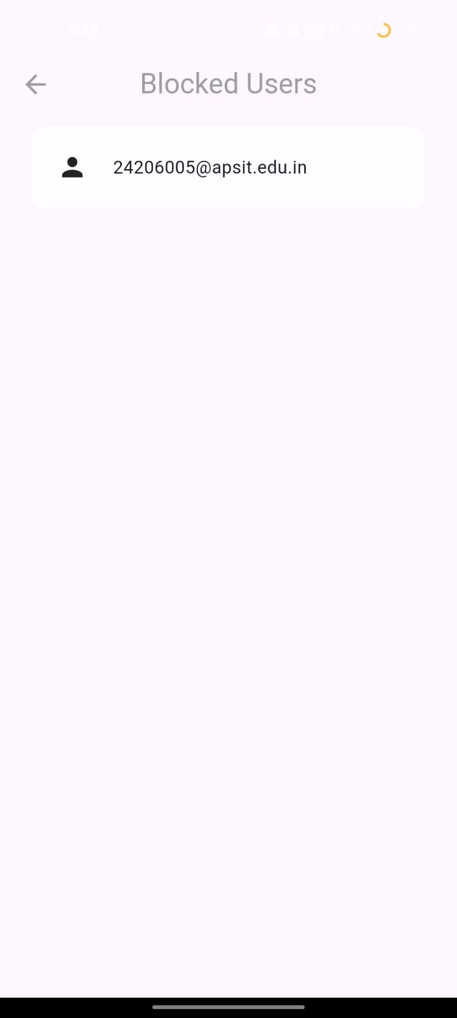
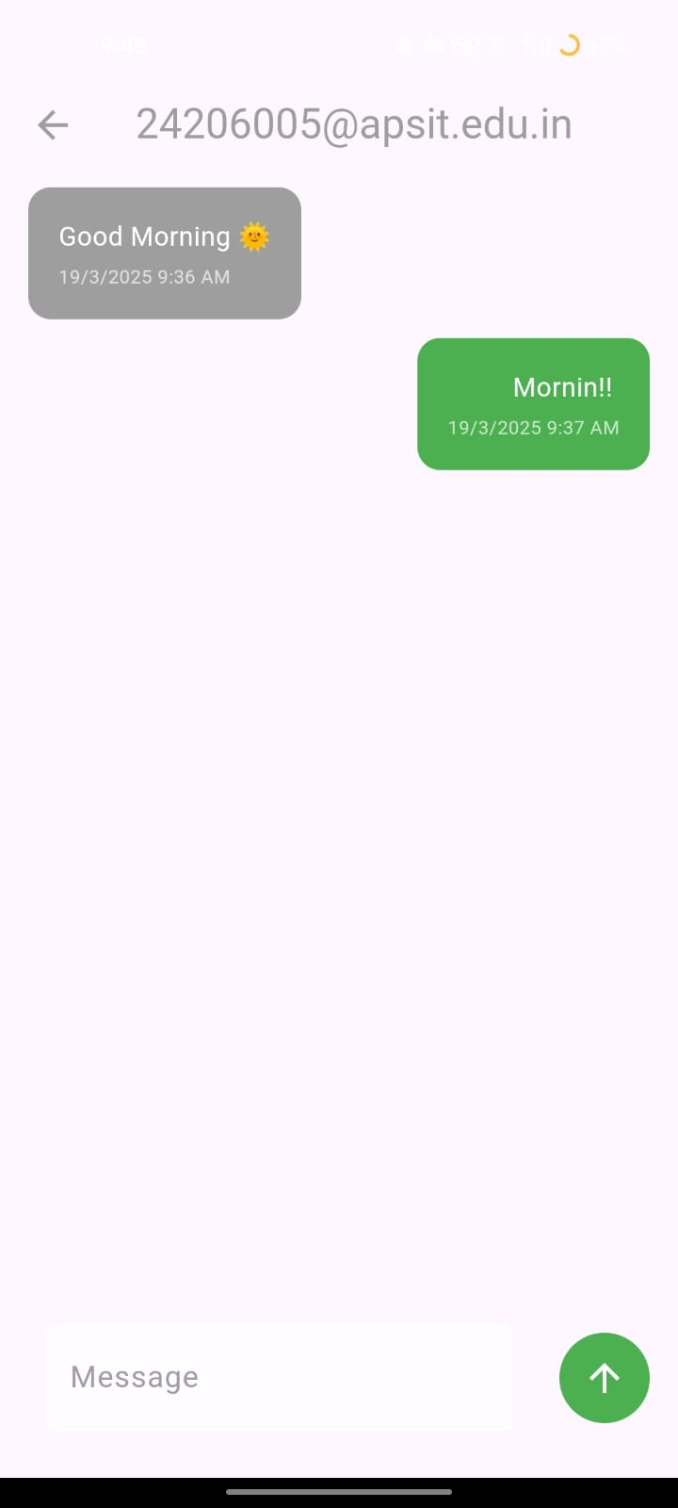
Implementation
Notes:
14
14

Slide 12
Conclusion
In conclusion, the messenger app offers a seamless user experience, providing real-time communication and customizable themes to cater to user preferences.
By integrating Firebase, the app ensures secure user authentication, efficient real-time messaging, and reliable push notifications across both iOS and Android platforms.
Built with Flutter and Firebase, the app is scalable and future-proof, making it adaptable for future enhancements and additional features.
Moreover, Firebase Authentication offers robust security, safeguarding user data and accounts, ensuring a secure environment for all users.
Notes:
15
15

Slide 13
References
[1] Madan Kumar R. "Chat Application Using Flutter and Firebase", December 2020 , Vol 05 Issue 01
https://ijiird.com/wp-content/uploads/050142.pdf
[2] Tanmay Sharma , Abhijay Singh, Nidhi Tyagi "Chat Messenger using Flutter" 30 April 2021, Vol 174
https://www.ijcaonline.org/archives/volume174/number30/sharma-2021-ijca-921240.pdf
[3] Varun Gowda M J , "Community chat app using flutter(android, iOS & web)" 2023, Vol-09 Issue-4
https://ijariie.com/AdminUploadPdf/Community_chat_app_using_flutter_android__iOS___web__ijariie21196.pdfsrsltid=AfmBOoo8nTQCtZSrokc2pZo7NLv3WGiBB1pvdhi9sD52q_hpv2uEvf-T
Notes:
16
16

Slide 14
References
[4] Christian Johansen, Aulon Mujaj "A Comparative Survey of Secure Instant Messaging Mobile Applications " , February 2021, Vol 02
https://arxiv.org/pdf/1807.07952
[5] Danny Sebastian, Restyandito, , Kristian Adi Nugraha, "Developing of Middleware and Cross Platform Chat Application", 2021, Vol-12
https://thesai.org/Downloads/Volume12No11/Paper_10Developing_of_Middleware_and_Cross_Platform_Chat.pdf
Notes:
14
14

Slide 15
Thank You...!!
Notes:
17
17

