Slide 1


A free internet metasearch engine

Slide 2
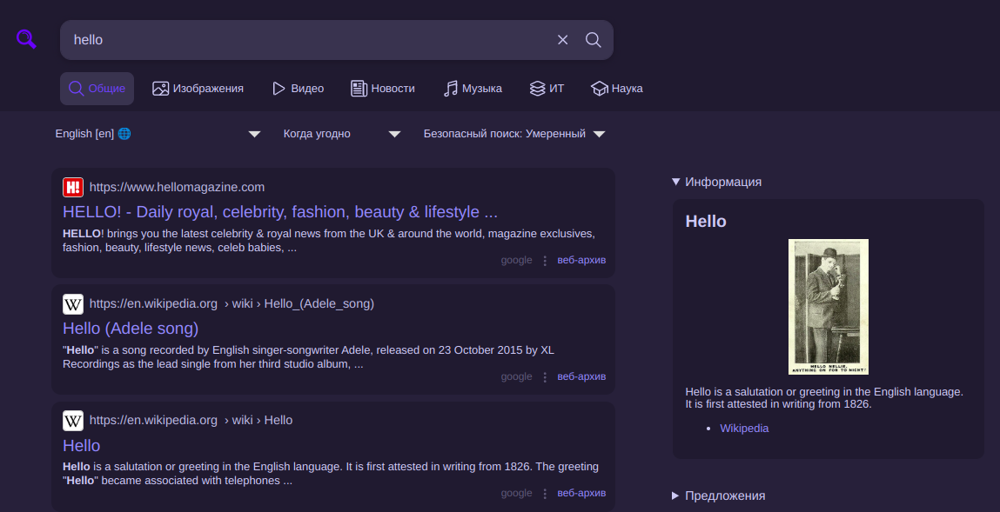

SearXNG
FOSS metasearch engine
Users are neither tracked nor profiled.

Slide 3

History
In 2021, SearX contributors forked the repository to SearXNG with a view to provide faster debugging and fixes of engine errors.
Searx is no longer maintained. Thank you for your support and all your contributions.

Slide 4
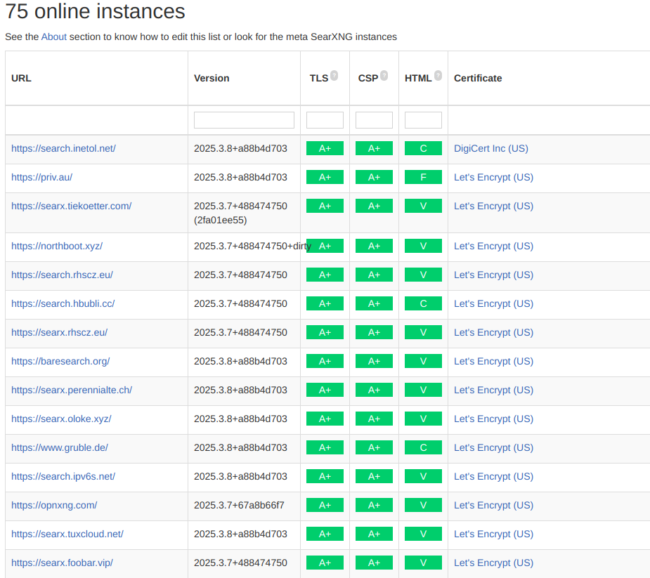
Instances
Private instances are hosted on a local network, or can be run on the user's desktop computer itself
Public instances are hosted on public web servers. A list of public instances is available at searx.space.

Slide 5











Features
Categorical searching
Engines
Privacy

Slide 6
Thank you for your attention

