Slide 1

AUTOGRANT
Funding discovery
for founders
A focused way to find relevant grants,
understand fit, and prepare a first draft.
HACKATHON PROJECT · OCTOBER 2026
autogrant-sigma.vercel.app
Notes:
AutoGrant is an early-stage product prototype. The cover image is an illustrative generated artwork, not a photograph of a real founder or grant application. Sources: README.md; live Vercel deployment: https://autogrant-sigma.vercel.app (team authentication is enabled).

Slide 2
THE CHALLENGE
Funding is fragmented across the founder’s workflow
The project focuses on the work before an application is submitted.
01
Find
02
Assess
03
Prepare
Funding opportunities are spread across programs and sources.
Eligibility criteria take work to compare with a venture’s profile.
Application answers often need to be drafted and adapted one program at a time.
AutoGrant narrows the search and gives founders a reason to review each match.
AUTOGRANT / PROJECT OVERVIEW
02
Notes:
This is product problem framing, not a quantified market claim. The workflow is inferred from the discovery, scoring and drafting capabilities described in README.md and implemented under app/api and python-service/app/services.

Slide 3
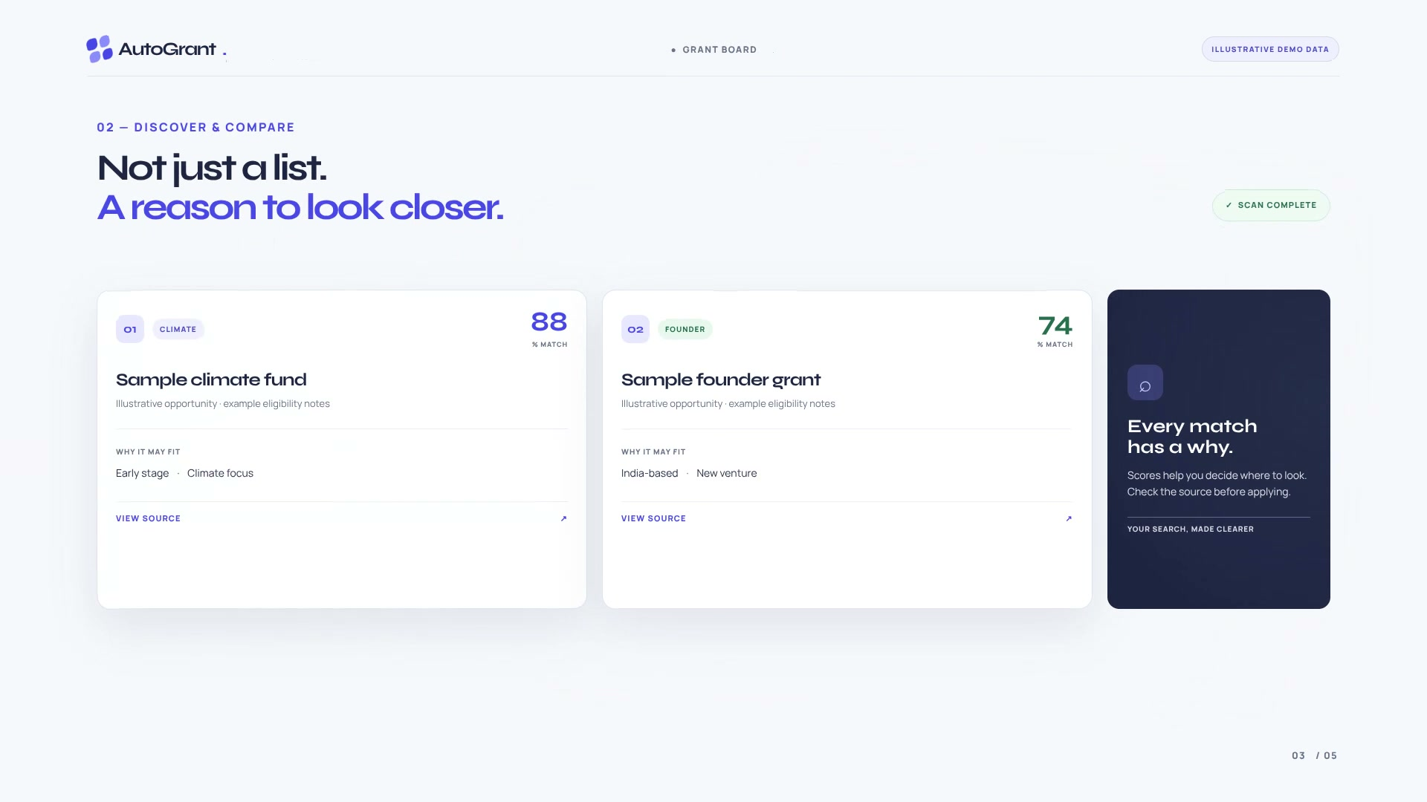
THE PRODUCT
A shortlist with a reason to look closer
Discovery results pair a match score with an explanation and a path back to the source.
GLOBAL SEARCH
Look across
opportunities
TinyFish Search and Fetch locate grant information for a founder’s sector and location.
REVIEW THE MATCH
Gemini scores results. Founders can inspect why a match surfaced and open its source.
Illustrative demo content — not verified grant listings
AUTOGRANT / PROJECT OVERVIEW
03
Notes:
The screenshot is from the repository’s launch-video visual. Its sample grant names, match scores and details are explicitly illustrative. Product flow and provider roles are described in README.md and python-service/app/services/tinyfish.py and gemini.py.

Slide 4
USER JOURNEY
The founder stays in the decision loop
AutoGrant prepares context; the founder decides whether and how to apply.
01
02
03
04
Describe
Discover
Draft
Submit
Set venture profile, sector and location.
Review opportunities with fit rationale and source links.
Generate answers, then edit them before a run.
Confirm the run; finish provider submission as needed.
No passwords or MFA codes are used in application runs.
AUTOGRANT / PROJECT OVERVIEW
04
Notes:
Product routes include signup, login and dashboard. The README explains that starting a run requires explicit confirmation, that the founder reviews and edits draft answers, and that provider-account forms requiring sign-in are completed by the founder on the provider site. Sources: app/dashboard/Dashboard.tsx; README.md.

Slide 5
ARCHITECTURE
A web app, an API service and managed data
The browser never receives the server-side provider credentials.
Founder
Next.js
FastAPI
Provider services
Profile · review · edit
Web app + API proxy
Firebase ID-token checks
Discovery · scoring
drafts · run tracking
TinyFish · search and fetch
Gemini · scoring and drafting
Firestore · profiles and runs
Authentication
Firebase email/password sign-in and verified email are required for grant actions.
State
Firestore stores user profiles and run records; service credentials remain server-side.
AUTOGRANT / PROJECT OVERVIEW
05
Notes:
Architecture verified from the Next.js API proxy and routes, Firebase client config and FastAPI service. Sources: app/api/_proxy.ts; app/api/*/route.ts; lib/firebase.ts; python-service/app/main.py; python-service/app/auth.py; python-service/app/services/firestore.py; README.md.

Slide 6
RELIABILITY BY DESIGN
A match is a prompt
for review — not a promise.
Application automation needs careful status reporting. AutoGrant only marks a run submitted when the provider response includes an explicit confirmation.
01
FOUNDER REVIEW
Edit and approve answers before a run.
02
EXPLICIT START
A run starts only after confirmation.
03
HONEST STATUS
AutoGrant does not handle provider passwords or MFA codes.
Ambiguous outcomes stay unknown until checked.
AUTOGRANT / PROJECT OVERVIEW
06
Notes:
README states that runs require explicit confirmation, no passwords or MFA codes are passed, and a run is marked submitted only when the TinyFish response contains submitted: true plus a confirmation number or URL. Other ambiguous outcomes remain unknown. Sources: README.md; python-service/app/services/tinyfish.py; python-service/app/main.py.

Slide 7
CURRENT STATE
A working prototype — not yet launch-ready
The product flow and deployment path exist; real-world validation is still ahead.
BUILT
STILL TO VALIDATE
01
Next.js product site, auth pages and founder dashboard
Grant coverage and eligibility accuracy
Test against real programs and verify every source and deadline.
02
FastAPI service for discovery, scoring, drafting and runs
Founder outcomes
03
Firebase authentication and Firestore-backed user state
No verified founder reviews or proven submission results are published yet.
04
Docker build and GitHub Actions image publishing
Public access
The Vercel frontend currently requires team authentication.
Demo cards and scores are illustrative, not live verified grant matches.
AUTOGRANT / PROJECT OVERVIEW
07
Notes:
The README identifies AutoGrant as an early-stage prototype, says no verified founder reviews are published and cautions that grant listings and eligibility must be confirmed. The frontend production URL requires Vercel team authentication. Docker image publishing succeeded in GitHub Actions run 39132047083. Sources: README.md; GitHub Actions run https://github.com/Krezmitent/AzinHack-2026/actions/runs/39132047083; https://autogrant-sigma.vercel.app.

Slide 8
NEXT MILESTONES
Validate usefulness before scaling
The next proof should come from real founders and real grant sources.
01
02
03
Verify the search
Watch founders use it
Measure real outcomes
Check coverage, source links, eligibility and deadlines against a curated set of live programs.
Observe how founders compare matches, edit drafts and decide what to pursue.
Track relevant matches, draft edits and confirmed provider submissions.
NEXT: TEST THE MATCH QUALITY WITH FOUNDERS
autogrant-sigma.vercel.app
AUTOGRANT / PROJECT OVERVIEW
08
Notes:
These are recommended validation steps, not completed work or promised milestones. The deployment is currently restricted by Vercel team authentication. No market size, customer count, grant count or success rate is claimed in this deck.

