Slide 1

AUTOGRANT / AZINHACK 2026
FIND FUNDING
THAT FITS.
A founder-first grant discovery and application assistant.
Search globally. See why a match surfaced.
Shape a first draft on your terms.
PROTOTYPE · OCT 2026
Notes:
Opening: AutoGrant helps founders move from a profile to a source-linked shortlist and an editable first draft. This is an early prototype; the artwork is illustrative. Source: README.md. Live deployment: https://autogrant-sigma.vercel.app (Vercel team authentication is enabled).

Slide 2
THE FRICTION
Grant work starts
before the form.
Founders first have to find opportunities, judge fit, then adapt their story for each program.
01
02
03
FIND
FIT
WRITE
The opportunity is somewhere across programs and sources.
Eligibility is hard to compare with a venture’s profile.
A useful answer still needs founder context and editing.
AUTOGRANT / AZINHACK 2026
02 / 08
Notes:
This is product problem framing, not a quantified market claim. It reflects the discovery, fit scoring and drafting workflow described in README.md and implemented in app/api and python-service/app/services.

Slide 3
THE IDEA
One profile. A clearer next step.
AutoGrant connects a founder’s context to opportunities worth reviewing.
FOUNDER
PROFILE
GLOBAL
OPPORTUNITY SEARCH
MATCH +
REASON
Sector · stage · location
Programs · sources · criteria
Fit signal · source link
The shortlist is a starting point, not an eligibility guarantee.
Always check the original source before applying.
AUTOGRANT / AZINHACK 2026
03 / 08
Notes:
Discovery uses a founder’s sector and location to search globally with TinyFish Search and Fetch. Gemini scores results. The founder can inspect source links and fit notes. Grant eligibility and availability need verification at the provider. Source: README.md; python-service/app/services/tinyfish.py; python-service/app/services/gemini.py.

Slide 4
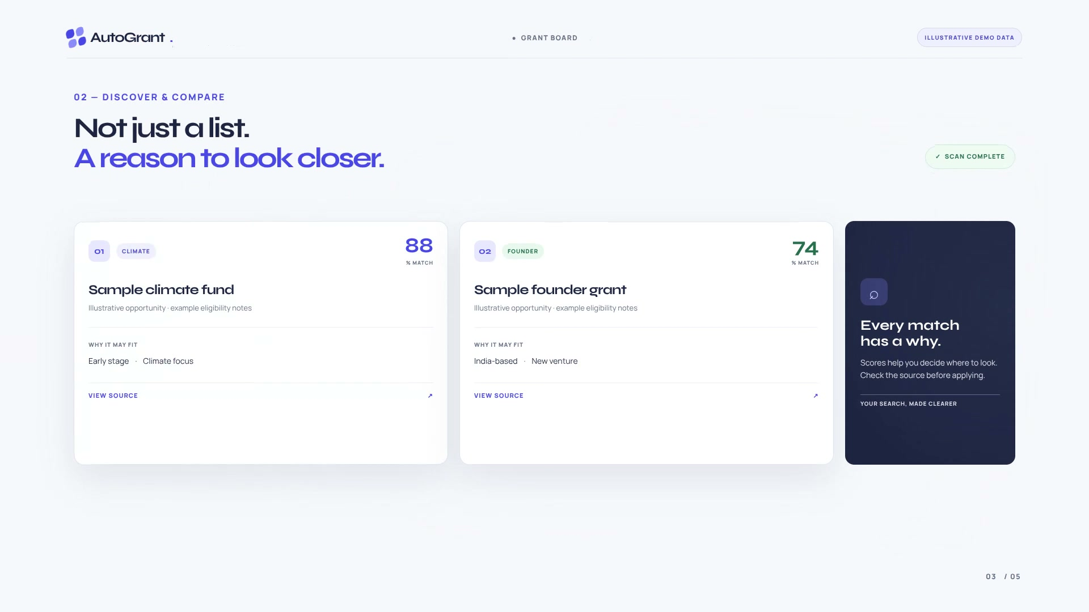
THE PRODUCT
A match should explain itself.
AutoGrant pairs a score with context and a route back to the source.
01 DISCOVER
Search results
for a founder’s
sector and location.
02 UNDERSTAND
See the fit signal.
Open the source.
Decide what to pursue.
DEMO DATA IS ILLUSTRATIVE — NOT VERIFIED GRANT LISTINGS
AUTOGRANT / AZINHACK 2026
04 / 08
Notes:
This product screenshot is from the repository’s launch video and explicitly shows illustrative demo data. Do not represent the displayed sample grants or scores as real opportunities. Sources: brag-output-2026-10-18-174914/brag.jpg; README.md.

Slide 5
FOUNDER JOURNEY
AI preps the work. The founder holds the pen.
01
02
03
04
05
PROFILE
SEARCH
REVIEW
EDIT
CONFIRM
Set venture
context.
Find global
programs.
Compare fit
and sources.
Shape draft
answers.
Choose the
next action.
No passwords or MFA codes. No application starts without explicit confirmation.
The founder completes provider forms that require an account.
AUTOGRANT / AZINHACK 2026
05 / 08
Notes:
This flow reflects the documented product behavior: founders review/edit answers, explicitly confirm each run, and complete provider sign-in flows themselves. No provider passwords or MFA codes are sent. Source: README.md; app/dashboard/Dashboard.tsx.

Slide 6
UNDER THE HOOD
A compact stack.
Clear boundaries.
The browser never receives the server-side provider credentials.
NEXT.JS
FASTAPI
AI + SEARCH
FIREBASE
Web app
API proxy + token checks
Discovery · scoring
Drafts · run tracking
TinyFish · source discovery
Gemini · score and draft
Identity · verified email
Firestore · profiles and runs
Ambiguous run results stay ‘unknown’ until confirmed.
AUTOGRANT / AZINHACK 2026
06 / 08
Notes:
Architecture from app/api proxy and routes, lib/firebase.ts, and Python service auth/main/services. The service requires a Firebase ID token and verified email; user state is held in Firestore. Run status is only marked submitted on explicit provider confirmation; ambiguous states stay unknown. Sources: app/api/_proxy.ts; lib/firebase.ts; python-service/app/main.py; python-service/app/auth.py; README.md.

Slide 7
WHERE IT STANDS
Built is not the same as validated.
A working prototype is in place. The next milestone is proof with real founders and real sources.
BUILT
OPEN QUESTIONS
Product flow
Are matches accurate?
Discovery · scoring · drafting · run tracking
Verify live sources, eligibility and deadlines.
Deployment pipeline
Do founders trust the draft?
Vercel prototype + successful GHCR image publishing
No verified founder reviews or submission results yet.
The Vercel demo currently requires team authentication.
AUTOGRANT-SIGMA.VERCEL.APP
AUTOGRANT / AZINHACK 2026
07 / 08
Notes:
Status: README describes an early-stage prototype, no verified founder reviews, and says listings and eligibility require confirmation. The frontend Vercel deployment requires team authentication. The 2026-10-18 GitHub Actions run completed successfully and published images: https://github.com/Krezmitent/AzinHack-2026/actions/runs/39132047083. Sources: README.md; GitHub Actions run; Vercel deployment.

Slide 8
THE NEXT PROOF
Shortlist AutoGrant
to test the match
with real founders.
Validate source quality.
Measure draft usefulness.
Confirm the full user journey.
FIND FUNDING THAT FITS.
autogrant-sigma.vercel.app
AUTOGRANT / AZINHACK 2026
08 / 08
Notes:
Close with the specific request to shortlist the project for founder validation. The proposed next work is validation, not a claim of proven results. The demo URL requires membership in the Vercel team. No market size, user count or success rate is claimed.

