Slide 1
Impermanence
@Krezzlu

Slide 2
Why impermanence?
Delete / on every boot
Because we can
Predictable state at every boot

Slide 3
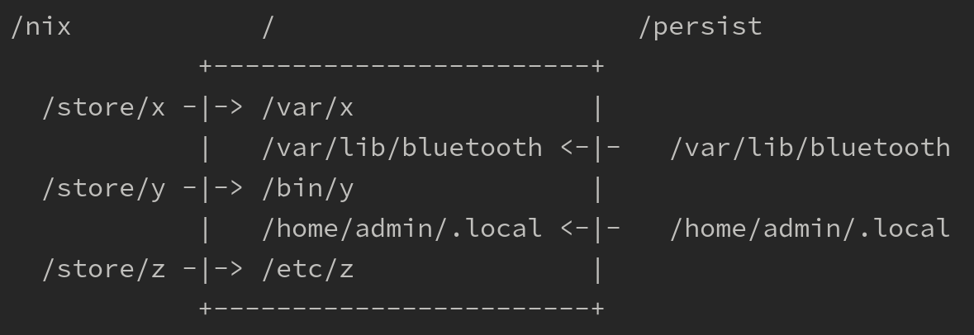
How is impermanence

Slide 4
How To Impermanence

Slide 5
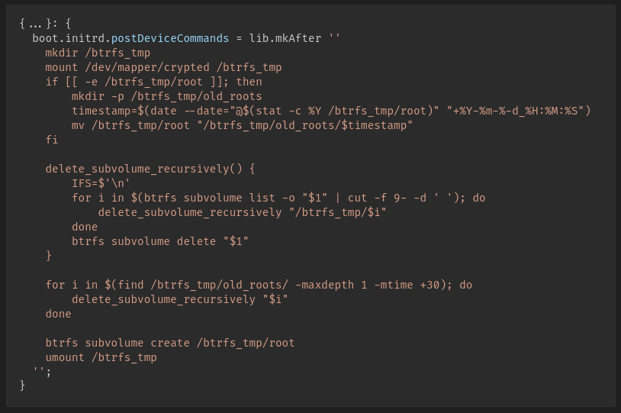

Slide 6
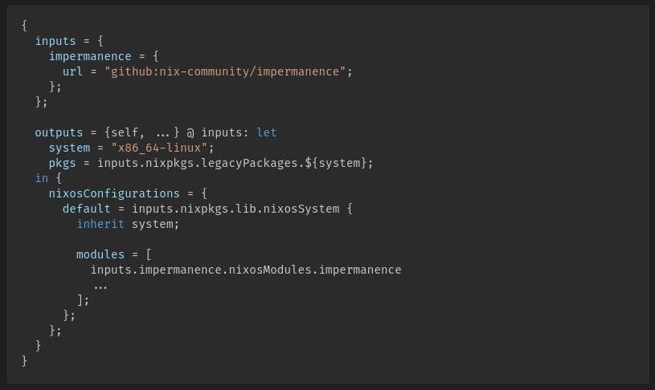

Slide 7
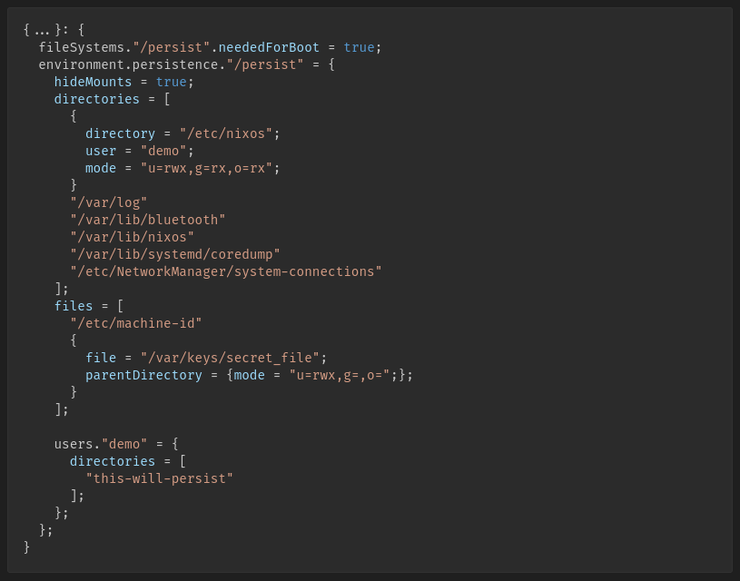

Slide 8
Live Demo

Slide 9
Resources
Impermanence
  https://github.com/nix-community/impermanence
  https://www.youtube.com/watch?v=YPKwkWtK7l0
  https://grahamc.com/blog/erase-your-darlings/
Disko
  https://github.com/nix-community/disko

Slide 10
Thanks

