Slide 1
Impermanence
@Krezzlu

Slide 2
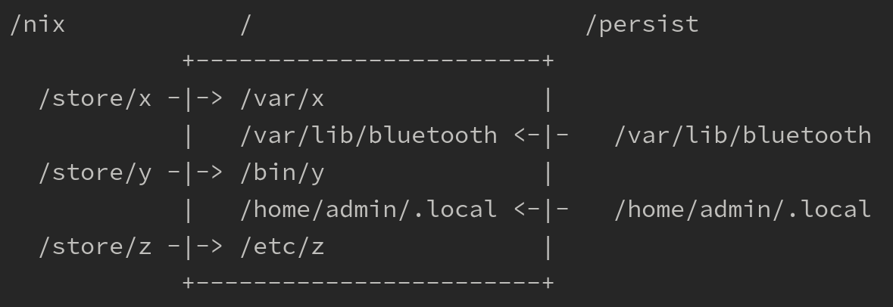
What is impermanence

Slide 3
Why is impermanence?

Slide 4
Live Demo

Slide 5
Resources

Slide 6
Thanks

