Slide 1
HYBRID QUANTUM
CHESS ENGINE
How the 2×2 circuit works, how Grover amplifies move indices,
and how the 3×3 and 8×8 routes fit together
FACULTY PROJECT WALKTHROUGH
2×2 / 3×3 / 8×8
Notes:
Open by explaining the three routes: the 2×2 circuit makes a gate-level diagnostic example, the 3×3 game uses classical Minimax, and the 8×8 game uses a hybrid selector that applies Grover to integer move-list indices. Keep the claim precise: the project demonstrates a software integration and a small simulator study, not a measured quantum speedup.

Slide 2
The project separates rule handling from quantum search
Problem framing and the proposed implementation split
WHAT THE ENGINE MUST DO
HOW THIS PROJECT RESPONDS
Generate legal moves from a changing chess state.
Rank candidates while accounting for captures, position, and opponent replies.
Make the quantum steps visible enough to explain gate by gate.
2×2: encode one supplied move and inspect coordinate/status logic.
Grover: amplify indices that Python has already ranked as best.
3×3 Minimax and 8×8 hybrid gameplay show two distinct selection strategies.
The board state, move legality, and final game update remain classical.
Notes:
The implementation targets a clear demonstration boundary. Classical code owns the source of truth: board state, legal move generation, the heuristic ranking, decoding, and move application. The circuit path is either a diagnostic coordinate/status prototype or a Grover search over list indices. This lets us inspect the gates without implying that the whole chess game is encoded in qubits.

Slide 3
Three foundations explain the algorithm choices
Literature survey: search, amplitude amplification, and game-tree pruning
Work | Main result | Connection to this project
Grover (1996) Database search | Unstructured search can find a marked item with O(√N) oracle queries. | Motivates an oracle plus diffuser over move indices.
Brassard et al. (2002) Amplitude amplification | Generalizes Grover’s probability amplification to broader state-preparation procedures. | Explains why the phase mark needs a reflection step to change measurement probability.
Knuth & Moore (1975) Alpha-beta pruning | Analyzes pruning that preserves the Minimax result while avoiding branches that cannot affect it. | Supports the classical 3×3 opponent-aware baseline and fallback.
Project question
Can we connect a chess move pipeline to these methods clearly, then measure what the simulator actually does?
Sources: Grover, STOC 1996, DOI 10.1145/237814.237866 · Brassard et al., Contemp. Math. 305 (2002) · Knuth & Moore, Artificial Intelligence 6(4) (1975)
Notes:
The literature slide names the foundational methods, not a claim that this project is a new quantum chess algorithm. Grover’s 1996 paper gives the unstructured-search result. Brassard, Høyer, Mosca, and Tapp formalize amplitude amplification as a generalization of Grover’s search. Knuth and Moore analyze alpha-beta pruning. The project-specific question is implementation transparency and simulator resource measurement.
Sources: Lov K. Grover, “A fast quantum mechanical algorithm for database search,” STOC 1996, https://arxiv.org/abs/quant-ph/9605043, DOI https://doi.org/10.1145/237814.237866. Gilles Brassard, Peter Høyer, Michele Mosca, and Alain Tapp, “Quantum Amplitude Amplification and Estimation,” 2002, https://arxiv.org/abs/quant-ph/0005055, DOI https://doi.org/10.1090/conm/305/05215. Donald E. Knuth and Ronald W. Moore, “An Analysis of Alpha-Beta Pruning,” Artificial Intelligence 6(4), 293–326 (1975), https://doi.org/10.1016/0004-3702(75)90019-3.

Slide 4
The architecture has three distinct decision paths
Shared classical game state feeds separate demonstration and selection routes
Shared classical core
GameState · board rules · legal Move objects
2×2 / 3×3 circuit demo
Supplied move
coordinates
Coordinate + status
quantum circuit
Measured diagnostic
bits
3×3 AI game
Legal move
list
Classical Minimax
depth 3
Selected Move
classical apply
8×8 hybrid AI
Legal moves +
heuristic scores
Grover over
move indices
Decode, validate,
fallback, apply
The pure coordinate/status circuit and Grover index circuit do not feed one another’s measurement bits.
Notes:
Walk the viewer from the shared classical state into three routes. The 2×2 and 3×3 pure-circuit demonstration receives a move that has already been chosen; it measures coordinate and status registers. The normal 3×3 AI route uses classical depth-3 Minimax. The 8×8 route scores legal moves classically, passes best indices into Grover, and then decodes and validates a Move in Python. The two quantum circuits solve different subproblems and are not composed into a single circuit.

Slide 5
2×2 example: one pawn and one legal move
Black Pawn at (row 0, col 0) moves to (row 1, col 0)
The move is selected before the circuit runs.
Register | Qubits | Input / expected value | Role in the circuit
cur | 4 | 0000 · source (0,0) | Source coordinate
tgt | 4 | 0001 · target (1,0) | Destination coordinate
dir | 4 | 0000 · stays zero here | Direction workspace
src | 3 | 001 · Black Pawn | Source square status
dst | 3 | 000 · empty | Destination square status
anc | 5 | 00000 · scratch | Temporary comparison logic
Total: 23 qubits | 2 bits per axis | coordinates store column bits then row bits (Qiskit q₀ is the rightmost bit)
Notes:
The 2×2 demo has one Black Pawn at (0,0), so the legal forward move is (0,0) to (1,0). BoardEncoder writes column bits first and then row bits. Thus (0,0) is 0000 and (1,0) is 0001. Qiskit indexes qubits from the rightmost end of the displayed bit string, so tgt[0] stores the row bit in this encoding. The registers are cur=4, tgt=4, dir=4, src=3, dst=3, anc=5, for 23 quantum bits total. The compact three-bit status code uses 001 for a Black Pawn and 000 for empty. The board itself is not loaded as a coherent 4-square quantum register.

Slide 6
The 2×2 implementation is a seven-stage gate pipeline
Each output becomes the next stage’s input; current output reveals where the prototype stops
Stage / method | Input and gate action | Output in this example | Why it is used
1 · Build `build_full_chess_circuit` | Python supplies state, source, target, and color. | Move already chosen classically. | Set circuit inputs from the game state.
2 · Encode `initialize_register` | X gates write the 1-bits into `cur` and `tgt`. | cur=0000, tgt=0001. | Represent square coordinates in binary.
3 · Read source `_add_status_extractor` | Complement zero controls, MCX on a matching square, then undo X. | src=001. | Look up the source piece’s compact status.
4 · Read target `_add_status_extractor` | Use target coordinate controls for the board lookup. | dst=000. | Determine whether destination starts empty or occupied.
5 · Detect direction `_add_direction_detection` | CX/X equality logic and CCX diagonal tests write direction bits. | dir=0000 here. | Try to classify movement before status logic.
6 · Try status update `_add_status_operator` | Temporary X plus MCX/CX gates condition a status transfer. | Controls fail; no update. | Prototype intends to move/capture status reversibly.
7 · Measure `circuit.measure` | Measure all 23 qubits into classical memory. | One diagnostic bit string. | Expose the circuit state to Python.
Notes:
Use this table as the stage-by-stage narration. First, build_full_chess_circuit receives a classical GameState and the already selected source/target. BoardEncoder initializes the coordinate wires. The status extractor loops over the Python board squares at build time and appends controlled operations for nonempty status values. Direction detection and status update are reversible gate routines. Measurement reports the quantum register state; a separate classical game method applies a move in interactive game routes. For option 7, the route stops after the pure-circuit diagnostic and does not apply the move to a persistent board.

Slide 7
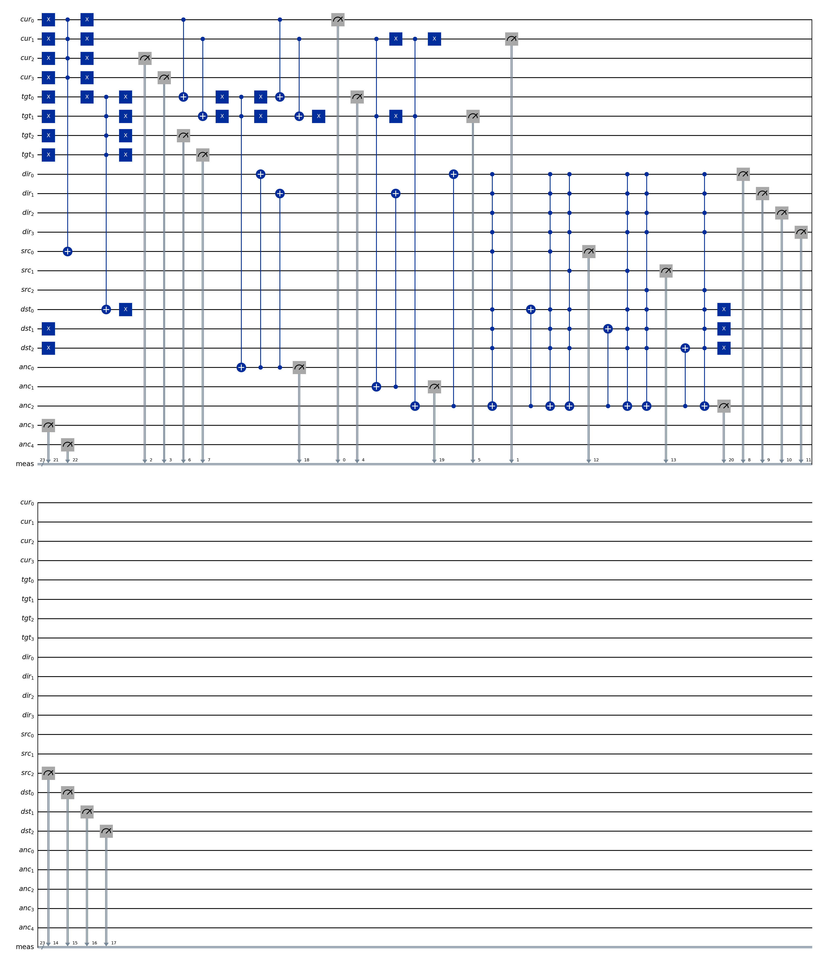
Follow the actual circuit from coordinate to status
The saved Qiskit drawing is the 2×2 example used in the trace
READ THE GATE CHAIN
X on tgt₀ flips 0 to 1, giving target 0001.
For the source, X temporarily maps control zeros to ones; MCX writes the matching status bit, then X restores the coordinate.
The source lookup produces src=001. The empty target matches no occupied square, so dst stays 000.
CX and CCX build comparison conditions; MCX acts only when every control is 1.
Gate groups: ops 1–9 source lookup · 10–18 target lookup · 19–37 direction · 38–52 status attempt
Notes:
Point to the blue X boxes first. X is a NOT gate: it flips |0⟩ to |1⟩ and |1⟩ to |0⟩. The target register starts at zero and X on tgt[0] loads the one bit of 0001. In the status lookup, the source is 0000; the builder temporarily complements all four zero-valued controls, creating the all-ones pattern needed by MCX. MCX flips only its target status qubit when every coordinate control is one. The gate then undoes the temporary X operations, restoring cur. For the only occupied square this writes src=001. The target is empty, so no nonzero status is written to dst. A CX flips its target under one control; a CCX requires two controls; an MCX requires all controls. Their targets here are status or ancilla wires, not chess-piece objects. The saved diagram includes measurements at the end of each wire’s use; Qiskit folds the long circuit to fit.

Slide 8
The measured output exposes an unfinished direction check
This is the circuit’s actual diagnostic result for the supplied move
anc dst src dir tgt cur
00000 000 001 0000 0001 0000
The source lookup succeeds; the destination is empty.
The direction comparison leaves dir=0000 for this forward move, so the later controlled status gates do not fire.
The circuit measures registers; the 2×2 Grover-labelled option returns its sole move before it builds a Grover circuit.
Interpretation: useful gate-level diagnostic, not a completed quantum board update.
Notes:
Read the Qiskit measurement string in grouped register order: anc=00000, dst=000, src=001, dir=0000, tgt=0001, cur=0000. Concatenated, the expected one-shot key is 00000000001000000010000. The source status correctly reports a Black Pawn. The destination remains empty. In this code’s bit-slice convention, direction comparison uses the row bits for the equality test; the source and target rows differ, so the comparison does not set the expected forward direction. With direction still zero, the status operator’s multi-controlled gates do not fire. Option 7 also has one legal move and the default Grover helper treats all one candidates as targets, so it takes the all-target shortcut and returns before circuit construction. The later circuit is the pure coordinate/status diagnostic. Do not describe this as a Grover-amplified 2×2 move.

Slide 9
Grover searches an index after Python ranks the moves
The move-index circuit is separate from the 23-qubit coordinate/status circuit
Phase | What enters | Gate operation | What comes out
1 · Prepare list | Legal Move objects from MoveGenerator; scores from HeuristicEvaluator. | Python selects `optimal_indices`. | Candidate list plus marked index set.
2 · Encode | L candidate moves. | n=ceil(log₂ L) index qubits; pad to N=2ⁿ states. | Integer basis states refer to list positions.
3 · Superpose | Index register |0…0⟩; flag |0⟩. | H on each index qubit; X then H on flag makes |−⟩. | Uniform index state and phase-kickback flag.
4 · Oracle | Index target(s) provided by Python. | X zero-bits, MCX on the matching pattern, then undo X. | Marked index amplitude changes sign.
5 · Decode | Measured index bit string. | Aer samples; Python converts bits to integer and validates target. | Move lookup, or first-target fallback.
Example: 3×3 Knight capture is index 0 (score 13.3); quiet move is index 1 (score 4.4). Python marks [0].
Notes:
The hybrid path begins with classical candidate construction: MoveGenerator returns legal Move objects, and HeuristicEvaluator.score_move assigns a score. QuantumMoveSearcher passes the highest-scoring list positions to GroverSearch. If there are L candidates, n=ceil(log2 L) qubits encode indices 0 through 2^n-1. Extra basis states are padding when L is not a power of two. H gates create a uniform superposition. The flag is prepared by X then H, taking |0⟩ to |1⟩ then |−⟩. The oracle uses X gates to turn zero index bits into one controls, applies MCX to the flag, and undoes those X gates. Python has already identified the target indices; chess rules and heuristic scores do not execute in superposition. The measured move register is decoded and validated classically. In the configured 3×3 example, the capture is index 0 with score 13.3 and the quiet move is index 1 with score 4.4, so the target list is [0].

Slide 10
The diffuser turns a phase mark into higher probability
Worked ideal example: four indices, one marked state, one Grover iteration
Index | Before oracle | After oracle | After diffuser
00 · target | +1/2 | −1/2 | +1 (p = 1)
01 | +1/2 | +1/2 | 0 (p = 0)
10 | +1/2 | +1/2 | 0 (p = 0)
11 | +1/2 | +1/2 | 0 (p = 0)
Diffuser sequence
Hⁿ · Xⁿ · MCZ · Xⁿ · Hⁿ
Reflection: aᵢ′ = 2ā − aᵢ
For N=2, M=1, one iteration leaves p=½; the code’s classical fallback still returns a target.
Notes:
The oracle’s phase flip changes signs, not probabilities: the target has amplitude −1/2 while unmarked states remain +1/2. Their mean amplitude is 1/4. The diffuser implements inversion about the mean: a-prime equals 2 times the mean minus the old amplitude. The target therefore becomes 1 and unmarked amplitudes become 0, so ideal measurement returns the target with probability 1 after one iteration. The circuit uses H^n, X^n, a central multi-controlled Z, X^n, H^n. With one index qubit, the central gate is Z. For the actual two-candidate example, N=2 and M=1, so the starting target probability is 1/2 and one iteration leaves it at 1/2. If measurement yields the non-target, this code returns the first target by classical fallback. This is why observed counts and the fallback must be explained separately. The console label “Prob Amplitude” is an empirical frequency, not an amplitude value.

Slide 11
The normal 3×3 AI uses classical Minimax
The pure-circuit demonstration processes a supplied move; it does not choose the AI move
DECISION LOOP
WHY MINIMAX HERE
Generate legal moves from the current 3×3 GameState.
Search to depth 3 plies: White maximizes the score; Black minimizes it.
At leaves, evaluate material and mobility; use move scores to order candidates.
Alpha-beta bounds prune branches that cannot change the chosen result.
Small board makes a shallow opponent-aware baseline understandable.
The same selector powers the 3×3 AI game and classical benchmark branch.
Hybrid Grover appears only in the comparison’s separate hybrid branch.
Source route: main.py sets HybridEngine(use_quantum=False) for the 3×3 game.
Notes:
Minimax assumes each side chooses to improve its own outcome. This implementation maximizes from White’s perspective and minimizes for Black. The 3×3 engine uses depth 3, meaning three plies, not three full move pairs. At depth zero it calls HeuristicEvaluator.evaluate, which delegates to material evaluation and adds a mobility term. It orders moves using a heuristic score, then alpha-beta pruning skips branches outside the current alpha/beta bounds. Pruning preserves the minimax choice while reducing explored nodes. In the ordinary 3×3 game route, main.py constructs HybridEngine with use_quantum=False. The pure circuit is a separate diagnostic called when a supplied game move is made; the 3×3 benchmark’s hybrid branch separately invokes Grover.

Slide 12
The 8×8 game adds Grover after classical scoring
HybridEngine keeps the board and move update in the classical engine
Step | 8×8 implementation | What it achieves
1 · Legal moves | MoveGenerator creates candidates from the current board. | Preserves classical rule checks.
2 · Heuristic | Python scores captures, pawn progress, and central control. | Supplies the target set: indices tied for the highest score.
3 · Grover index search | A compact move register, phase-kickback oracle, and diffuser run in Aer. | Samples a high-scoring list index, not a board square or game tree.
4 · Decode and apply | Decode the bit string; validate the candidate; fallback to depth-3 Minimax if needed. | Return a Move for classical Game.make_move.
The 8×8 game does not run the separate 33-qubit coordinate/status diagram as its move-selection circuit.
Notes:
Menu option 1 sets the board size to eight and creates HybridEngine(use_quantum=True). If one legal move exists, HybridEngine returns it without Grover. Otherwise QuantumMoveSearcher scores legal moves classically and selects the best-scoring indices. GroverSearch encodes the candidate-list index, not the board. After measurement, Python decodes the integer, confirms it points to a target, and returns the corresponding Move. If quantum search yields no move, HybridEngine falls back to depth-3 Minimax. The board is then updated by Game.make_move. The separate architecture_8x8.png is a 33-qubit pure coordinate/status circuit drawing, not the circuit used by 8×8 hybrid gameplay.

Slide 13
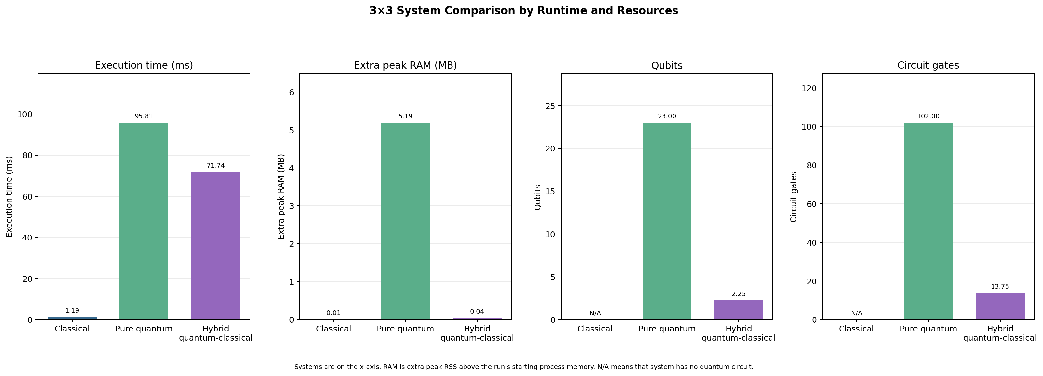
The checked-in benchmark is slower on the simulator paths
Four seeded 3×3 positions · average local runtime and circuit resources
Classical selector 1.19 ms Pure circuit 95.81 ms Hybrid search 71.74 ms
Notes:
These are the checked-in results in evaluation/results/3x3_comparison_summary.csv and the corresponding chart. The average legal-move count is 2.25. The benchmark uses four seeded positions (seed 20261013), depth-3 Minimax for the classical selector, one shot for the pure circuit branch, and 2048 shots for the hybrid Grover branch. Both quantum branches use local CPU Aer matrix-product-state simulation with noise disabled; simulator setup is excluded from the timing. Treat these as measurements from one environment and one small input set.

Slide 14
The three result rows measure different workloads
Use the values to describe implementation cost, not to claim a speedup
System | Measured work | Avg. time | Circuit resources
3×3 classical | Depth-3 Minimax move selection | 1.19 ms | No quantum circuit
3×3 pure circuit | Build + simulate a circuit for a fixed legal move | 95.81 ms | 23 qubits · 102 gates · depth 32.25
3×3 hybrid | Classical score + Grover index circuit + Aer sampling | 71.74 ms | 2.25 qubits · 13.75 gates · depth 10.25
The pure circuit has more wires and gates, so its simulator cost is high for this tiny move list.
Grover’s index circuit is smaller, but circuit building and shot sampling still cost more than classical selection at about two candidates.
The branches do not select moves in identical ways; the result does not measure move quality, real hardware, or quantum advantage.
Notes:
The average extra peak RAM was 0.0068 MB for classical, 5.1924 MB for pure circuit, and 0.0430 MB for hybrid. These are sampled process RSS increases and can miss brief peaks. The classical branch reports selection time only. The pure branch processes a fixed legal move and reports circuit build plus simulation. The hybrid branch scores candidates, builds the Grover circuit, transpiles, and simulates it. All positions average 2.25 legal moves, so this is a very small search. Simulator overhead and shots can dominate here. The measurements are not an apples-to-apples benchmark and do not establish a quantum speedup or stronger play.

Slide 15
Simulator settings explain what each measurement means
Terminology used in the code and how to state it during the presentation
Term | Meaning in this repository
Shot | One circuit execution that ends in measurement; repeated shots estimate outcome frequencies.
AerSimulator | Qiskit’s local software simulator. The project does not submit these circuits to a QPU.
QuantumSimulator wrapper | Shared helper for Aer execution, transpilation, shot count, and optional noise model.
Noise / gate rate | Configured depolarizing probability, not a measured device error rate: 0.01 for single-qubit gates and 10× for selected two-qubit gates in the wrapper.
Route-specific settings | Shared default: 1024 shots and noise on. Option 7 uses direct statevector Aer for one shot; benchmark uses CPU matrix-product-state with noise off.
Always name the backend, shots, and noise setting alongside a reported result.
Notes:
A shot is one circuit run followed by measurement. Qiskit Aer is a classical simulator; it is not a physical quantum processor. The shared QuantumSimulator wrapper centralizes settings and builds a configurable noise model. Defaults in config.py are 1024 shots and noise enabled, with a 0.01 single-qubit depolarizing parameter and a two-qubit setting scaled by ten for selected gates. That number is a model parameter, not an empirical hardware gate error rate. Routes override defaults: the 2×2 interactive route uses direct Aer statevector with one shot, and the benchmark disables noise and uses a CPU matrix-product-state simulator. Always report backend, shots, and noise setting when citing results.

Slide 16
What the project demonstrates, and what remains open
A concise faculty summary
2×2 makes coordinate encoding and controlled status lookup visible; direction/status completion remains a prototype task.
3×3 shows why Minimax is useful when the opponent’s reply matters.
8×8 connects classical move preparation to Grover sampling over a compact index register.
The measured results show simulator and circuit costs for this small setup; they do not show quantum speedup.
NEXT VALIDATION
Fix and verify reversible direction/status logic, then benchmark matched selectors over larger candidate sets with documented noise and hardware conditions.
Notes:
Close by distinguishing implementation from aspiration. The 2×2 circuit is valuable because its wires and control logic can be explained gate by gate, even though the direction comparator and status operator do not complete the example. The 3×3 route grounds the project in an opponent-aware classical baseline. The 8×8 route demonstrates a hybrid software pipeline around Grover’s move-index search. The local benchmark reflects simulator overhead and unequal tasks, not hardware advantage. A defensible next step is to correct and test the small-board reversible logic, then perform a matched evaluation over larger candidate lists with fixed hardware/backend, shots, and noise settings.

